Slide 1
Project: IEEE P802.15 Working Group for Wireless Personal Area Networks (WPANs)
Submission Title: [802.15.4ad Proposal Simulations for High Rates]
Date Submitted: [12 March, 2025]
Source: [Joerg ROBERT] Company [FAU Erlangen-Nuernberg/ Fraunhofer IIS]
Address []
Voice:[], FAX: [], E-Mail:[Joerg.Robert@ieee.org]
Re: []
Abstract: [Simulation results for 802.15.4ad proposal]
Purpose: [Presentation in TG 802.15.4ad]
Notice: This document has been prepared to assist the IEEE P802.15. It is offered as a basis for discussion and is not binding on the contributing individual(s) or organization(s). The material in this document is subject to change in form and content after further study. The contributor(s) reserve(s) the right to add, amend or withdraw material contained herein.
Release: The contributor acknowledges and accepts that this contribution becomes the property of IEEE and may be made publicly available by P802.15.

Slide 2
802.15.4ad Proposal Simulations for High Rates
Joerg Robert
(FAU/Fraunhofer IIS)

Slide 3
Background
PAR for 802.15.4ad requires higher rates
This document shows simulation results for the FAU/Fraunhofer IIS proposal [2] addressing high rate

Slide 4
Simulation Assumptions
Simulation of TDL-B/D and interference according to Technical Guidance Document [5]
Perfect channel and noise estimation
Perfect timing synchronization assumed → preambles are currently not part of the signal
1000 packets or 20 erroneous packets
Packet length of 64 payload bytes
Raised-Cosine Shaped OFDM Reception Window [2]
Noise figure F=0dB
OFDM parameters are 120µs symbol duration with 108 active carriers

Slide 5
802.15.4g OFDM Pilot Structure
White: Payload, Red: Pilot, Blue/Green: Preamble, Grey: Not used
Existing pilot patterns are not optimized for higher constellation sizes
For using 64-QAM updates are required

Slide 6
Proposed Pilot Pattern
White: Payload, Green/Yellow: Pilot, Blue: Preamble, Grey: Not used
Continual Pilots (yellow) allow for phase noise estimation
Pattern is densified to 1/3
Improved estimation at the edges of the channel
Additional sync. preamble tbd.

Slide 7
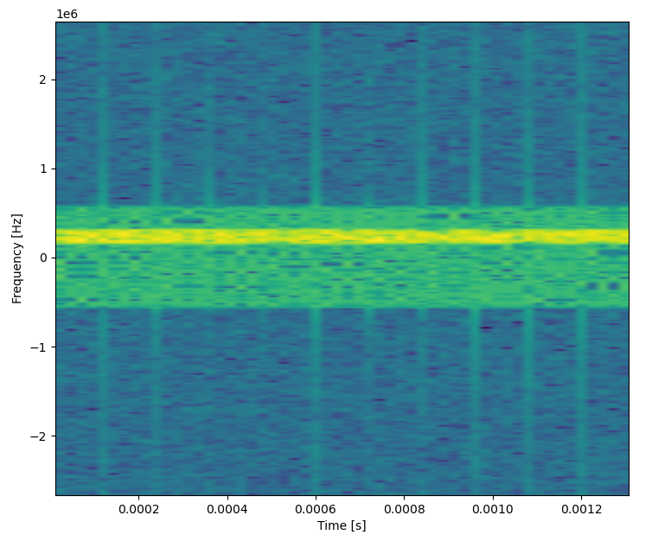
Example of Spectrum with 125kHz Interferer

Slide 8
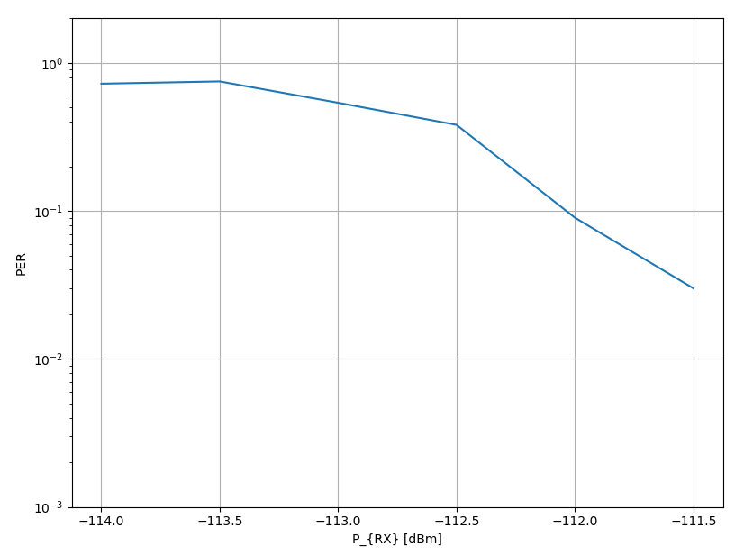
Simulation BPSK - AWGN
BPSK modulation with CR 1/2
-112 dB for to achieve 10% PER
Not useful to have lower spectral efficiency
Use LR OFDM instead

Slide 9
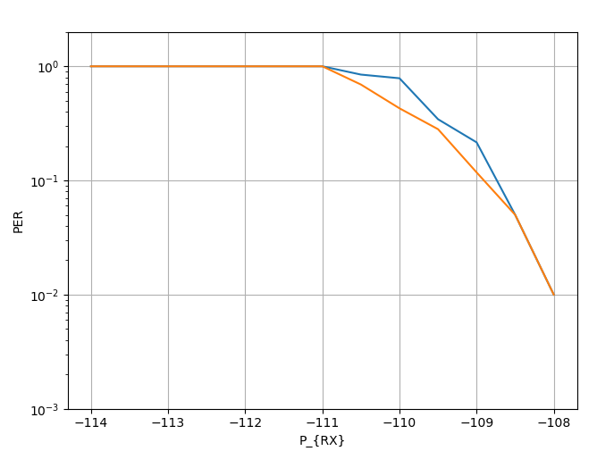
QPSK AWGN
QPSK modulation with CR 1/2
-109 dB for to achieve 10% PER (exactly 3dB to BPSK)
Yellow curve is with Reed Solomon decoder capable to correct 2 erroneous bytes

Slide 10
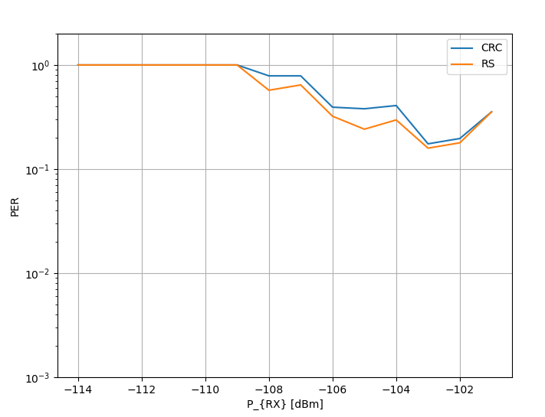
QPSK with -100dBm 125 kHz Interferer
QPSK modulation with CR ½
-100dBm 125kHz interferer
Current 802.15.4g interleaver
Error-free decoding is not possible

Slide 11
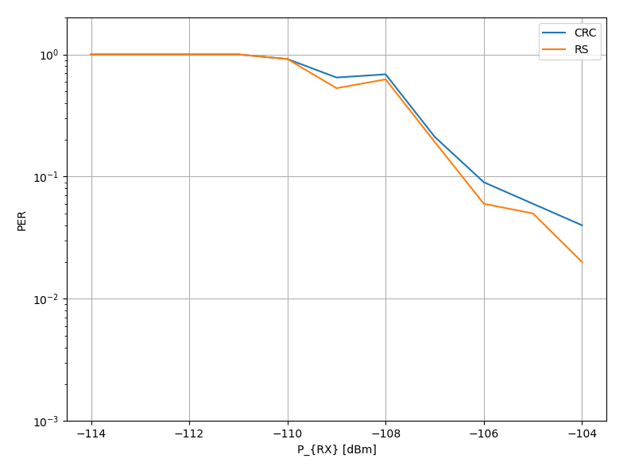
QPSK with -100dBm 125 kHz Interferer – Longer Interleaver
QPSK modulation with CR ½
-100dBm 125kHz interferer
Current 802.15.4g interleaver
Error-free decoding achieved by means of optimized interleaver

Slide 12
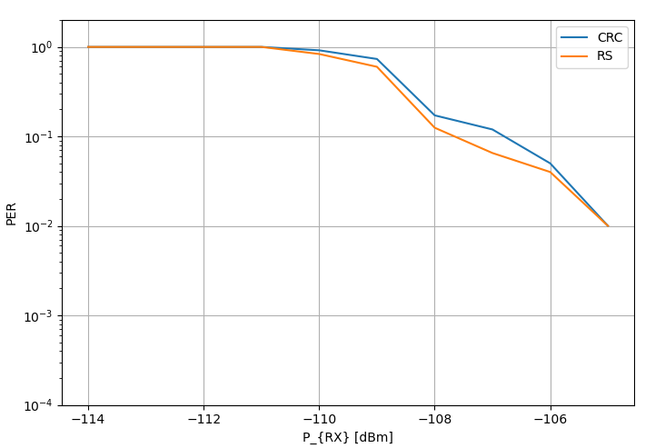
QPSK with -70dBm Narrowband Interferer
QPSK modulation with CR ½
-70dBm 10kHz interferer
Current 802.15.4g interleaver
Error-free decoding with penalty of 2dB compared to AWGN

Slide 13
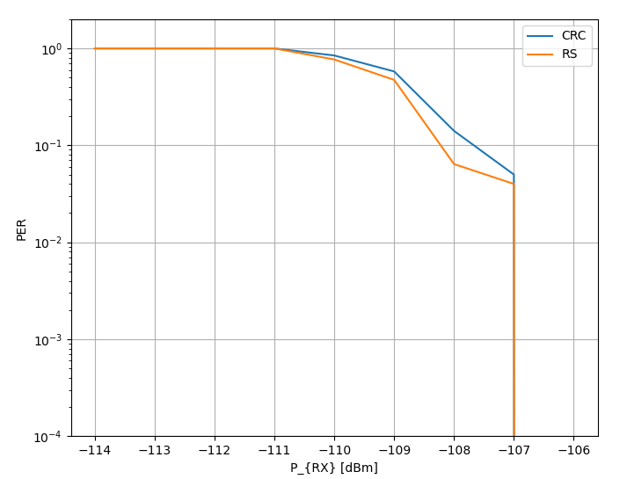
QPSK with -70dBm Narrowband Interferer – Longer Interleaver
QPSK modulation with CR ½
-70dBm 10kHz interferer
Optimized interleaver
Error-free decoding with penalty of only 1dB compared to AWGN

Slide 14
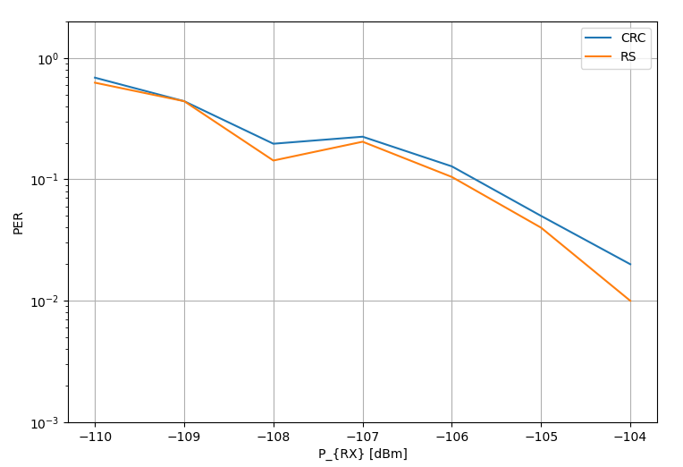
QPSK LOS Channel
QPSK modulation with CR ½
TDL-D LOS channel
Current 802.15.4g interleaver
Error-free decoding with penalty of 3dB compared to AWGN

Slide 15
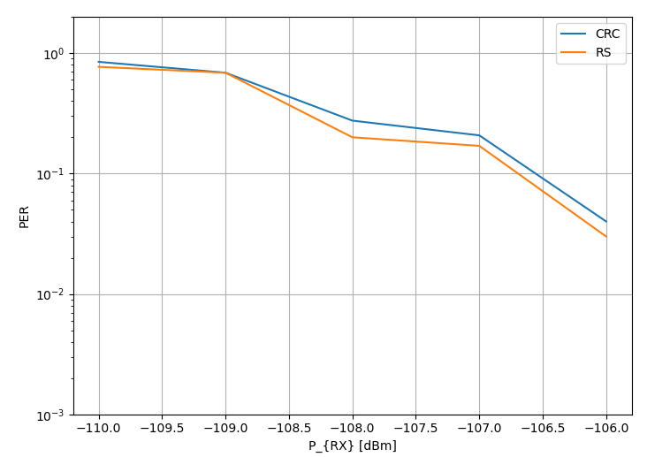
QPSK LOS Channel – Longer Interleaver
QPSK modulation with CR ½
TDL-D LOS channel
Optimized interleaver
Error-free decoding with penalty of 2dB compared to AWGN

Slide 16
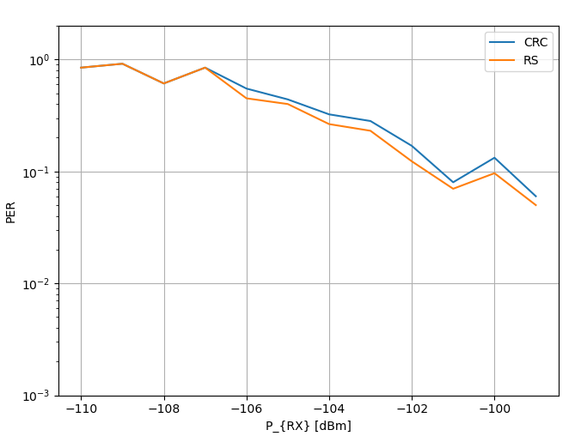
QPSK NON-LOS Channel
QPSK modulation with CR ½
TDL-D LOS channel
Current 802.15.4g interleaver
Error-free decoding with penalty of 8dB compared to AWGN

Slide 17
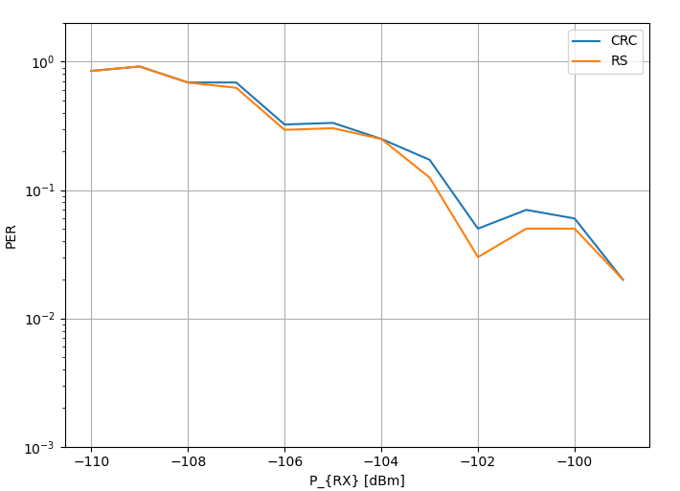
QPSK NON-LOS Channel – Longer Interleaver
QPSK modulation with CR ½
TDL-D LOS channel
Optimized interleaver
Error-free decoding with penalty of 6dB compared to AWGN

Slide 18
Conclusions of the Simulation Results
A longer interleaver can significantly improve the performance
The system becomes robust against narrow-band and wide-band noise, if the OFDM demodulation takes this into account
Pilot pattern has to be modified to get optimum performance
No significant gain of replacing CRC with Reed Solomon (RS) code that is able to correct 2 byte errors

Slide 19
Next Planned Simulations
Add 16-QAM and 64-QAM with multi-level coding as defined in ETSI ES 201 980 Section 7.3.1 [1]
  Multi-Level coding is able to approach performance of Turbo- /LDPC codes without being an iterative code
  Already specified in ETSI ES 201 980 around year 2000
  Does not work with BPSK/QPSK
Real channel estimation and synchronization
Real noise estimation

Slide 20
Literature
[1] Digital Radio Mondiale (DRM); System Specification https://www.etsi.org/deliver/etsi_es/201900_201999/201980/04.02.01_60/es_201980v040201p.pdf
[2] FAU/Fraunhofer IIS Proposal, DCN 15-25/0049r00

