Slide 1
Project: IEEE P802.15 Working Group for Wireless Personal Area Networks (WPANs)
Submission Title: [TG15.6ma Closing Report for May 2025]
Date Submitted: [15th May 2025]
Source: [Ryuji Kohno1,2,] [1;Yokohama National University, 2;YRP International Alliance Institute(YRP-IAI)]
Address [1; 79-5 Tokiwadai, Hodogaya-ku, Yokohama, 240-8501 Japan
2; YRP1 Blg., 3-4 HikarinoOka, Yokosuka-City, Kanagawa, 239-0847 Japan]
Voice:[1; +81-90-5408-0611], FAX: [+81-45-383-5528],
Email:[1: kohno@ynu.ac.jp, 2: kohno@yrp-iai.jp] Re: []
Abstract: [This document contains closing report for TG15.6ma for Revision of P802.15.6-2012 with Enhanced Dependability May 2025.]
Purpose: [information]
Notice: This document has been prepared to assist the IEEE P802.15. It is offered as a basis for discussion and is not binding on the contributing individual(s) or organization(s). The material in this document is subject to change in form and content after further study. The contributor(s) reserve(s) the right to add, amend or withdraw material contained herein.
Release: The contributor acknowledges and accepts that this contribution becomes the property of IEEE and may be made publicly available by P802.15.

Slide 2
IEEE 802.15 TG6ma
(Revision of IEEE802.15.6-2012)
Closing Report
In Personal and Virtual Hybrid Plenary Session
Warsaw, Poland
May 15th, 2025
Ryuji Kohno
Yokohama National University(YNU),
YRP International Alliance Institute(YRP-IAI)

Slide 3
Objectives of TG 6ma – Enhanced Dependability Body Area Network (ED-BAN)
Objective: Enhancements to the BAN Ultra Wideband (UWB) physical layer (PHY) and media access control (MAC) to support enhanced dependability to a human BAN (HBAN) and adds support for vehicle body area networks (VBAN), a coordinator in a vehicle with devices around the vehicular cabin.
Action:
•Comments Resolutions for LB217 2nd recirculation
•Review of Comments for draft D05
•Necessary Process and Documentation for Recirculation Letter Ballot such as Coexistence Assurance Document, Progess Report, Project Task List
•Performance Evaluation of Technologies in PHY; Channel Coding According to 8 QoS Levels of Packets and Coexistence Levels, Interference.
•Performance Evaluation of Technologies in MAC; Channel Management, CCA, Hybrid Contention Free/Access Protocol According to 8 QoSs and Coexistences.
•Harmonization or Commonality with 4ab in Coexistence and Feasible Implementation of 6ma and 4ab
•Feasibility of TSN of 802.1 in MAC
•WG Motion to Recirculation and Formation of CRG
Next Things to Do： Recirculation of draft D06 for 3rd Recirculation and Proceed to SA Ballot

Slide 4
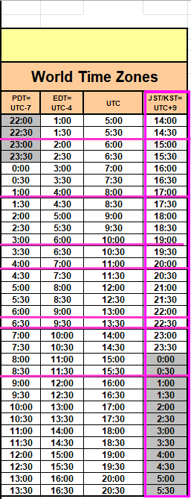
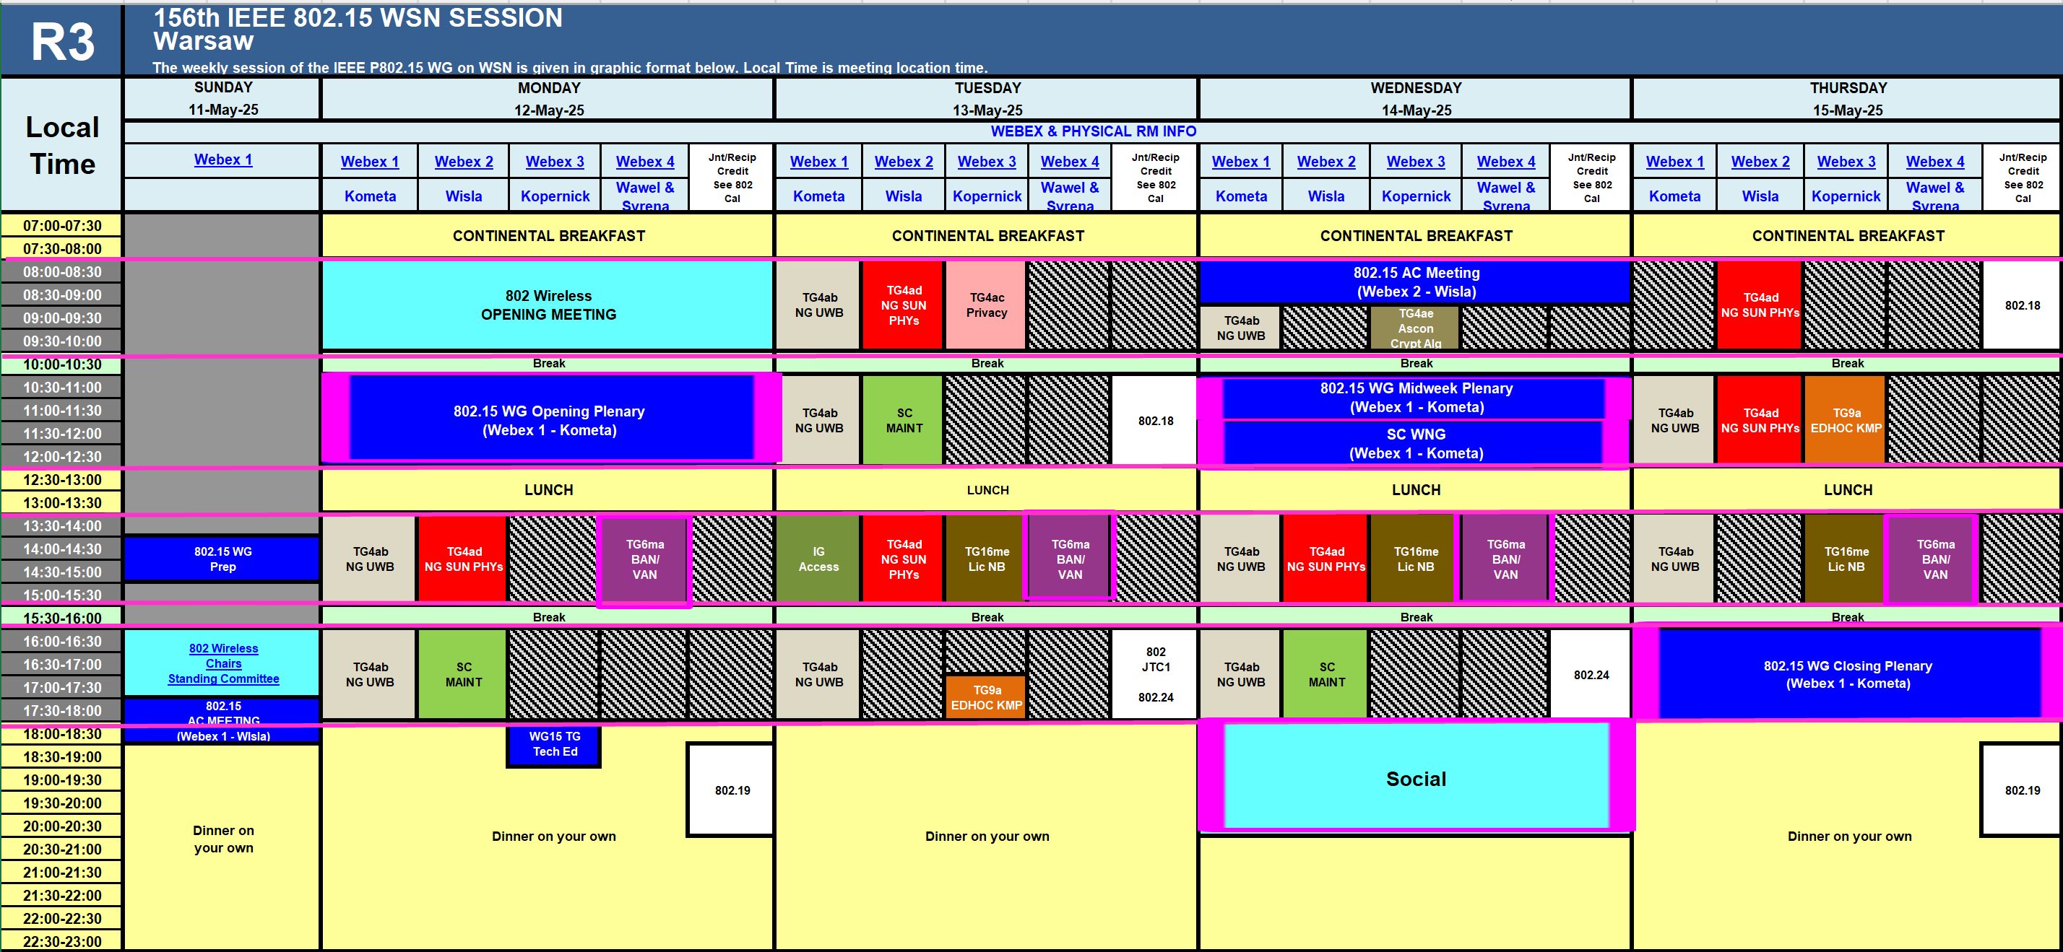
TG15.6ma Interim Session Schedule for 12th-16th, May 2025
TG15.6ma has three own sessions such as
Session1(Virtual RM#4) PM1 13:30-15:30 May 12 (MON) in Warsaw time, 8:30-10:30PM May 12(MON) in JST/KST
Session2(Virtual RM#4) PM1 13:30-15:30 May 13 (TUE) in Warsaw time, 8:30-10:30PM May 13(TUE) in JST/KST
Session3(Virtual RM#4) PM1 13:30-15:30 May 14 (WED) in Warsaw time, 8:30-10:30PM May 14(WED) in JST/KST Session1(Virtual RM#4) PM1 13:30-15:30 May 15 (THU) in Warsaw time, 8:30-10:30PM May 15(THU) in JST/KST

Slide 5
Agenda items for the week
TG15.6ma meeting call to order
Call for essential patents and policies & procedures reminder doc.#15-25-0193-02-06ma
Approve last meeting minutes: TG 15.6ma Meeting Minutes for May 2025 doc.#15-25-0152-00-06ma
Agenda of TG15.6ma May 2025 doc.#15-25-0192-04-06ma
Review and Summary
  Overview of IG, SG, TG15.6ma doe Dependable BAN Revision of IEEE802.15.6-2012 doc.#15-25-0033-03-06ma
  Basic Consensus in MAC and PHY of Revision of IEEE802.15.6-2012(IEEE802.15.6ma) doc.#15-23-0557-07-06ma
  Review of Letter Ballot(LB)217 for draft D05 doc.#15-25-0xxx-00-06ma
  Consolidated comments & resolutions LB217 doc.#15-25-0255-01-06ma
  Rescheduling Timeline doc.#15-23-0361-13-06ma
  Draft P802.15.6ma_D05
  Presentation
  1.. Hybrid ARQ Scheme for High QoS Packets in High Class of Coexistence of IEEE 802.15.6ma #15-23-0576-08-06ma
  2. Proposed resolution draft for GBAN maintenance doc.#15-25-0188-00-06ma
  3. Evaluation of IEEE 802.15.6 Ultra-wideband Physical Layer Utilizing Super Orthogonal Convolutional 22-0562-15-06ma
  4. Ranging Accuracy Evaluation under TG6ma Communication Senarios doc.#15-24-0248-06-06ma
  5. MAC Performance Evaluation of Multiple BAN Coexistence Under TG6ma Channel doc.#15-24-0246-06-06ma
  7 MAC superframe structure and frames doc.#15-24-0573-03-06ma
  8 15.6ma MAC time reference base for superframe and group superframe structure doc.#15-25-0132-00-06ma
  9 Proposed resolution draft for GBAN frame doc.#15-24-0187-00-06ma
  10. TG Motion to Recirculation doc.#15-25-0zzz-00-06ma
  11. Interference Mittigation Schemes in Class 3, 5, 6, and 7 of Coexisitence in TG6ma doc.#15-24-0074-07-06ma
  12. Coordinator-to-Coordinator(C2C) Ranging and Communication for Multiple BAN Coexistence 15-25-0vvv-00-06ma
  13. TG15.6ma Coexistence Assessment Document doc.#15-24-0348-04-06ma
  14 MAC services support for IEEE P802.1ACea doc.#15-24-0594-01-006a
  15..TG6ma Channel Model Document for Enhanced Dependability doc.#15-22-0519-09-06ma
  16. Comments to channel-model-document doc.#15-24-0073-04-06ma
  17. Progress Report of TG6ma doc#15-23-0056-13-06ma
  18. Timeline of TG6ma doc.#15.23-0361-11-06ma
  19. TG15.6ma Closing Report for March 2025 doc.#15-25-0265-00-06ma
  20. TG15.6ma Meeting Minutes for March 2025 doc.#15-25-0266-00-06ma

Slide 6
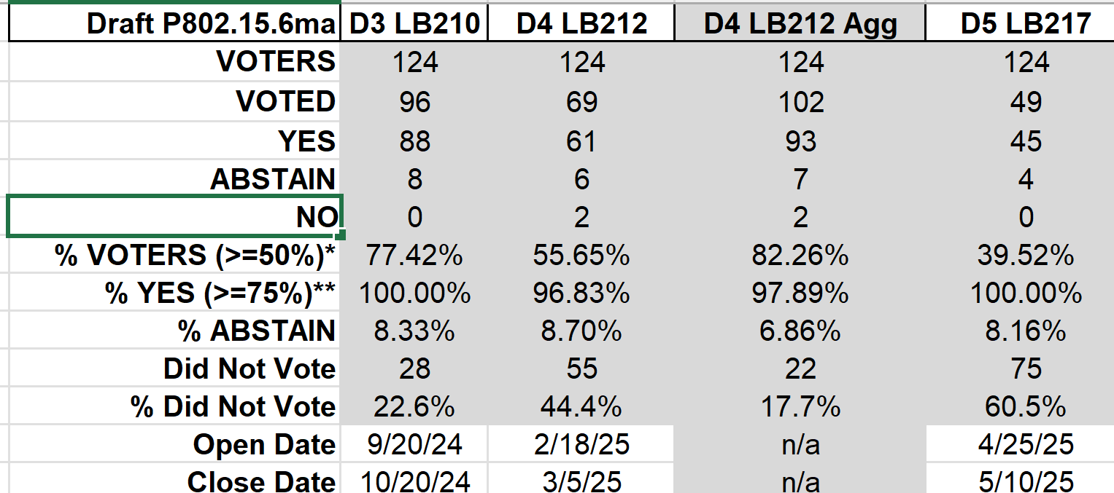
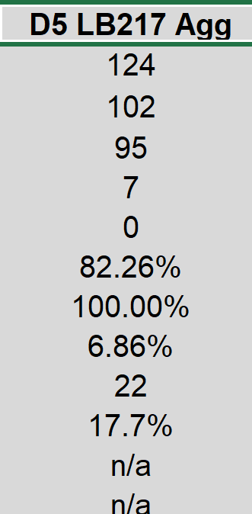
Result of Letter Ballot LB217 for 2nd Recirculation of the Draft P802.15.6ma_D05 （April 25-May 10, 2025)
YES | 45
NO | 0
ABSTAIN | 4
total votes | 49
Result of LB217(Ap.25-May 10, 2025): 82.26% of Voters voted YES in aggregation which is over 75%. Then LB217 was officially Approved.
Voted YES with and without Comments are 45 while No. of Comments is 130.
In Warsaw Interim Meeting May 2025, Comments Resolution has been done. The 3rd recirculation will start in June and In Madrid Plenary Meeting July 2025, the Revised Draft P802.15.6ma_D06 will be approved in WG802.15. Then it may move to SA ballot
Slide 6

Slide 7
Preparation for 3rd Recirculation
TG motion: Approval of Comment Resolutions 25-0161-01
TG Motion to approve the formation of CRG 25-0161-01
TG6ma Coexistence Assurance Document 24-0348-06
Project Task List of 802.15.6ma 25-0062-02
Progess report of 802.15.6ma 23-0056-13

Slide 8
WG motion:
Draft needs to be edited before LB
Move that 802.15 WG start a WG Letter Ballot requesting approval of CA document 15-24-0348-06 and document P802-15-6ma_D05 (as edited in accordance with the instructions in document 15-15-23-0138-01-0mag) and to forward document P802-15-6ma_D04, as edited in accordance with the instructions in document 15-15-23-0138-01-0mag, and CA document 15-24-0348-06 to Standards Association ballot pending the completion and inclusion of the edits in the draft.
Moved by: Ryuji Kohno
Seconded by: Joerg Robert
Result: Approved
Yes 28 100.0%
No 0 0.0%
Abstain 0 0.0%
Total 28

Slide 9
WG Motion to approve the formation of CRG
Move that 802.15 WG approves the formation of a Comment Resolution Group (CRG) for the WG balloting of P802.15.6ma with the following membership: Ryuji Kohno (YNU/YRP-IAI), Marco Hernandex(CWC), Huan-Bang Li(NICT), Takumi Kobayashi (OMU), Seong-Soon Joo (NHT). The 802.15.6ma CRG is authorized to approve comment resolutions, edit the draft according to the comment resolutions, and to approve the start of recirculation ballots of the revised draft on behalf of the 802.15 WG. Comment resolution on recirculation ballots between sessions will be conducted via reflector email and via teleconferences announced to the reflector as per the LMSC 802 WG P&P.
Moved By: Ryuji Kohno
Seconded By: Joerg Robert
Result: Approved
Yes 29 100.0%
No 0 0.0%
Abstain 0 0.0%
Total 29

Slide 10
TG 6ma Timeline(expected)
Final SB recirculation, if required. Submission to RevCom
Jan 2026
Tech Req Doc July 2022
Presentation of proposals
May 2023
Comment Resolutionfor LB210
Nov. 2024
Comment Resolutionfor LB212
March 2025
Comment Resolutionfor LB217
May
2025
Comment Resolution for LB217
July
2025
SA Ballot
Sept
2025
WG PreBallot submission for Draft2.5 August 2024
Revcom Approve
March 2026
SA recirculation if required
Oct 2025
^{Draft V1,18 Com}
May. 2024
Recirculation (LB212)
Jan. 2025
RevcomSubmission
Feb. 2026
TRD,CMD
Call Proposals Sept 2022
Std. Draf V1.9 Proposals
Nov. 2023
Comment Resolution fo Draft v2.3 on WG for PreBallot July 2024
1st Letter Ballot(LB210)
Sept. 2024
2nd Recirculation (LB217)
April 2025
3rd Recirculation (LB)
June 2025
Unconditional approval for Standard Association Ballot (SA)
July 2025
Request EC approval for SA Ballot
Nov. 2026
Comment Resolution for SA Ballot
Oct. 2025
Notes: SASB/RevCom scheduled for 2024 a guess

Slide 11
Expecting Timeline detail
Topic item | Deadline | Action items | Notes
Std Draft D2_3 WG pre-ballot recirculation. | July/2024 |  | Editorial comments from 802.15 technical editor were addressed. Still missing cross-references.
Towards the July 2024 meeting | July/2024 | Adding MAC text. Revise PHY text. Editorial revisions.
Target WG letter ballot (LB) submit draft to TEG | August/2024 | Disposition of comments. | 1. Based on pre-ballot resolutions, prepare Draft D2_4 2. Request LB submission before the September meeting. Consequently, the July meeting is used to resolve comments.
TG and WG Motion to letter ballot (LB) submit draft to EC | Sep/2024 | TG and WG Motion to LB | Prepare all necessary documents: Project Task List, Progress Repor, Coexistence Assurance(CA) document, TG Motion to LB, WG Motion to LB
1st LB circulation LB210 | Sep/2024
Comment Resolution for LB210 | Nov/2024 |  | Comment-resolutions to LB recirculation.
1st LB recirculation LB212 | Jan./2025
Comment Resolution for LB212 | March/2024 |  | Comment-resolutions to LB recirculation.
2nd LB recirculation LB217 | April/2025
Comment Resolution for LB217 | March/2025 |  | Comment-resolutions to LB recirculation.
3rd LB recirculation LB | June/2025
Comment Resolution for 3rd LB recirculation | July/2025 |  | Comment-resolutions to LB recirculation.
Submission for Unconditional Approval for SA Ballot | July/2025
SA Ballot | Sept./2025
Conditional approval for Stanadard Association(SA Ballot | Oct/2025 |  | Seek conditional approval for SB by the Executive Committee.
1st SA Ballot recirculation. | Nov/2025 |  | WG approval to request SB submission.
Request EC approval for SA Ballot | Jan/2026 |  | Request SB approval by the EC (conditional or not)
IEEE Standard Association(SA) Ballot submission | Jan/2026 |  | One month for IEEE SA editorial review.
Final SB recirculation, if required. Submission to RevCom | Feb/2026 |  | Submission to SASB
RevCom submission | March/2026 |  | RevCom approval
Note: the deadlines are subject to change.

Slide 12
Contributions
・TG15.6ma opening report for May 2025 meeting 15-25-0193-04-06ma
・TG15.6ma Agenda of May 2025 Meeting 15-25-0192-01-06ma
・Overview of IG, SG, TG15.6ma doe Dependable BAN Revision of IEEE802.15.6-2012 15-25-0033-03-06ma
・Basic Consensus in MAC and PHY of Revision of IEEE802.15.6-2012(IEEE802.15.6ma) 15-23-0557-07-06ma
・Review of Letter Ballot(LB)217 for draft D05 15-25-0xxx-00-06ma
・Consolidated comments & resolutions LB217 15-25-0255-01-06ma
・Hybrid ARQ Scheme for High QoS Packets in High Class of Coexistence of IEEE 802.15.6ma 23-0576-08
・ Proposed resolution draft for GBAN maintenance 15-25-0188-00-06ma
・ Evaluation of IEEE 802.15.6 UWB Physical Layer Utilizing Super Orthogonal Convolutional 22-0562-15-06ma
・Ranging Accuracy Evaluation under TG6ma Communication Senarios 15-24-0248-06-06ma
・MAC Performance Evaluation of Multiple BAN Coexistence Under TG6ma Channel 15-24-0246-06-06ma
・MAC superframe structure and frames 15-24-0573-03-06ma
・15.6ma MAC time reference base for superframe and group superframe structure 15-25-0132-00-06ma
・Proposed resolution draft for GBAN frame 15-24-0187-00-06ma
・TG Motion to Recirculation 15-25-0zzz-00-06ma
・Interference Mittigation Schemes in Class 3, 5, 6, and 7 of Coexisitence in TG6ma 15-24-0074-07-06ma
・TG15.6ma Coexistence Assessment Document 15-24-0348-04-06ma
・MAC services support for IEEE P802.1ACea 15-24-0594-01-006a
・TG6ma Channel Model Document for Enhanced Dependability 15-22-0519-09-06ma
・Comments to channel-model-document 15-24-0073-04-06ma
・Progress Report of TG6ma 15-23-0056-13-06ma
・Timeline of TG6ma 15.23-0361-13-06ma
・TG15.6ma Closing Report for March 2025 15-25-0265-00-06ma
・TG15.6ma Meeting Minutes for March 2025 15-25-0266-00-06ma

Slide 13
Contacts and Conference call
Chair; Ryuji Kohno, YNU/YRP-IAI
kohno@ynu.ac.jp, kohno@yrp-iai.jp
1st Vice-Chair; Marco Hernandez, YRP-IAI/CWC
marco.hernandez@ieee.org
2nd Vice-Chair; Daisuke Anzai, Osaka Metropolitan Univ.
d.anzai@omu.ac.jp
Secretary; Takumi Kobayashi, Osaka Metropolitan Univ./YRP-IAI
kobayashi-takumi@yrp-iai.jp, Kobayashi.takumi@omu.ac.jp
Technical Editors;
Minsoo Kim, YRP-IAI minsoo@minsookim.com
Seong-Soon Joo, Nano HiTech ssjoo@etri.sci.kr
Kento Takabayashi, Toyo U. takabayashi@toyo.jp
Marco Hernandez, YRP-IAI/CWC marco.hernandez@ieee.org

Slide 14
Thank You !
Any Questions ?

