Slide 1
Project: IEEE P802.15 Working Group for Wireless Personal Area Networks (WPANs)
Submission Title: [Simulations of the Frequency Sync]
Date Submitted: [09 July, 2025]
Source: [Joerg ROBERT] Company [FAU Erlangen-Nuernberg/ Fraunhofer IIS]
Address []
Voice:[], FAX: [], E-Mail:[Joerg.Robert@ieee.org]
Re: []
Abstract: []
Purpose: [Presentation in TG 802.15.4ad]
Notice: This document has been prepared to assist the IEEE P802.15. It is offered as a basis for discussion and is not binding on the contributing individual(s) or organization(s). The material in this document is subject to change in form and content after further study. The contributor(s) reserve(s) the right to add, amend or withdraw material contained herein.
Release: The contributor acknowledges and accepts that this contribution becomes the property of IEEE and may be made publicly available by P802.15.

Slide 2
Simulations of the Frequency Sync
Joerg Robert
(FAU/Fraunhofer IIS)

Slide 3
Introduction
The TI proposals uses a narrow-band signal for the synchronization
Our additions to the TI proposal [2] improve the sensitivity significantly and we get a sensitivity of -135dBm for 1% PER in the AWGN channel
This raises the questions, if the current TI preamble is sensitive enough for the optimized mode

Slide 4
Optimized Decoding
Our optimized decoder creates a ¼ convolutional code out of the existing ½ convolutional code in a backwards-compatible way
The sensitivity increases significantly and offer a sensitivity of
-135dBm, which requires a more robust time and frequency synchronization
The optimized decoding assumed a more sophisticated receiver, that is able to implement the frequency synchronization according to [1]
We assume the most robust mode (most challenging) with the single preamble proposal of TI (preamble duration of 19.2ms)
The following simulations indicate the achievable performance

Slide 5
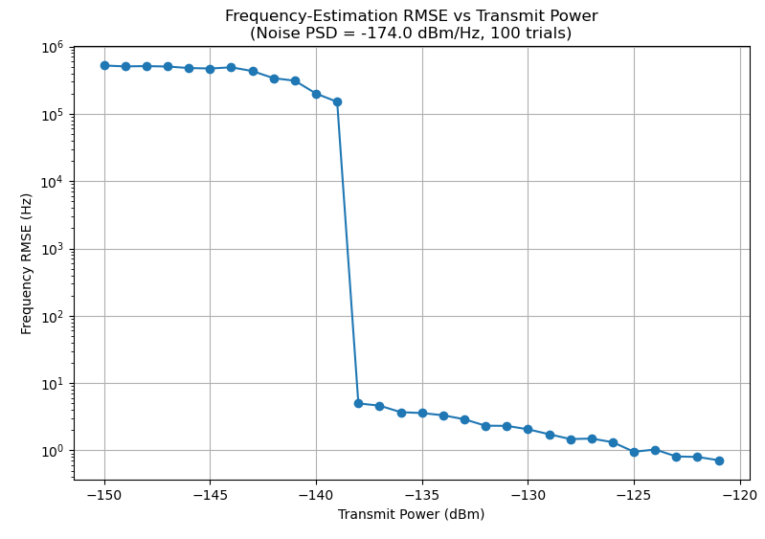
Simulation Results for Frequency Sync.
The RSME for -135dBm is 50 Hz, while the subcarrier spacing is more than 10kHz → practically no effect on the demodulation

Slide 6
Conclusions
We analyzed if the performance of the current preamble proposal of TI is sufficient for the improved
The current preamble offers a sufficient margin for the decoding in the AWGN channel
We have not investigated additional approaches that would further increase the sensitivity of the synchronization

Slide 7
Literature
[1] Barry G. Quinn, “Estimating Frequency by Interpolation Using Fourier Coefficients,” IEEE Transactions on Signal Processing, vol. 42, no. 5, pp. 1264-1270, May 1994.
[2] https://mentor.ieee.org/802.15/dcn/25/15-25-0259-00-04ad-updated-simulation-results-for-the-ofdm-lr-mode.pptx

