Slide 1
Project: IEEE P802.15 Working Group for Wireless Personal Area Networks (WPANs)
Submission Title: [CCA Modes and Adaptive ED Threshold in suspendable CSMA-CA]
Date Submitted: [29 July. 2025]
Source: [Susumu Ishihara¹, Masakatsu Ogawa², Tetsushi Ikegami³, Shugo Kajita⁴, Arata Kato⁴, Mineo Takai⁵]
Company [¹Shizuoka University, ²Sophia University, ³Meiji University, ⁴Space-Time Engineering Japan, Inc., ⁵Space-Time Engineering, LLC]
Address []
Voice:[], FAX: [], E-Mail:[ishihara.susumu@shizuoka.ac.jp, m-ogawa@sophia.ac.jp, ikegami@meiji.ac.jp, skajita@spacetime-eng.com, akato@spacetime-eng.com, mineo@ieee.org]
Re: []
Abstract: [This document discusses issues in the CCA modes for suspendable CSMA-CA]
Purpose: [Discussing the issues in the CCA modes for suspendable CSMA-CA in the coexistence of different modulations]
Notice: This document has been prepared to assist the IEEE P802.15. It is offered as a basis for discussion and is not binding on the contributing individual(s) or organization(s). The material in this document is subject to change in form and content after further study. The contributor(s) reserve(s) the right to add, amend or withdraw material contained herein.
Release: The contributor acknowledges and accepts that this contribution becomes the property of IEEE and may be made publicly available by P802.15.

Slide 2
CCA Modes and Adaptive ED threshold in suspendable CSMA-CA
Susumu Ishihara¹, Masakatsu Ogawa², Tetsushi Ikegami³, Shugo Kajita⁴, Arata Kato⁴, Mineo Takai⁵
¹Shizuoka University, ²Sophia University, ³Meiji University, ⁴Space-Time Engineering Japan, Inc., ⁵Space-Time Engineering, LLC

Slide 3
Topics in this presentation
Recap of the last presentation
  Suspendable CSMA-CA
  Operations in CCA Mode 3 in Suspendable CSMA-CA
    CCA modes and ED threshold
Proposed strategy for suspendable CSMA-CA in mixed environments
  CCA mode
  ED threshold
  Using SRM for adapting the receiver’s environment

Slide 4
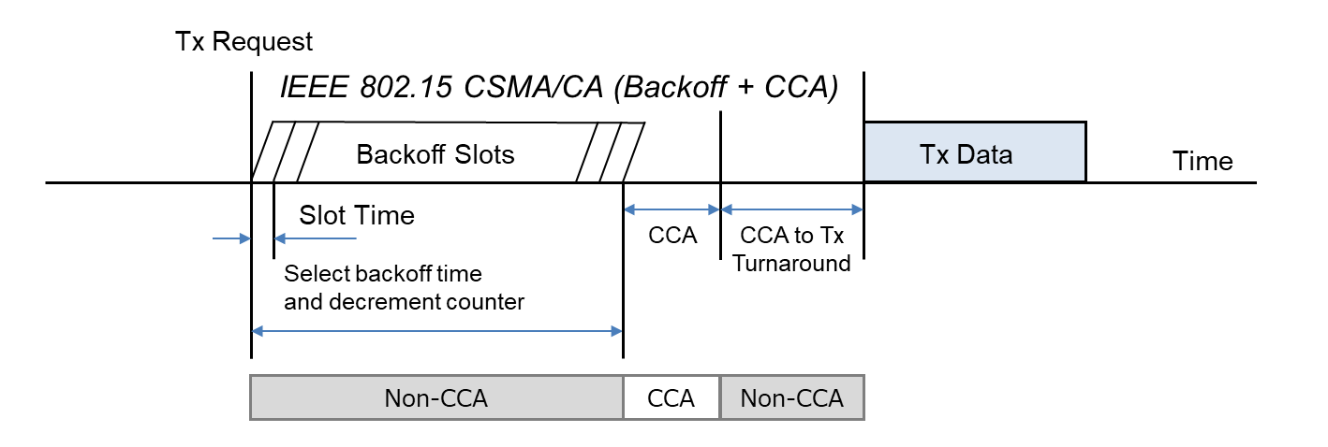
IEEE 802.15.4 CSMA-CA
IEEE 802.15.4 CSMA-CA performs CCA (Clear Channel Assessment) only when the backoff timer expires, and does not perform carrier sense in order to minimize power consumption during backoff. (IEEE 802.11 CSMA/CA performs CCA even during the backoff periods.)
Cited from IEEE 802.19-25/0006r0 [1]

Slide 5
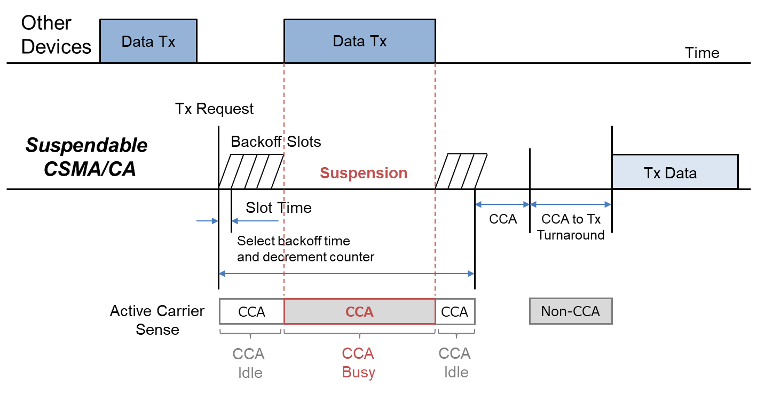
Suspendable CSMA-CA introduced in IEEE 802.15.4-2024 [2]
With the suspendable CSMA-CA option, CCA (mode 1, 2, or 3) is performed during the backoff period, and the backoff timer is suspended until CCA indicates that the channel is clear or macSuspendedCsmaMaxTime is exceeded.
If macSuspendedCsmaMaxTime is exceeded, backoff ends in “Failure” and CSMA-CA algorithm terminates with a channel access failure.
Cited from IEEE 802.19-25/0006r0 [1]

Slide 6
Operations in CCA Mode 3
CCA Mode3 = {3a: CS and ED, 3b: CS or ED}
  CS: Carrier Sense, ED: Energy Above Threshold
Can IEEE 802.15.4 devices perform CS-CCA and ED-CCA simultaneously?
  We confirmed that at least some chip vendors do not implement CCA Mode 3.
  Sequential operation would be realistic. However, the order is not defined.
In the context of Suspendable CSMA-CA, we can select CCA for each slot.
  What CCA do we use for each slot?
  e.g.
What ED threshold in ED-CCA?
  Fixed value vs. Dynamic selection of ED threshold
    If we use a Dynamic threshold, how do we select the threshold value?
CS
CS
CS
CS
ED
CS
ED
CS
ED
CS
ED
ED
CS
CS
CS
ED

Slide 7
Scenarios
Strong Background Noise
IEEE 802.11ah and IEEE 802.15.4 coexistence
Coexistence of various bandwidth networks working at the same frequency.

Slide 8
Coexistence of various bandwidth networks working at the same frequency
All channels have the same TX power
Slow, Long communication range
Narrow frequency occupation bandwidth
Long Airtime
Fast, Short communication range
Wide frequency occupation bandwidth
Short Airtime

Slide 9
Proposed Strategy
Link speed | CCA during backoff period (except the last few slots) | CCA in the last few backoff slots | CCA at the end of backoff
Fast | No CCA or CS or ED with a higher threshold | ED with a higher threshold | CS
Slow | ED with a higher threshold | ED with a lower threshold | ED with a lower threshold
Adapting the receiver’s environment
  Use lower ED-threshold (make conservative) if the receiver is in a congested area.

Slide 10
Simple Mixed Scenario: 50 kbps networks & 150 kbps networks
Slow net: SUN FSK PHY 50 kbps 2FSK
Fast net: SUN FSK PHY 150 kbps 2FSK
They work on the same channel
50 kbps
150 kbps
200 kHz

Slide 11
Difference in CS range
Slow-mode nodes have smaller CS range due to the lower Power/BW.
50 kbps
150 kbps

Slide 12
ED Range … depends on the ED threshold
ED range can be equal or larger than CS range of slow-mode nodes
→ED range is larger than CS range of fast-mode nodes
In this scenario,
transmission from the coordinator of the 150 kbps network will not affect the reception from the 50 kbps coordinator at the edge nodes
50 kbps
150 kbps

Slide 13
Slow mode transmission → Long Airtime
One frame sent in a slow mode has a stronger impact on the channel
  If a fast-mode node executes ED-CCA and detects a channel busy caused by a slow-mode node, the fast node must wait for a long time compared to its airtime.
  If the frame is resent multiple times, the channel remains occupied for an extended period.
For Fast-mode nodes, waiting time caused by slow modes’ transmission may be waste of time because they tend to be exposed to slow nodes’ transmission.
  If the receiver of the slow-mode transmission is far away from the fast-mode node,
  the fast-mode node defers its transmission even though it does not affect the slow-mode transmission. (Exposed terminal problem)
  Of course, if the receiver of the slow-mode transmission is close to the fast-mode node, it is reasonable that the fast-mode node defers transmission.

Slide 14
Effect of a slow-mode node’s transmission in suspendable CSMA-CA from the viewpoint of a fast-mode node
CS-CCA during the backoff does not affect the latency of the fast-mode node
because the result of the CCA is ”clear” even if a slow-mode node is transmitting a frame.
ED-CCA during the backoff would needlessly prolong the transmission latency of fast-mode nodes if they are exposed nodes.
ED-CCA at the end of the backoff would contribute to increasing the number of backoffs (NB) and transmission failure of fast-mode nodes even if they are exposed.
Ego node
Slow
Fast
TX
ED-CCA range
ED-CCA range

Slide 15
Effect of a fast-mode node’s transmission in suspendable CSMA-CA from the viewpoint of a slow-mode node
CS-CCA during the backoff does not affect the latency of the slow-mode node
because the result of the CCA is ”clear” if a fast-mode node is transmitting a frame.
ED-CCA during the backoff would contribute to avoid interference at the receiver of the fast-mode node’s receiver.
ED-CCA at the end of the backoff would contribute to increasing the number of backoffs (NB) and transmission failure of fast-mode nodes. Also, it contributes to avoiding the reception error of the fast-mode receiver node.
Fast
Slow
Ego node
TX
ED-CCA range
ED-CCA range

Slide 16
The Role of CCAs in backoff period in Suspendable CSMA-CA
The failure at the end of backoff directly leads to an increase in the number of backoffs (NB) and transmission failure.
CCAs in the backoff period contribute to avoiding failure (i.e., CCA busy) at the end of the backoff.
A more sensitive CCA is needed to avoid failure at the end of the backoff.
  Sensitive CCA: ED CCA.
    With a lower ED threshold, it is more sensitive.

Slide 17
Do we always need such a sensitive CCA?
CCA “busy” prolongs the backoff period (including the suspended period)
  It may lead to needlessly longer latency.
  How about using a sensitive CCA for the last few backoff slots?
    It is sufficient to avoid the CCA failure at the end of the backoff.
    It will contribute to shortening the frame transmission latency.

Slide 18
The sender is unaware of the environment surrounding the receiver
The MAC protocol should work to avoid collisions at the receivers, including both my receiver and others'.
If we can know the environment of the receiver, can we do anything at the sender?
  Changing the ED threshold is effective?
  E.g., Make the sender conservative if the receiver's neighborhood is congested and the sender's neighborhood is not congested.
How to know the environment of the receiver?
  Use the Spectrum resource measurement (SRM) defined in IEEE 802.15.4-2024 10.28
    The coordinator requests measurement of metrics at leaf nodes and receives metrics,
    then use the values to control TX power (Transmit Power Control, TPC, defined in IEEE 802.15.4-2024 10.28.3.3)

Slide 19
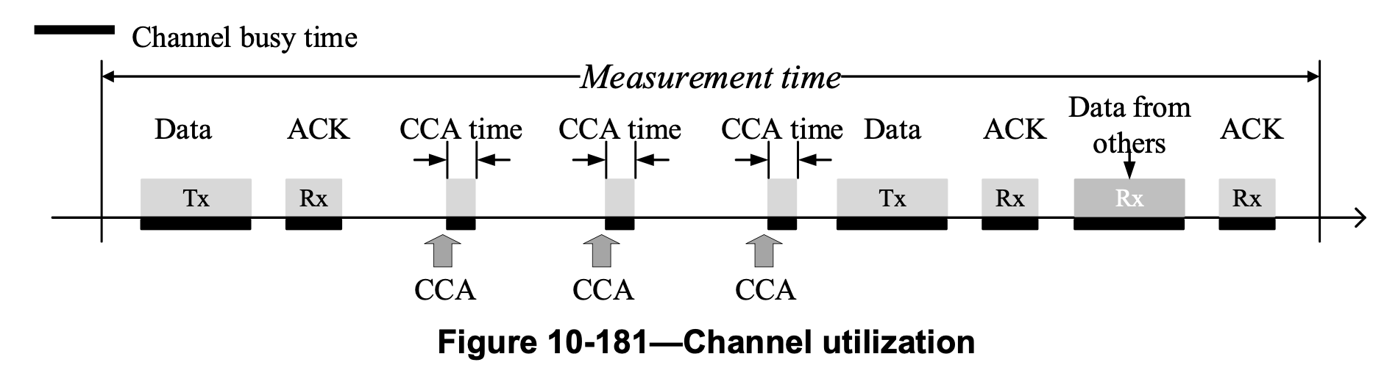
SRM performance metrics
Energy detection (ED)
Percentage of time of failed transmissions
Percentage of time of deferred transmissions
Retry histogram
Channel utilization
Received channel power indicator (RCPI)
Received signal noise indicator (RSNI)
Received signal strength indicator (RSSI)
Noise histogram
Average access delay
MAC performance metrics specific MAC PIB attributes
Not defined
10.28.2.5 Channel utilization
Are existing metrics sufficient for configuring CCA operation?

Slide 20
Proposed Strategy (represented)
Link speed | CCA during backoff period (except the last few slots) | CCA in the last few backoff slots | CCA at the end of backoff
Fast | No CCA or CS or ED with a higher threshold | ED with a higher threshold | CS
Slow | ED with a higher threshold | ED with a lower threshold | ED with a lower threshold
Adapting the receiver’s environment
  Use lower ED-threshold (make conservative) if the receiver is in a congested area.

Slide 21
Summary
Proposed strategy for suspendable CSMA-CA in mixed environments
  CCA mode
  ED threshold
  Using SRM for adapting the receiver’s environment
What should be included in the standard?
  Reconsideration of SRM metrics for CCA/ED threshold configuration.
Simulation and Analysis are needed, assuming typical applications.
Next step
  Designing SRM metrics for CCA/ED threshold configuration.
  Simulations of the effect of the proposed strategy in typical scenarios

Slide 22
References
[1] T. Sumi, Y. Nagai, J. Guo, P. Orlik, K. Parsons, IEEE 802.11ah and IEEE 802.15.4g SUN OFDM PHY Coexistence Simulation for Case 1-3 with Suspendable CSMA/CA, DCN: 802.19-25/0006r0
[2] IEEE Standard for Low‐Rate Wireless Networks, IEEE Std 802.15.4-2024.

