Slide 1
Project: IEEE P802.15 Working Group for Wireless Specialty Networks (WSN)
Submission Title: WaveformSelectionForLowPowerMode.
July 2025
Date Submitted: 2025-07-29
Source: Menashe Shahar, Vishal Kalkundrikar, Ondas Networks
Abstract: Various Modulations with FCC Mask D and PAPR analysis are presented.
Purpose: Proposal for the Lowe Power Mode single carrier modulation.
Notice: This document has been prepared to assist the IEEE P802.15. It is offered as a basis for discussion and is not binding on the contributing individual(s) or organization(s). The material in this document is subject to change in form and content after further study. The contributor(s) reserve(s) the right to add, amend or withdraw material contained herein.
Release: The contributor acknowledges and accepts that this contribution becomes the property of IEEE and may be made publicly available by P802.15.

Slide 2
Objective
Select a waveform for the new ieee802.16me single channel mode that will help reduce power consumption while maintaining frequency utilization as close as possible to 2 bits/sec/Hz.
Waveform characteristics:
  Low PAPR
  Low sensitivity to non-linearity to support operation with Class C PA
  Meet FCC Part 90 requirements including Spectrum Emission Mask D.
Candidate waveforms:
  SOQPSK-TG as per IRIG-106 (the symbol rate needs to be reduced to enable operation in a 12.5 KHz wide channel subject to FCC Part 90).
  OQPSK
  QPSK
  GMSK

Slide 3
Ability to Operate with a Class C PA
Objectives:
  Determine if QPSK, SOQPSK, SQPSK (OQPSK) and GMSK can operate with a Class C Power Amplifier and at what conduction angle.
    The impact of the Class C PA on BER vs SNR performance
    The impact of the Class C PA on the spectrum and whether the radio will pass FCC Part 90 Spectrum Emission Mask D.
  Assess the power consumption that can be saved in the PA section.
  Determine the frequency utilization of each modulation.
Methodology:
  A MATLAB simulation is used to simulate the radio transmitter, the radio recover, the Class C PA.
  A filter is added on the transmit path before the PA to try limit the bandwidth such that the frequency utilization is 2 bits/sec/Hz.
  Class C PA is modeled as a limiter. When the level of the waveform exceeds a threshold, the PA is turned on and below this level, the PA is turned off. The threshold level determines the conduction angle at which the PA is on.

Slide 4
Simulation Block Diagram

Slide 5
QPSK – Spectrum before PA

Slide 6
QPSK – Spectrum After Class C PA

Slide 7
QPSK - BER vs SNR

Slide 8
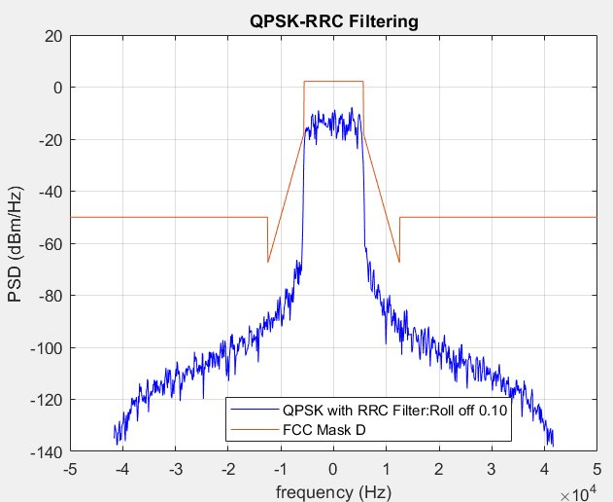
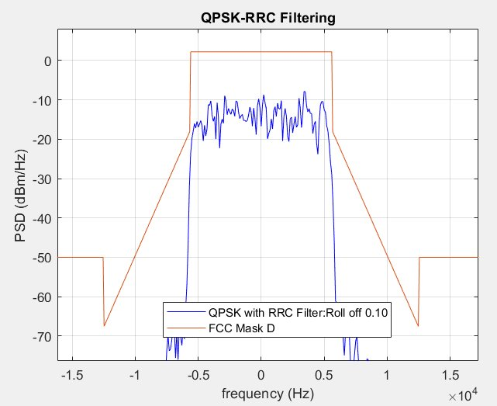
FCC Mask-D Conformance : QPSK, 1.85 bps/Hz

Slide 9
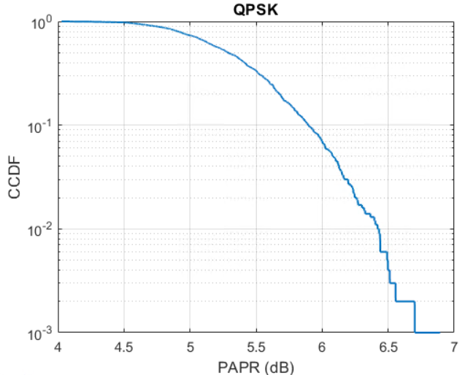
PAPR Analysis : QPSK,1.85 bps/Hz, Roll Off 0.1
Mean PAPR = 5.32 dB

Slide 10
SQPSK (OQPSK) – Spectrum before PA

Slide 11
SQPSK (OQPSK) – Spectrum after PA

Slide 12
SQPSK (OQPSK) – BER vs SNR

Slide 13
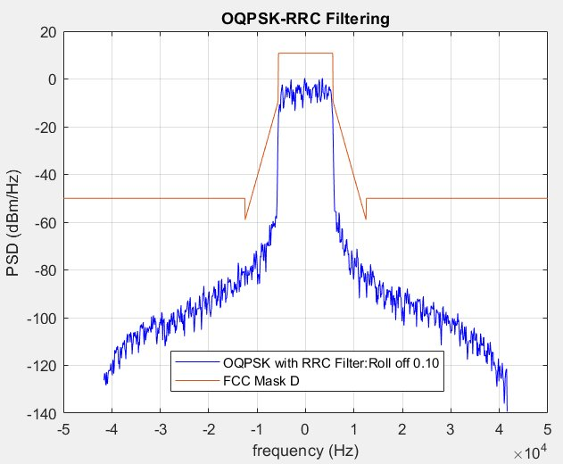
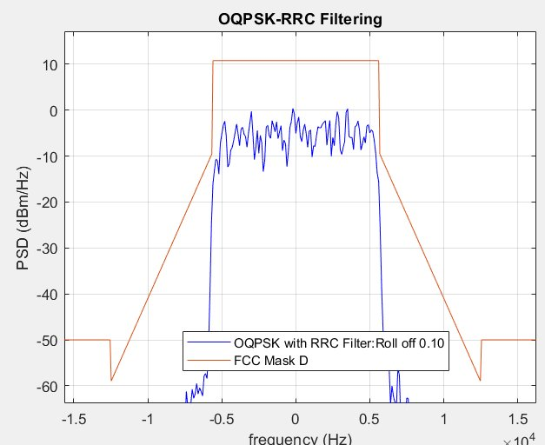
FCC Mask-D Conformance : OQPSK, 1.85 bps/Hz

Slide 14
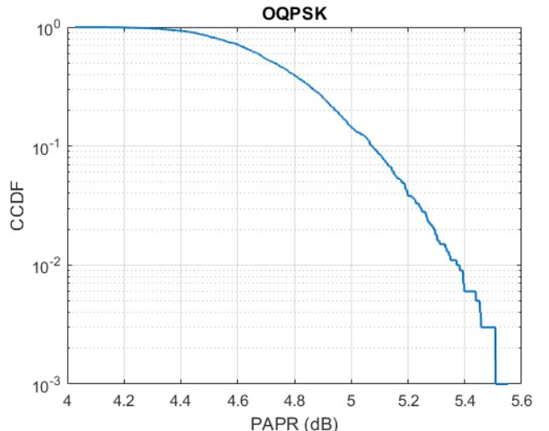
PAPR Analysis : OQPSK, 1.85 bps/Hz, Roll off 0.1
Mean PAPR = 4.75 dB

Slide 15
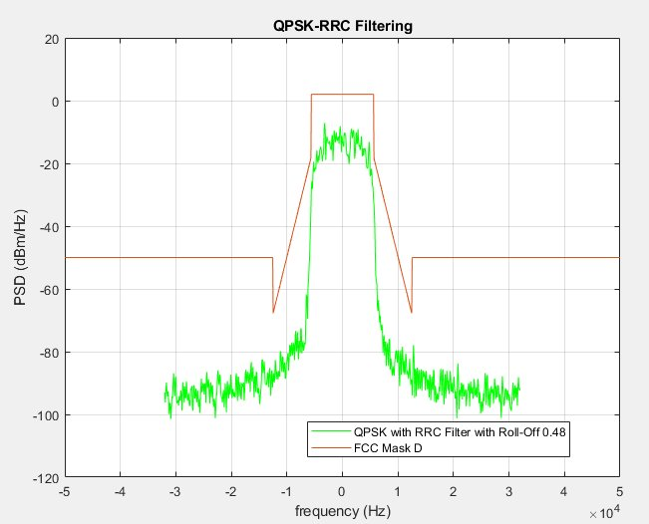
QPSK mask D plots for Roll of factor 0.48 and spectral efficiency of 1.42 bps/Hz. PAPR is 3.2 dB

Slide 16
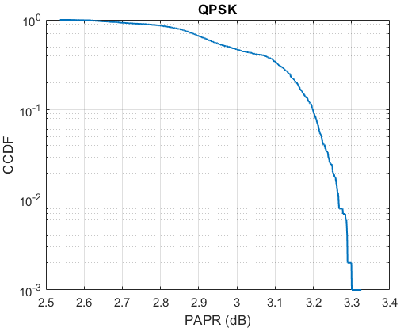
PAPR Analysis : QPSK, Roll Off 0.48

Slide 17
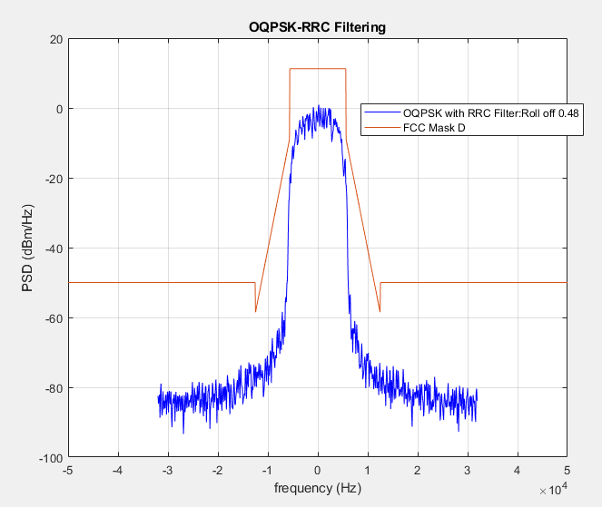
OQPSK mask D plots for Roll of factor 0.48 and spectral efficiency of 1.42 bps/Hz. PAPR 2.98 dB

Slide 18
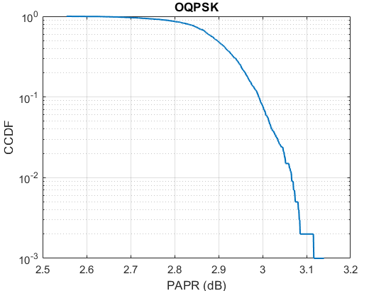
PAPR Analysis : OQPSK , Roll Off 0.48
Mean PAPR = 2.89 dB

Slide 19
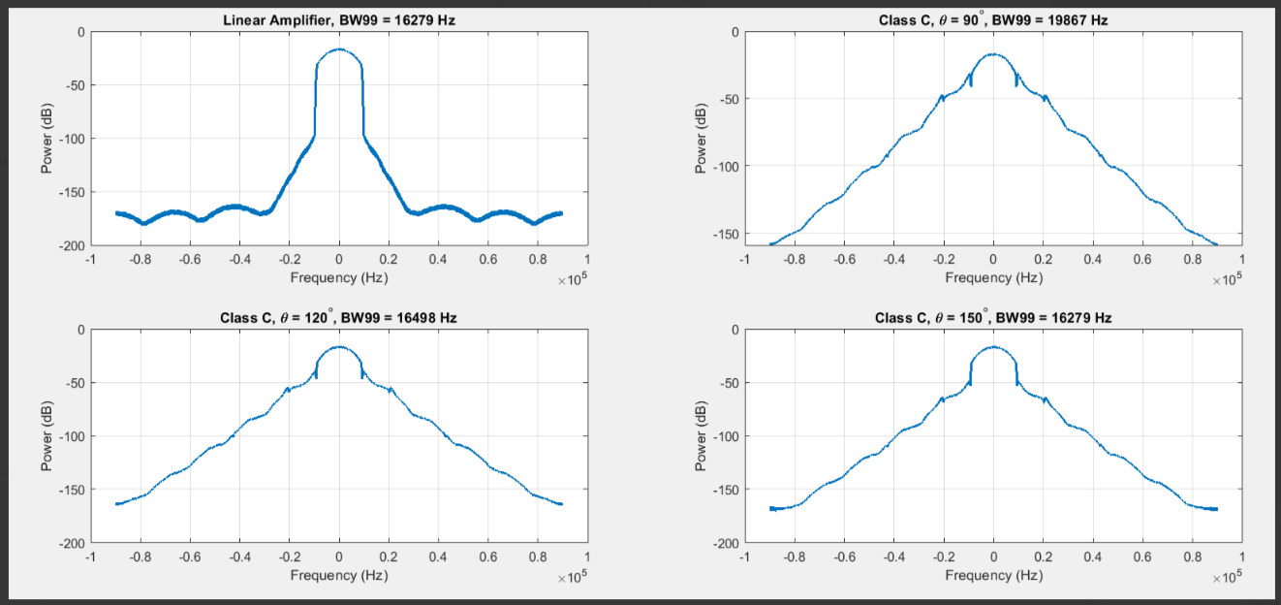
SOQPSK: Spectrum After PA (Bit rate = 22.4 kb/s, BW = 16 KHz)

Slide 20
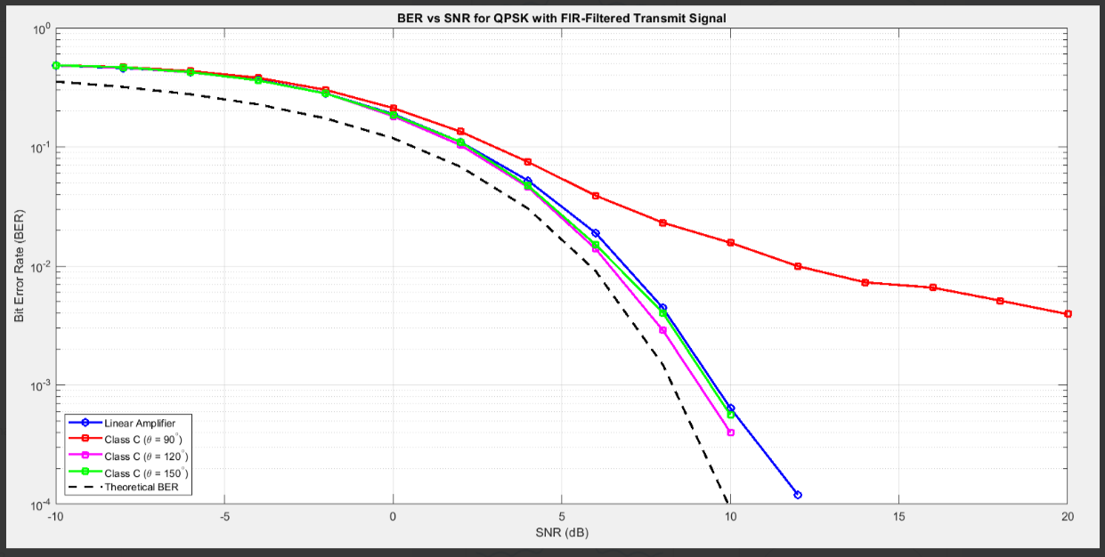
SOQPSK: BER vs SNR (bit rate = 22.4 kb/s, filter bandwidth = 16 KHz)

Slide 21
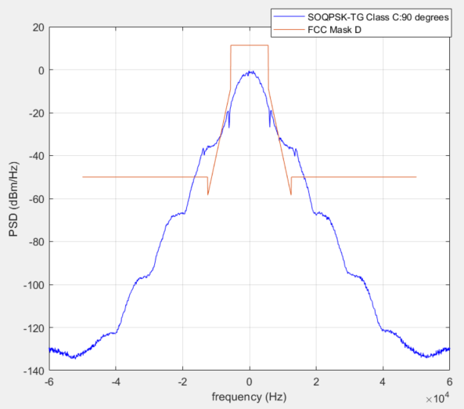
SOQPSK with 15 kbps data rate Mask D Failing.

Slide 22
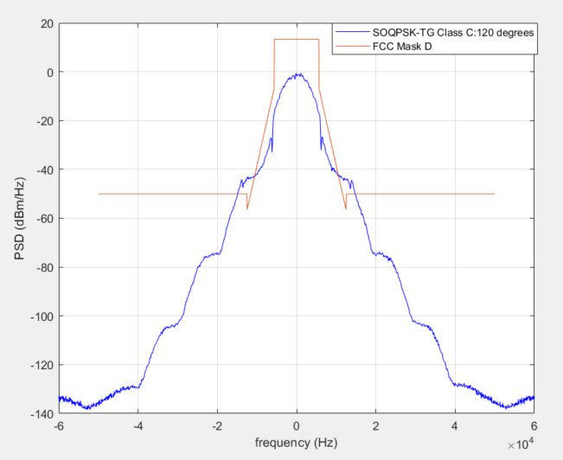
SOQPSK with 15 kbps data rate Mask D Failing.

Slide 23
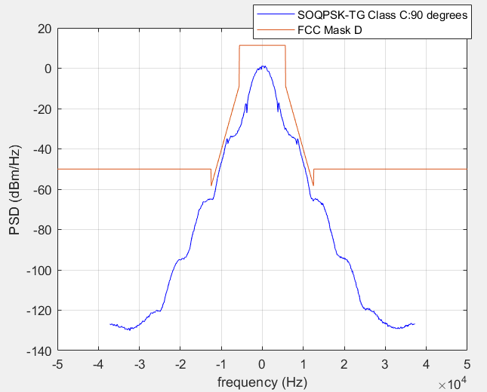
SOQPSK with 9.3 kbps data rate Mask D passing.

Slide 24
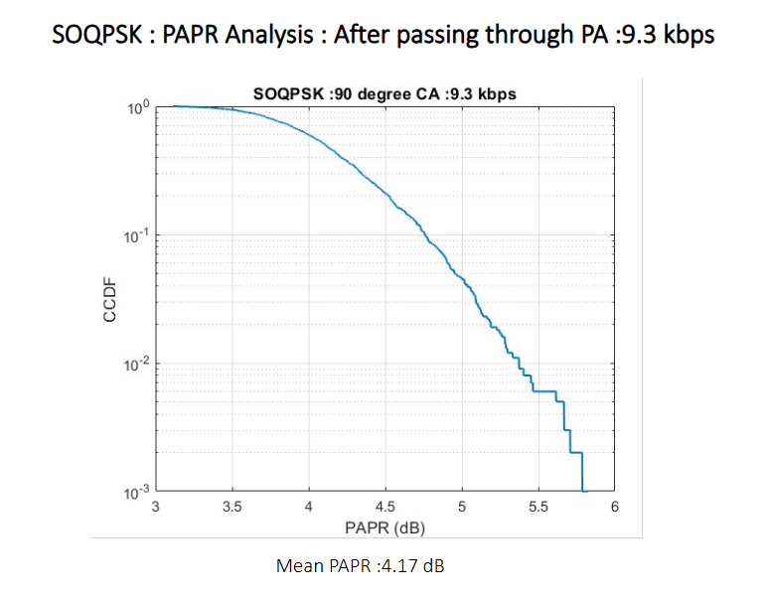

Slide 25
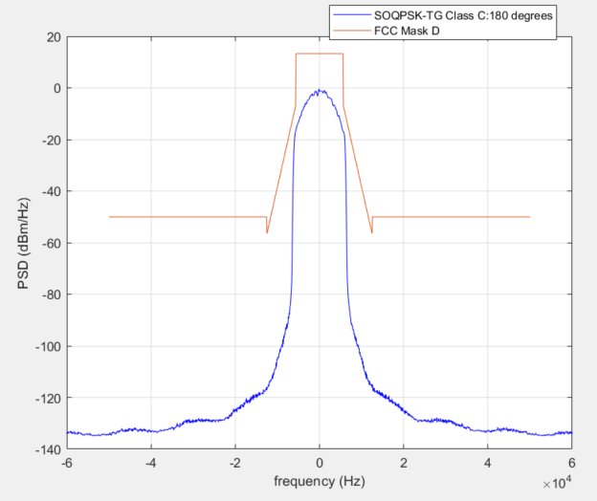
SOQPSK with 15 kbps data rate Mask D Passing CA 180 Deg.

Slide 26
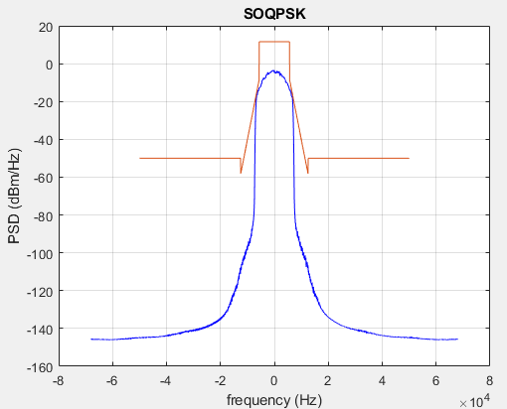
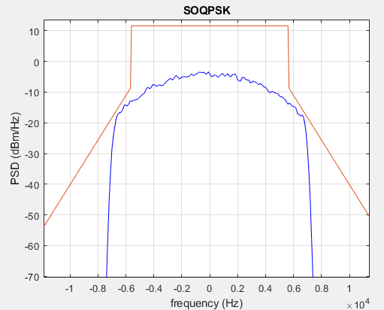
SOQPSK with Bitrate 17 kbps and Mask D

Slide 27
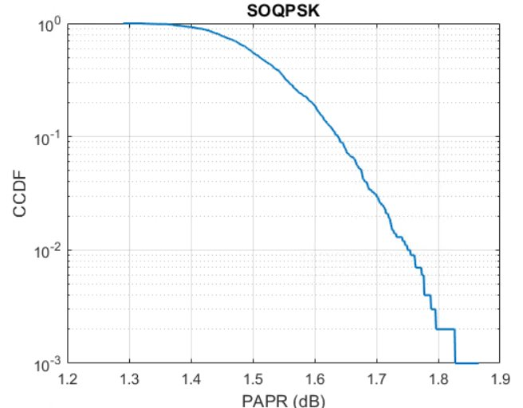
PAPR Analysis : SOQPSK
Mean PAPR = 1.52 dB

Slide 28
SOQPSK: Frequency Utilization vs Class C Amplifier Conduction Angel
As shown in the following slides, SOQPSK Waveform can operate with a Class C PA and pass Spectrum Emission Mask D if the bit rate and conductance angle is selected appropriately.
The spectral regrowth increases as the conductance angle is decreased.
To meet FCC Part 90 spectrum emission mask D, the symbol rate need to be redcued as the conduction angel is reduced. PAPR increases to 5.5 dB.
Increasing the conductance angel translates into a higher power consumption. This implies the higher the bit rate, the higher the power consumption. This tradeoff is shown in the next couple of slides:
  Operating at 17 kb/s (frequency utilization = 1.51 bits/sec/Hz) in a 12.5 KHz channel requires a conduction angel > 180°
  Operating at conductance angle of 90° requires a reduction in bit rate to 9.3 kb/s. with PAPR 5.5 dB.

Slide 29
GMSK: Waveform before and after PA

Slide 30
GMSK – BER vs SNR

Slide 31
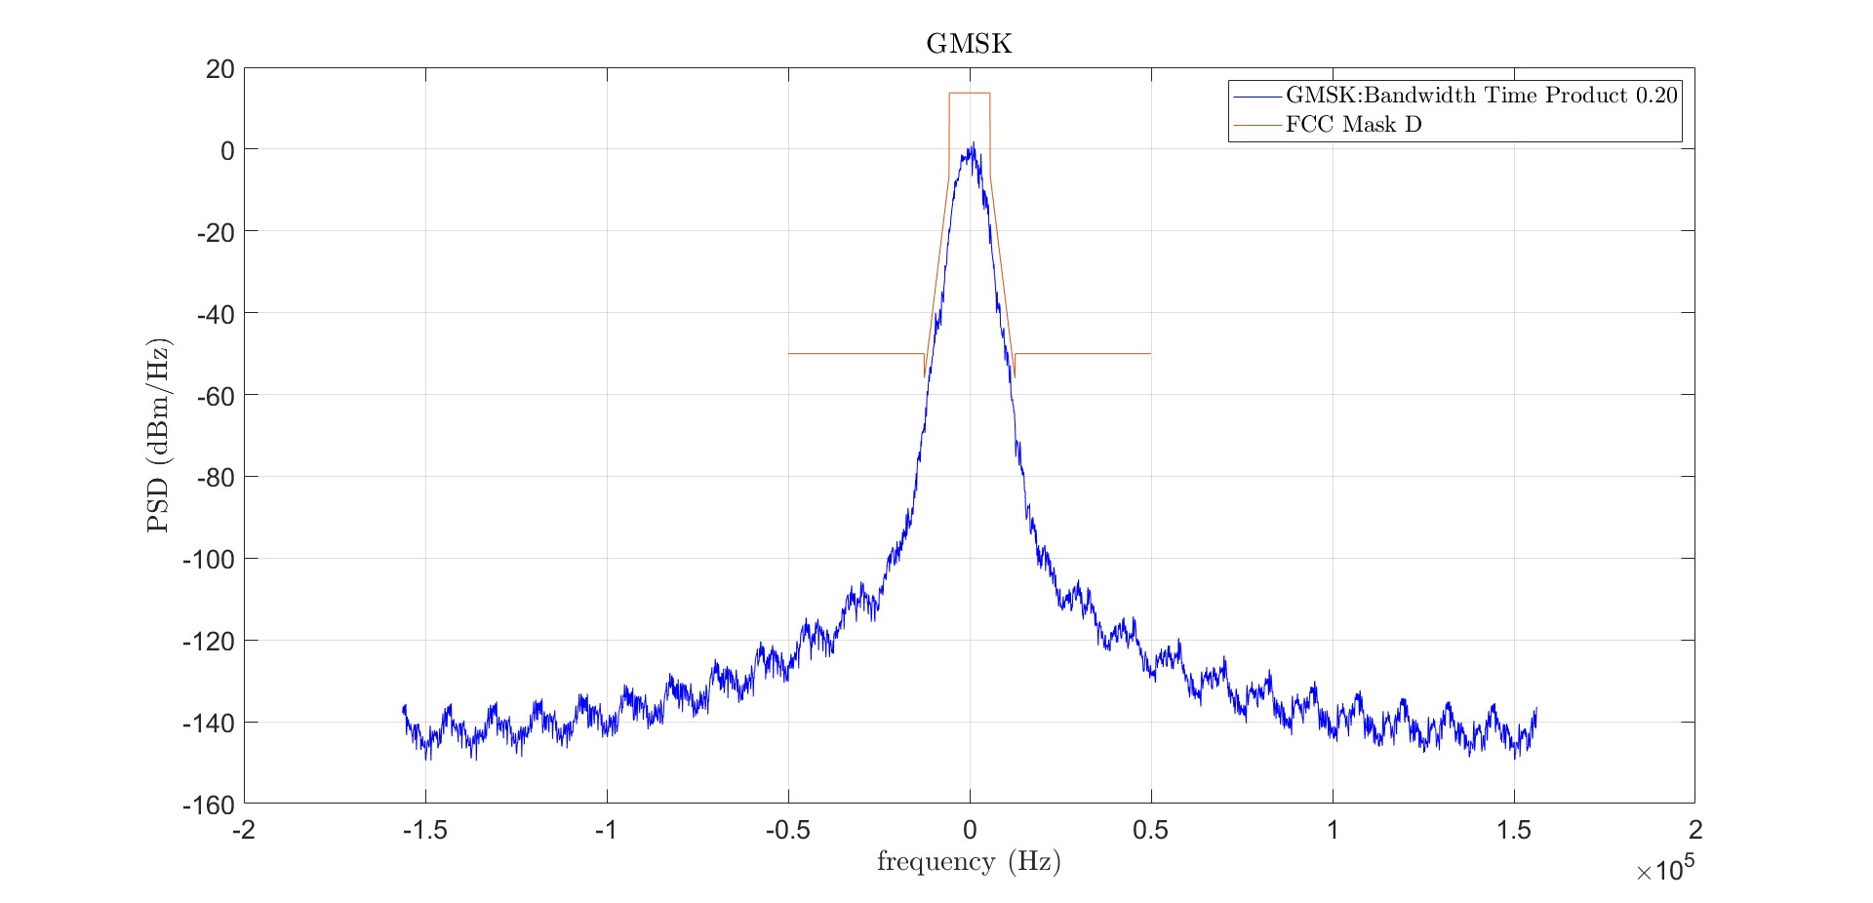
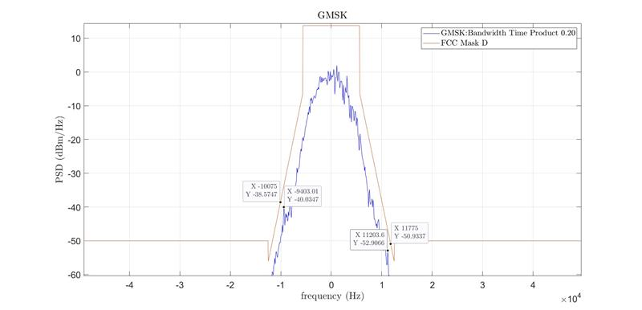
GMSK has 0 dB PAPR and 1.11 bps/Hz Spectral Efficiency

Slide 32
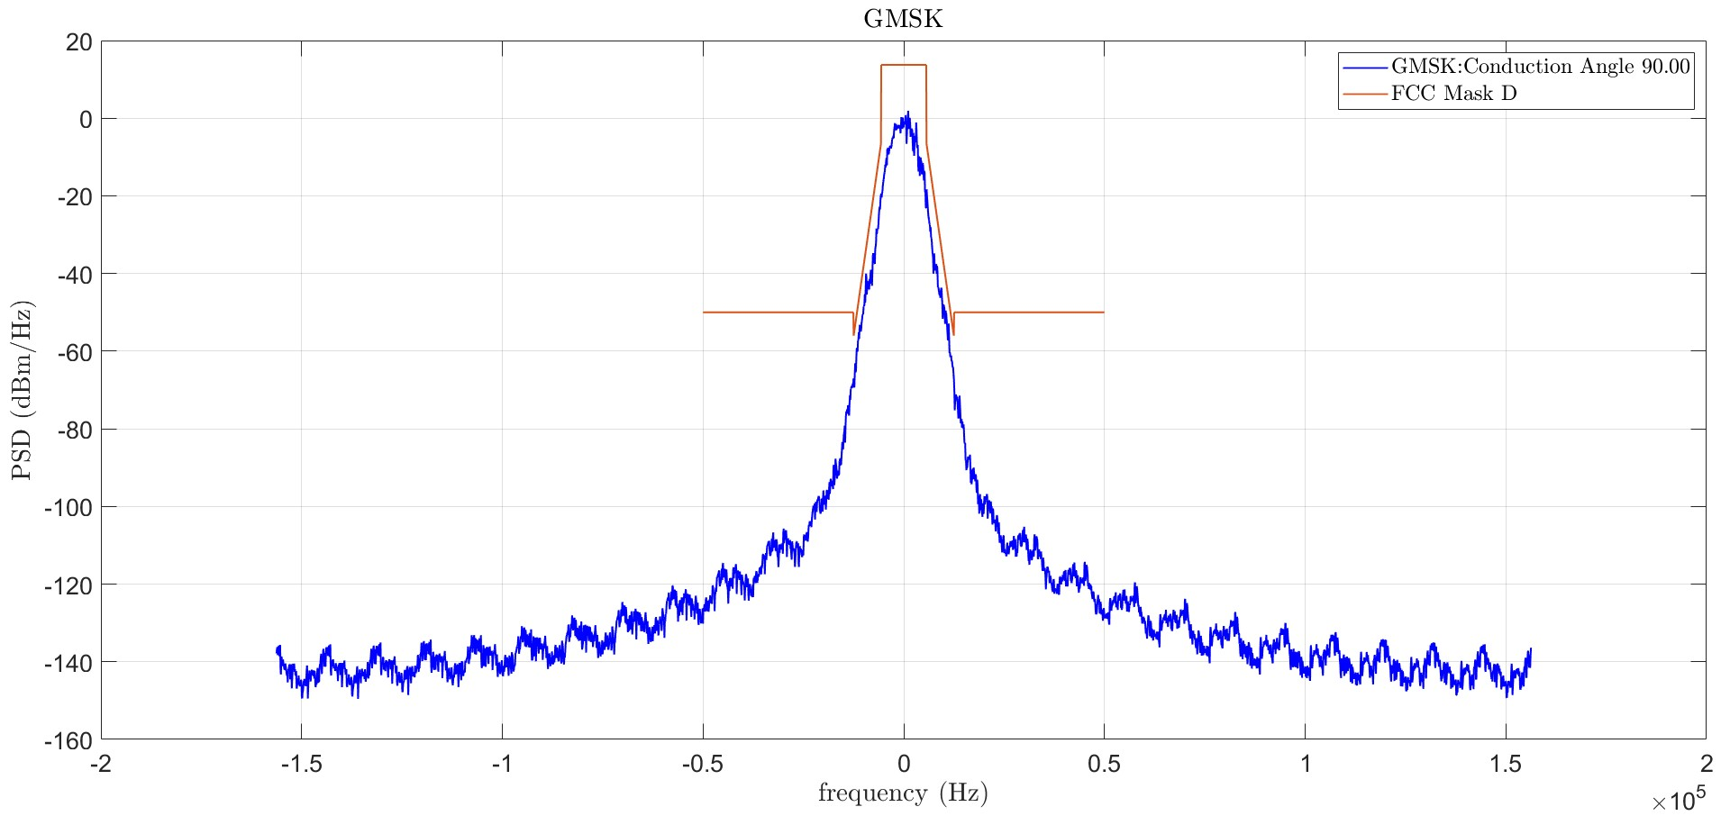
GMSK has 0 dB PAPR and 1.11 bps/Hz Spectral Efficiency with Class C PA Conduction angle 90 Degree.

Slide 33
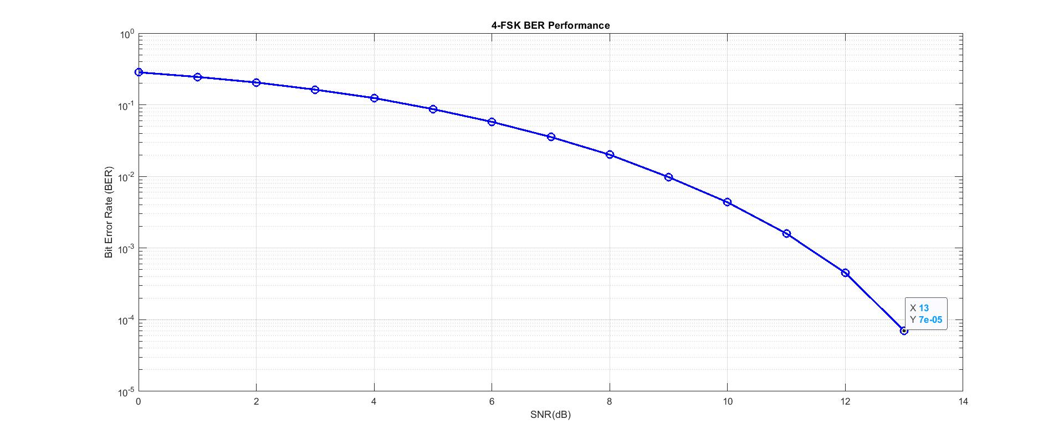
Four FSK BER Vs SNR

Slide 34
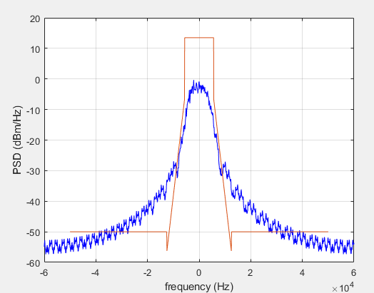
Four FSK 9600 bps Mask D fails. Needs pulse shaping but PAPR will increase.

Slide 35
Summary
The waveform is passed through a low pass filter. As the filter become more selective (smaller Rolloff), the PAPR increases.
Here are couple of data points:
  For QPSK and OQPSK waveforms, with spectral efficiency of 1.85 bps/Hz, Rolloff factor of 0.1, FCC mask D Passing, PAPR is 6.6 and 5.5 dB respectively.
  The minimum PAPR with mask D passing for QPSK is seen with roll of factor of 0.48. The PAPR is 3.3 dB for QPSK and 3.1 dB for OQPSK. The spectral efficiency is 1.42 bps/Hz.
  For SOQPSK we get 1.5 bps/Hz spectral efficiency with 1.82 dB PAPR and mask D passing.
  For GMSK we get 1.11 bps/Hz spectral efficiency with 0 dB PAPR mask D passing with Class C PA conduction angle 90 degree.
  Note: PAPR considered is for 0.1% CCDF.

Slide 36
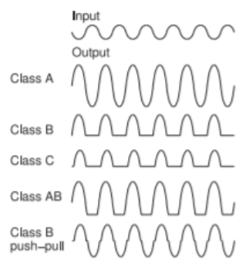
Basics of PA Class
PA Class | Conduction Angle | Theoretical Efficiency | Practical Efficiency
Class A | 360 Degrees | 50.0 % | 25 – 30 %
Class B | 180 Degrees | 78.5 % | 55 – 65 %
Class AB | Between 180 – 360 Degree | Less than 78.5 % | 50 – 60 %
Class C | < 180 Degrees | For meaningful operation 70 – 85% (smaller angle – higher efficiency but lower utility) | 65 – 75 %
Why Practical Efficiency is lower than Theoretical Efficiency
Non-linear operation – power wasted in unwanted frequencies like harmonics.
Quiescent current – constant DC flows even without input signal.
DC Power dissipation as heat.
Impedance mis-match – causes power reflections, reduces power delivered to the load and reduces efficiency.
Biasing – variations in biasing due to various reasons, can lead to signal clipping and distortion and reduces efficiency.
PCB Layout imperfections and soldering may impact ground return path and hence reduce efficiency.

Slide 37
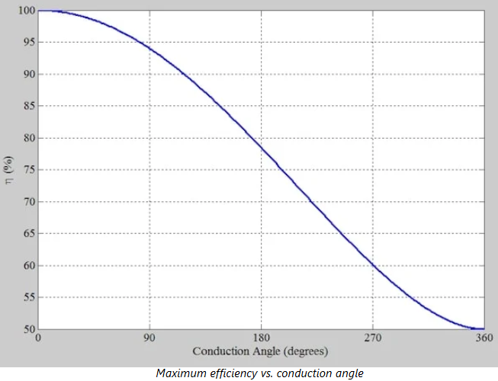
Theoretical Class C PA Efficiency vs Conduction Angle

Slide 38
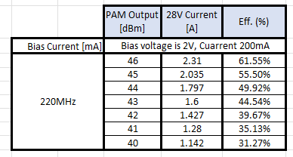
PAPR Effect on PA efficiency

Slide 39
Conclusions
The PAPR increases significantly for QPSK, OQPSK and SOQPSK when the bit rate is increased. In contrast, the PAPR is always zero for GMSK.
SQPSK seems not to have much of a differentiation relative to QPSK.
The use of Class C PA with a conduction angel < 180° , limits significantly the SOQPSK bit rate. It is recommended to use SOQPSK with Class A-B PA.
When used with a Class A-B PA, SOQPSK shows a 4.8 dB better PAPR compared to QPSK and OQPSK for a frequency utilization of 1.51 bits/sec/Hz. The corresponding frequency utilization of QPSK and SOQPSK is 1.42 bits/sec/Hz.
GMSK is a viable option here. It has a slightly lower frequency utilization of 1.1 bits/sec/Hz but it has a much better power consumption than all other waveforms.

