Slide 1
Project: IEEE P802.15 Working Group for Wireless Specialty Networks (WSN)
Submission Title: WaveformSelectionForLowPowerMode.
July 2025
Date Submitted: 2025-07-29
Source: Menashe Shahar, Vishal Kalkundrikar, Ondas Networks
Abstract: Various Modulations with FCC Mask D and PAPR analysis are presented.
Purpose: Proposal for the Low Power Mode single carrier modulation.
Notice: This document has been prepared to assist the IEEE P802.15. It is offered as a basis for discussion and is not binding on the contributing individual(s) or organization(s). The material in this document is subject to change in form and content after further study. The contributor(s) reserve(s) the right to add, amend or withdraw material contained herein.
Release: The contributor acknowledges and accepts that this contribution becomes the property of IEEE and may be made publicly available by P802.15.

Slide 2
Objective
Select a waveform for the new ieee802.16me single channel mode that will help reduce power consumption while maintaining frequency utilization as close as possible to 2 bits/sec/Hz.
Waveform characteristics:
  Low PAPR
  Low sensitivity to non-linearity to support operation with Class C PA
  Meet FCC Part 90 requirements including Spectrum Emission Mask D.
Candidate waveforms:
  SOQPSK-TG as per IRIG-106 (the symbol rate needs to be reduced to enable operation in a 12.5 KHz wide channel subject to FCC Part 90).
  OQPSK
  QPSK
  GMSK

Slide 3
Ability to Operate with a Class C PA
Objectives:
  Determine if QPSK, SOQPSK, SQPSK (OQPSK) and GMSK can operate with a Class C Power Amplifier and at what conduction angle.
    The impact of the Class C PA on BER vs SNR performance
    The impact of the Class C PA on the spectrum and whether the radio will pass FCC Part 90 Spectrum Emission Mask D.
  Assess the power consumption that can be saved in the PA section.
  Determine the frequency utilization of each modulation.
Methodology:
  A MATLAB simulation is used to simulate the radio transmitter, the radio recover, the Class C PA.
  A filter is added on the transmit path before the PA to try limit the bandwidth such that the frequency utilization is 2 bits/sec/Hz.
  Class C PA is modeled as a limiter. When the level of the waveform exceeds a threshold, the PA is turned on and below this level, the PA is turned off. The threshold level determines the conduction angle at which the PA is on.

Slide 4
Simulation Block Diagram

Slide 5
QPSK – Spectrum before PA

Slide 6
QPSK – Spectrum After Class C PA

Slide 7
QPSK - BER vs SNR

Slide 8
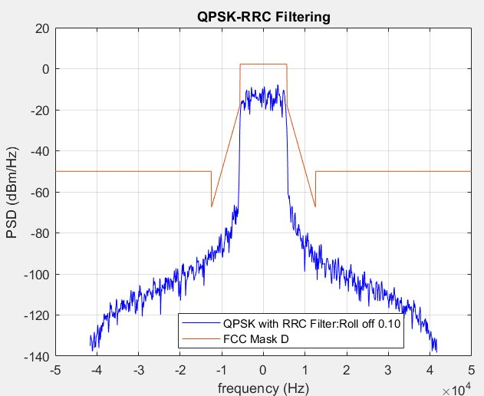
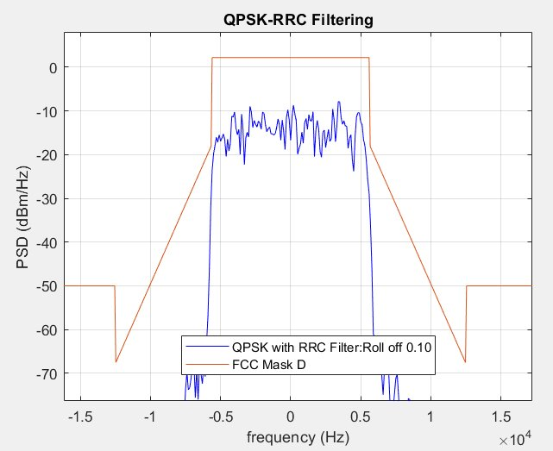
FCC Mask-D Conformance : QPSK, 1.85 bps/Hz

Slide 9
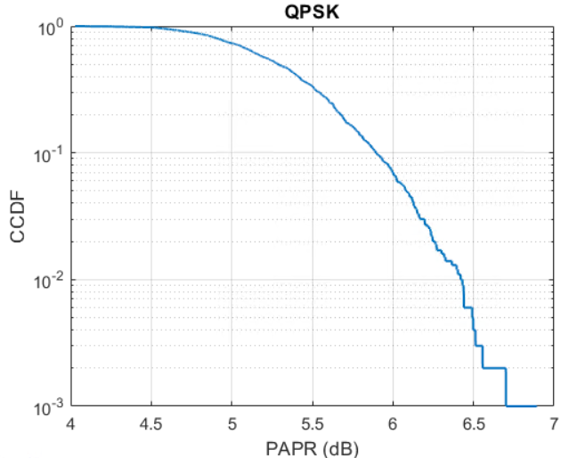
PAPR Analysis : QPSK,1.85 bps/Hz, Roll Off 0.1
Mean PAPR = 5.32 dB

Slide 10
SQPSK (OQPSK) – Spectrum before PA

Slide 11
SQPSK (OQPSK) – Spectrum after PA

Slide 12
SQPSK (OQPSK) – BER vs SNR

Slide 13
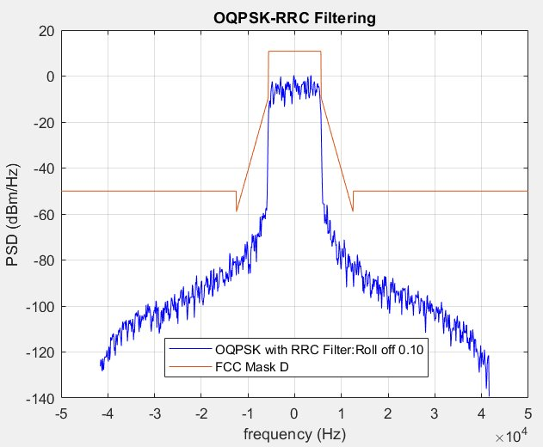
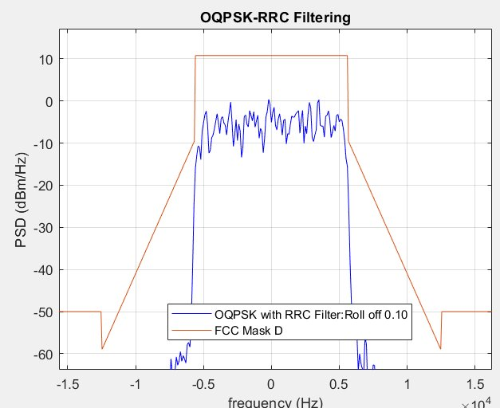
FCC Mask-D Conformance : OQPSK, 1.85 bps/Hz

Slide 14
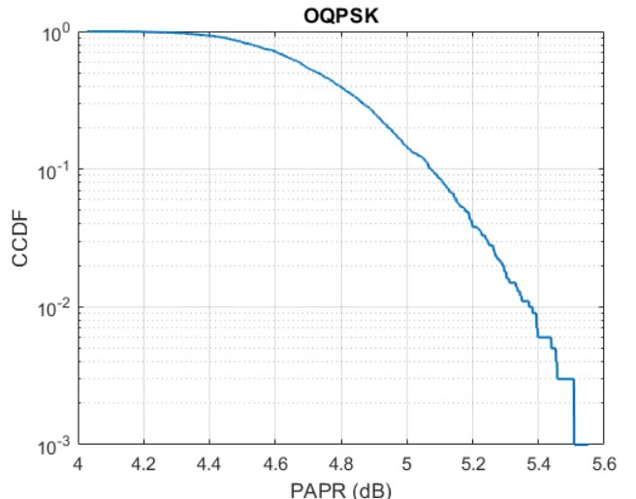
PAPR Analysis : OQPSK, 1.85 bps/Hz, Roll off 0.1
Mean PAPR = 4.75 dB

Slide 15
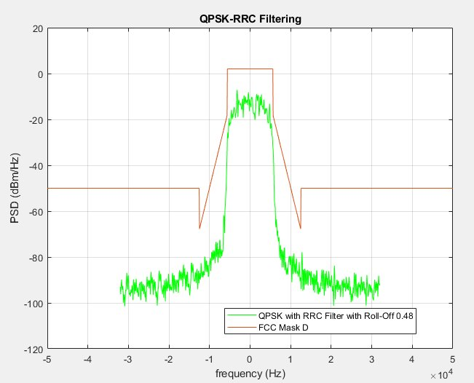
QPSK mask D plots for Roll of factor 0.48 and spectral efficiency of 1.42 bps/Hz. PAPR is 3.2 dB

Slide 16
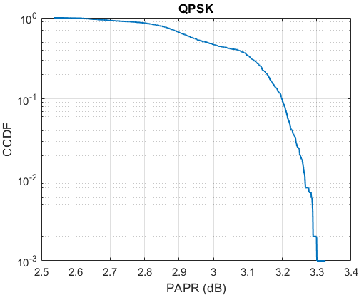
PAPR Analysis : QPSK, Roll Off 0.48

Slide 17
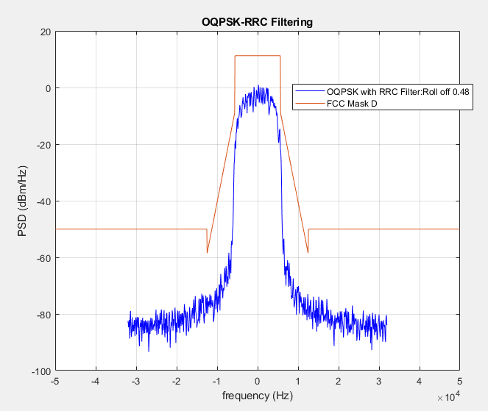
OQPSK mask D plots for Roll of factor 0.48 and spectral efficiency of 1.42 bps/Hz. PAPR 2.98 dB

Slide 18
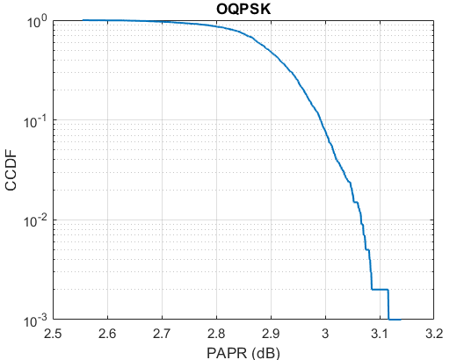
PAPR Analysis : OQPSK , Roll Off 0.48
Mean PAPR = 2.89 dB

Slide 19
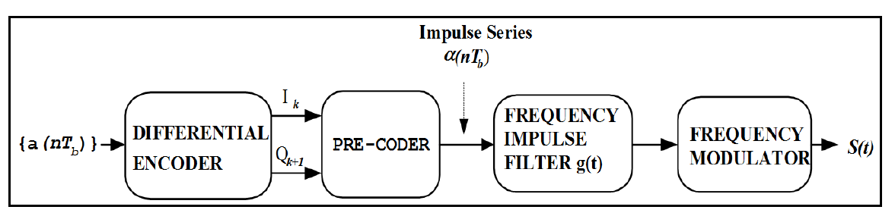
SOQPSK-TG Transmitter
SOQPSK-TG waveform is generated as per the IRIG 106-20 Telemetry Group Standard.

Slide 20
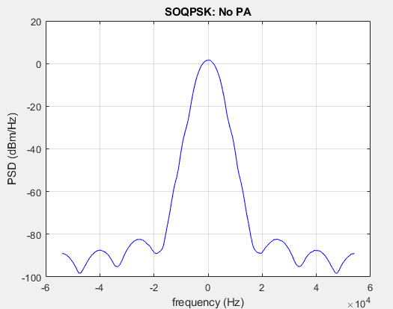
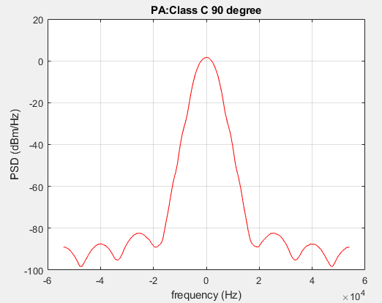
SOQPSK-TG 13.5 kbps No PA Vs Class C PA CA 90 Deg

Slide 21
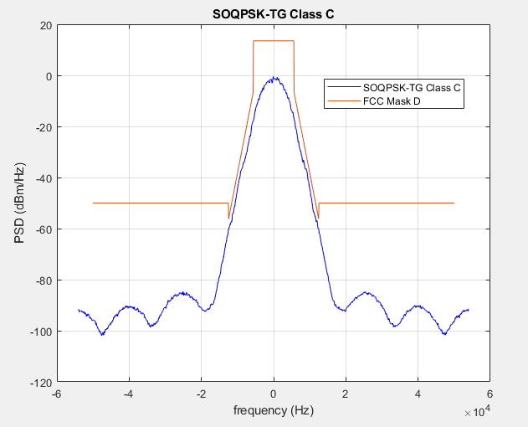
SOQPSK-TG with 0 dB PAPR, 13.5 kbps Class C PA 90 Degree Angle

Slide 22
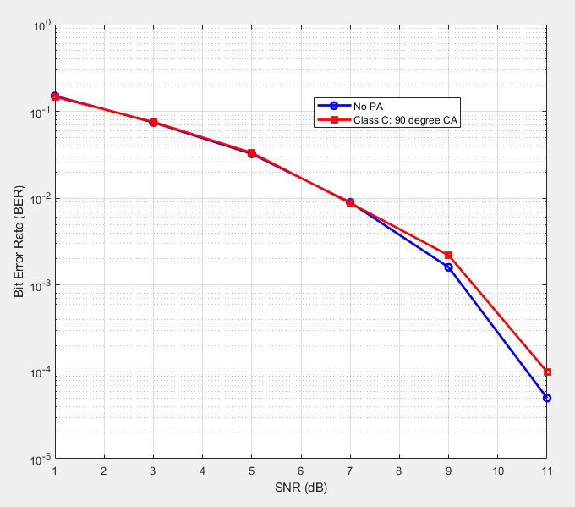
SOQPSK-TG BER Vs SNR No PA Vs Class C PA CA 90 Degree

Slide 23
SOQPSK: Frequency Utilization vs Class C Amplifier Conduction Angle
SOQPSK Waveform can operate with a Class C PA with conduction angle 90 degrees and pass Spectrum Emission Mask D if the bit rate is selected appropriately.
To meet FCC Part 90 spectrum emission mask D, maximum bit rate used is 13.5 kbps. With this Frequency utilization is 1.2 bits/sec/Hz.

Slide 24
GMSK: Waveform before and after PA

Slide 25
GMSK – BER vs SNR

Slide 26
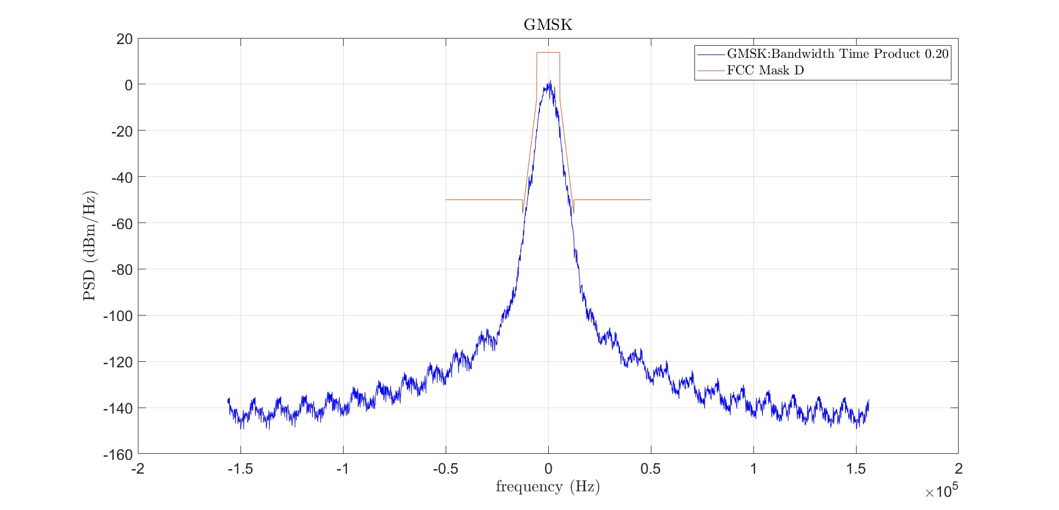
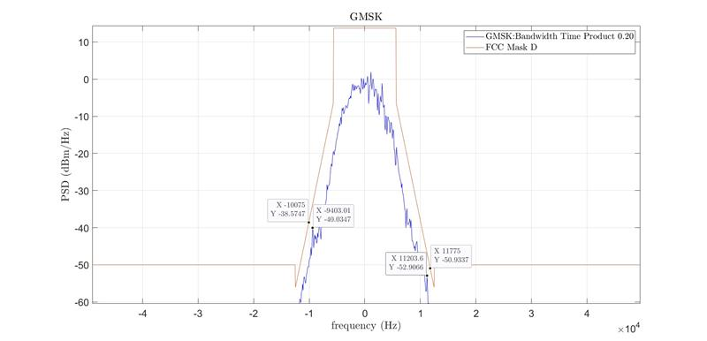
GMSK 0 dB PAPR Bit rate 12.5kbps, 1.11 bps/Hz Spectral Efficiency.

Slide 27
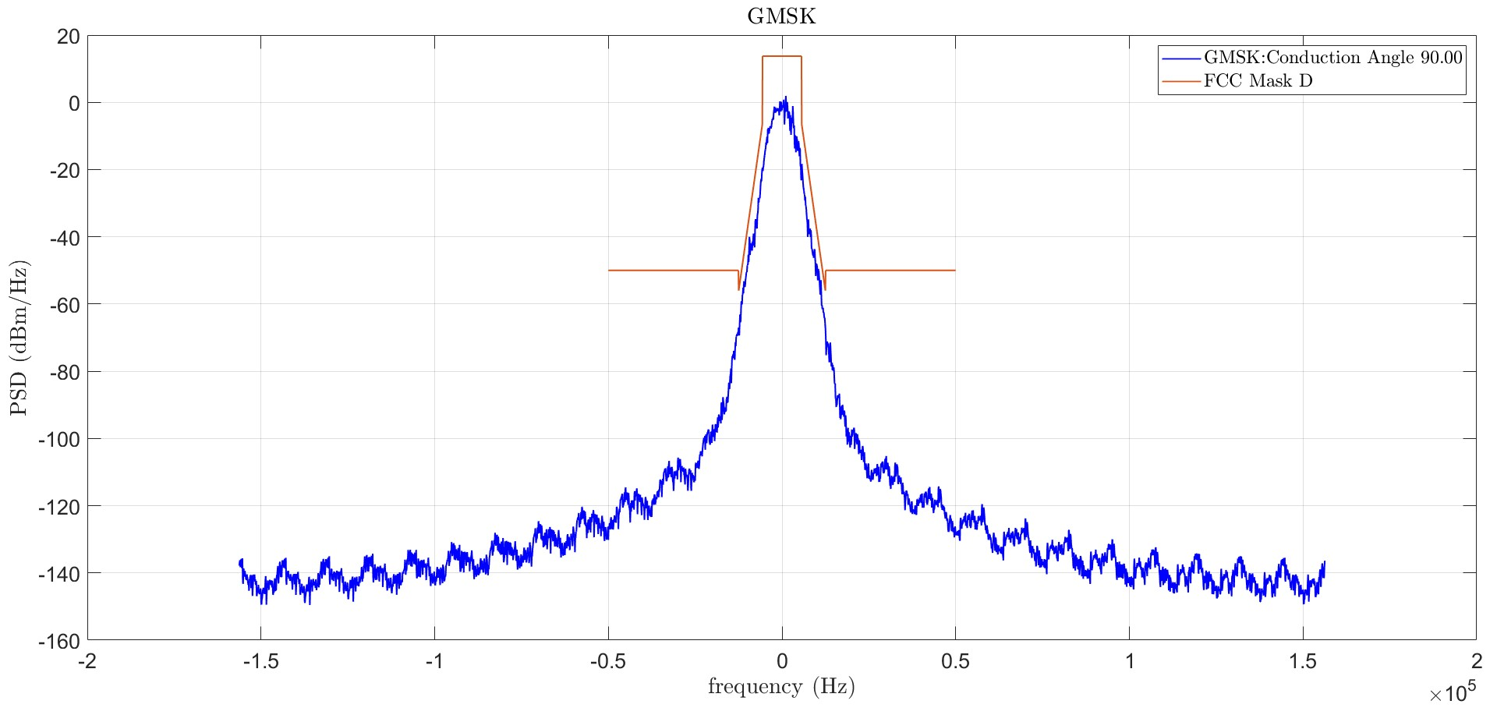
GMSK 0 dB PAPR Bit rate 12.5kbps, 1.11 bps/Hz Spectral Efficiency with Class C PA Conduction angle 90 Degree.

Slide 28
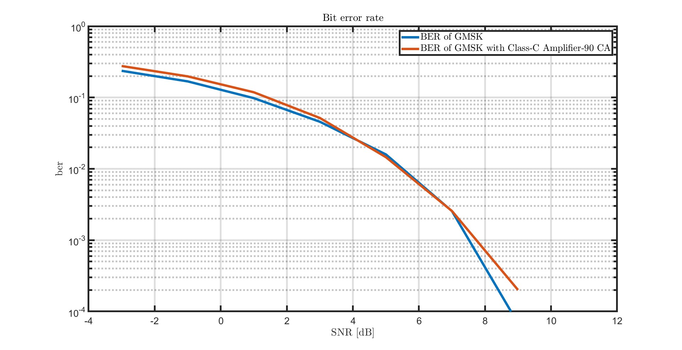
GMSK BER Vs SNR No PA Vs Class C PA CA 90 Degree

Slide 29
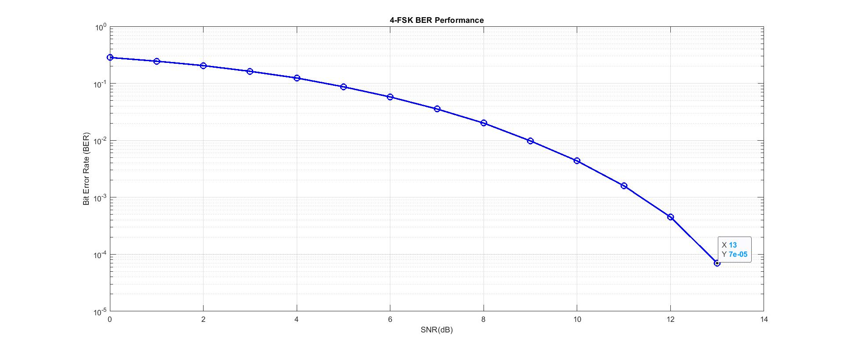
Four FSK BER Vs SNR

Slide 30
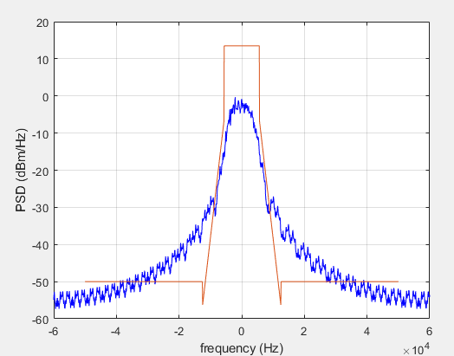
Four FSK 9600 bps Mask D fails. Needs pulse shaping but PAPR will increase.

Slide 31
Summary
The waveform is passed through a low pass filter. As the filter become more selective (smaller Rolloff), the PAPR increases.
Here are couple of data points:
  For QPSK and OQPSK waveforms, with spectral efficiency of 1.85 bps/Hz, Rolloff factor of 0.1, FCC mask D Passing, PAPR is 6.6 and 5.5 dB respectively.
  The minimum PAPR with mask D passing for QPSK is seen with roll of factor of 0.48. The PAPR is 3.3 dB for QPSK and 3.1 dB for OQPSK. The spectral efficiency is 1.42 bps/Hz.
  For SOQPSK we get 1.2 bps/Hz spectral efficiency with 0 dB PAPR and mask D passing.
  For GMSK we get 1.11 bps/Hz spectral efficiency with 0 dB PAPR mask D passing with Class C PA conduction angle 90 degree.
  Note: PAPR considered is for 0.1% CCDF.

Slide 32
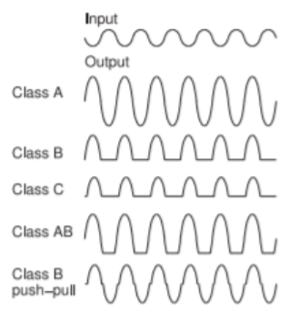
Basics of PA Class
PA Class | Conduction Angle | Theoretical Efficiency | Practical Efficiency
Class A | 360 Degrees | 50.0 % | 25 – 30 %
Class B | 180 Degrees | 78.5 % | 55 – 65 %
Class AB | Between 180 – 360 Degree | Less than 78.5 % | 50 – 60 %
Class C | < 180 Degrees | For meaningful operation 70 – 85% (smaller angle – higher efficiency but lower utility) | 65 – 75 %
Why Practical Efficiency is lower than Theoretical Efficiency
Non-linear operation – power wasted in unwanted frequencies like harmonics.
Quiescent current – constant DC flows even without input signal.
DC Power dissipation as heat.
Impedance mis-match – causes power reflections, reduces power delivered to the load and reduces efficiency.
Biasing – variations in biasing due to various reasons, can lead to signal clipping and distortion and reduces efficiency.
PCB Layout imperfections and soldering may impact ground return path and hence reduce efficiency.

Slide 33
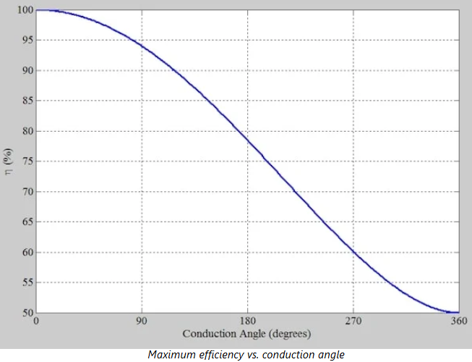
Theoretical Class C PA Efficiency vs Conduction Angle

Slide 34
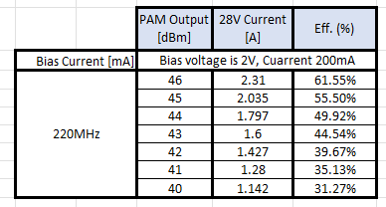
PAPR Effect on PA efficiency

Slide 35
Power Consumption Comparison.

Slide 36
Waveform Comparison Methodology (1)
Uncoded frequency utilization: frequency utilization before FEC is applied
SNR for BER = 10 exp-4 (dB) uncoded: The SNR needed to support a BER of 10 exp -4 for the uncoded waveform.
SNR for BER = 10 exp-4 (dB) with CTC ½: The SNR needed to support a BER of 10 exp -4 for a CTC ½ coded waveform.
SNR for BER = 10 exp-4 (dB) with CTC ¾ : The SNR needed to support a BER of 10 exp -4 for a CTC 3/4 coded waveform.
CTC1/2 coded frequency utilization: the frequency utilization when CTC1/2 is applied to the waveform.
CTC3/4 coded frequency utilization: the frequency utilization when CTC3/4 is applied to the waveform.

Slide 37
Waveform Comparison Methodology (2)
PA Class: A-B or C. Class C is only selected if the conduction angle that can be supported is 90°.
Post PA Insertion Loss: this is the combined insertion loss of the T/R switch, a coupler and an anti-harmonic filter needed to meet the strict FCC harmonics requirements. I used the value 0.5 dB for all cases.
Peak to Average Power Ratio (PAPR): This is derived from the CCDF function. It is determined as the value at which the probability of a higher PAPR value is less than 10 exp -3.
Power supply efficiency: this is typically 0.85 to 0.90. I used for the value 0.90 for all cases.
PA Efficiency at peak TX power: The PA is most efficient at this point. I used the value 60% for Class A-B PA and 75% for Class C PA with 90° conductance angle.

Slide 38
Waveform Comparison Methodology (3)
PA Efficiency at average TX power: The PA is less efficient at this point. I used the table in slide 35 to determine the PA efficiency based on PAPR. For example, for QPSK @ 1.8 bits/sec/Hz, the PAPR is 4.87 dB. According to the table in slide 35, the PA efficiency at 5 dB below the peak power is 35%.
Average output TX power: This is the power required at the antenna port. It is 8 Watts (39.03 dBm) in all cases.
The peak output TX power is computed by adding the PAPR on top of the average output power. For example, in the case of QPSK @ 1.8 bits/sec/Hz, the peak power in dBm is 39.03 + 4.87 = 43.90 dBm or 24.6 Watts.
The peak PA TX power equal the peak output power plus the post PA insertion loss. In the case of QPSK @ 1.8 bits/sec/Hz, this translates into 43.90 + 0.5 = 44.40 dBm or 27.8 Watts.

Slide 39
Waveform Comparison Methodology (4)
The average PA TX power equal the average output power plus the post PA insertion loss. In the case of QPSK @ 1.8 bits/sec/Hz, this translates into 39.03 + 0.5 = 39.53 dBm or 9 Watts. Note: this is the average TX power during the time the PA is transmitting. This does not include the RX time.
The peak power consumption is the power consumption at the moment the PA is at its peak. In the case of QPSK @ 1.8 bits/sec/Hz, this is computed as Peak PA TX power/(PA efficiency at peak power * Power supply efficiency) = 27.8/(0.9*0.6) = 51.48 Watts.
The average power consumption during TX is the average TX power during TX divided by the power supply efficiency and the redcued PA efficiency. In the case of QPSK @ 1.8 bits/sec/Hz, this is computed as 9/(0.9*0.35) = 28.57 Watts.

Slide 40
Waveform Comparison Methodology (5)
Power consumption during RX: We are focusing here on PA related power consumption so this will only include the PA power consumption when it is idle. Non-zero PA power consumption during RX is typical of Class A PA but Class A-B and Class C PA power consumption during RX is zero.
TX duty cycle is the percentage of the time the PA is transmitting. The value of 2% was used here in all cases.
Average power consumption during (TX + RX) is very low due to the very low duty cycle.

Slide 41
Conclusions
The PAPR increases significantly for QPSK and OQPSK when the bit rate is increased. In contrast, the PAPR is always zero for SOQPSK and GMSK.
SQPSK seems not to have much of a differentiation relative to QPSK.
Both SOQPSK and GMSK can operate with Class C PA with 0 dB PAPR and operate with same power consumption.
SOQPSK offers a slightly better uncoded spectral efficiency over GMSK (1.2 vs 1.1 bits/sec/Hz).
GMSK offers a better BER vs SNR performance (2 dB lower SNR for BER = 10 exp-4). We can match the BER vs SNR performance by using CTC ½ for SOQPSK and CTC 2/3 for GMSK. The coded frequency utilization will be 0.6 bits/sec/Hz for SOQPSK and 0.73 bits/sec/Hz for GMSK.

