Slide 1
Project: IEEE P802.15 Working Group for Wireless Specialty Networks (WSNs)
Submission Title: Medium Access Control (MAC) for IG-NG OWC
Date Submitted: July 28, 2025
Source: Herfandi Herfandi, Nguyen Ngoc Huy, Yeong Min Jang (Kookmin University)
Address: Room #603 Mirae Building, Kookmin University, 77 Jeongneung-Ro, Seongbuk-Gu, Seoul, 136702, Republic of Korea
Voice: +82-2-910-5068 E-Mail: yjang@kookmin.ac.kr
Re:
Abstract: Present the Medium Access Control (MAC) for IG-NG OWC
Purpose: Presentation for contribution on IG NG-OWC
Notice: This document has been prepared to assist the IG NG-OWC. It is offered as a basis for discussion and is not binding on the contributing individual(s) or organization(s). The material in this document is subject to change in form and content after further study. The contributor(s) reserve(s) the right to add, amend or withdraw material contained herein.
Release: The contributor acknowledges and accepts that this contribution becomes the property of IEEE and may be made publicly available by IG NG-OWC.

Slide 2
Medium Access Control (MAC) for IG-NG OWC
July 30, 2025

Slide 3
Contents
Background
Limitations of Existing MAC Protocols
Proposed MAC Architecture
MAC Frame Structure
Results
Conclusion

Slide 4
Background
Optical Camera Communication (OCC)
OCC is a part of Optical Wireless Communication (OWC) that uses LED light sources to transmit data, which is received by cameras in devices such as smartphones, tablets, and CCTVs [1].
OCC transmits information by modulating light changing its intensity, color, flicker, or patterns to encode data effectively[2].
Benefits of OCC
OCC is low-cost, energy-efficient, and operates over unlicensed visible light, removing the need for regulated spectrum [3].
It is also immune to electromagnetic interference (EMI), making it suitable for sensitive environments such as hospitals and aircraft cabins [1] [2] [3].
Challenge
Medium Access Control (MAC) remains a key challenge in OCC, as current solutions are not effective enough to handle multiple users or dynamic conditions.
Without a robust MAC protocol, simultaneous transmissions can lead to data collisions, resulting in packet loss and delays. An adaptive and efficient design is necessary for OCC to operate effectively in real-world applications.

Slide 5
Limitations of Existing MAC Protocols
MAC Protocols (Current Standards)
MAC protocols in OCC remain underdeveloped. Although standards like IEEE 802.15.7-2011 and 802.15.7-2018 define MAC mechanisms such as slotted and unslotted CSMA/CA, they are primarily designed for photodiode-based VLC and do not address the unique constraints of camera-based receivers. As a result, these protocols may suffer from high collision rates and inefficient user coordination in OCC scenarios [4][5].
Limitations of Current Standards
Recent updates, such as IEEE 802.15.7a-2024, introduced improvements including higher data rates, longer communication ranges, and enhanced security features [6].
However, these enhancements do not fully support real-time multi-user access, making OCC at risk of reduced performance in crowded or highly dynamic environments.

Slide 6
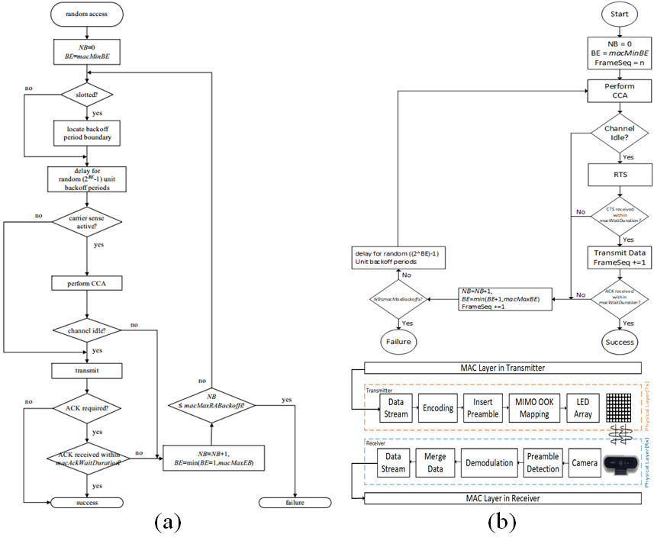
Proposed MAC Architecture
Proposed MAC Architecture for OCC
The proposed MAC is built on CSMA/CA.
A novel Transform Alignment method at the transmitter helps correct angular misalignment, reducing Bit Error Rate (BER) under dynamic conditions.
MIMO-OOK is integrated into the MAC-PHY design, enabling simultaneous multi-node transmission through an 8×8 LED matrix.
PHY-MAC integration supports better scalability and communication efficiency in high-density scenarios.
< (a) Random access [4] [5] (b) Proposed OCC MAC [7]>

Slide 7
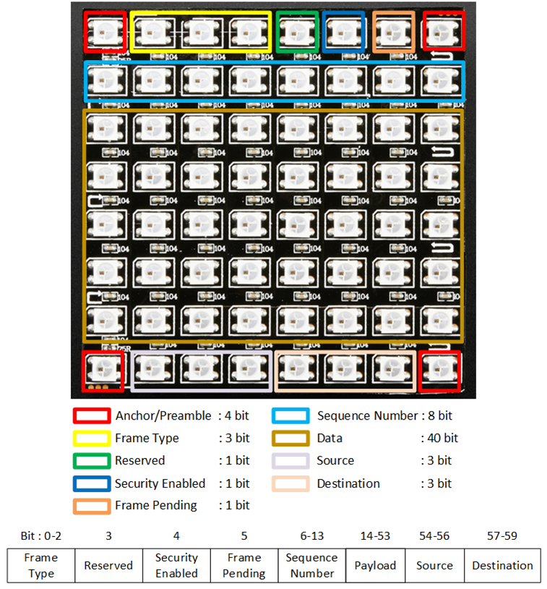
MAC Frame Structure
Proposed MAC Frame Structure for OCC
The proposed MAC uses an enhanced Frame Control Field with new subfields such as: Frame type, Sequence number, Source/Destination address, Security flags
These subfields support synchronization, secure communication, and multi-node addressing
The structure is optimized for MIMO-OOK, embedding control data directly into the LED matrix
Ensures accurate data interpretation and frame integrity even in mobile or dynamic environments
<Proposed Frame Control Structure for CSMA/CA-based MIMO-OOK MAC>

Slide 8
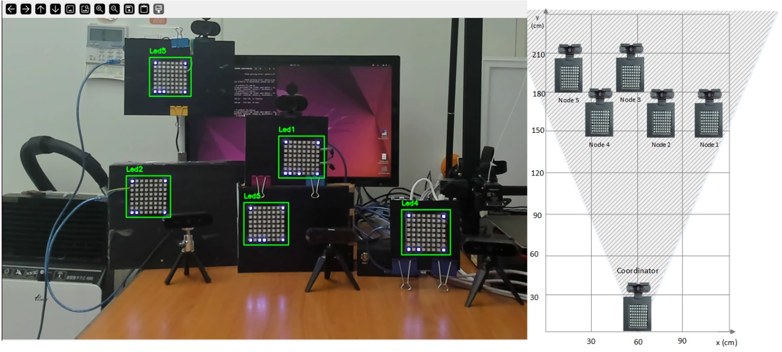
Results
<OCC System Testbed with Real-Time MAC Protocol and Node Positioning Layout>
Experimental Testbed & Results
A real-world OCC testbed was built with 5 communicating nodes, using off-the-shelf hardware (Jetson Nano, YOLO, Arduino-MIMO LEDs).
The system was tested under dynamic conditions to evaluate throughput, collisions, drop rate, and latency.
The proposed MAC protocol significantly improved channel efficiency, reduced collisions, and lowered packet loss, enabling more stable and scalable communication in multi-node OCC environments.

Slide 9
Conclusion
A CSMA/CA-based MAC protocol was developed to improve OCC performance in dynamic, multi-node scenarios.
The design includes Transform Alignment, MIMO-OOK integration, and enhanced frame control for robust, scalable communication.
The protocol supports bidirectional transmission, and optimized MAC parameters for high efficiency.
Real-world evaluation demonstrated better channel usage, fewer collisions, and more stable data exchange compared to baseline schemes.
However, traditional CSMA/CA still uses a lot of processing power and struggles to adapt in crowded or fast-moving situations.
Future work will explore the integration of lightweight AI-based techniques for channel prediction to further enhance responsiveness and efficiency.

Slide 10
References
M. R. A. Nasution, H. Herfandi, O. S. Sitanggang, H. Nguyen, and Y. M. Jang, “Proximity-based optical camera communication with multiple transmitters using deep learning,” Sensors, vol. 24, no. 2, p. 702, 2024.
S. Sitanggang, V. L. Nguyen, H. Nguyen, R. F. Pamungkas, M. M. Faridh, and Y. M. Jang, “Design and implementation of a 2D MIMO OCC system based on deep learning,” Sensors, vol. 23, no. 17, p. 7637, 2023.
D. T. A. Le, H. Nguyen, and Y. M. Jang, “An experimental demonstration of 2D-multiple-input-multiple-output-based deep learning for optical camera communication,” Applied Sciences, vol. 14, no. 3, p. 1003, 2024.
"IEEE Standard for Local and Metropolitan Area Networks--Part 15.7: Short-Range Wireless Optical Communication Using Visible Light," in IEEE Std 802.15.7-2011 , vol., no., pp.1-309, 6 Sept. 2011, doi: 10.1109/IEEESTD.2011.6016195.
"IEEE Standard for Local and metropolitan area networks--Part 15.7: Short-Range Optical Wireless Communications," in IEEE Std 802.15.7-2018 (Revision of IEEE Std 802.15.7-2011) , vol., no., pp.1-407, 23 April 2019, doi: 10.1109/IEEESTD.2019.8697198.
"IEEE Standard for Local and Metropolitan Area Networks - Part 15.7: Short-Range Optical Wireless Communications Amendment 1: Higher Rate, Longer Range Optical Camera Communication (OCC)," in IEEE Std 802.15.7a-2024 (Amendment to IEEE Std 802.15.7-2018) , vol., no., pp.1-52, 14 Feb. 2025, doi: 10.1109/IEEESTD.2025.10884983.
M. M. Faridh, H. Herfandi, O. S. Sitanggang, M. R. A. Nasution, H. Nguyen and Y. M. Jang, "Implementation of CSMA/CA-Based MAC Protocol for Optical Camera Communication," in IEEE Access, vol. 13, pp. 14611-14625, 2025, doi: 10.1109/ACCESS.2025.3531198.

