Slide 1
Project: IEEE P802.15 Working Group for Wireless Personal Area Networks (WPANs)
Submission Title: Wireless Next Generation Meeting Slides May 2025
Date Submitted: 30 July 2025
Source: Benjamin A. Rolfe (Blind Creek Associates)
Contact:
E-Mail: ben.rolfe @ ieee.org
Re: Wireless Next Generation
Abstract: Meeting Slides for the July 2025 Wireless Interim Session.
Purpose: Support the illusion of organization.
Notice: This document has been prepared to assist the IEEE P802.15. It is offered as a basis for discussion and is not binding on the contributing individual(s) or organization(s). The material in this document is subject to change in form and content after further study. The contributor(s) reserve(s) the right to add, amend or withdraw material contained herein.
Release: The contributor acknowledges and accepts that this contribution becomes the property of IEEE and may be made publicly available by P802.15.
Notes:
Jul 12, 2010
Page 1

Slide 2

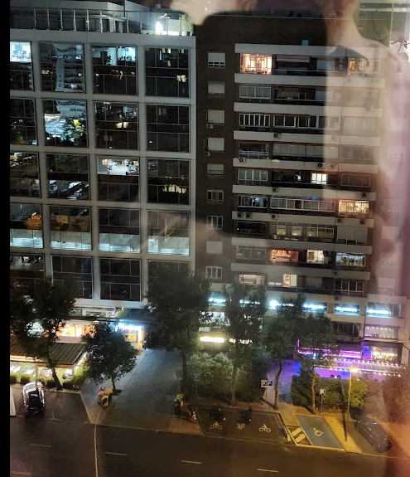
March 2025
802 Plenary Session
Madrid, Spain

Slide 3
Mixed Mode Meeting
Registration is required
Please remember to enter your attendance in IMAT
Reminder:
This is a non-PAR activity
All the rules of conduct apply https://grouper.ieee.org/groups/802/sapolicies.shtml

Slide 4
802.15 WNG Agenda
Topic | Presenter | Time
WNG Open | Ben Rolfe | 0:05
Technical presentation: Surface Wave Propagation for NG-SUN PHY in Ship Area Netwo | Jung-Hwan Hwang (Daniel) | 0:45
WNG Close | Ben Rolfe | 0:05

Slide 5
The usual question
What would you like the group to do now?
Options:
Information for the group
Form an interest group to pursue
Consider in the future a new project

Slide 6
References
Surface Wave Propagation for NG-SUN PHY in Ship Area Network https://mentor.ieee.org/802.15/dcn/25/15-25-0350-00-04ad-surface-wave-propagation-for-ng-sun-phy-in-ship-area-netwo.pdf

Slide 7

Any Other Business

Slide 8
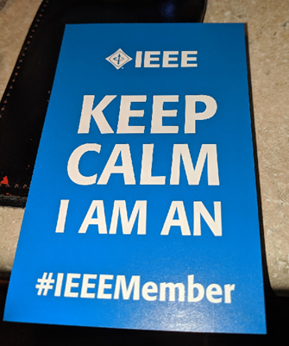
Adjourned

