Slide 1
Project: IEEE P802.15 Working Group for Wireless Specialty Networks (WSNs)
Submission Title: Improving Code Rate of Drone-FSO Communication Using Deep Learning Joint Source-Channel Coding
Date Submitted: July 28, 2025
Source: Irzal Zaini, Yeong Min Jang (Kookmin University)
Address: Kookmin University, 77 Jeongneung-Ro, Seongbuk-Gu, Seoul, 136702, Republic of Korea
Voice: +82-2-910-5068 E-Mail: yjang@kookmin.ac.kr
Re:
Abstract: Present the use case of DL JSCC for Drone FSO Communication
Purpose: Presentation for contribution on IG NG-OCC
Notice: This document has been prepared to assist the IG NG-OCC. It is offered as a basis for discussion and is not binding on the contributing individual(s) or organization(s). The material in this document is subject to change in form and content after further study. The contributor(s) reserve(s) the right to add, amend or withdraw material contained herein.
Release: The contributor acknowledges and accepts that this contribution becomes the property of IEEE and may be made publicly available by IG NG-OCC.

Slide 2
Improving Code Rate of Drone-FSO Communication Using Deep Learning Joint Source-Channel Coding
Contribution
July 31, 2025

Slide 3
Contents
Background
Drone-FSO Communication System
Deep Learning Joint Source-Channel Coding
JSCC Performance Comparison
Conclusion

Slide 4
Background
Drone-FSO communication system is a promising future of the wireless technology.
However, FSO system performance suffers greatly from the channel noise such as dust, rain droplets, and small particles.
Therefore, a new approach of robust channel coding scheme is required to mitigate this issue.
Joint Source-Channel Coding (JSCC) scheme can improve the FSO system performance with coding rate close to unity.
The utilization of Deep Learning implementation can reduce the JSCC process load and be deployed in a lightweight Drone-FSO systems.

Slide 5
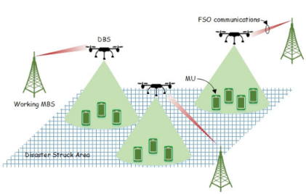
Drone-FSO Communication Architecture
The FSO has advantages over radio system thanks to its superior bandwidth and transmission speed.
However, this exploit comes with a price, that the channel condition affects greatly to FSO system performance.
In the cellular network, a Drone can be used as a hovering base-station to cover mobile user that can’t be reached by ground base-station.
<Role of Drones in FSO network>

Slide 6
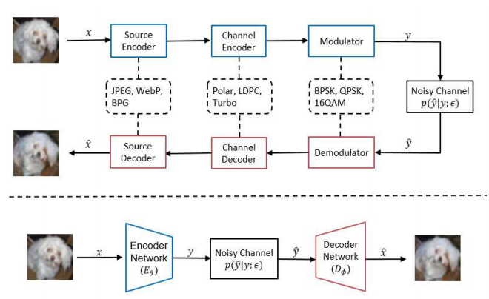
Deep Learning Joint Source-Channel Coding
The usage of bit-level channel coding is usually redundant in the fragile FSO communication system, hence not efficient.
Therefore, considering high-level semantic coding scheme can improve the performance and effectiveness of FSO system.
The DL JSCC combines the process of source encoding and channel coding into one network process.
This tandem of source and channel coding results in more reliable and efficient data transmission, especially in bandwidth-limited or highly error-prone wireless systems.
<Deep JSCC architecture>

Slide 7
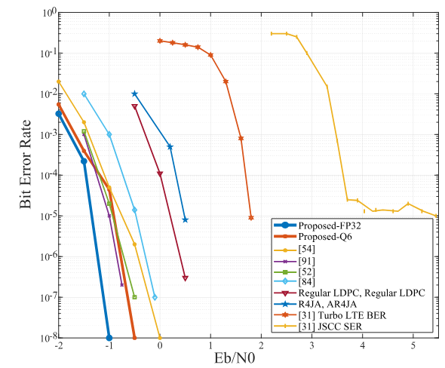
JSCC Performance Comparison
<JSCC BER performance>
The 32-bit employed JSCC shows BER value at best with the lower Eb/N0.
Compared to the regular channel coding schemes such as LDPC and Turbo, the proposed-FP32 JSCC scheme perform better.

Slide 8
Conclusion
JSCC scheme can improve the FSO system performance with coding rate close to unity by combining the process of source coding (data compression) and the channel coding (error correction algorithm).
The utilization of Deep Learning implementation can reduce the JSCC process load and be deployed in a lightweight Drone-FSO systems.

Slide 9
Reference
Xu, J., et al. (April 2022). Wireless Image Transmission Using Deep Source Channel Coding With Attention Modules. IEEE Transactions on Circuits and Systems for Video Technology. 10.1109/TCSVT.2021.3082521.
Wang, J., et al. (October 2021). Hovering UAV-Based FSO Communications: Channel Modelling, Performance Analysis, and Parameter Optimization. IEEE Journal on Selected Areas in Communications. 10.1109/JSAC.2021.3088656.
Wu, D., et al. (September 2020). An FSO-Based Drone Assisted Mobile Access Network for Emergency Communications. IEEE Transactions on Network Science and Engineering. 10.1109/TNSE.2019.2942266.
Meng, S., et al. (February 2025). Semantics-Empowered Space-Air-Ground-Sea Integrated Network: New Paradigm, Frameworks, and Challenges. IEEE Communications Surveys & Tutorials. 10.1109/COMST.2024.3416309.
Yang, M., et al. (May 2021). Deep Joint Source Channel Coding for Wireless Image Transmission with OFDM. ICC 2021 - IEEE International Conference on Communications. 10.1109/ICC42927.2021.9500996.
Zhong, X., et al. (January 2024). Joint Source-Channel Coding System for 6G Communication: Design, Prototype and Future Directions. IEEE Access. 10.1109/ACCESS.2024.3360003.

