Slide 1
Project: IEEE P802.15 Working Group for Wireless Specialty Networks (WSNs)
Submission Title: Future Directions for Handover Mechanism in Hybrid FSO/OCC-RF Networks
Date Submitted: July 30, 2025
Source: Muhammad Ayaz, Yeong Min Jang (Kookmin University)
Address: Room #603 Mirae Building, Kookmin University, 77 Jeongneung-Ro, Seongbuk-Gu, Seoul, 136702, Republic of Korea
Voice: +82-2-910-5068 E-Mail: yjang@kookmin.ac.kr
Re:
Abstract: Future Directions for Handover Mechanism in Hybrid FSO/OCC-RF Networks.
Purpose: Presentation for contribution on IG NG-OWC
Notice: This document has been prepared to assist the IG NG-OWC. It is offered as a basis for discussion and is not binding on the contributing individual(s) or organization(s). The material in this document is subject to change in form and content after further study. The contributor(s) reserve(s) the right to add, amend or withdraw material contained herein.
Release: The contributor acknowledges and accepts that this contribution becomes the property of IEEE and may be made publicly available by IG NG-OWC.

Slide 2
Future Directions for Handover Mechanism in Hybrid FSO/OCC-RF Networks.
July 28 , 2025

Slide 3
Contents
Background
Existing Issues in Handover Mechanism
Intelligent Handover Strategy Using Machine Learning for Hybrid Systems
Conclusion
References

Slide 4
Background
Hybrid FSO/OCC-RF Networks
Free Space Optics (FSO): High-speed optical communication using laser beams through free space.
FSO: High data rates (>10 Gbps), low latency, but requires line-of-sight (LOS)
Optical Camera Communication (OCC): Data transmission using visible light and camera receivers (e.g., smartphones, vehicle cameras).
OCC: Uses existing LED infrastructure, ideal for vehicular and indoor applications.
RF (Radio Frequency): Traditional wireless communication (e.g., Wi-Fi, 5G).
RF: Reliable in non-LOS scenarios but limited by spectrum congestion.
Hybrid systems combine FSO/OCC’s high bandwidth with RF’s reliability.
Advantages of Hybrid Systems
High throughput, low latency, and resilience to environmental challenges.
  Example: FSO/OCC for clear weather, RF for adverse conditions (fog, rain).

Slide 5
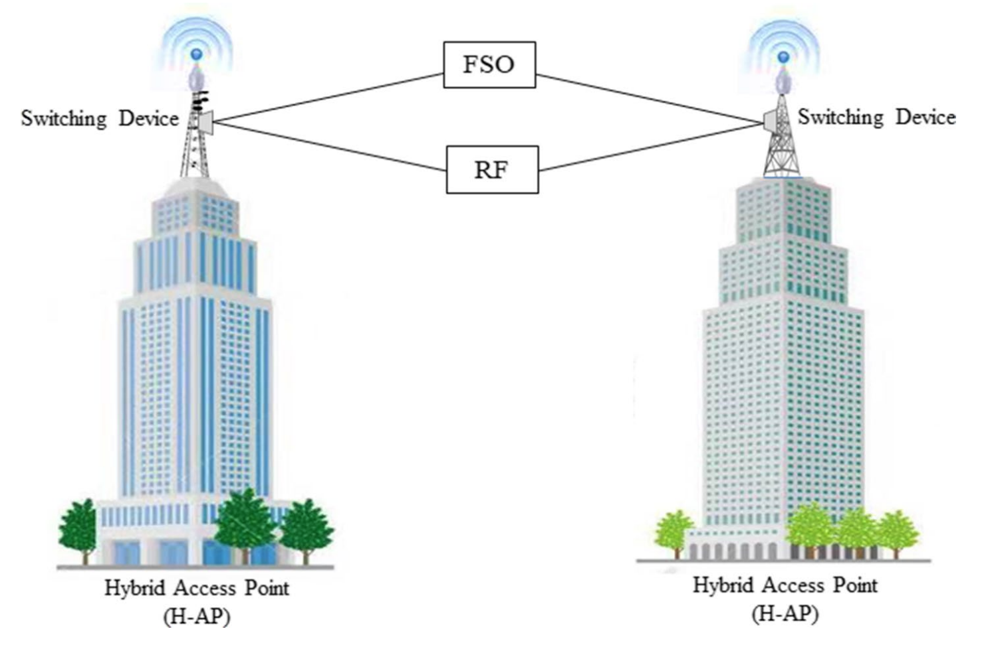
Conti..
Types of Handover:
Hard Handover: Break-before-make (connection drops before switching).
Soft Handover: Make-before-break (maintains parallel links during transition).
Challenges in Hybrid Networks:
Different physical properties of FSO/OCC (optical) and RF
Need for rapid, context-aware decisions to maintain quality of service (QoS).
Current Approaches:
Threshold-based handover (e.g., signal strength triggers).
Basic machine learning for link selection.
<An overview of hybrid FSO/RF system>

Slide 6
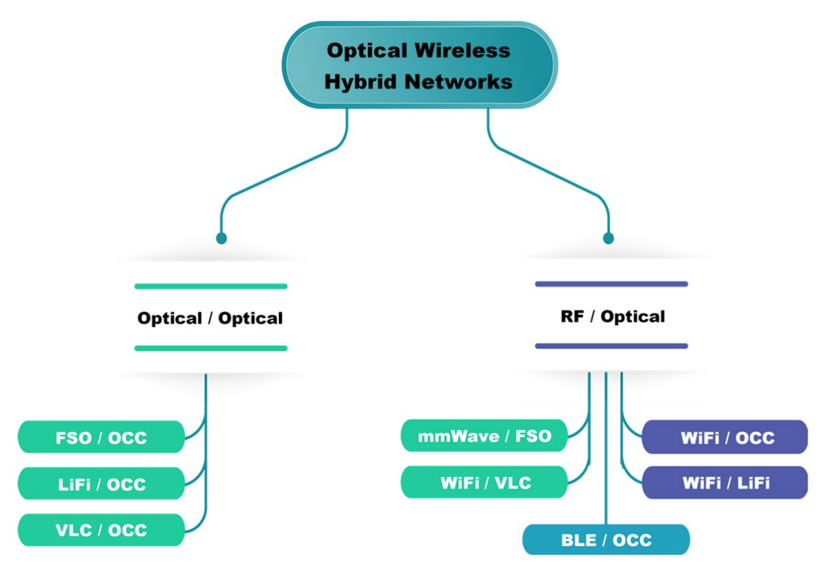
Current Issues in Handover Mechanism
Environmental Sensitivity
FSO/OCC links are disrupted by atmospheric turbulence, fog, rain, or misalignment.
Alignment Challenges:
FSO requires precise LOS and OCC depends on camera field-of-view (FOV).
Misalignment in mobile scenarios (e.g., UaV) triggers frequent handovers
Latency and Packet Loss
Hard handovers cause delays and dropped packets, affecting real-time applications (e.g., autonomous driving).
<Optical wireless hybrid systems>

Slide 7
Intelligent Handover Strategy Using Machine Learning for Hybrid Systems
AI-Driven Handover Decisions:
Use machine learning (ML) to predict link quality based on real-time data (e.g., weather, user mobility)
Reinforcement learning to optimize handover policies, reducing latency
Predictive Models:
Deep learning to forecast FSO/OCC link disruptions, enabling proactive RF handovers.
  Predict fog-induced FSO failures using RF beacon signals.
Soft Handover Mechanisms:
Maintain parallel FSO/OCC and RF links during transitions to minimize packet loss.
Use multi-path architectures for simultaneous data transmission.
Cooperative Relaying:
UAVs as relay nodes to improve link reliability.
  UAV-based RF relay for FSO link disruptions in urban

Slide 8
Adaptive Optics (AO):
AO can be used to adjust FSO beam direction in real time, countering turbulence and misalignment.
  AI-driven beam tracking for mobile FSO links.
Weather-Resilient Strategies:
Integrate real-time weather data to trigger RF handovers during adverse conditions.
Reconfigurable Intelligent Surfaces (RIS):
Deploy RIS to redirect FSO/OCC signals around obstacles, reducing handover frequency.
  UAV-mounted RIS for hybrid RF/FSO links in rural areas.
Distributed Handover Algorithms:
Offload handover decisions to edge nodes to reduce centralized processing.

Slide 9
Conclusion
The future of intelligent handover in hybrid FSO/OCC-RF networks lies in leveraging AI/ML, advanced optics, and cooperative architectures to achieve seamless, reliable, and high-speed connectivity.
Hybrid FSO/OCC-RF networks are key to 5G/6G, offering high speed and reliability.
Intelligent handover mechanism addresses environmental, alignment, and scalability challenges.

Slide 10
References
[1] Mohsan, S. A. H., & Amjad, H. (2021). A comprehensive survey on hybrid wireless networks: practical considerations, challenges, applications and research directions. In Optical and Quantum Electronics (Vol. 53, pp. 523–523). https://doi.org/10.1007/s11082-021-03141-1
[2] Hassan, H., Althunibat, S., Amneh Al-Mbaideen, Mazen Hasna, & Khalid A. Qaraqe. (2025). A survey on hybrid free space optical and radio frequency systems: classification, progress, observations, and challenges. International Journal of Engineering Research and Reviews, 13–2025. https://doi.org/10.1109/ACCESS.2025.3558500
[3] Sun, Q., Hu, Q., Wu, Y., Chen, X., Zhang, J., & López-Benítez, M. (2024). Performance Analysis of Mixed FSO/RF System for Satellite-Terrestrial Relay Network. IEEE Transactions on Vehicular Technology, 73(8), 11378–11393. https://doi.org/10.1109/tvt.2024.3373653
[4] Lee, J., Park, J., Bennis, M., & Ko, Y. (2022). Integrating LEO satellites and Multi-UAV reinforcement learning for hybrid FSO/RF Non-Terrestrial networks. IEEE Transactions on Vehicular Technology, 72(3), 3647–3662. https://doi.org/10.1109/tvt.2022.3220696
[5] Zhang, Q., Yu, J., Long, J., Wang, C., Chen, J., & Lu, X. (2025). A hybrid RF/FSO transmission system based on a shared transmitter. Sensors, 25(7), 2021. https://doi.org/10.3390/s25072021

