Slide 1
Project: IEEE P802.15 Working Group for Wireless Personal Area Networks (WPANs)
Submission Title: [Further Updated Simulation Results for the OFDM LR-Mode]
Date Submitted: [30 July, 2025]
Source: [Joerg ROBERT] Company [FAU Erlangen-Nuernberg/ Fraunhofer IIS]
Address []
Voice:[], FAX: [], E-Mail:[Joerg.Robert@ieee.org]
Re: []
Abstract: []
Purpose: [Presentation in TG 802.15.4ad]
Notice: This document has been prepared to assist the IEEE P802.15. It is offered as a basis for discussion and is not binding on the contributing individual(s) or organization(s). The material in this document is subject to change in form and content after further study. The contributor(s) reserve(s) the right to add, amend or withdraw material contained herein.
Release: The contributor acknowledges and accepts that this contribution becomes the property of IEEE and may be made publicly available by P802.15.

Slide 2
Further Updated Simulation Results for the OFDM LR-Mode
Joerg Robert
(FAU/Fraunhofer IIS)

Slide 3
Motivation
TG4ad decided to compare the performance of the different proposals in 15-25-0240-00
An update on the FAU/Fraunhofer IIS proposal was presented in 15-25-0199-00
This presentation gives additional simulation results for the interference channels
All data given for 20 bytes and payload bit-rate of 2.083kBit/s
Theoretical limit is given by -142.4 dBm
Realistic synchronization is not considered here

Slide 4
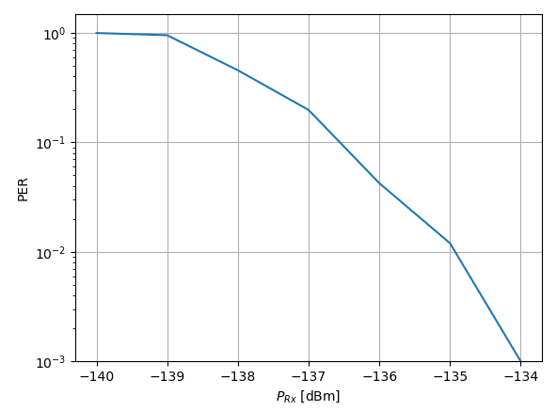
AWGN Channel
10% PER at -136.5 dBm → 4.9dB gap to theoretical limit
1% PER at -135 dBm → 7.4dB gap to theoretical limit

Slide 5
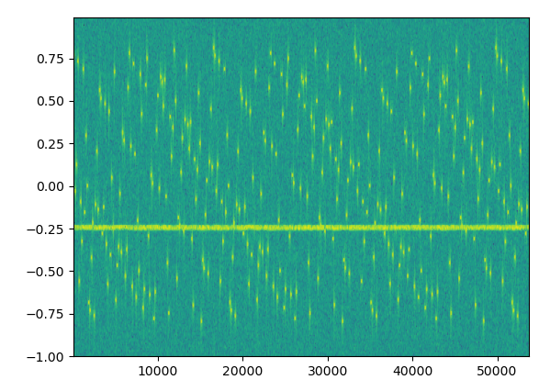
Narrow-Band Interferer
Narrow-band interference as defined in Technical Guidance Document
Fixed interferer power of -100dBm
Wanted signal power varied with fixed noise power spectral density of -174dBm/Hz

Slide 6
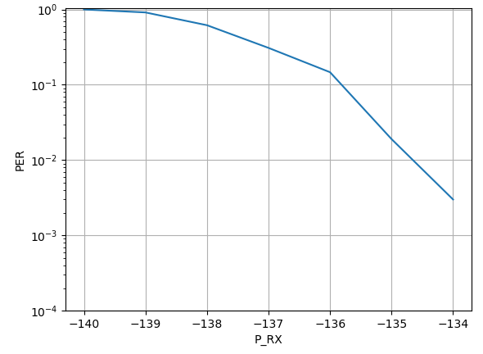
Narrow-Band Interferer
Very small impact of the interferer on the simulation results
The interferer only affects very few OFDM sub-carriers than can be easily recovered by the FEC
AWGN 1% PER

Slide 7
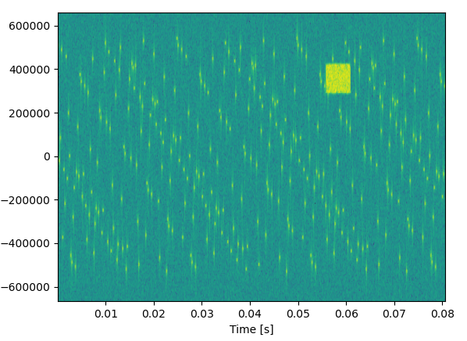
Wide-Band Interferer 125kHz
Wide-band interferer of 125kHz with duration of 5ms
Signal level of the interferer of
-100dBm
Wanted signal power varied with fixed noise power spectral density of -174dBm/Hz

Slide 8
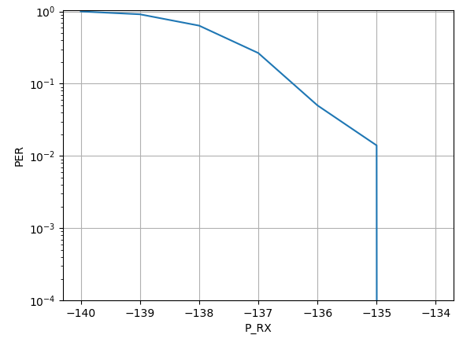
Wide-Band Interferer 125kHz
Very small impact of the interferer on the simulation results
The interferer only affects very few OFDM sub-carriers than can be easily recovered by the FEC
AWGN 1% PER

Slide 9
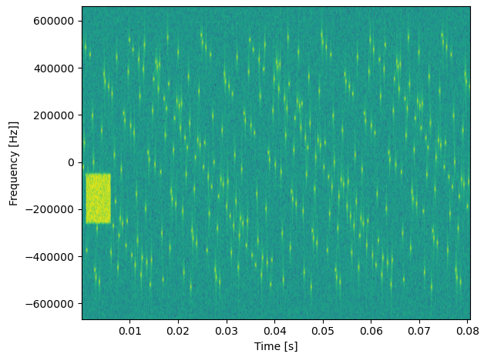
Wide-Band Interferer 200kHz
Wide-band interferer of 200kHz with duration of 5ms
Signal level of the interferer of
-100dBm
Wanted signal power varied with fixed noise power spectral density of -174dBm/Hz

Slide 10
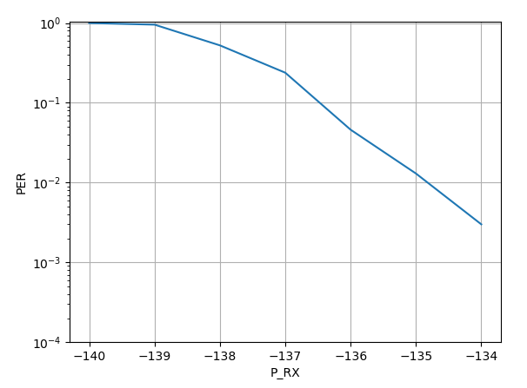
Wide-Band Interferer 200kHz
Very small impact of the interferer on the simulation results
The interferer only affects very few OFDM sub-carriers than can be easily recovered by the FEC
AWGN 1% PER

Slide 11
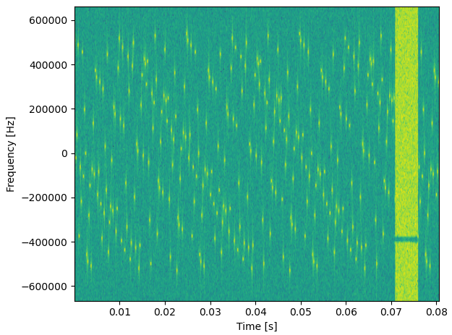
Wide-Band Interferer 2MHz
Wide-band interferer with full bandwidth with of 5ms
Signal level of the interferer of
-80dBm
Wanted signal power varied with fixed noise power spectral density of -174dBm/Hz

Slide 12
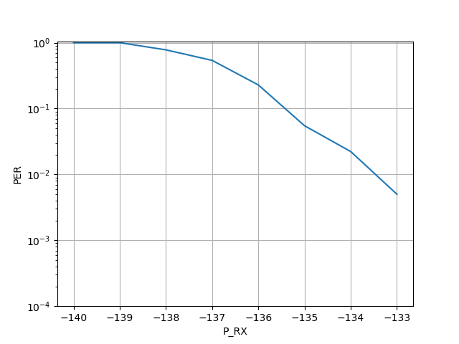
Wide-Band Interferer 2MHz
Very small impact of the interferer on the simulation results
The lost data can be recovered by the FEC, but there is a loss due to the significant loss
AWGN 1% PER

Slide 13
Conclusions
The presentation shows updates results on the interference channels
If designed properly, the lost data can be easily compensated by means of the FEC

