Slide 1
Project: IEEE P802.15 Working Group for Wireless Personal Area Networks (WPANs)
Submission Title: [TG15.6ma Closing Report for July 2025]
Date Submitted: [31st July 2025]
Source: [Ryuji Kohno1,2,] [1;Yokohama National University, 2;YRP International Alliance Institute(YRP-IAI)]
Address [1; 79-5 Tokiwadai, Hodogaya-ku, Yokohama, 240-8501 Japan
2; YRP1 Blg., 3-4 HikarinoOka, Yokosuka-City, Kanagawa, 239-0847 Japan]
Voice:[1; +81-90-5408-0611], FAX: [+81-45-383-5528],
Email:[1: kohno@ynu.ac.jp, 2: kohno@yrp-iai.jp] Re: []
Abstract: [This document contains closing report for TG15.6ma for Revision of P802.15.6-2012 with Enhanced Dependability July 2025.]
Purpose: [information]
Notice: This document has been prepared to assist the IEEE P802.15. It is offered as a basis for discussion and is not binding on the contributing individual(s) or organization(s). The material in this document is subject to change in form and content after further study. The contributor(s) reserve(s) the right to add, amend or withdraw material contained herein.
Release: The contributor acknowledges and accepts that this contribution becomes the property of IEEE and may be made publicly available by P802.15.

Slide 2
IEEE 802.15 TG6ma
(Revision of IEEE802.15.6-2012)
Closing Report
In Personal and Virtual Hybrid Plenary Session
Madrid, Spain
July 31st, 2025
Ryuji Kohno
Yokohama National University(YNU),
YRP International Alliance Institute(YRP-IAI)

Slide 3
Objectives of TG 6ma – Enhanced Dependability Body Area Network (ED-BAN)
Objective: Enhancements to the BAN Ultra Wideband (UWB) physical layer (PHY) and media access control (MAC) to support enhanced dependability to a human BAN (HBAN) and adds support for vehicle body area networks (VBAN), a coordinator in a vehicle with devices around the vehicular cabin.
Action:
•Review of the Third Recirculation Letter Ballot LB221 for draft D06
•Preparation for Report to LMSC for Unconditional Approval to go to SA Ballot
•Feasibility Study of the Draft by Performance Evaluation of Technologies in PHY; Channel Coding According to 8 QoS Levels of Packets and Coexistence Levels, Interference.
•Feasibility Study of the Draft by Performance Evaluation of Technologies in MAC; Channel Management, CCA, Hybrid Contention Free/Access Protocol According to 8 QoSs and Coexistences.
•Harmonization or Commonality with 4ab in Coexistence and Feasible Implementation of 6ma and 4ab
•Feasibility of TSN of 802.1 in MAC
Next Things to Do： Proceed to SA Ballot and Comment Resolution for SA Ballot

Slide 4
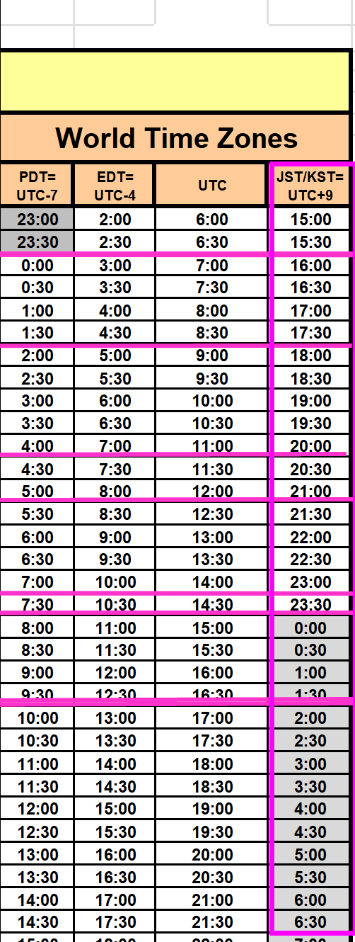
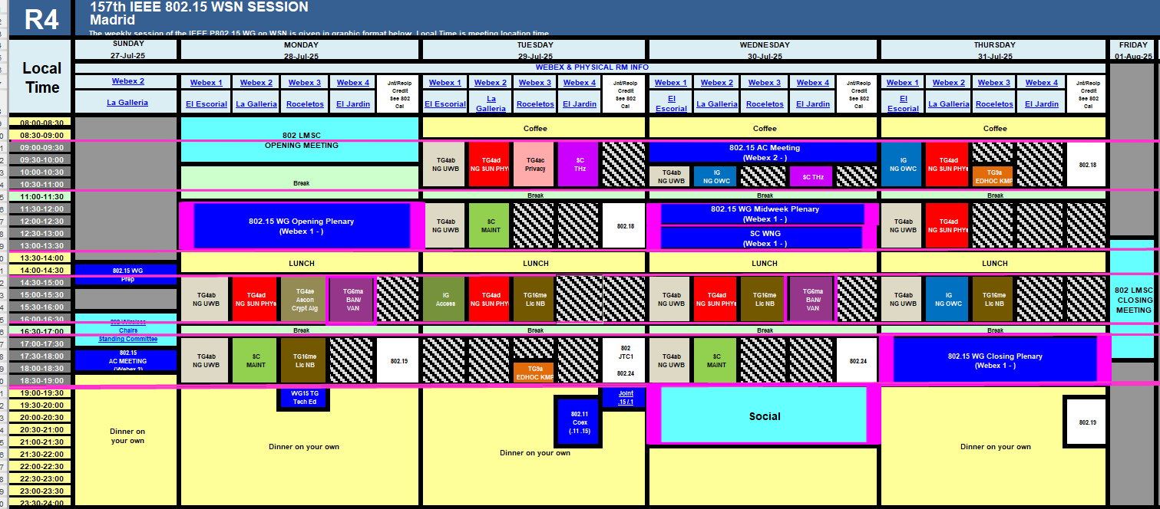
TG15.6ma Plenary Session in Madrid Schedule for 27-31st, July 2025
July 2025
TG15.6ma has three own sessions such as
Session1(Virtual RM#3) PM1 14:30-16:30 July 28(MON) in Madrid time, 21:30-23:30 July 28(MON)in EST
Session2(Virtual RM#3) PM1 Cancelled
Session3(Virtual RM#3) PM1 14:30-16:30 July 30(WED) in Kobe time, 21:30-23:30 July 30(WED) in EST
Session4(Virtual RM#3) PM1 Cancelled
Slide 4

Slide 5
Agenda items for the week
TG15.6ma meeting call to order
Call for essential patents and policies & procedures reminder doc.#15-25-0192-00-06ma
Approve last meeting minutes: TG 15.6ma Meeting Minutes for May 2025 doc.#15-25-0266-00-06ma
Agenda of TG15.6ma July 2025 doc.#15-25-0298-06-06ma
Review and Summary
  Overview of IG, SG, TG15.6ma doe Dependable BAN Revision of IEEE802.15.6-2012 doc.#15-25-0033-03-06ma
  Basic Consensus in MAC and PHY of Revision of IEEE802.15.6-2012(IEEE802.15.6ma) doc.#15-23-0557-08-06ma
  Review of Letter Ballot(LB)221 for draft D06 doc.#15-25-0xxx-00-06ma
  Consolidated comments & resolutions LB221 doc.#15-25-0yyy-00-06ma
  Rescheduling Timeline doc.#15-23-0361-13-06ma
  P802.15.6ma Report to LMSC on Unconditional Approval to go to SA Ballot doc.#15-25-0324-01-06ma
  Presentation
  1.. Hybrid ARQ Scheme for High QoS Packets in High Class of Coexistence of IEEE 802.15.6ma #15-23-0576-08-06ma 2. Evaluation of IEEE 802.15.6 Ultra-wideband Physical Layer Utilizing Super Orthogonal Convolutional 22-0562-15-06ma
  3. Ranging Accuracy Evaluation under TG6ma Communication Senarios doc.#15-24-0248-06-06ma
  4. MAC Performance Evaluation of Multiple BAN Coexistence Under TG6ma Channel doc.#15-24-0246-06-06ma
  5 MAC superframe structure and frames doc.#15-24-0573-04-06ma
  6 15.6ma MAC time reference base for superframe and group superframe structure d0c.#15-25-0132-01-06ma
  7 MAC Service Feature doc.#15-24-0356-03-06ma
  8. TG Motion to Recirculation doc.#15-25-0zzz-00-06ma
  9. Interference Mittigation Schemes in Class 3, 5, 6, and 7 of Coexisitence in TG6ma doc.#15-24-0074-08-06ma
  10. Coordinator-to-Coordinator(C2C) Ranging and Communication for Multiple BAN Coexistence 15-25-0vvv-00-06ma
  11. TG15.6ma Coexistence Assessment Document doc.#15-24-0348-05-06ma
  12 MAC services support for IEEE P802.1ACea doc.#15-24-0594-02-006a
  13..TG6ma Channel Model Document for Enhanced Dependability doc.#15-22-0519-10-06ma
  14. Comments to channel-model-document doc.#15-24-0073-05-06ma
  15. Progress Report of TG6ma doc8#15-23-0056-10-06ma
  16. Timeline of TG6ma doc.#15.23-0056-10-06ma
  17. TG15.6ma Closing Report for July 2025 doc.#15-25-0389-00-06ma
  18. TG15.6ma Meeting Minutes for July 2025 doc.#15-25-0390-00-06ma

Slide 6
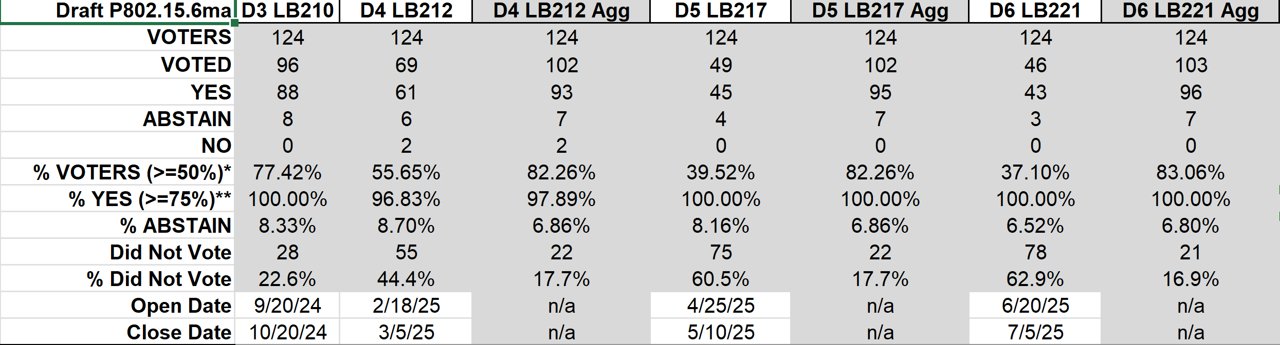
Result of Letter Ballots LB210, 212, 217, 221 for the Draft P802.15.6ma_D03, 04, 05, and 06 （Sept. 2024- July 2025)
Result of LB221(June 20-July 05, 2025): 83.06% of Voters voted YES in aggregation which is over 75%. Then LB221 was officially Approved.
Voted YES with and without Comments are 103 while No. of Comments is 0.
In Madrid Plenary Meeting July 2025, Working Group will approve to submit to SA Ballot.
Slide 6

Slide 7
July 2025
doc.: IEEE 802.15 25-0324-02-006a
P802.15.6ma Report to LMSC on Unconditional Approval to go to SA Ballot
Date: 2025-07-27
Author(s):
Name | Affiliations | Email
Ryuji Kohno | YNU/YRP-IAI | Kohno@ynu.ac.jp
Slide 7
Notes:
doc.: IEEE 802.11-yy/xxxxr0
Month Year
John Doe, Some Company
Page 7

Slide 8
July 2025
doc.: IEEE 802.15 25-0324-02-006a
Introduction
This document contains the report to the IEEE 802 LMSC in support of a request for unconditional approval to send IEEE P802.15.6ma D06 to SA Ballot.
The WG motion to request unconditional approval was approved during the July session of the 802.15 working group on 31st July 2025.
  Passed in the Working Group 41yes, 1 no, 3 abstain
Slide 8
Notes:
doc.: IEEE 802.11-yy/xxxxr0
Month Year
John Doe, Some Company
Page 8

Slide 9
July 2025
doc.: IEEE 802.15 25-0324-02-006a
Status Summary
The TG15.6ma Draft went through 4 WG Letter Ballots. Draft P802.15.6ma/D06 achieved 100% approval rate (> 75% needed for an approved draft)
The TG has resolved 113 comments received on drafts P802.15.6ma/D03
The TG has resolved 265 comments received on drafts P802.15.6ma/D04
The TG has resolved 127 comments received on drafts P802.15.6ma/D05
The TG did not receive any comments for P802.15.6ma/D06
Slide 9

Slide 10
July 2025
doc.: IEEE 802.15 25-0324-02-006a
802.15 WG Letter Ballot Results – P802.15.6ma
Ballot ID | Ballot Close Date | Title | Ballot Type | Pool | Return | %Return | Abstain | %Abstain | Approve | Disapprove | %Approve
LB210 | 20-10-2024 | Technical Letter Ballot for P802.15.6ma/D03 | Technical | 124 | 96 | 77.42% | 8 | 8.33% | 88 | 0 | 100%
LB212 | 05-03-2025 | First recirculation draft, P802.15.6ma/D04 | Recirculation | 124 | 102 | 82.26% | 7 | 6.86% | 93 | 2 | 97.89%
LB217 | 10-05-2025 | Second recirculation draft, P802.15.6ma/D05 | Recirculation | 124 | 102 | 82.26% | 7 | 6.86% | 95 | 0 | 100%
LB221 | 05-07-2025 | Third recirculation draft, P802.15.6ma/D06 | Recirculation | 124 | 104 | 83.87% | 7 | 6.73% | 97 | 0 | 100%
 |  |  | Final Tally | 124 | 104 | 83.87% | 7 | 6.73% | 97 | 0 | 100%
Slide 10
Notes:
doc.: IEEE 802.11-yy/xxxxr0
Month Year
John Doe, Some Company
Page 10

Slide 11
July 2025
doc.: IEEE 802.15 25-0324-02-006a
802.15 WG Letter Ballot Comments – P802.15.6ma
Ballot ID | Ballot Close Date | Title | Total Number of Comments received (Yes and No votes)
LB210 | 20-10-2024 | Technical Letter Ballot for P802.15.6ma/D03 | 113 (88 G&T, 25 E)
LB212 | 05-03-2025 | First recirculation draft, P802.15.6ma/D04 | 265 (44 G&T, 221 E)
LB217 | 10-05-2025 | Second recirculation draft, P802.15.6ma/D05 | 127 (14 G&T, 113 E)
LB221 | 05-07-2025 | Third recirculation draft, P802.15.6ma/D06 | 0 (0 G&T, 0 E)
Total |  |  | 505 (146 G&T, 359 E)
Slide 11
Notes:
doc.: IEEE 802.11-yy/xxxxr0
Month Year
John Doe, Some Company
Page 11

Slide 12
July 2025
doc.: IEEE 802.15 25-0324-02-006a
IEEE-SA Mandatory Editorial Coordination
Mandatory Editorial Coordination (MEC) completed in the final report doc.: IEEE802.15-25-0323-00-006a
Slide 12

Slide 13
July 2025
doc.: IEEE 802.15 25-0324-02-006a
Unsatisfied comments by “No” voting commenter
(0 must-be-satisfied comments received in LB221)
No unsatisfied comments, no “No” votes in LB221
Voter | D3 LB210 | D4 LB212 | D5 LB217 | D6 LB221 | Total
 | 0 | 0 | 0 | 0 | 0
Total |  |  |  |  | 0
Slide 13
Notes:
doc.: IEEE 802.11-yy/xxxxr0
Month Year
John Doe, Some Company
Page 13

Slide 14
July 2025
doc.: IEEE 802.15 25-0324-02-006a
Unsatisfied Comments in Categories
(0 must-be-satisfied comments received in LB221)
No unsatisfied comments, no “No” votes in LB221
Slide 14
Notes:
doc.: IEEE 802.11-yy/xxxxr0
Month Year
John Doe, Some Company
Page 14

Slide 15
July 2025
doc.: IEEE 802.15 25-0324-02-006a
Unsatisfied comments
(No must-be-satisfied comments received in LB221)
No unsatisfied comments, no No votes in LB221
Slide 15

Slide 16
July 2025
doc.: IEEE 802.15 25-0324-02-006a
TG15.6ma Timeline(expected)
 | Open | Close
First SA Ballot | August 14, 2025 | September 14, 2025
Second SA Ballot | October 1, 2025 | October 30, 2025
Third SA Ballot | December 15, 2025 | January 10, 2026
LMSC to Revcom | January 2026
Revcom to SB | March 2026
Slide 16
Notes:
doc.: IEEE 802.11-yy/xxxxr0
Month Year
John Doe, Some Company
Page 16

Slide 17
WG motion:
TG6ma: Unconditional approval for SA Ballot
July 2025
802.15 has reviewed and approves the CSD [15-21-0260-03-006a], and the CA document [15-24-0348-06]; and requests unconditional approval from the LMSC to submit P802.15.6ma-D06 to Standards Association ballot.
Moved by: Ryuji Kohno
Seconded by: Phil Beecher
Result: Approved
Yes 41 91.1%
Abstain 3 6.7%
No 1 2.2%
Valid 45
Unexercised 0
Total 45
Slide 17

Slide 18
TG 6ma Timeline(expected)
Final SB recirculation, if required. Submission to RevCom
Jan 2026
Tech Req Doc July 2022
Presentation of proposals
May 2023
Comment Resolutionfor LB210
Nov. 2024
Comment Resolutionfor LB212
March 2025
Comment Resolutionfor LB217
May
2025
Comment Resolution for LB217
July
2025
SA Ballot
Sept
2025
WG PreBallot submission for Draft2.5 August 2024
Revcom Approve
March 2026
SA recirculation if required
Oct 2025
^{Draft V1,18 Com}
May. 2024
Recirculation (LB212)
Jan. 2025
RevcomSubmission
Feb. 2026
TRD,CMD
Call Proposals Sept 2022
Std. Draf V1.9 Proposals
Nov. 2023
Comment Resolution fo Draft v2.3 on WG for PreBallot July 2024
1st Letter Ballot(LB210)
Sept. 2024
2nd Recirculation (LB217)
April 2025
3rd Recirculation (LB)
June 2025
Unconditional approval for Standard Association Ballot (SA)
July 2025
Request EC approval for SA Ballot
Nov. 2026
Comment Resolution for SA Ballot
Oct. 2025
Notes: SASB/RevCom scheduled for 2024 a guess

Slide 19
Expecting Timeline detail
Topic item | Deadline | Action items | Notes
Std Draft D2_3 WG pre-ballot recirculation. | July/2024 |  | Editorial comments from 802.15 technical editor were addressed. Still missing cross-references.
Towards the July 2024 meeting | July/2024 | Adding MAC text. Revise PHY text. Editorial revisions.
Target WG letter ballot (LB) submission: submit draft to TEG | August/2024 | Disposition of comments. | 1. Based on pre-ballot resolutions, prepare Draft D2_4 2. Request LB submission before the September meeting. Consequently, the July meeting is used to resolve comments.
TG and WG Motion to letter ballot (LB) submission: submit draft to EC | Sep/2024 | TG and WG Motion to LB | Prepare all necessary documents: Project Task List, Progress Repor, Coexistence Assurance(CA) document, TG Motion to LB, WG Motion to LB
1st LB circulation | Sep/2024 |  | Comment-resolutions to LB recirculation.
Comment Resolution for LB210 | Nov/2024 |  | Comment-resolutions to LB recirculation.
1st LB recirculation LB212 | Jan/2025 |  | Comment-resolutions to LB recirculation.
Comment Resolution for LB212 | Jan/2025 |  | Seek conditional approval for SB by the Executive Committee.
2nd LB recirculation. LB217 | Mar/2025 |  | WG approval to request SB submission.
Comment Resolution for LB217 | May/2025 |  | Comment-resolutions to LB recirculation.
3rd LB recirculation. LB221 | Jun/2025 |  | WG approval to request SB submission.
Complete draftinig D06 for LB221 | July/2025 |  | Comment-resolutions to LB recirculation.
IEEE SA Sponsor Ballot unconditional approval Submission | July//2025 |  | One month for IEEE SA editorial review.
1st SB recirculation | Aug/2025 |  | Comment-resolutions to SB and recirculation.
Comment Resolution for 1st SB Ballot | Sept/2025 |  | Comment resolution for 1st SB Ballot in Sept. Meeting
2nd SB recirculation | Oct/2025 |  | SB and recirculation if 1st SB Ballot has comments etc.
Comment Resolution for 2nd SB Ballot | Nov/2025 |  | Comment resolution for 1st SB Ballot in Sept. Meeting
Request conditional/unconditional approval to RevCom | Jan/2026 |  | Submission to LMSC agenda
Final SB recirculation, if required. Submission to RevCom | Jan/2025 |  | Submission to SASB
RevCom submission | Feb/2025 |  | RevCom approval
Note: the deadlines are subject to change.
Reference: doc.#15-23-0369-09-06ma
Slide 19

Slide 20
Contributions
・TG15.6ma opening report for July 2025 meeting 15-25-0299-01-06ma
・TG15.6ma Agenda of July 2025 Meeting 15-25-0298-06-06ma
・Overview of IG, SG, TG15.6ma doe Dependable BAN Revision of IEEE802.15.6-2012 15-25-0033-03-06ma
・P802.15.6ma Report to LMSC on Unconditional Approval to go to SA Ballot 15-25-0324-01-06ma
・Review of Letter Ballot(LB)221 for draft D05 15-25-0xxx-00-06ma
・Hybrid ARQ Scheme for High QoS Packets in High Class of Coexistence of IEEE 802.15.6ma 23-0576-09
・ 15.6ma MAC updates 15-25-0368-00-06ma
・ Evaluation of IEEE 802.15.6 UWB Physical Layer Utilizing Super Orthogonal Convolutional 22-0562-16-06ma
・Ranging Accuracy Evaluation under TG6ma Communication Senarios 15-24-0248-07-06ma
・MAC Performance Evaluation of Multiple BAN Coexistence Under TG6ma Channel 15-24-0246-07-06ma
・TG motion for Unconditional submittal to LMSC and CRG formation for SA Ballot 15-25-0377-00-06ma
・TG15.6ma Coexistence Assessment Document 15-24-0348-04-06ma
・MAC services support for IEEE P802.1ACea 15-24-0594-01-006a
・TG6ma Channel Model Document for Enhanced Dependability 15-22-0519-09-06ma
・Progress Report of TG6ma 15-23-0056-14-06ma
・Timeline of TG6ma 15.23-0361-14-06ma
・TG15.6ma Closing Report for July 2025 15-25-0389-00-06ma
・TG15.6ma Meeting Minutes for July 2025 15-25-0390-00-06ma

Slide 21
Contacts and Conference call
Chair; Ryuji Kohno, YNU/YRP-IAI
kohno@ynu.ac.jp, kohno@yrp-iai.jp
1st Vice-Chair; Marco Hernandez, YRP-IAI/CWC
marco.hernandez@ieee.org
2nd Vice-Chair; Daisuke Anzai, Osaka Metropolitan Univ.
d.anzai@omu.ac.jp
Secretary; Takumi Kobayashi, Osaka Metropolitan Univ./YRP-IAI
kobayashi-takumi@yrp-iai.jp, Kobayashi.takumi@omu.ac.jp
Technical Editors;
Minsoo Kim, YRP-IAI minsoo@minsookim.com
Seong-Soon Joo, Nano HiTech ssjoo@etri.sci.kr
Kento Takabayashi, Toyo U. takabayashi@toyo.jp
Marco Hernandez, YRP-IAI/CWC marco.hernandez@ieee.org

Slide 22
Thank You !
Any Questions ?

