Slide 1
Project: IEEE P802.15 Working Group for Wireless Specialty Networks (WSNs)
Submission Title: Smart and Secure Drones: A Next-Generation OWC-Enabled Framework for IoD Networks
Date Submitted: July 28, 2025
Source: Lai Yi Aung, Yeong Min Jang (Kookmin University)
Address: Kookmin University, 77 Jeongneung-Ro, Seongbuk-Gu, Seoul, 02707, Republic of Korea
Voice: +82-2-910-5068 E-Mail: yjang@kookmin.ac.kr
Re:
Abstract: Present Smart and Secure Drones: A Next-Generation OWC-Enabled Framework for IoD Networks
Purpose: Presentation for contribution on IG NG-OWC
Notice: This document has been prepared to assist the IG NG-OWC. It is offered as a basis for discussion and is not binding on the contributing individual(s) or organization(s). The material in this document is subject to change in form and content after further study. The contributor(s) reserve(s) the right to add, amend or withdraw material contained herein.
Release: The contributor acknowledges and accepts that this contribution becomes the property of IEEE and may be made publicly available by IG NG-OWC.

Slide 2
Smart and Secure Drones: A Next-Generation OWC-Enabled Framework for IoD Networks
Contribution
July 31, 2025

Slide 3
Contents
Introduction
Challenges in Current IoD Security
Security Integration Strategy
UAV Cyberattacks
Multi-UAV Network
Benefits and Applications
Conclusion
References

Slide 4
Introduction
The Internet of Drones (IoD) enables coordinated, autonomous UAV missions in sectors like surveillance, logistics, and agriculture.
However, security threats such as cyberattacks and signal jamming remain critical.
This framework integrates Post-Quantum Cryptography (PQC), Blockchain trust, PUF-based authentication, and AI navigation.
Optical Wireless Communication(OWC) offers secure, high-speed alternatives to RF, enhancing communication reliability and physical-layer security.
The proposed approach enables smart, secure, and scalable IoD operations in complex environments.

Slide 5
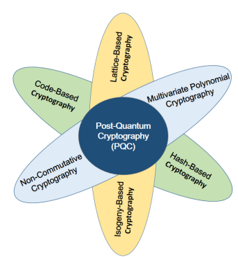
Challenges in Current IoD Security
Table 1. Challenges of IoD
Challenge | Description | OWC Benefit
Cyberattacks | DoS, spoofing, MitM, injection | Directional links reduce attack surface
Signal Jamming | Easy to disrupt RF signals | Immune to RF-based jamming
Eavesdropping | RF signals can be intercepted | Hard to intercept line-of-sight links
Low Resource Devices | Limited power and processing in UAVs | Supports lightweight optical signaling
Key Management | Secure distribution is complex | Enables secure short-range key exchange
Scalability Issues | Growing drone numbers increase security load | Local optical links simplify trust setup
FIGURE 1. Basic types of PQC[6].

Slide 6
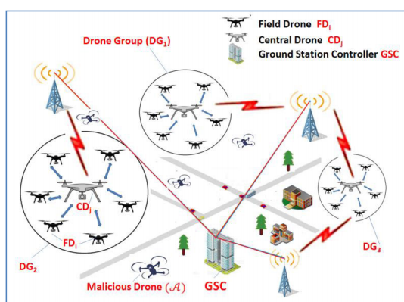
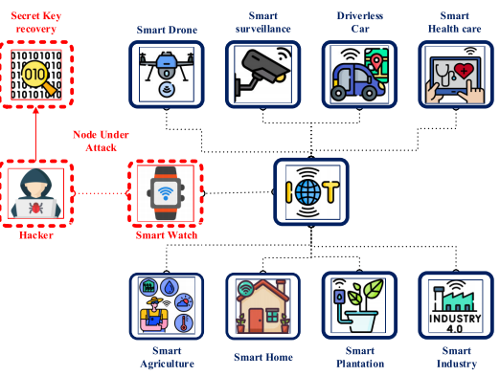
Security Integration Strategy
FIGURE 2. IoT ecosystem and adversaries[1].
FIGURE 3. System model[2].

Slide 7
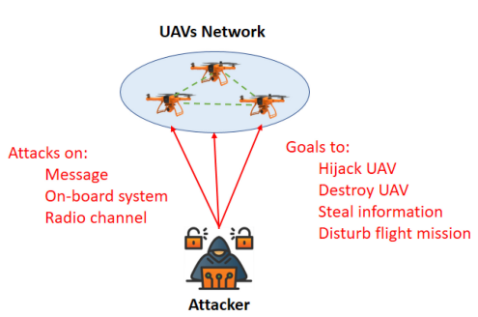
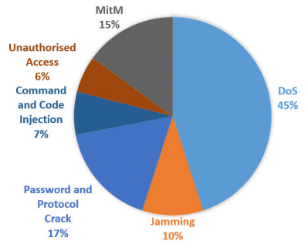
UAV Cyberattacks
DoS (Denial of Service): 45%
Password and Protocol Crack: 17%
MitM (Man-in-the-Middle): 15%
Jamming: 10%
Command and Code Injection: 7%
Unauthorised Access: 6%
FIGURE 4. Cyberattacks against UAV networks[6].
FIGURE 5. Distribution according to cyber attacks used[3].

Slide 8
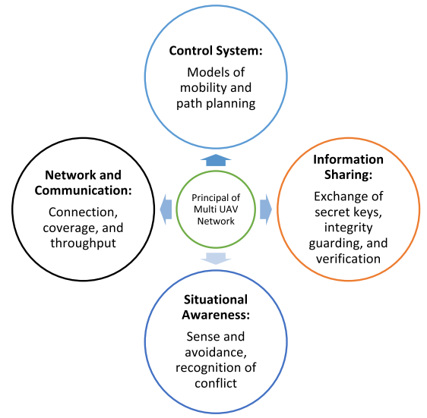
Multi-UAV Network
A secure UAV network is built on four foundations:
  Communication – ensuring coverage and throughput
  Control – managing drone mobility and path planning
  Awareness – sensing and avoiding threats
  Information Sharing – securely exchanging keys and verifying data integrity
FIGURE 6. The foundation of a network of multiple UAVs[5].

Slide 9
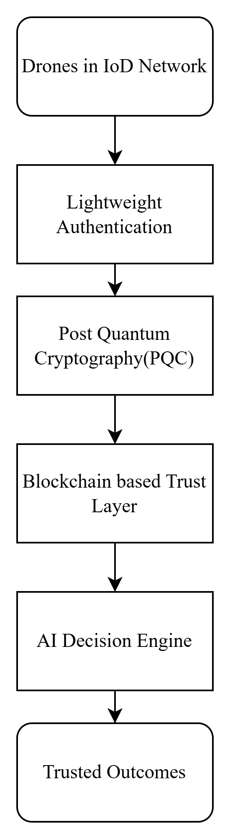
Proposed Framework Components
Table 2: Core Security Technologies
Component | Functionality | Benefit
PQC | Kyber512, SPHINCS+ | Quantum-safe encryption
PUF | Unique ID at hardware | Prevents cloning/spoofing
TS-PAID | Mutual authentication protocol | Secure UAV login/access
Table 3: Intelligence & Trust Layers
Component | Functionality | Benefit
AI | Path planning, obstacle avoidance | Efficient navigation
Blockchain | Distributed ledger, consensus | Secure data & trust sharing
Consensus | PoW/PoS variants adapted for UAVs | Reliable swarm ops
<Proposed OWC-enabled framework>

Slide 10
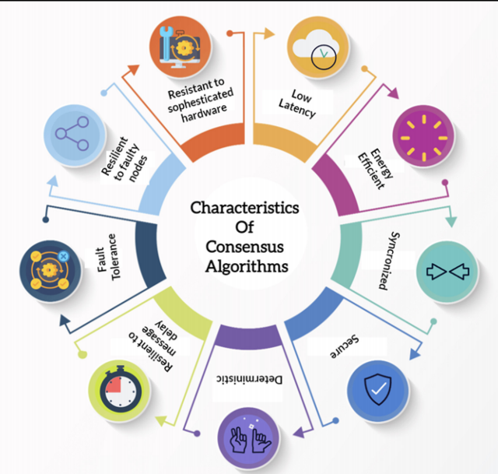
Consensus Algorithms in IoD
Fault Tolerance:
Resilient to Sybil Attacks:
Resistant to Sophisticated Hardware:
Low Latency:
Energy Efficient:
Synchronized:
Secure:
Deterministic:
Resilient to Network Delay:
FIGURE 7. Characteristics of consensus algorithm[4].

Slide 11
Benefits and Applications
Table 4: Drone Application and Benefit
Applications |  | Benefits
Military Drone Swarms | 🛰 | Secure communications
Emergency Medical Delivery | 🚑 | Low-latency decision-making
Smart City Drone Surveillance | 🏙 | Scalable to swarm-scale ops
Logistics & Cargo Transport | 📦 | Resistant to quantum & AI-driven threats

Slide 12
Conclusion
This framework combines cutting-edge technologies—PQC, PUF, blockchain, and AI—to prepare IoD networks for the next decade of evolved threats and autonomous capabilities.
Future work includes testbed evaluations, hybrid PQC deployment schemes, and edge-based AI navigation modules.

Slide 13
References
S. Ahmed et al., "Lightweight AES Design for IoT Applications: Optimizations in FPGA and ASIC With DFA Countermeasure Strategies," in IEEE Access, vol. 13, pp. 22489-22509, 2025, doi: 10.1109/ACCESS.2025.3533611.
S. Ashraf Chaudhry, A. Irshad, B. A. Alzahrani, A. Alhindi, M. Shariq and A. Kumar Das, "TS-PAID: A Two-Stage PUF-Based Lightweight Authentication Protocol for Internet of Drones," in IEEE Access, vol. 13, pp. 1458-1469, 2025, doi: 10.1109/ACCESS.2024.3523352.
B. Branco, J. Silvestre Serra Silva and M. Correia, "Cyber Attacks on Commercial Drones: A Review," in IEEE Access, vol. 13, pp. 9566-9577, 2025, doi: 10.1109/ACCESS.2025.3527698.
A. Jain et al., "A Walkthrough of Blockchain-Based Internet of Drones Architectures," in IEEE Internet of Things Journal, vol. 11, no. 21, pp. 34924-34940, 1 Nov.1, 2024, doi: 10.1109/JIOT.2024.3447465.
M. R. Rezaee, N. A. W. A. Hamid, M. Hussin and Z. A. Zukarnain, "Comprehensive Review of Drones Collision Avoidance Schemes: Challenges and Open Issues," in IEEE Transactions on Intelligent Transportation Systems, vol. 25, no. 7, pp. 6397-6426, July 2024, doi: 10.1109/TITS.2024.3375893.
M. A. Khan, S. Javaid, S. A. H. Mohsan, M. Tanveer and I. Ullah, "Future-Proofing Security for UAVs With Post-Quantum Cryptography: A Review," in IEEE Open Journal of the Communications Society, vol. 5, pp. 6849-6871, 2024, doi: 10.1109/OJCOMS.2024.3486649.

