Slide 1
Project: IEEE P802.15 Working Group for Wireless Specialty Networks (WSNs)
Submission Title: Symmetric UAV-to-UAV FSO Communication with Dual-Mode QPD-Based ATP
Date Submitted: July 31, 2025
Source: Fadhila Ahmad, Yeong Min Jang(Kookmin University), Hyoung-Jun Park, Chan Il Yeo, Siwoong Park (ETRI)
Address: Kookmin University, 77 Jeongneung-Ro, Seongbuk-Gu, Seoul, 02707, Republic of Korea
Voice: +82-2-910-5068 E-Mail: yjang@kookmin.ac.kr
Honam Research Division/ Optical ICT Convergence Research Section, ETRI, Republic of Korea
Voice: +82-62-970-6635 E-Mail: swp@etri.re.kr
Re:
Abstract: Present the advancements in the Future directions of ATP for UAV-to-UAV FSO Communication
Purpose: Presentation for contribution on ATP for UAV-to-UAV FSO Communication
Notice: This document has been prepared to assist the IG NG-OCC. It is offered as a basis for discussion and is not binding on the contributing individual(s) or organization(s). The material in this document is subject to change in form and content after further study. The contributor(s) reserve(s) the right to add, amend or withdraw material contained herein.
Release: The contributor acknowledges and accepts that this contribution becomes the property of IEEE and may be made publicly available by IG NG-OWC

Slide 2
Symmetric UAV-to-UAV FSO Communication with Dual-Mode QPD-Based ATP
Contribution
July 31, 2025

Slide 3
Contents
Background
QPD-based ATP Overview
Current Challenges in ATP for UAV-to-UAV FSO
Future Directions
Conclusion

Slide 4
Background
A drone network (UAV-to-UAV) connects multiple drones to work together on specific missions.
FSO communication offers high data rates using laser beams but needs very accurate alignment.
Small UAVs can’t carry heavy gimbals, so using a QPD helps widen the field of view and allows fine pointing to be handled by other UAVs or a ground station.

Slide 5
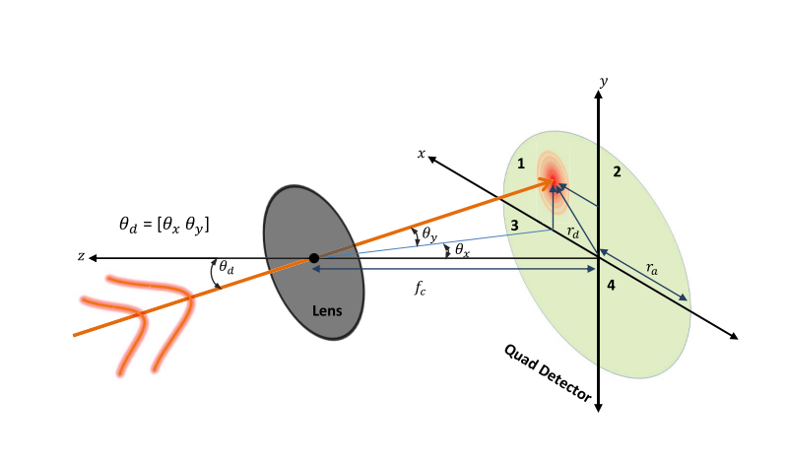
QPD-Based ATP Overview
Quadrant Photodiode (QPD) is a 4 quadrant position sensor that measures 2D offset of an incoming laser spot. A QPD can estimate the beam’s centroid and angle of arrival by comparing photocurrents from its four segments.

Slide 6
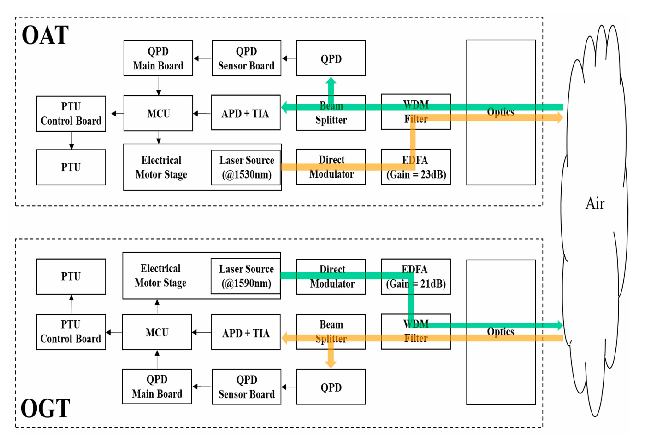
QPD-Based ATP Overview
Common path QPD ATP:
  Shared optical path for data and tracking
  QPD senses beam drift at the receiver
  Feedback controls beam-steering mirror (FSM)
  Works in synchronized UAV systems

Slide 7
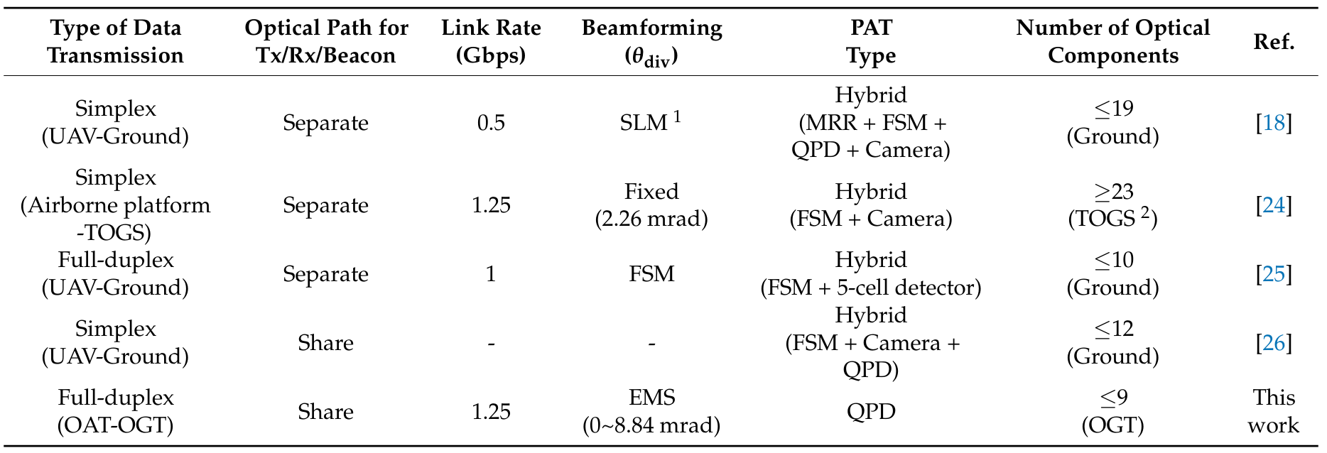
QPD-Based ATP Overview
Prototype Performance:
Dual-direction FSO system with common-path QPD ATP
1.25 Gbps full-duplex at 50 m range
Error-free link maintained
4.25× faster tracking vs conventional method

Slide 8
Current Challenges in ATP for UAV-to-UAV FSO
Dual Mobility: In a UAV-to-UAV link both endpoints are moving in 3D space.
QPD Linearity and Dynamic Range: The QPD’s response depends on spot size and position.
Environmental Effects: UAVs experience turbulence and vibration.
Symmetry Complexity: In a fully symmetric UAV-to-UAV link, both nodes must act as transmitter and receiver (transceivers).

Slide 9
Future Directions
LSTM-Based Signal Prediction: Integrate LSTM neural networks to predict QPD error signals under dynamic UAV motion.
Hybrid ATP Architectures: Combine QPD sensing with other actuators (e.g. MEMS FSM, FSM)

Slide 10
Conclusion
Dual mode QPD based ATP enables simple, high-performance UAV-to-UAV FSO link and reducing system complexity
Main challenges include QPD sensitivity to beam size (needs linearized control) and beam splitting loss
Possible solutions: LSTM-based prediction for robust tracking under UAV dynamics, and hybrid ATP using QPD with fast steering mirrors (FSM)
The concept supports agile, high rate optical links between UAVs and provides a strong foundation for future UAV-FSO networks

Slide 11
Reference
Park, S. et al. (2022) ‘Tracking Efficiency Improvement According to Incident Beam Size in QPD-Based PAT System for Common Path-Based Full-Duplex FSO Terminals’, Sensors, 22(20), pp. 7770–7770. doi.org/10.3390/s22207770
Wang, J. et al. (2021) ‘Hovering UAV-Based FSO Communications: Channel Modelling, Performance Analysis, and Parameter Optimization’, IEEE Journal on Selected Areas in Communications, 39(10), pp. 2946–2959. https://doi.org/10.1109/jsac.2021.3088656
Safi, H., Akbar Dargahi and Cheng, J. (2021) ‘Beam Tracking for UAV-Assisted FSO Links With a Four-Quadrant Detector’, IEEE communications letters, 25(12), pp. 3908–3912. https://doi.org/10.1109/lcomm.2021.3113699
Singh, N. et al. (2024) ‘Modelling and analysis of QPD based track sensor developed for inter-satellite optical communication’, pp. 1–6. https://doi.org/10.1109/ants63515.2024.10898355
Shah, A. and Rangan, S. (2022) ‘Multi-Cell Multi-Beam Prediction Using Auto-Encoder LSTM for mmWave Systems’, IEEE Transactions on Wireless Communications, 21(12), pp. 10366–10380. https://doi.org/10.1109/twc.2022.3183632

