Slide 1
Project: IEEE P802.15 Working Group for Wireless Specialty Networks (WSN)
Submission Title: TG4ab Closing Report July 2025
Date Submitted: 11 May 2025
Source: Benjamin A. Rolfe (Blind Creek Associates)
Contact:
Voice: [deprecated]
E-Mail: ben.rolfe @ ieee.org
Re: Task Group 4ab: 802.15.4 UWB Next Generation
Abstract: Closing report for the 802 Plenary July 2025
Purpose: report on project progress and reenforce the illusion of organization
Notice: This document has been prepared to assist the IEEE P802.15. It is offered as a basis for discussion and is not binding on the contributing individual(s) or organization(s). The material in this document is subject to change in form and content after further study. The contributor(s) reserve(s) the right to add, amend or withdraw material contained herein.
Release: The contributor acknowledges and accepts that this contribution becomes the property of IEEE and may be made publicly available by P802.15.

Slide 2

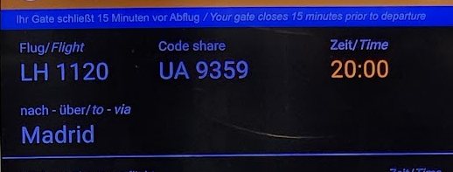
Task Group 15.4ab
Next Generation UWB Amendment
July 2025
802 Plenary Session
Mixed Mode
Live from
Madrid, Spain
And remote worldwide

Slide 3
Session Objectives
Goals for the week:
Resolve Comments
Complete comment resolution on D02

Slide 4
Goals for the week
Resolve comments through friendly and productive collaboration
Work on outstanding issues
Complete comment resolution ☹

Slide 5
Stats, Opening
Comments and Resolution Status
Total # Comments | # with Blank resolution | # with non-blank resolution | # with "Rejected" resolution | # with "Accepted" resolution | # with "Revised" resolution | # Assigned | No Resolution, not Assigned
663 | 254 | 409 | 35 | 234 | 140 | 254 | 0
Technical | Editorial | Okay | 409
447 | 211
General | Okay | 61.69% | 5.28% | 35.29% | 21.12% | 38.31% | 0.00%
5 | 663

Slide 6
Stats, Closing
Comments and Resolution Status
Total # Comments | # with Blank resolution | # with non-blank resolution | # with "Rejected" resolution | # with "Accepted" resolution | # with "Revised" resolution | # Assigned | No Resolution, not Assigned
663 | 123 | 540 | 69 | 268 | 203 | 123 | 0
Technical | Editorial | Okay | 540
447 | 211
General | Okay | 81.45% | 10.41% | 40.42% | 30.62% | 18.55% | 0.00%
5 | 663

Slide 7

Agenda
https://mentor.ieee.org/802.15/dcn/25/15-25-0288-12-04ab-tg4ab-detailed-agenda-july-2025.xlsx

Slide 8
Project Information

Slide 9
5.2.b Scope of the project (As approved):
This amendment enhances the Ultra Wideband (UWB) physical layers (PHYs) medium access control (MAC), and associated ranging techniques while retaining backward compatibility with enhanced ranging capable devices (ERDEVs).
Areas of enhancement include:
  additional coding, additional coding, preamble and modulation schemes to support improved link budget and/or reduced air-time relative to IEEE Std 802.15.4 UWB;
  additional channels and operating frequencies;
  interference mitigation techniques to support greater device density and higher traffic use cases relative to the IEEE Std 802.15.4 UWB;
  improvements to accuracy, precision and reliability and interoperability for high-integrity ranging; schemes to reduce complexity and power consumption;
  definitions for tightly coupled hybrid operation with narrowband signaling to assist UWB;
  enhanced native discovery and connection setup mechanisms;
  sensing capabilities to support presence detection and environment mapping;
  and mechanisms supporting low-power low-latency streaming as well as high data-rate streaming allowing at least 50 Mb/s of throughput.
Support for peer-to-peer, peer-to-multi-peer, and station-to-infrastructure protocols are in scope, as are infrastructure synchronization mechanisms. This amendment includes safeguards so that the high throughput data use cases do not cause significant disruption to low duty-cycle ranging use cases.
https://development.standards.ieee.org/myproject-web/app#viewpar/9081

Slide 10
Near Term Working Milestones
 | Current Schedule
First letter ballot | June 2024
Initial LB comment resolution | Start: July 2024
First recirculation | March 2025
Recirculation comment resolution | April-July 2025
Second recirculation | Aug 2025??
Recirculation comment resolution | Sept-Oct 2025
LMSC Conditional Approval for SA-Ballot | Sept 2025
First SA-Ballot | Oct-Nov 2025
SA-Ballot comment resolution | December 2025 to ….
We are here

Slide 11
SA Ballot and Beyond
Conditional LMSC approval Sept 2025
 | Current Schedule
First SA-Ballot | October 2025
SA-Ballot comment resolution | November 2025 - January 2026
First recirculation | Feb/Mar 2026
Recirculation comment resolution | Mar 2026
Second recirculation | April 2026
Recirculation comment resolution | May 2026
Final comment resolution | July 2026
Third and final recirculation | Aug 2026
REVCOM and SASB | Nov 2026
Conditional LMSC approval for REVCOM

Slide 12

Next Steps

Slide 13
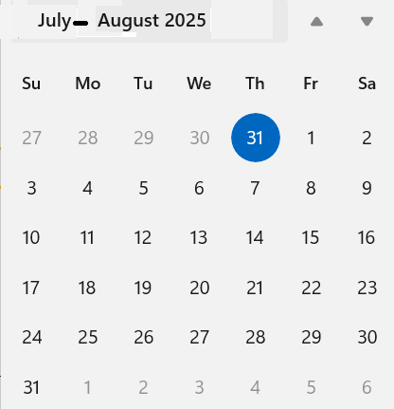
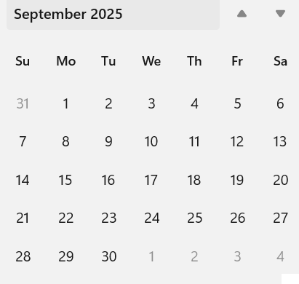
Telecom/Webex Schedule
Sept Interim
Agenda: Resolve comments, produce D03, recirculate
Commencing 12th Aug 2025, continuing through 8th Sept 2025
Once per week, 1.5 hour Tuesday 06:00

Slide 14

Aloha!

