Slide 1
  Heterogeneous Networking – Setting the Scene
[IEEE 802.16 Mentor Presentation Template (Rev. 0)]
Document Number:
  16-12-0354-00-Shet
Date Submitted:
  2012-05-09
Source:
  Max Riegel Voice: +49 173 293 8240
  Nokia Siemens Networks E-mail: maximilian.riegel@nsn.com
Re:
  Call for contributions for IEEE802.16 HET SG for session #79
Base Contribution:
  n/a
Purpose:
  Introduction of terminology and basic concepts of heterogeneous networking
Notice:
  This document does not represent the agreed views of the IEEE 802.16 Working Group or any of its subgroups. It represents only the views of the participants listed in the “Source(s)” field above. It is offered as a basis for discussion. It is not binding on the contributor(s), who reserve(s) the right to add, amend or withdraw material contained herein.
Copyright Policy:
  The contributor is familiar with the IEEE-SA Copyright Policy <http://standards.ieee.org/IPR/copyrightpolicy.html>.
Patent Policy:
  The contributor is familiar with the IEEE-SA Patent Policy and Procedures:
      <http://standards.ieee.org/guides/bylaws/sect6-7.html#6> and <http://standards.ieee.org/guides/opman/sect6.html#6.3>.
  Further information is located at <http://standards.ieee.org/board/pat/pat-material.html> and <http://standards.ieee.org/board/pat >.

Slide 2
Heterogeneous Networking
Setting the Scene
2012-05-09
Max Riegel
NSN

Slide 3
ToC
Definiton of Heterogeneous Networking
Heterogeneous Networks
  Multi-Layer
  Multi-RAT
  Multi-Service
  Multi-Operator
Rationale for Heterogeneous Networking
Heterogeneous Networking in IEEE802
  Potential way forward

Slide 4
What is
‘Heterogeneous Networking’?
“Getting access
to the same content or applications
by different networks.”
Network
A
Network
B
Network
C

Slide 5

Open: Same Terminal for all Networks?
(Terminal = STA / SS / MS / UE)
Network
A
Network
B
Network
C

Slide 6




What are Heterogeneous Networks?
Multi-Layer:
Various cell sizes at same or different frequency layers
(macro and micro cells, metro, pico and femto cells operating eventually in different frequency bands)
Multi-RAT:
Various Access Network Technologies
Multi-Operator:
Various operators operating parts or all of the access networks offering whole-sale of access services to other operators
(Roaming)
Multi-Service:
Various access networks providing either fixed, nomadic, portable or mobile network access

Slide 7
Multi-Layer Networking
Macro cell – Macro cell
Macro cell – Micro cell
Macro cell – Wi-Fi/Femto
Macro cell – Wi-Fi/Femto
Indoors
Wi-Fi/Femto
Macro cell – Pico cell
Indoors
Wi-Fi/Femto

Slide 8
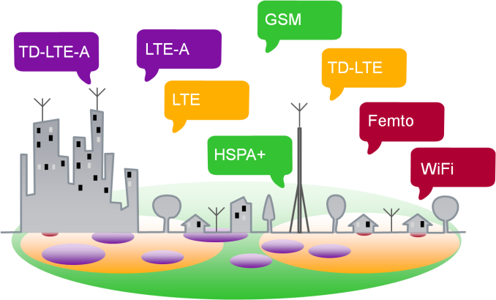
Multi-RAT Networking
Ethernet
WiMAX
CDMA
Wi-Fi

Slide 9
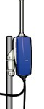
Multi-Service Networking
Fixed
DSL, Cable, FWA
Nomadic
Fixed WiMAX
Wi-Fi
no session
continuity
Portable
Wi-Fi
session continuity
Mobile
Cellular
seamless handover

Slide 10

Operator Relations
Access Networks for the Internet
User
Access
Core
Content
NSP
Internet
The Internet decouples the Content from the Core
  Split between Application Service Provider and Network Service Provider
Often Access is not owned by Network Service Provider but operated as independent business
  Network Access Provider does not deal with the particular subscriber but concentrates on establishment and operation of network infrastructure
  Possibility to sell network access to multiple service providers enables economy of scale and reduces ROI

Slide 11
Operator Roles in the Internet
Network Access Provider (NAP)
  A business entity that provides radio access infrastructure to one or more Network Service Providers.
Network Service Provider (NSP)
  A business entity that provides IP connectivity and network services to subscribers compliant with the Service Level Agreement it establishes with sub-scribers. To provide these services, an NSP establishes contractual agreements with one or more NAPs.
  An NSP may also establish roaming agreements with other NSPs and contractual agreements with third-party application providers (e.g. ASPs) for providing IP services to subscribers.
ASP (Application Service Provider)
  Provides and manages applications on top of IP
  Provides value added services, Layer 3+ (e.g. VoIP, corporate access, ...)

Slide 12
Multi-Operator Networking
ASP
ASP
ASP
A NSP may have a special relationship with an ASP for value added services
Internet
A NSP may have a contract with another NSP
A NSP may have contracts with multiple NAPs
NSP
NSP
NSP
NAP
NAP
NAP
NAP
NAP
A NAP may have contracts with multiple NSPs
Subscriber
Subscriber

Slide 13
Why Heterogeneous Networking?
Heterogeneous Networking is deployed for cost and performance reasons
  Multi-Layer
    Higher performance of cellular systems by smaller cells and better link budget
  Multi-RAT
    Optimized radio interfaces
  Multi-Service
    Reduced complexity and higher throughput when less mobility is needed
  Multi-Operator
    Better usage of network resources by sharing
Heterogeneous Networking is considered as the solution for the data explosion in the mobile networks.

Slide 14
Heterogeneous Networking in IEEE802
IEEE802 provides PHY and MAC of User-Network-Interfaces for
  macro, micro, pico and femto cells
  IEEE802.3, IEEE802.11, IEEE802.15, IEEE802.16, IEEE802.20, IEEE802.22
  fixed, nomadic, portable and mobile service
However, IEEE802 does not provide any specifications for inter-operator relations or higher layers of the Network-User-Interface.
Due to the varieties of its User-Network Interfaces, heterogeneous networking seems to be a reasonable topic for IEEE802.

Slide 15
How to proceed?
Is there any benefit of specifications for heterogeneous networking in IEEE802?
Analysis necessary, what is missed by the current IEEE802 specifications:
  Are there other specifications which can be used for IEEE802 network interfaces?
  Would cooperation with other SDOs lead to more widely accepted/deployed standards?
  Which SDOs would be appropriate partners?
Who would be interested in deploying IEEE802 HetNet standards?

