Slide 1
  OmniRAN - Overview and status
[IEEE 802.16 Mentor Presentation Template (Rev. 0)]
Document Number:
  16-12-0670-01-Shet
  Date Submitted:
  2012-11-13
Source:
  Max Riegel Voice: +49 173 293 8240
  Nokia Siemens Networks E-mail: maximilian.riegel@nsn.com
Re:
  Discussion in IEEE 802.16 HET SG
Base Contribution:
  n/a
Purpose:
  Overview and status of OmniRAN aimed for presentation to other IEEE 802 WGs
Notice:
  This document does not represent the agreed views of the IEEE 802.16 Working Group or any of its subgroups. It represents only the views of the participants listed in the “Source(s)” field above. It is offered as a basis for discussion. It is not binding on the contributor(s), who reserve(s) the right to add, amend or withdraw material contained herein.
Copyright Policy:
  The contributor is familiar with the IEEE-SA Copyright Policy <http://standards.ieee.org/IPR/copyrightpolicy.html>.
Patent Policy:
  The contributor is familiar with the IEEE-SA Patent Policy and Procedures:
      <http://standards.ieee.org/guides/bylaws/sect6-7.html#6> and <http://standards.ieee.org/guides/opman/sect6.html#6.3>.
  Further information is located at <http://standards.ieee.org/board/pat/pat-material.html> and <http://standards.ieee.org/board/pat >.

Slide 2
OmniRAN
Overview and status
2012-11-13
Max Riegel
NSN

Slide 3
OmniRAN
OmniRAN discussed in 802.16 HetNet study group since March 2012
  IEEE 802 tutorial in July 2012
OmniRAN defines generic network side interfaces for access networks based on IEEE 802 technologies
What does OmniRAN stand for?
  Open mobile network interface for omni-Range Area Networks
It addresses all IEEE 802 access technologies including IEEE 802.3!

Slide 4
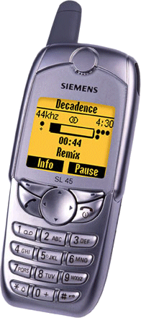
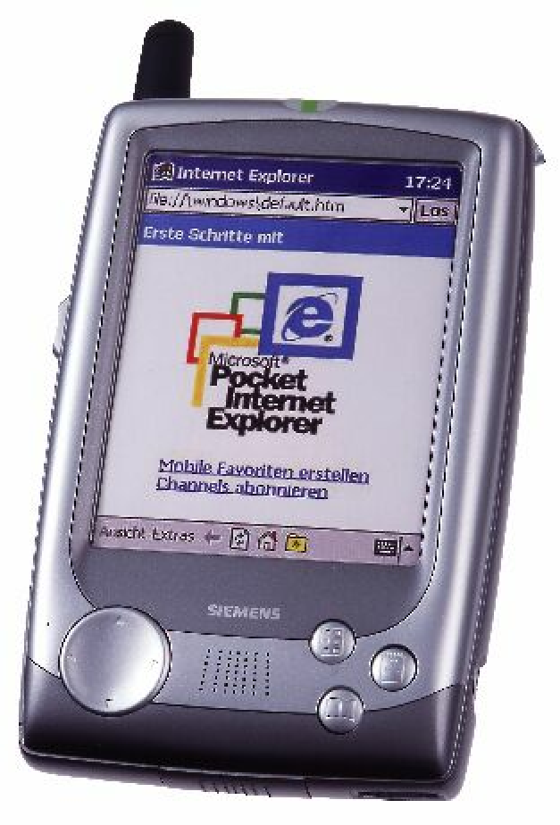
Legacy Communication Networking
Close relationship between user terminal, access network and service provider
  Single interface in terminal
  Single access network topology
  Single operator
    single entity (operator, IT department) controls complete service chain
Operators with long-term experience in networks
Internet
Control
Access

Slide 5

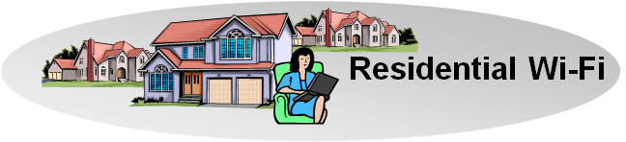
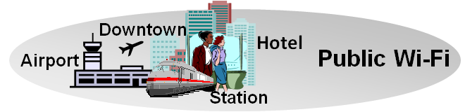
OmniRAN for Hetereogeneous Networks
User-Terminals have to support
  multiple network interfaces
    e.g. Cellular, IEEE 802.3, IEEE 802.11,
  multiple access network topologies
    e.g. IEEE802.11 in residential, corporate and public
  multiple network subscriptions
    e.g. multiple subscriptions for same interface
Generic solution to cope with complexity
Cellular
802.11
802.15

Slide 6
OmniRAN for Emerging Networking Markets
Many more (huge) networks are coming up by everything gets connected
  e.g. SmartGrid, HomeAutomation, Car, …
Many new markets for IEEE 802 access technologies
  e.g. factory automation, in-car communication
New deployments suffering by the same old networking issues
  e.g. service control, security, provisioning
  new operators lacking long-term experience
Generic solution to foster market growth

Slide 7
Scope of OmniRAN
Network detection and selection
  Finding the most appropriate network when multiple networks are available
Setting up the access link
  Scope of individual IEEE 802.xx specifications
Authentication
  Framework, based on IEEE 802.1X
Setting up the e2e communication link
  Authorization, Service management
Management of user data connection
  mobility support to maintain connectivity
Usage and inventory reporting
  accounting, monitoring, location

Slide 8
Additional functions for large scale networks
Subscription management
  Adding new users to a network
  Maintaining subscriptions
    e.g. renewal, change, termination
Management of terminals
  Initial configuration of new terminals
  Provisioning and update of policies

Slide 9
OmniRAN Architecture Overview

Slide 10
OmniRAN Interfaces
R1: Access link, technology specific
R2: User & terminal authentication, subscription & terminal management
R3: Authorization, service management, user data connection, accounting, monitoring
R4: Inter-access network coordination and cooperation, fast inter-technology handover
R5: Inter-operator roaming control interface
Specification work can be done in sequence!

Slide 11
OMNIRAN-3GPP SaMOG
Antonio de la Oliva (UC3M),Ivano Guardini (Telecom Italia),
Carlos J. Bernardos (UC3M),Loris Marchetti (Telecom Italia)
Summary slide of Contribution IEEE 802.16-12-0660-00
Work at the 3GPP SaMOG groups and OMNIRAN can be complementary
  OMNIRAN would need to define how the Trusted Non-3GPP network behaves according to requirements from 3GPP
  Work can be done for both network and terminal sides
  The use of OMNIRAN can open the door to the use of more IEEE 802 technologies as part of the operator´s RAN in a managed way

Slide 12
What OmniRAN would provide to 3GPP
SaMOG is defining a gateway controlling the Trusted Non-3GPP network by the EPC
OmniRAN would provide an interface (R3) to which 3GPP would be able to reference.
  Expanded beyond IEEE 802.11/802.16
R3

Slide 13
Relation to other standardization activities
There are plenty of related standardization activities
  WFA Hotspot 2.0
    solving the networking issues for IEEE802.11
  WiMAX Forum
    Mobile WiMAX network specifications
  3GPP
    interworking with non-3GPP technologies
    OmniRAN group could provide the interface for network oriented liaisons to IEEE 802.
  IEEE1905.1
    integration of multiple access technologies in home networks
  SmartGrid, IoT and M2M
    many activities somehow touching the topic
  …
    there may be even many more related activities

Slide 14
How to proceed?
There are benefits to work on OmniRAN in IEEE 802.
Further analysis necessary to define the missing pieces to enable broader ecosystem for IEEE 802 networks
Discussions need involvement across all IEEE 802 WGs.
Proposal: Establish IEEE 802 EC Study Group on OmniRAN this week.

