Slide 1
  Considerations for Mobile Wireless SCB
Document Number:
  IEEE 802.16-14-0071-00-000r
Date Submitted:
  2014-08-19
Source:
  Junhyeong Kim, Hee-Sang Chung, and Il Gyu Kim
  Electronics and Telecommunications Research Institute (ETRI)
  E-mail: jhkim41jf@etri.re.kr, hschung@etri.re.kr, igkim@etri.re.kr
Re:
  Call for Contributions (16-14-0064-01-000r)
Base Contribution:
  None
Purpose:
  To propose a new concept of mobile wireless SCB and discuss related issues on modification of PAR
Notice:
  This document does not represent the agreed views of the IEEE 802.16 Working Group or any of its subgroups. It represents only the views of the participants listed in the “Source(s)” field above. It is offered as a basis for discussion. It is not binding on the contributor(s), who reserve(s) the right to add, amend or withdraw material contained herein.
Copyright Policy:
  The contributor is familiar with the IEEE-SA Copyright Policy <http://standards.ieee.org/IPR/copyrightpolicy.html>.
Patent Policy:
  The contributor is familiar with the IEEE-SA Patent Policy and Procedures:
      <http://standards.ieee.org/guides/bylaws/sect6-7.html#6> and <http://standards.ieee.org/guides/opman/sect6.html#6.3>.
  Further information is located at <http://standards.ieee.org/board/pat/pat-material.html> and <http://standards.ieee.org/board/pat >.

Slide 2

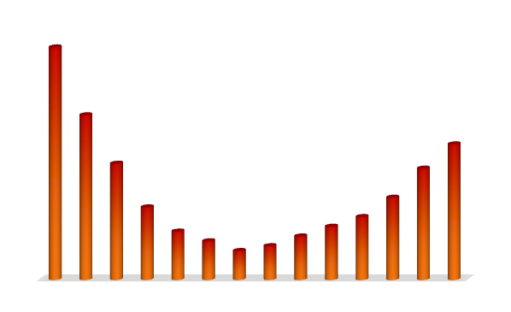
Background (1/3)
High mobility environments are getting important
  Most people enjoy wireless internet services at ‘low’ or ‘high’ mobility
  About 10 billions of passengers use bus, subway and train yearly in Korea
Mobile Internet Use
Freedom of two hands !
Low Medium High mobility
(above 100km/h )

Slide 3

Background (2/3)
‘Home’ and ‘Vehicle’ are the most preferred places to use mobile internet
89.6
81.3
62.1
62.0
52.6
Where?
Mobile
Internet
34.0
28.0
Home
Vehicle
Streets
Outdoor
(Coffee shops)
Work
Public
space
School
※ Survey 2012 for Mobile Internet Usage by Korea Internet & Security Agency

Slide 4
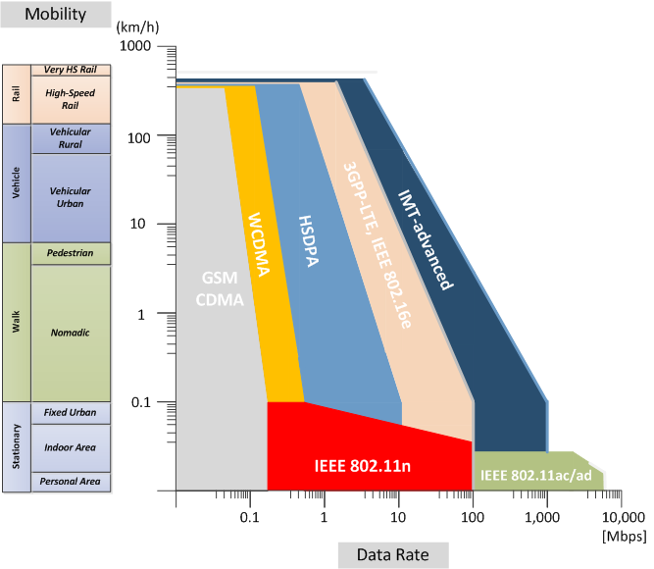
Background (3/3)
Nomadic users have been prioritized
  Optimized for (low speed) pedestrian user
Velocity Range | Performance Characterization
0~15 km/h | Optimal
15~120km/h | High
120~350km/h | Functional
Current cellular systems are not
enough to provide multimedia
services for passengers in the
fast moving vehicles!
Wireless Internet use
Low Medium High mobility
(above 100km/h )

Slide 5
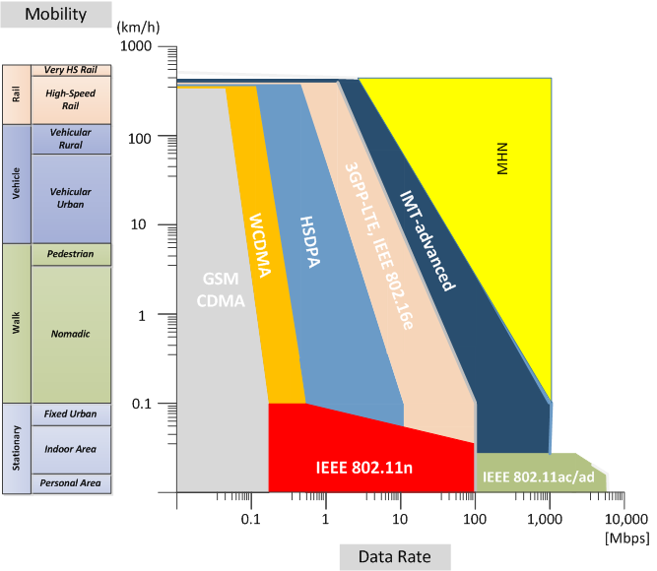
Objective (1/3)
RAT for high-mobility regions
  The same level of QoE for high-speed group users compared to nomadic users
    High data rate beyond Gbps for mobile wireless backhaul
Wireless Internet use
Low Medium High mobility
(above 100km/h )

Slide 6

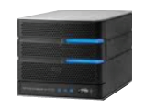




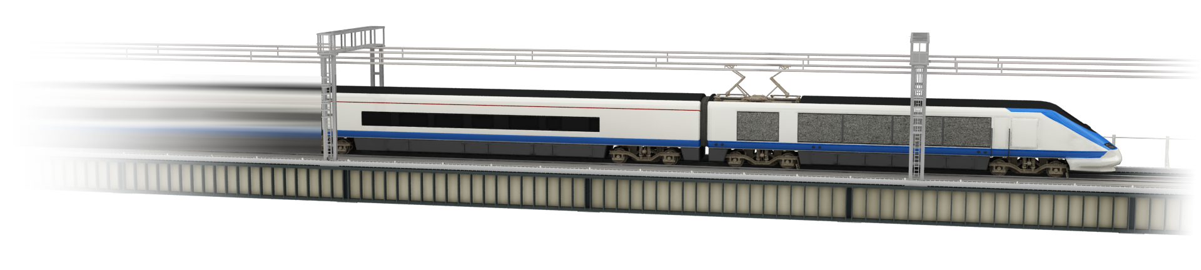




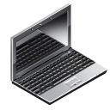

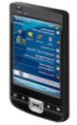
Objective (2/3)
Backhaul and Access Link
Public Internet
DU
GW
DU
RU
RU
SHF/EHF
RU
RU
TE
TE
WiFi/Femto
WiFi/Femto
WiFi/Femto
RU : Radio Unit
DU : Digital Unit
TE : Terminal Equiptment
GW : Gateway

Slide 7
Objective (3/3)
Features
New RAT for Mobile Wireless Backhaul
Wireless Backhaul Link | OFDM based on mmWave
Data throughput (DL) | 1 Gbps using 250 MHz bandwidth
Spectral efficiency | 4 bps/Hz
Velocity (Mobility) | 400 km/h
Access Link (Inside Vehicle) | WiFi or Femto

Slide 8
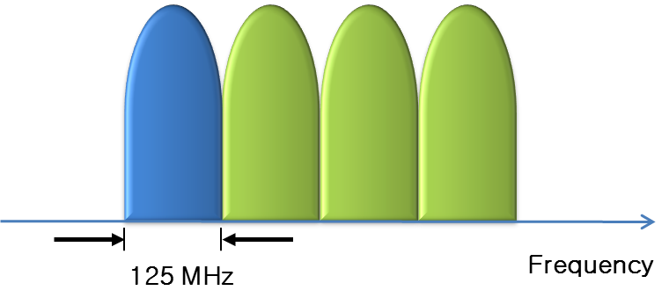
Technical Issues (1/3)
Wide spectrum over millimeter waves
  Considerations for frequency resources and implementation
    Primary bandwidth : 125 MHz
    Carrier aggregation up to 500 MHz

Slide 9
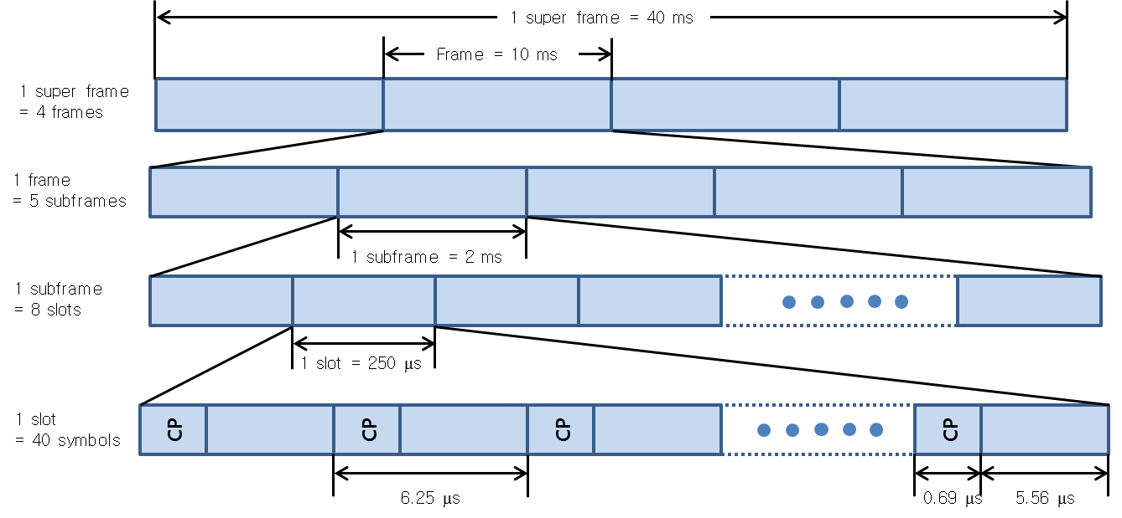
Technical Issues (2/3)
Frame structure

Slide 10
Technical Issues (3/3)
Downlink resource grid (OFDM)

Slide 11
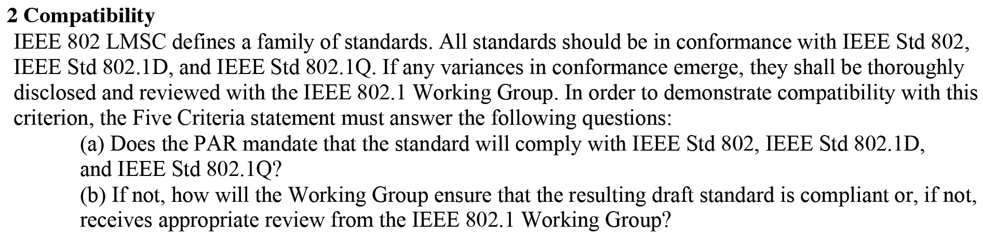
Discussions on modification of PAR
Modification of PAR based on a new RAT
  Mobile wireless SCB (small cell backhaul) with wide spectrum
    Introduce mobile wireless SCB (small cell backhaul)
    Wide spectrum for improving throughput of wireless backhaul network
      For example, SHF/EHF
  Should modified PAR support existing standard (IEEE 802.16-2012) ?
    Is it mandatory or optional?
    Current PAR document says “The MAC is structured to support the WirelessMAN-SC, WirelessMAN-OFDM, and WirelessMHN-OFDMA PHY specifications”.
    Hard to meet Five Criteria
      (2) Compatibility

