Slide 1
  Metrics integration in 802.16.3 architecture: proposals overview
Document Number: IEEE 802.16-14-0080-00-03R0
Date Submitted: 2014-10-23
Source:
  Antonio Bovo Voice: +390497623908
  TEKCOMMS E-mail: antonio.bovo@tekcomms.com
  *<http://standards.ieee.org/faqs/affiliationFAQ.html>
Re: 16-14-0080-00-03R0
Base Contribution:
Purpose: WG discussion
Notice:
  This document does not represent the agreed views of the IEEE 802.16 Working Group or any of its subgroups. It represents only the views of the participants listed in the “Source(s)” field above. It is offered as a basis for discussion. It is not binding on the contributor(s), who reserve(s) the right to add, amend or withdraw material contained herein.
Copyright Policy:
  The contributor is familiar with the IEEE-SA Copyright Policy <http://standards.ieee.org/IPR/copyrightpolicy.html>.
Patent Policy:
  The contributor is familiar with the IEEE-SA Patent Policy and Procedures:
      <http://standards.ieee.org/guides/bylaws/sect6-7.html#6> and <http://standards.ieee.org/guides/opman/sect6.html#6.3>.
  Further information is located at <http://standards.ieee.org/board/pat/pat-material.html> and <http://standards.ieee.org/board/pat >.

Slide 2
Goal of the document
Allow discussion on “active” or “passive” measurements integration over 802.16.3 by means of:
  A proposal about IPPM measurements protocols integration over the 802.16.3 architecture environment.
  An example of a possible IPPM active measurement integration over the 802.16.3 architecture environment.
  An example of a possible passive measurement integration over the 802.16.3 architecture environment.

Slide 3
Recap of available IPPM documents
Summary of IPPM-related specifications is available at: http://datatracker.ietf.org/wg/ippm/
There are either stable specifications or drafts related to new proposals (I-D Initial Default state).
A couple of specifications describe the so called “Two-Way Active Measurement Protocol” (TWAMP) and the “One-way Active Measurement Protocol” (OWAMP)
  These protocols are dedicated to activation, control and results’ collection for one-way or two-way metrics.
  The specifications are RFC 5357 (TWAMP) and RFC 4656 (OWAMP).
The IPPM specified metrics are related to the active test scenario (so called Type-T testing).
There are several IP Performance metrics defined, as for example:
  ROUND TRIP DELAY
  ONE-WAY CONNECTIVITY
  ONE-WAY DELAY
  ONE-WAY LOSS
  LOSS DISTRIBUTION, LOSS PATTERNS
  JITTER
  ROUND TRIP PACKET LOSS
  TCP THROUGHPUT
  …

Slide 4
Interworking of TWAMP with 802.16.3 architecture
Protocol | Basics on TWAMP protocol | 802.16.3
TWAMP (Two Way Active Measurement Protocol) | TWAMP is defined in RFC 5357 and it is related to two-way active measurements (e.g. round trip measurements). The Logical entities defined in TWAMP are: Session-Sender (sending endpoint) Session-Reflector (it is also the Session-Receiver endpoint) Control-Client (it initiates the session and start/stop it) Server (it manages the test sessions and eventually configure the pre-test status of endpoints) Control-Client and Session-Sender can be co-located (let’s name it CC-SS); the same for Session-Reflector and Server (SR-S, in this case). Control Client and Server are connected via a TCP connection over a well-known port #862. They negotiate security for both integrity and encryption. Control-Client request establishment of a test session with a TWAMP Control message sent to the server, that responds back for acceptance. All test session starts with a Start-Session message, acknowledged by the Server. Session-Sender sends test packet to Session-Reflector that responds accordingly to the test. These packets are sent via UDP protocol. The control and test messages from Control-Client/Session-Sender and from Session-Reflector/Server are the following: CC-SS SR-S Request-TW-Session → ← Accept-Session Start-Sessions → ← Start-Ack TWAMP-Test Packet → ← TWAMP-Test Packet Continue the test with additional packets sent …. → ← …continue the test with additional packets sent back Stop-Sessions → The Session-Reflector/Server is stopping all the sessions indicated in the received ` message. Control-Client sends a stop message for terminating one or more sessions from the same endpoint. | The logical entities are: Client Controller Server Data Collector Client can be mapped to Session-Sender Server has a role similar to Session-Reflector and partly to Server in TWAMP. Data Collector is not there in TWAMP 802.16.3 Controller is not there with the same functionalities in TWAMP: part of its functionalities are included in TWAMP Control-Client (those related to session initiation/start/stop), once it has been already chosen which test to perform.

Slide 5
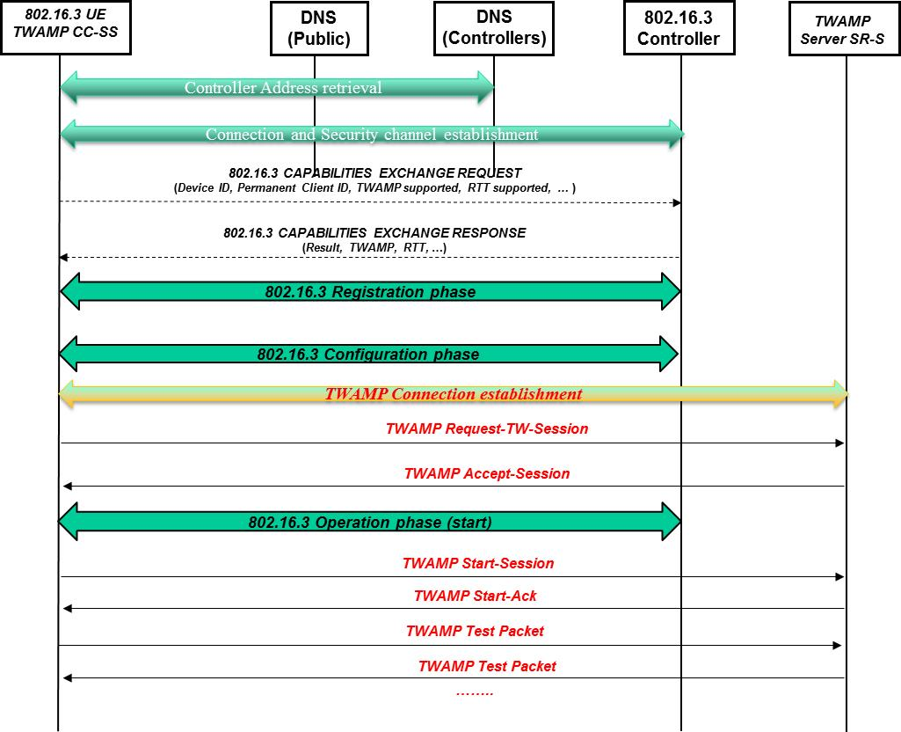
Example of TWAMP-802.16.3 IW (1/2)
The basic idea for interworking TWAMP and 802.16.3 is encapsulating the TWAMP dialogue into a 802.16.3 dialogue.
This allows the 802.16.3 Controller to configure the test session and being informed about the session starting.
At the same time, there’s the dialogue between Client and TWAMP server to establish the session.

Slide 6
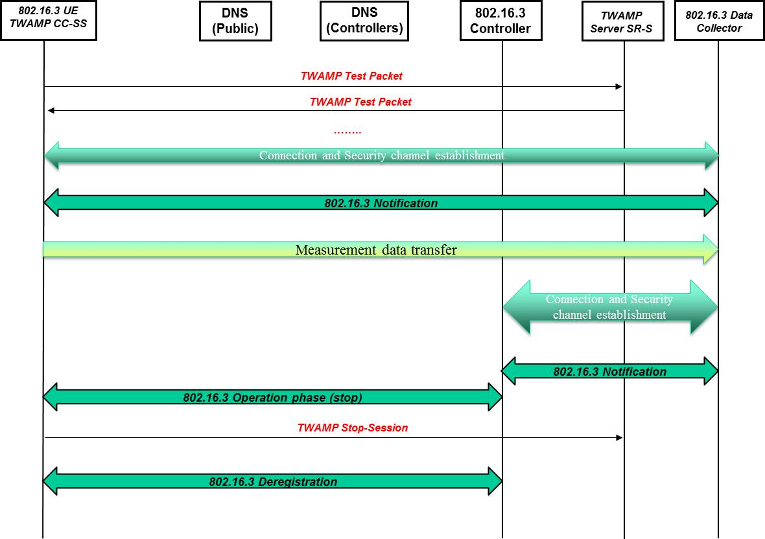
Example of TWAMP-802.16.3 IW (2/2)
Then, once the TWAMP test is completed, the 802.16.3 UE can proceed with the measurement transfer to the Data Collector.
Finally the UE is informing either the 802.16.3 Controller or the TWAMP server about the termination of the session, with proper “stop” messaging.

Slide 7
Interworking of OWAMP with 802.16.3 architecture
Protocol | Basics on OWAMP protocol | 802.16.3
OWAMP (One Way Active Measurement Protocol) | The Logical entities are: Session-Sender (sender endpoint for tests) Session-Receiver (receiver endpoint for tests) Control-Client (it manages the start/stop of the test session and it requests the test sessions) Server (it can return the test sessions results) Fetch-Client (this is an entity in charge of fetching measurements about a completed test session) Control-Client, Fetch-Client and Session-Sender can be co-located; the same for Session-Receiver and Server. Let’s name them CC-FC-SS and SRC-S, respectively. Control Client and Server are connected via a TCP connection over a well-known port #86; the connection is established with a “Connection Setup”. On the other hand, OWAMP-Test packets are sent via UDP, using a port negotiated at the beginning during session establishment (Request/Accept Session messages). The peers can negotiate security for both integrity and encryption. The control and test messages from CC-FC-SS and from SRC-S are the following: CC-FC-SS SRC-S INITIAL PHASE Connection Setup → ← Server-Greeting Setup-Response → ← Server-Start SESSION ESTABLISHMENT Request-Session → ← Accept-Session SESSION TEST Start-Session → ← Start-Ack OWAMP-Test packet → Continue the test with additional OWAMP-Test packets sent …. → … STOP TEST and RETRIEVE RESULTS Stop-Session → ← [ Even the server can send the Stop-Session ] Fetch-Session → ← Fetch-Ack ← In case of Fetch accepted, it is sent back the OWAMP-Test session data. | As described before, the logical entities for 802.1.6.3 are: Client Controller Server Data Collector A possible mapping between 802.16.3 and OWAMP logical entities is the following: 802.16.3 Client can be mapped to OWAMP Session-Sender. 802.16.3 Server has a role very similar to TWAMP Server, if Session-Receiver and Server logical entities are collapsed. Data Collector is not there in OWAMP. OWAMP Control-Client is fetching the session results without downloading them to any other entity. 802.16.3 Controller is not there with the same functionalities in OWAMP: part of its functionalities are included in Control-Client (those related to session setup), once it has been already chosen which test session to perform. As Control-Client can fetch the measurements results, it is the best candidate to download them to the 802.16.3 Data Collector, as in the previous TWAMP-802.16.3 scenario.

Slide 8
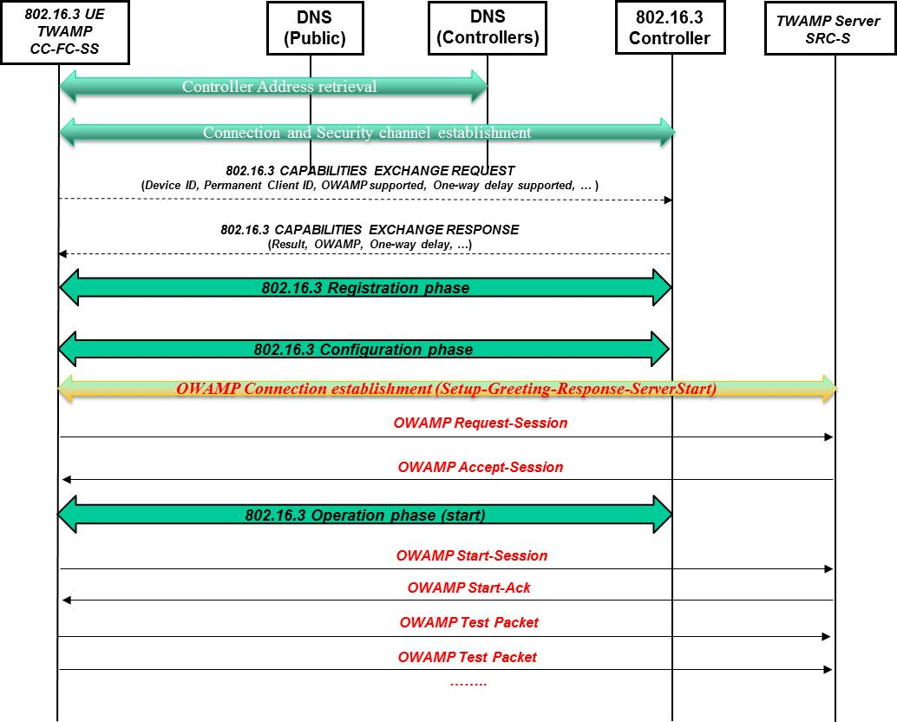
Example of OWAMP-802.16.3 IW (1/2)
As before, the idea for interworking OWAMP and 802.16.3 is again encapsulating the OWAMP dialogue into a 802.16.3 dialogue.
This allows the 802.16.3 Controller to configure the test session and being informed about the session starting.
At the same time, there’s the dialogue between Client and OWAMP server to establish the session.

Slide 9
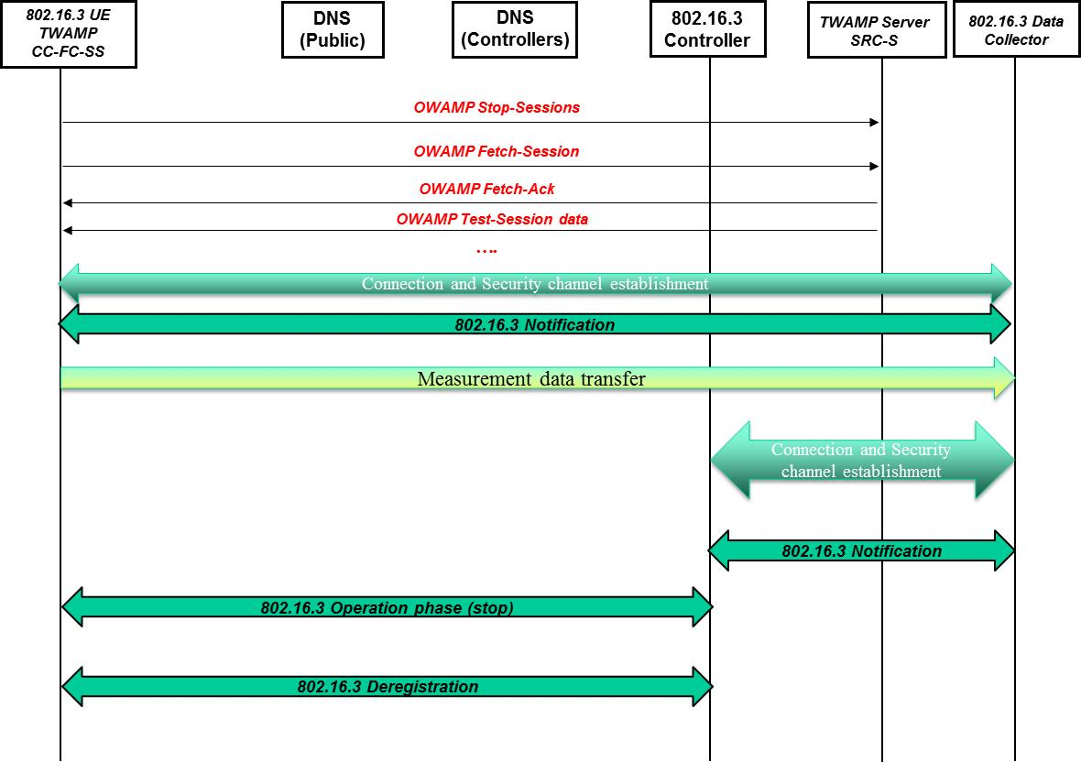
Example of OWAMP-802.16.3 IW (2/2)
Then, once the OWAMP test is completed, the Client can fetch the results from the TWAMP server and proceed with the measurement transfer to the Data Collector.
Finally the Client UE is informing the 802.16.3 Controller about the termination of the session, with proper “stop” messaging.

Slide 10
Highlights on TWAMP/OWAMP – 802.16.3 IW
From the slides just presented it is possible an interworking between TWAMP/OWAMP and 802.16.3 protocols for mobile broadband network performance measurements.
Basically, 802.16.3 allows a framework that is encapsulating the former TWAMP/OWAMP maintaining their behavior and message handshake.
What is provided in addition is the possibility to configure in a more flexible way the measurements to be done, providing also a set of identifiers to track the results later.
Even the possibility to download the measurements on a Data Collector allows a flexible way to manage the measurements’ results, in order to characterize more the network behavior than the single Client/UE behavior, with the possibility of aggregating several results together in a structured way.
Now let’s discuss an example of an IPPM measurement (eventually using TWAMP or OWAMP, depending on the measurement type) integrated over 802.16.3, to analyze the specific handling necessary to support the IPPM measurements.
Note that TWAMP and OWAMP adopt UDP for sending Test packets. On the other hand, in some cases IPPM metrics are based on TCP instead of UDP.

Slide 11
Example of IPPM RTT over 802.16.3 framework
IPPM Round Trip Time (RTT) measurement is defined in RFC 2681.
The metric is named “Type-P-Round-trip-Delay”, where Type-P refers to the general requirements specified in RFC 2330 for the IPPM metrics framework.
It is explicitly specified in RFC 2681 that the measurement depends on the Type-P packet choice, for example considering the application protocol, the TCP or UDP transport and port (well-known or arbitrary), the size of the packet and eventually any applied priority/precedence.
RFC 2681 states also the need for accurate timing measurements, including client and server synchronization, and also the need to measure calibration.
It is discussed even the generation of a single Type-P packet for testing or a stream of Poisson Type-P packets with certain flow characteristics.
Finally the RFC describes some guidelines about how to aggregate and report the results.
About the integration within 802.1.6.3 framework:
  802.16.3 framework doesn’t prevent the usage of such IPPM metric.
  Client and Server can adopt all the guidelines specified in RFC 2681 to provide the RTT measurements.
  Even the timing synchronization between client and server is not prevented by the 802.16.3 framework.
  What is specifically added is the possibility to configure such measurement, assign proper identifiers to the session and finally concentrate the results at the Data Collector in a flexible way.

Slide 12
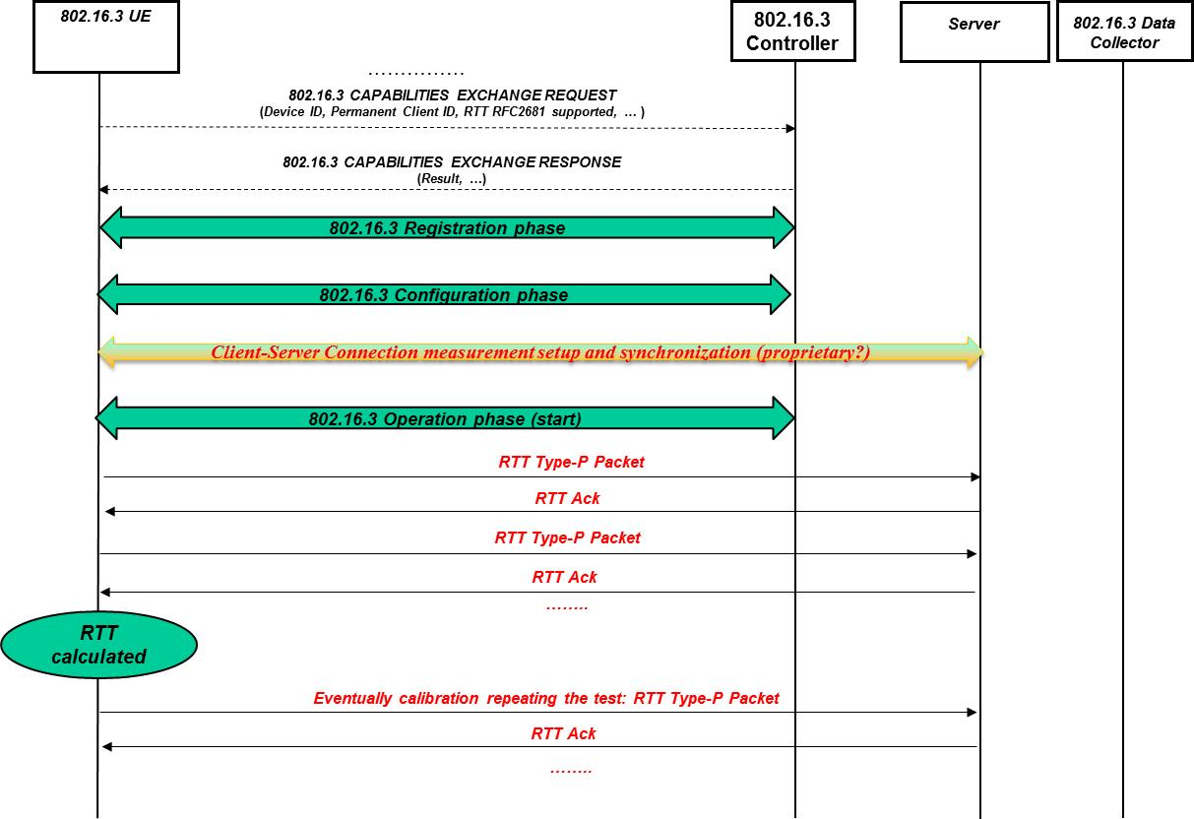
Example of RTT RFC2681 and 802.16.3 IW (1/2)
This synthetic message flow is related to the integration of IPPM RTT within the 802.16.3 framework.
Note that, after the initial 802.16.3 phases, there is a dialogue for establishing the connection to TWAN Server.
The RTT Packet flows and related Ack messages allow the RTT calculation, followed by an optional calibration phase.
It has been omitted the initial phase with DNS queries

Slide 13
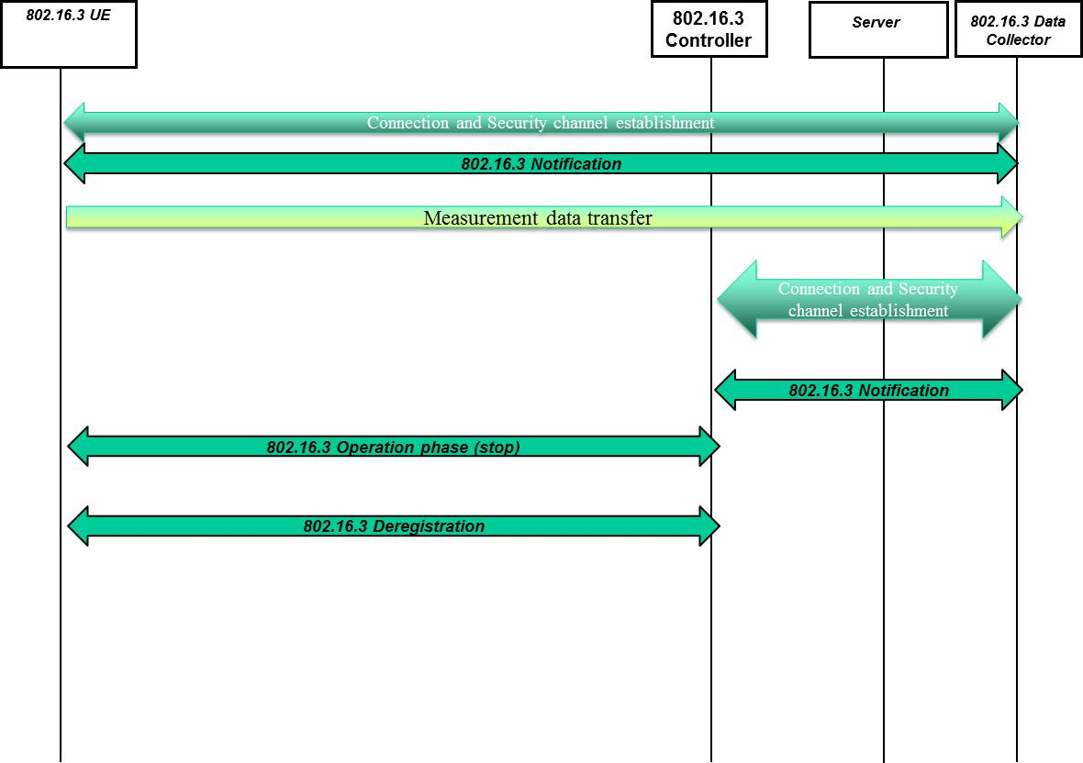
Example of RTT RFC2681 and 802.16.3 IW (2/2)
Once the measurement is done, it could be possible transferring the results to the Data Collector with usual 802.16.3 mechanism.

Slide 14
Example of passive RTT measurement over 802.16.3 framework
Passive measurements are basically different from active ones, due to the fact that the peers are exchanging real traffic (not test traffic) under real user experience conditions.
The 802.16.3 architecture considers both active and passive measurements in principle.
So, let’s make an example of a typical well-known measurement, as the “Packet loss”, and the implications of implementing it within such 802.16.3 architecture. RFC 2680 specification is related to the definition of Packet loss active test.
Let’s restrict for the moment the “Packet loss” measurement definition to one of the typical protocols involved in a VoIP call, the RTP protocol.
One possibility to infer “Packet loss” measurement is to monitor the information within the RTCP reports, that include the “Packet lost” information, while an alternative option is monitoring directly the RTP packets sequence numbers to detect lost packets, based on missing sequence numbers. Then it can be applied for example the algorithm specified in RFC 3550 Appendix A.3 to compute the metric.
In any case, a Software Agent running on a mobile (Client-UE) could monitor passively the RTP traffic to a certain destination and measure the number of lost packets in a specific timeframe. This is a measurement instance that can be considered for example to compute Max, Min, and Mean values or eventually populating “bin” values.
Now, about the integration within 802.16.3 framework:
  802.16.3 framework doesn’t prevent the usage of passive metrics, configuring a specific passive measurement to the client.
  Based on this configuration the Client should activate the Software Agent running the passive measurements just configured.
  At the end of the measurement period, configured as well by the Controller, the Software Agent can download the results (for example as min/max/mean values or bin values), correlated with the specific destinations and services involved.

