Slide 1
  802.16.3 and LMAP liaison
Document Number: IEEE 802.16-15-0011-00-03R0
Date Submitted: 2015-03-11
Source:
  Antonio Bovo Voice: +393771821211
  E-mail: antonio1234.pd@gmail.com
  *<http://standards.ieee.org/faqs/affiliationFAQ.html>
Re: 16-15-0011-00-03R0
Base Contribution:
Purpose: WG discussion
Notice:
  This document does not represent the agreed views of the IEEE 802.16 Working Group or any of its subgroups. It represents only the views of the participants listed in the “Source(s)” field above. It is offered as a basis for discussion. It is not binding on the contributor(s), who reserve(s) the right to add, amend or withdraw material contained herein.
Copyright Policy:
  The contributor is familiar with the IEEE-SA Copyright Policy <http://standards.ieee.org/IPR/copyrightpolicy.html>.
Patent Policy:
  The contributor is familiar with the IEEE-SA Patent Policy and Procedures:
      <http://standards.ieee.org/guides/bylaws/sect6-7.html#6> and <http://standards.ieee.org/guides/opman/sect6.html#6.3>.
  Further information is located at <http://standards.ieee.org/board/pat/pat-material.html> and <http://standards.ieee.org/board/pat >.

Slide 2
Goal of the document
Allow discussion on the possible liaison between IEEE 802.16.3 and IETF LMAP WGs by means of:
  An overview of the current proposition value of IEEE 802.16.3 and how this can help the LMAP WG
  An overview of the current status of IEEE 802.1.6.3 architecture and requirements in the perspective of add-on elements to LMAP.

Slide 3
IEEE 802.16.3 proposition value
The main purpose of IEEE 802.16.3 is “…characterizing the performance of deployed mobile broadband networks from a user perspective…”
By means of “…metrics and test procedures as well as communication protocols and data formats…allowing a network-based server to coordinate and manage test operation and data collection…”
And as well “…collect information from a disparate set of devices in the network…”
Where the potential stakeholders of such measurements are not only network operators or regulators but also for example “…users of broadband mobile networks, including enterprises…policy makers…researchers…”.
Some highlights:
  The end-user perspective.
  The focus on MOBILE broadband networks.
  The variety of measurements stakeholders.
  The inclusion of metrics in the scope.
  The inclusion of protocol details in the scope.
  The generality of measurement devices active in the network.
  The coordination of measurements done by an external entity not necessarily included in the network under test.

Slide 4
Use cases in 802.16.3 architecture
 | Stakeholder
Measurement application | Governmental policy maker | User (individual or enterprise) | Cell tower operator | Wireless carrier / Network operator | Researcher | Standards developer | User device vendor | Application developer | Mobile Application Service Provider
Overall data on Quality of Experience of set of networks available to consumers | x | x | x | x | x |  | x | x | x
Quality of Experience of a specific network |  | x | x | x | x |  | x | x | x
Identify limitations in deployment of a specific network |  | x | x | x |  |  |  | x
Monitor for changes in operation of a specific network |  | x |  | x
Diagnose problems in a specific network |  |  | x | x
improve knowledge of system performance |  |  |  | x | x |  |  |  | x
lead the market toward more effective networks | x |  |  |  |  |  |  |  | x
encourage the redeployment of scarce spectrum using efficient technologies and implementations | x |  | x | x
compare measured performance data to simulated results |  |  |  |  | x | x
assess theoretical models |  |  |  |  | x | x
assess technology elements proposed during standards development |  |  |  |  |  | x
The table above from Architecture and requirements document lists the identified use cases for the measurements.
This includes a number of possible stakeholders that are not only ISPs and Regulators.

Slide 5
802.16.3 and LMAP commonalities / differences
Both the WGs have the focus on measuring the performance of broadband services with the end user perspective.
The two frameworks have several commonalities as the MA (Measurement Agent) concept, that in 802.16.3 is embedded either in the Client or in the Server entities while in LMAP is a separate logical entity.
CONTROLLER and COLLECTOR are logical entities that have similar roles in both the scenarios.
Apparently, it is not very clear the role of the “Measurement peer” in LMAP, as it is claimed “out of scope”, while in 802.16.3 CLIENT entity is including basically the MA and the “Measurement peer” as well.
The link to the IETF IPPM workgroup is common in both the WGs to include such metrics, if makes sense.
The definition of a protocol to communicate among the different entities is present in both the WGs, even if the details are different.
Both the WGs consider security as one of the major topics.

Slide 6
802.16.3 add-on to LMAP
Possible add-on to LMAP coming from 802.16.3 can be the following, based on previous concepts.
The MOBILE aspects. In fact the mobile domain is including some specifics that are potentially very important to capture.
  One example is the following: the IRAT mobility can bring potential issues to security or to latency experienced by the end user, that can drop connections or affect badly the QoS (Quality of Service).
  Another example: the same measurement could be performed differently in different mobile radio technologies due to specific networks behavior (e.g. dynamic drop of radio channels during the connection instead of stable radio channel, for example).
  So, including the mobile aspects as dimensions in the measurements is important to characterize better the end user experience correlated with the specific mobile domain.
The inclusion of several use cases. They can imply specific needs in the metrics, in the way to manage the tests but also architecture specific needs.
  One of the major example is the ENTERPRISE use case, where an organization can adopt a private “server” and a private “Data collector”, in order to manage its own tests and store the results.
Finally, the protocol definition and the data model that has been proposed into 802.16.3 can be examined by LMAP to find some possible reuse.
  An example is the encapsulation of basic procedures in some workflows that can be helpful for the measurement process.
  Another example is the definition of some peers behaviors related to the protocols message exchange.
  Finally, the modeling of some IPPM metrics into this protocol can be helpful even for LMAP.

Slide 7
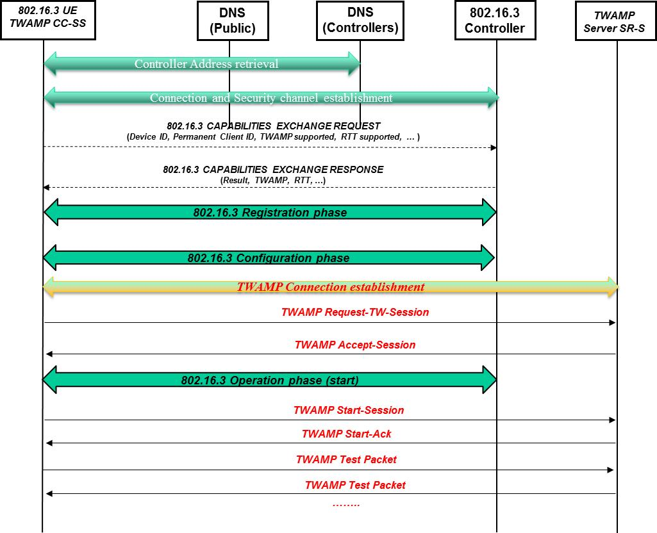
Example of TWAMP into 802.16.3 framework (1/2)
The following graph is an example of the 802.16.3 protocol workflow with TWAMP.
LMAP is also mentioning this TWAMP example, even if the schematic of the protocol is per procedure more than per entire workflow.

Slide 8
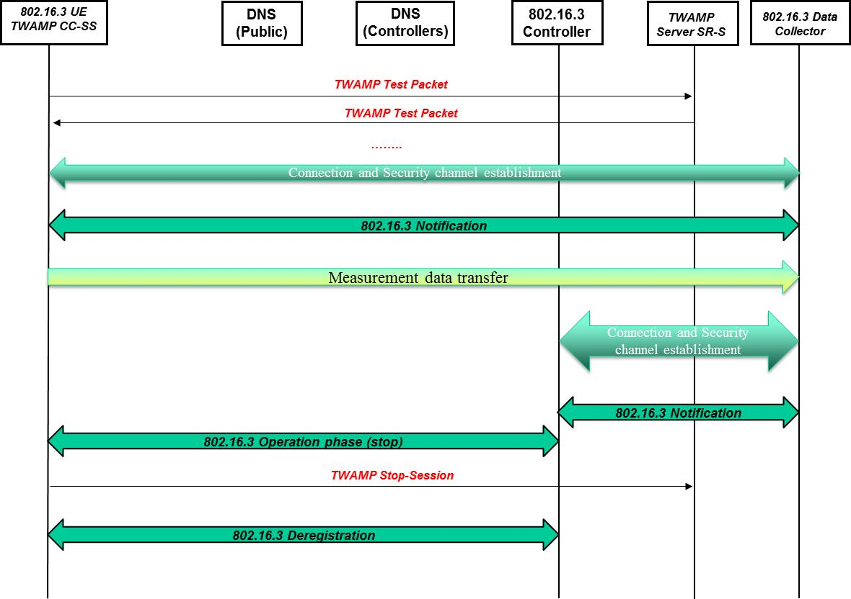
Example of TWAMP-802.16.3 IW (2/2)
Continuation of the example.

