Slide 1

  802.16 GRIDMAN Task Group - Session #103
[IEEE 802.16 Mentor Presentation Template (Rev. 0)]
Document Number:
  IEEE 802. 16-16-0031-00-Gdoc
  Date Submitted:
  15 May 2016
Source:
  Tim Godfrey Voice:
  EPRI E-mail:
  *<http://standards.ieee.org/faqs/affiliationFAQ.html>
Re:
Base Contribution:
  N/A
Purpose:
  Session #103 Task Group Meeting Presentation (May 2016)
Notice:
  This document does not represent the agreed views of the IEEE 802.16 Working Group or any of its subgroups. It represents only the views of the participants listed in the “Source(s)” field above. It is offered as a basis for discussion. It is not binding on the contributor(s), who reserve(s) the right to add, amend or withdraw material contained herein.
Copyright Policy:
  The contributor is familiar with the IEEE-SA Copyright Policy <http://standards.ieee.org/IPR/copyrightpolicy.html>.
Patent Policy:
  The contributor is familiar with the IEEE-SA Patent Policy and Procedures:
      <http://standards.ieee.org/guides/bylaws/sect6-7.html#6> and <http://standards.ieee.org/guides/opman/sect6.html#6.3>.
  Further information is located at <http://standards.ieee.org/board/pat/pat-material.html> and <http://standards.ieee.org/board/pat >.

Slide 2
GRIDMAN Discussion Items
Link to Agenda
Project Planning and Milestones
Review of PAR Scope
Review of Requirements
  Development of System Requirements Document
Develop Table of Contents of Draft Standard
Develop Call for Proposals

Slide 3
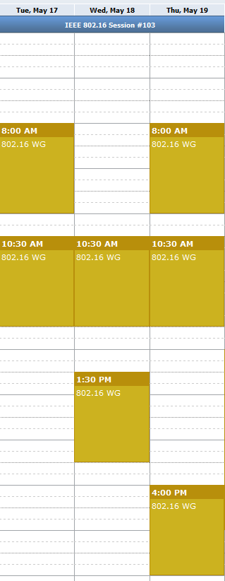
Meeting Plan for Week
802.16 WG
  Tuesday AM1
  Thursday PM2
GRIDMAN TG
  Tuesday AM2
  Wednesday AM2
  Wednesday PM1
  Thursday AM1
  Thursday AM2

Slide 4
Possible Project Plan and Milestones
May 2016 Planning, TOC, Requirements, Call for Proposals
July 2016 Discussion of Contributions
Sept 2016 Draft Development
Nov 2016 Draft Development, WG Letter Ballot
Mar 2017 Start Sponsor Ballot
July 2017 Forward to RevCom

Slide 5
PAR Scope
From 802.16-16-0012-03-Gdoc:
This project specifies WirelessMAN-OFDMA TDD operation in exclusively-licensed spectrum with channel bandwidth from 100 kHz up to 1.25 MHz, including 1 MHz explicitly. The amendment will target operation in the 700 MHz band but will also support operation in other VHF/UHF bands. The project amends Clause 12 of IEEE Std 802.16, adding a new system profile and amending other clauses as required to support the narrower channel widths. The range and data rate supported by the added profile are commensurate with those of the base standard, as scaled by the reduced channel bandwidth.

Slide 6
Review of Requirements
Contributed documents that may contain relevant requirements:
  802.16-15-0010-01-Gcon: Narrowband Ad-Hoc Status Update Tim Godfrey (EPRI)
  802.16-15-0020-00-Gcon: Narrowband Requirements Tim Godfrey (EPRI)
  802.16-16-0001-00-Gcon: 802.16/802.24 Tutorial: Proposed 802.16s Narrowband Project Tim Godfrey (EPRI)
  802.16-16-0011-00-Gcon: An Evaluation of Alternative Solutions for 1 MHz Channels for Smart Grid Applications Tim Godfrey (EPRI), Doug Gray (TCS)
  802.16-16-0029-01-Gcon: 802.16s Air Interface Considerations Menashe Shahar (Full Spectrum)

Slide 7
Development of System Requirements Document (SRD)

Slide 8
Development of Table of Contents for Draft Standard
Baseline document – IEEE Std 802.16-2012
Relevant Contributions
  802.16-0030-00-Gcon: 802.16s Amendment Outline Menashe Shahar (Full Spectrum), Guy Simpson (Full Spectrum)
Create a group document representing the agreed outline and clauses for amendment
IEEE 802.16™: BROADBAND WIRELESS METROPOLITAN AREA NETWORKS (MANs)
IEEE 802.16™-2012 IEEE Standard for Air Interface for Broadband Wireless Access Systems

Slide 9
Amendment boundaries based on PAR
“The project amends Clause 12 of IEEE Std 802.16, adding a new system profile and amending other clauses as required to support the narrower channel widths”

Slide 10
Development of Call for Proposals
After approval of project by RevCom:
Issue Call for Proposals
  Refer to draft SRD and TOC

