Slide 1

  802.16 GRIDMAN Task Group - Session #103
[IEEE 802.16 Mentor Presentation Template (Rev. 0)]
Document Number:
  IEEE 802. 16-16-0031-01-Gdoc
  Date Submitted:
  19 May 2016
Source:
  Tim Godfrey Voice:
  EPRI E-mail:
  *<http://standards.ieee.org/faqs/affiliationFAQ.html>
Re:
Base Contribution:
  N/A
Purpose:
  Session #103 Task Group Meeting Presentation (May 2016)
Notice:
  This document does not represent the agreed views of the IEEE 802.16 Working Group or any of its subgroups. It represents only the views of the participants listed in the “Source(s)” field above. It is offered as a basis for discussion. It is not binding on the contributor(s), who reserve(s) the right to add, amend or withdraw material contained herein.
Copyright Policy:
  The contributor is familiar with the IEEE-SA Copyright Policy <http://standards.ieee.org/IPR/copyrightpolicy.html>.
Patent Policy:
  The contributor is familiar with the IEEE-SA Patent Policy and Procedures:
      <http://standards.ieee.org/guides/bylaws/sect6-7.html#6> and <http://standards.ieee.org/guides/opman/sect6.html#6.3>.
  Further information is located at <http://standards.ieee.org/board/pat/pat-material.html> and <http://standards.ieee.org/board/pat >.

Slide 2
GRIDMAN Discussion Items
Link to Agenda
Project Planning and Milestones
Review of PAR Scope
Review of Requirements
  Development of System Requirements Document
Develop Table of Contents of Draft Standard
Develop Call for Proposals

Slide 3
Status of 802.16s PAR/CSD
The PAR is on the agenda for NesCom and the standards board.
The NesCom members can send questions to the WG chair in advance of the meeting.
The board meeting is on June 30th
The Call for Contributions should be post-dated for July 1st.
Action: Fix editorial error on PAR’s Purpose statement.

Slide 4
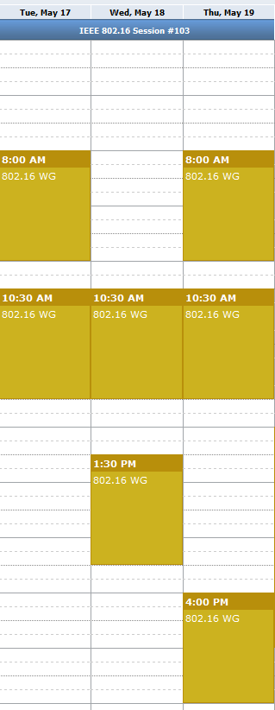
Meeting Plan for Week
802.16 WG
  Tuesday AM1
  Thursday PM2
GRIDMAN TG
  Tuesday AM2
  Wednesday AM2
  Wednesday PM1
  Thursday AM1
  Thursday AM2

Slide 5
Discussion of Contributions
Documents reviewed
  16-16-0029-01-Gcon
  16-16-0030-00-Gcon

Slide 6
Possible Project Plan and Milestones
May 2016 Planning, TOC, Requirements, Call for Proposals (July 1)
July 2016 Discussion of Contributions
Sept 2016 Draft Development
Nov 2016 Draft Development, WG Letter Ballot
Mar 2017 Start Sponsor Ballot
July 2017 Forward to RevCom

Slide 7
Review of Requirements
Contributed documents that may contain relevant requirements:
  802.16-15-0010-01-Gcon: Narrowband Ad-Hoc Status Update Tim Godfrey (EPRI)
  802.16-15-0020-00-Gcon: Narrowband Requirements Tim Godfrey (EPRI)
  802.16-16-0001-00-Gcon: 802.16/802.24 Tutorial: Proposed 802.16s Narrowband Project Tim Godfrey (EPRI)
  802.16-16-0029-01-Gcon: 802.16s Air Interface Considerations Menashe Shahar (Full Spectrum)

Slide 8
Development of System Requirements Document (SRD)
The task group agrees to develop an SRD
The SRD will define the requirements for the amendment
The SRD will be developed based on current and future contributions, and edited into a single document.
  Doug Gray is the editor of the SRD
The SRD can be edited with the agreement of the task group.

Slide 9
Review of Draft SRD
Draft SRD is posted as 802.16-16-0034r1
https://mentor.ieee.org/802.16/dcn/16/16-16-0034-01-000s-draft-p802-16s-system-requirements-document.docx

Slide 10
Development of Call for Contributions
Call for Contributions posted as 802.16-16-0035r0
CFC will be revised to remove “draft” notice before forwarding notice to reflector on 1 July

Slide 11
Teleconference
GRIDMAN teleconference planned for
Thursday 6/30/2016 at 12:00 Pacific, 3pm Eastern
Agenda
    Provide update of Standards Board actions on PAR authorization
    Review 802.16s Call for Contributions (CFC)
    Discuss agenda for July Plenary and possible contributions
    Provide information for new participants regarding meeting logistics, mailing lists, documentation, etc.

