Slide 1

  802.16 GRIDMAN Task Group Closing Report- Session #105
[IEEE 802.16 Mentor Presentation Template (Rev. 0)]
Document Number:
  IEEE 802. 16-16-0057-00-000s
  Date Submitted:
  15 Sept 2016
Source:
  Tim Godfrey Voice:
  EPRI E-mail:
  *<http://standards.ieee.org/faqs/affiliationFAQ.html>
Re:
Base Contribution:
  N/A
Purpose:
  Session #105 Task Group Closing Report (September 2016)
Notice:
  This document does not represent the agreed views of the IEEE 802.16 Working Group or any of its subgroups. It represents only the views of the participants listed in the “Source(s)” field above. It is offered as a basis for discussion. It is not binding on the contributor(s), who reserve(s) the right to add, amend or withdraw material contained herein.
Copyright Policy:
  The contributor is familiar with the IEEE-SA Copyright Policy <http://standards.ieee.org/IPR/copyrightpolicy.html>.
Patent Policy:
  The contributor is familiar with the IEEE-SA Patent Policy and Procedures:
      <http://standards.ieee.org/guides/bylaws/sect6-7.html#6> and <http://standards.ieee.org/guides/opman/sect6.html#6.3>.
  Further information is located at <http://standards.ieee.org/board/pat/pat-material.html> and <http://standards.ieee.org/board/pat >.

Slide 2
GRIDMAN Discussion Items
Link to Agenda
Review of System Requirements Document
Review Contributions
Develop System Design Document (SDD)

Slide 3
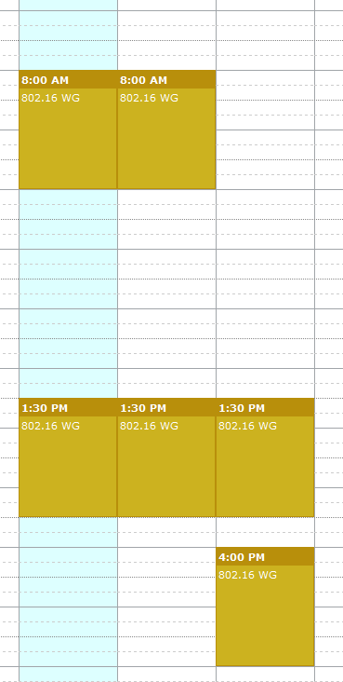
Meeting Plan for Week
802.16 WG
  Tuesday AM1
  Thursday PM2
GRIDMAN TG (802.16s)
  Tuesday PM1
  Wednesday AM1
  Wednesday PM1
  Thursday PM1

Slide 4
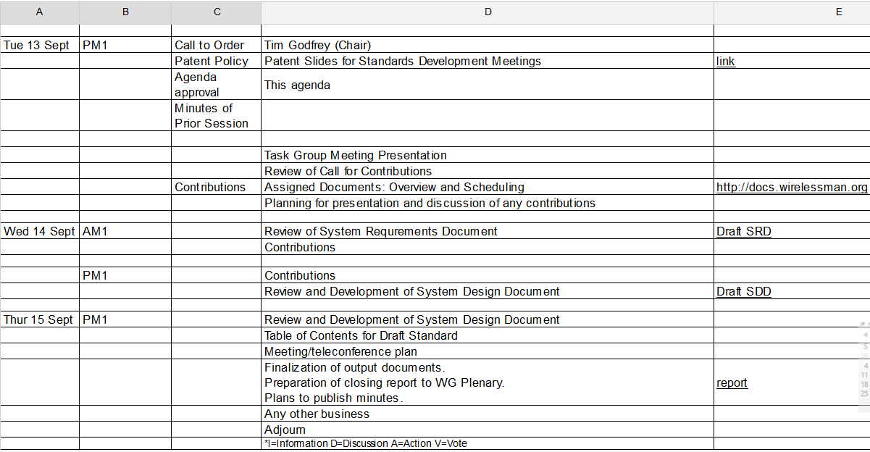
Agenda
From docs.google.com

Slide 5
Project Plan and Milestones
Sept 2016 SDD Development
Nov 2016 SDD, Draft Development
Jan 2016 Draft Development, WG Letter Ballot
Mar 2017 Comment Resolution, recirc,
Conditional Sponsor Ballot
May 2017 Comment resolution, recirculation
July 2017 Forward to RevCom

Slide 6
Contributions for Sept 2016
Evaluation of Alternatives for 1 MHz Channels (Doug Gray) 16-16-37r2
Proposed PHY Layer Parameters for IEEE 802.16s (Menashe Shahar) 16-16-39r1
MAC Overhead Calculator (Menashe Shahar) 16-16-49r0
Benefits of Specific PHY Layer Parameters to Support 1MHz Channels (Doug Gray) 16-16-47r1
Proposed MAC Changes (Menashe Shahar) 16-16-51r0

Slide 7
Development and Editing of Draft SRD
Draft SRD was updated to 802.16-16-34r3

Slide 8
Discussion Notes: Proposed PHY Layer Parameters for IEEE 802.16s 16-16-39r1
Discuss how fine of resolution we want to specify parameters for channel width, sampling clock, etc.
3 cases
  Full sampling clock: 1 MHz, 500 KHz
  Reduced sampling clock: 250 KHz and below
Preambles:
  Need alignment of preamble for 500, 250, 125, 100 KHz
  Calls for disassociating preamble from sectorID and IDcell
  Allow preamble to be transmitted over consecutive subcarriers.
CDMA codes:
  Extend by transmitting over multiple symbols as needed to fit
  Reduce chance of collisions in case of large numbers of connected SS

Slide 9
802.16-16-0047r1 Discussion
Option 3, 1 MHz BW example, matches proposal in 0039r3.

Slide 10
802.16-16-0047r1 Discussion
Option 12, cyclic prefix modification
  Reduce cyclic prefix: # OFDMA Symbols per Frame 38 (with reduced prefix: 41) (in case of 5 mS Frame)
CP is one additional variable parameter to consider in SDD

Slide 11
Development of SDD
Based on contributions and discussion, SDD was updated to 802.16-16-0044r4

Slide 12
Accomplishments at September meeting
Meeting presentation in 802.16-16-0050-02
Updated SRD to 802.16-16-0034r3
Reviewed contributions
Developed SDD
  Version at end of meeting 802.16-16-0044r4
Updated Call for Contributions
  Comments and contributions related to SDD
  Document 802.16-16-0035-03-000s-call-for-contributions-project-802-16s

Slide 13
Tentative Agenda for November
Review contributions
Discussion and Updates on SRD and SDD
Approve SDD as system description baseline
Develop Table of Contents framework for Draft
Consider text proposals for Draft

Slide 14
TG Closing
Plan for November
  Finalize and approve SDD (802.16-16-0044r4 or subsequent) defining technical approach
    There are a number of “TBD” items for comment and contribution
  Assignment of Technical Editor
  Develop Table of Contents / Draft Framework
Updated Call for Contributions 802.16-16-0035r3
  Text proposals for adoption into the SDD
Conference call for coordination
  Select date: Thursday, October 20, 9:00 PDT / 12:00 EDT / 18:00 CEST
  To be announced on reflector
Adjourn

