Slide 1
IEEE 802.18 Tutorial
Rich Kennedy
Director, Global Spectrum Strategy
Hewlett Packard Enterprise
July 10, 2017

Slide 2
Agenda
IEEE 802.18 – The RR-TAG
History
IEEE 802.18 Charter
Regulatory
Looking to the Future

Slide 3
IEEE 802.18 - The Radio Regulatory Technical Advisory Group
IEEE 802 includes four wireless technology standards groups
  802.11 Wireless Local Area Networks (WLAN)
  802.15 Wireless Personal Area Networks (WPAN)
  802.16 Wireless Metropolitan Area Networks (WMAN)
  802.22 Wireless Regional Area Networks (WRAN)
These groups develop the standards that drive the development of wireless technologies operating in Radio Frequency (RF) spectrum
Use of the RF spectrum is regulated by governmental bodies to protect licensed and authorized license-exempt users
IEEE 802.18 provides guidance for the standards development process, and works with government regulators to ensure that spectrum is available to support the technologies based on the standards

Slide 4
History
The TAG was started in January 2002 by Vic Hayes, with its first formal meeting in July of the same year
  Charter approved in March 2002 (see next slide)
  Chair was Carl Stevenson (Agere)
  Focusing on the upcoming 2003 World Radiocommunication Conference (WRC-03)

Slide 5
Charter for the Radio Regulatory TAG Approved during Formation
To encourage collaborative participation in the radio regulatory process by members of the TAG including official representatives from the relevant Working Groups
To prepare, review, and submit balanced position statements on radio regulatory matters for those Working Groups responsible for producing standards for radio devices and to fairly reflect all points of view
To serve as the official communications channel between the 802 WGs and TAGs and other standards and industry bodies on radio regulatory matters
  To liaise and seek cooperative relationships on radio regulatory matters of mutual interest with other standards and industry bodies
To serve as the official communications channel between the 802 WGs and TAGs and regulatory agencies and spectrum management bodies
  To establish and maintain contacts within, and understand the processes for interaction with, radio regulatory and spectrum management bodies
To liaise with such co-existence groups as may exist in the 802 domain on radio regulatory matters

Slide 6
Regulatory
Regulations are specific to countries and regions
In general terms, regulations of the EU (ETSI) and the US (FCC) are the model for most national regulations
As wireless device transmissions do not obey national boundaries, the International Telecommunications Union (ITU) makes rules and negotiates treaties to deal with regulatory difference between bordering countries, and provides Recommendations to guide global harmonization

Slide 7
ETSI-based Rules Dominate World Economies
Rank | Country | 2020 GDP ($B)* | Delta | FCC or ETSI
 | World | 149,464 | 144% | N/A
1 | China (PRC) | 28,920 | 174% | ETSI
2 | Unites States | 22,294 | 134% | FCC
3 | India | 12,706 | 187% | ETSI
4 | Japan | 5,512 | 117%
5 | Germany | 4,514 | 124% | ETSI
6 | Russia | 3,998 | 114%
7 | Brazil | 3,827 | 119% | FCC
8 | Indonesia | 4,103 | 163%
9 | France | 3,159 | 124% | ETSI
10 | United Kingdom | 3,250 | 132% | ETSI
11 | Mexico | 2,844 | 137% | FCC
12 | Italy | 2,519 | 119% | ETSI
13 | South Korea | 2,408 | 142%
14 | Saudia Arabia | 2,124 | 139% | ETSI
15 | Turkey | 2,043 | 141% | ETSI
16 | Canada | 1,982 | 129% | FCC
17 | Spain | 1,990 | 130% | ETSI
18 | Nigeria | 1,525 | 157% | ETSI
19 | Iran | 1,866 | 146% | ETSI
20 | Australia | 1,440 | 137%
5 GHz Regulations in 2020 based on:
ETSI Rules $55,908B
FCC Rules $30,947B
*IMF Projected - http://www.imf.org/external/pubs/ft/weo/2015/02/weodata/index.aspx

Slide 8
ETSI vs FCC

Slide 9
The Spectrum Crunch Is Coming
Regulators worldwide know that with spectrum being a finite resource, changes are needed to support the future
  Interference cause by devices “listening outside their band” is no longer acceptable
    Ofcom test in 2014 showed that band 40 LTE was interfering with low-cost Wi-Fi in 2.4 GHz
    In spite of sharp LTE TX filters, poor Wi-Fi RX filtering created an interference condition
  Spectrum efficiency will soon become a critical factor
  Low-cost consumer grade device makers will not meet the grade
Carrier profits are falling, and Wi-Fi is a cause
  The vast majority of mobile data is over Wi-Fi
  Controlling the full wireless ecosystem is their goal; metering and billing end-to-end is in their plans
  They send their hordes to standards meeting to ensure this future; Wi-Fi industry is not up to this challenge
Wi-Fi future is in doubt
  3GPP wants available spectrum denoted as IMT-2020, where Wi-Fi will not be allowed access

Slide 10



Global Radio Regulators
The International Telecommunications Union (ITU)
Asia-Pacific Telecommunity (APT)
Arab Spectrum Management Group (ASMG)
African Telecommunications Union (ATU)
European Conference of Postal and Telecommunications Administrations (CEPT)
Inter-American Telecommunications Commission (CITEL)
[Russia] Regional Commonwealth in the Field of Communications (RCC)
The US Federal Communications Commission (FCC)

Slide 11
ITU-R Recommendations
ITU-R Recommendations constitute a set of international technical standards developed by the Radiocommunication Sector (formerly CCIR) of the ITU. They are the result of studies undertaken by Radiocommunication Study Groups
ITU-R Recommendations are approved by ITU Member States. Their implementation is not mandatory; however, as they are developed by experts from administrations, operators, the industry and other organizations dealing with radiocommunication matters from all over the world, they enjoy a high reputation and are implemented worldwide.
  WRC-2003 opened segments of the 5 GHz band, yet even today parts of the world still have not enabled them

Slide 12
World Radio Conferences
World Radiocommunication Conferences (WRC) are held every three to four years to review, and, if necessary, revise the Radio Regulations, the international treaty governing the use of the radio-frequency spectrum and the geostationary-satellite and non-geostationary-satellite orbits
The general scope of the agenda of World Radiocommunication Conferences is established four to six years in advance, with the final agenda set by the ITU Council two years before the conference, with the concurrence of a majority of Member States

Slide 13
WRC-15 Findings re the 5 GHz Bands for WRC-19
Conduct studies with a view to identify potential WAS/RLAN* mitigation techniques to facilitate sharing with incumbent systems:
  in the frequency bands 5 150-5 350 MHz, 5 350-5 470 MHz, 5 725-5 850 MHz and 5 850-5 925 MHz, while ensuring the protection of incumbent services including their current and planned use
    This is a re-study of 5150-5350 MHz, i.e. changes may be necessary to hold it
    This is a new study of 5350-5470 and 5725-5850 MHz, i.e. possible gains
  in the frequency band 5 150-5 350 MHz with the possibility of enabling outdoor WAS/RLAN operations including possible associated conditions;
    Outdoor use of this band would be ideal for automotive use, but Mobile Satellite Services (MSS) and Earth Exploration Satellite Services (EESS) interference mitigation is required
*Wireless Access Systems/Radio Local Area Networks

Slide 14
WRC-15 Findings re the 5 GHz Bands for WRC-19
Conduct detailed sharing and compatibility studies, including mitigation techniques, between WAS/RLAN and incumbent services
  in the frequency band 5 725-5 850 MHz with a view to enabling a mobile service allocation to accommodate WAS/RLAN use;
    This is a new study of 5725-5850 MHz, sharing with FSS (probable exclusion zones)
  in the frequency band 5 850-5 925 MHz with a view to accommodating WAS/RLAN use under the existing primary mobile service allocation while not imposing any additional constraints on the existing services,
    This is a new study of 5850-5925, sharing with ITS and road tolling
    Detect and vacate and/or SAS required
Positive outcomes could increase available spectrum to 775 MHz contiguous
Negative outcomes could reduce overall available 5 GHz spectrum

Slide 15
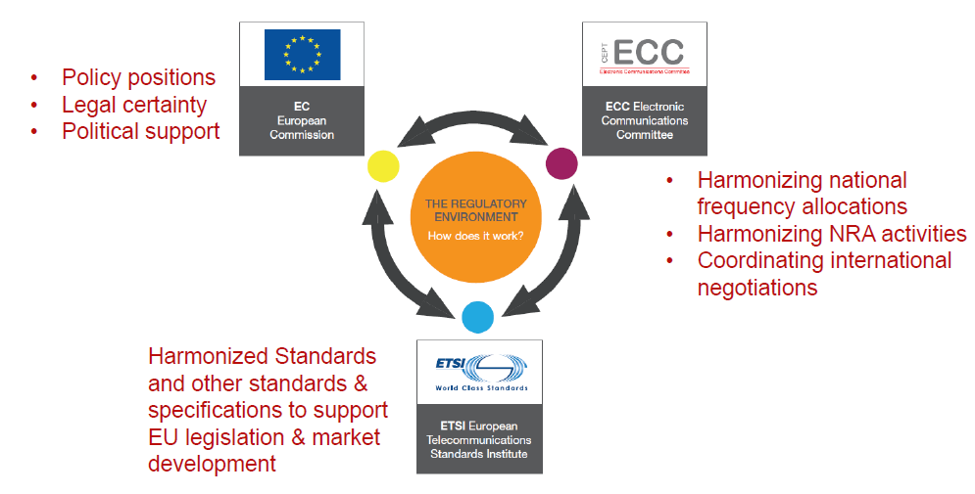
EU Environment for Radio Equipment & Spectrum
We monitor Frequency Management and Spectrum Engineering as a prelude to regulations, via Wi-Fi Alliance and IEEE 802.18
Our primary focus is ETSI, where the regulations are written

Slide 16
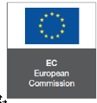

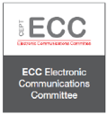

EMEA
European Commission (EC)
  Directives
  Mandates
CEPT
  48 European countries cooperating to regulate posts, radio, spectrum and communications networks
ECC
  The ECC considers and develops policies on electronic communications activities in European context, taking account of European and international legislations and regulations
ETSI
  ETSI, the European Telecommunications Standards Institute, produces globally-applicable standards for Information and Communications Technologies (ICT), including fixed, mobile, radio, converged, broadcast and Internet technologies.

Slide 17
EMEA - EU – ECC and ETSI
Electronic Communications Committee
  Conference Preparatory Group (CPG)
  Working Group Frequency Management (WGFM)
  Working Group Spectrum Engineering (WGSE)
European Telecommunications Standards Institute
  Develop and revise Harmonised Standards / European Norms (ENs)
  EMC and Radio Spectrum Matters (ERM)
    EN 300 328 (2.4 GHz)
    EN 300 220 (<1 GHz)
  Broadband Radio Access Networks (BRAN)
    EN 301 893 (5 GHz)
    EN 302 567 (60 GHz)
    EN 301 598 (TVWS)
  Regulations adopted by regulatory domains around the world

Slide 18
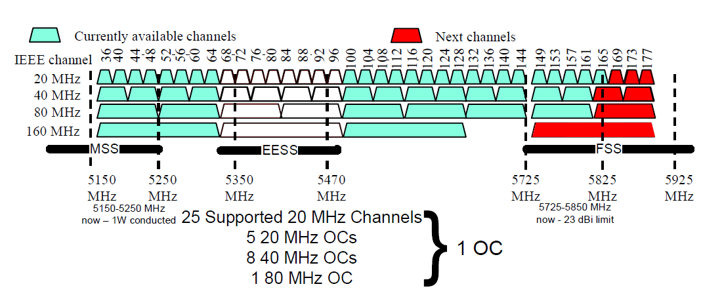
5 GHz Spectrum in the EU
Mobile Satellite Service (MSS)
Earth Exploration Satellite Service (EESS)
Fixed Satellite Service (FSS)

Slide 19
European Mandate for 5 GHz WAS/RLAN Spectrum
In September 2013, the European Commission issued a mandate to study the opening of additional spectrum in the 5 GHz range to enable contiguous spectrum from 5150 MHz all to 5925 MHz
  MANDATE TO CEPT TO STUDY AND IDENTIFY HARMONISED COMPATIBILITY AND SHARING CONDITIONS FOR WIRELESS ACCESS SYSTEMS INCLUDING RADIO LOCAL AREA NETWORKS IN THE BANDS 5350-5470MHZ AND 5725-5925MHZ ('WAS/RLAN EXTENSION BANDS') FOR THE PROVISION OF WIRELESS BROADBAND SERVICES
This mandate initiated work in the CEPT to produce the reports A and B according to the timeline provided in the Mandate
  Report A (SE24 WI52) has been completed.
  Report B has to be delivered by July 2016. The European Commission, together with member states have agreed to move the deadline for Report B until end of 2016.
The most challenging part of this work: Proof of sharing with ITS and sharing with Satellite Services (both EESS and FSS) is possible.

Slide 20
The New Radio Equipment Directive (RED)
Requirements for placing telecom products on the market in the EU
ETSI Harmonised Standards
Products self-certified
The R&TTE Directive (1999/5/CE) expired June 12, 2017
New RED adds
  Health and Safety requirements:
    Health : as per EMF recommendation 1999/519/CE
    Safety : as per Directive 2006/95/CE (LVD) but with the lower limit removed
    EMC requirements: as per Directive 2004/108/CE
  Radio equipment needs to effectively use the spectrum and not cause harmful interference; includes receiver requirements

Slide 21


EMEA - Others
ASMG
  The Arab Spectrum Management Group was established in 1997 to cooperate in the field of Spectrum Management by sharing and exchanging views on the emerging radio communication aspects as well as to manage and coordinate all issues related to Spectrum Management, World Radiocommunications Conferences and other spectrum matters between Arab States
  22 member ASMG countries
ATU
  Founded in Kinshasa in 1977 as a specialized agency of the Organization of African Unity (OAU) now African Union (AU) in the field of telecommunications, ATU is the leading continental organization fostering developments of information and communications technologies infrastructure and services.

Slide 22


Americas – FCC and CITEL
The Federal Communications Commission regulates interstate and international communications by radio, television, wire, satellite and cable in all 50 states, the District of Columbia and U.S. territories. An independent U.S. government agency overseen by Congress, the commission is the United States' primary authority for communications law, regulation and technological innovation. In its work facing economic opportunities and challenges associated with rapidly evolving advances in global communications
CITEL Vision
  The full integration of the American States into the Global Information Society, with a view to enabling and accelerating social, economic and environmentally sustainable development for all the region’s inhabitants through the development of telecommunications and information and communication technologies (ICTs).
CITEL Mission
  To facilitate and promote the integral and sustainable development of interoperable, innovative and reliable telecommunications/ICTs in the Americas, under the principles of universality, equity and affordability.

Slide 23
Americas - FCC
Chairman and four Commissioners
  Political appointees (currently two Republican, one Democrats)
  Office of Engineering Technology provides technical advice
  Technical Certification Bodies (TCBs) test and review compliance test data
    Until recently, FCC lab performed critical testing
Regulations development
  Notice of Inquiry (NOI) usually starts the process; general information gathering
  Notice of Proposed Rule Making (NPRM) specific questions for public comment
  (Further NPRM if needed, i.e. need more information)
  Report & Order (R&O) includes wording for the Code of Federal Regulations (CFR)
  (Second R&O if needed)

Slide 24
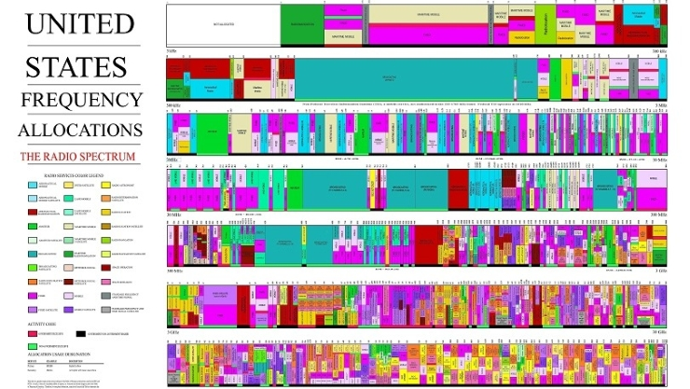
The US Frequency Chart
Unallocated spectrum is in white
(3-6 kHz)

Slide 25
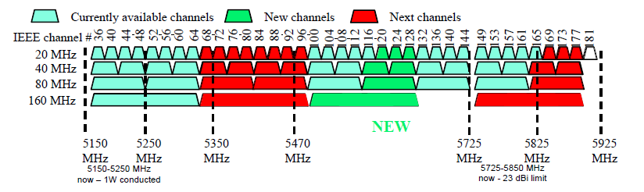
5 GHz Spectrum in the US
Now Closed

Slide 26

APAC
APT Wireless Group
  The APT is an intergovernmental organization that operates in conjunction with telecom service providers, manufacturers of communications equipment, and research and development organizations active in the field of communication, information and innovation technologies
  38 member APAC countries

Slide 27
The Unlicensed / License-exempt Bands
2400-2483.5 MHz ISM band
  US: 1W EIRP
  EU: 100mW EIRP
3550-3700 MHz band (US only) – licensed by rule
  Citizen Band Radio Service (CBRS)
  General Authorized Access 3-level sharing with incumbents and Priority Access Licensees
5150-5250 MHz band (US U-NII-1)
  EU: Low power, indoor only
  US: 1W EIRP, 125mW EIRP outdoor max EIRP above 30 degrees
5250-5350 MHz band (US U-NII-2a)
  DFS required
5470-5725 MHz band (US U-NII-2c)
5725-5850 MHz band (US U-NII-3)
  US: 1W EIRP
  EU: 25mW SRD
5850-5925 MHz band (US U-NII-4)

Slide 28
Other Unlicensed and IoT
Relatively narrow-band technologies have other options
  Parts of the 800-900 MHz band are available in some regions for unlicensed use
    US 902-928 MHz
    EU 863-870 MHz low duty cycle, low power, some specific applications
    EU 915-921 MHz bandwidth (600kHz) and duty cycle (1%) limits
    Spotty availability globally
  SigFox Ultra Narrow Band for low bit-rate (~5kbps), long range communications
    Primarily EU in 868 MHz band
    Thousands of base stations in Western Europe
  LoRaWAN long range low power applications
    Sensor networks
    Utility networks
TV White Spaces (IEEE 802.11af, 802.22)
  Use of “white spaces” between TV channels, hampered by no global standard for TV spectrum, regulators consideration for LTE auction revenues
  Backhaul where broadcast TV is sparse, e.g. developing countries, US farmland

Slide 29
Looking to the Future
US and EU studying license-exempt/unlicensed sharing of the 6 GHz band
  FCC looking at 5925-7125 MHz
  WGFM/WGSE/ETSI looking at 5925-6425 MHz
US legislation would open 3700-4200 MHz band
But wireless applications continue to grow unabated
  Old rules and allocations must be reviewed
  Better and more sharing methods must be explored
“Internet access for all” still billions short of its goal
  Wireless backhaul is the only option in many regions
IEEE 802.18 will continue to support the standardization all of the wireless LAN/MAN/RAN technologies in this effort
  Fairness in the use of spectrum
  Outreach to regulators to drive the needed actions

Slide 30
Questions?

