Slide 1
UWB in IEEE 802 and
FCC Mid-band Spectrum NOI
Authors:

Slide 2
INTRODUCTION
PURPOSE:
To make 802.18 more aware of UWB,
particularly in the context of the FCC NOI*
“Expanding Flexible Use in Mid-Band
Spectrum Between 3.7 and 24 GHz”,
and request that the response from 802.18
takes 802 UWB use into account
* (FC 17-104, Released: August 3, 2017)

Slide 3
UWB in IEEE 802
IEEE 802.15.4a (2007) and IEEE 802.15.6 (2012)
  500 MHz channel bandwidths, (with some up to 1.3 GHz in 4a)
  FCC power limits -41.3 dBm/MHz
  Low band C_{f} = 3494.4, 3993.6 and 4492.8 MHz
  High band C_{f} = 6489.6, 6988.8, 7488.0, 7987.2, ….9984.0 MHz
IEEE 802.15.4f (2012)
  Three channels C_{f} = 6489.6, 6988.8 and 7987.2 MHz
IEEE 802.15.8 – currently at sponsor ballot stage
  Low band from 3100 to 4800 MHz
  High band from 6000 to 10600 MHz

Slide 4
Related UWB standards
ISO/IEC 24730-61 and ISO/IEC 24730-62
  Real time locating systems (RTLS) – UWB air interface standards
  Based on IEEE 802.15.4f and IEEE 802.15.4a modulations

Slide 5
IEEE 802.15.4a (2007) band plan
Figure from
IEEE 802.15.4 (2015)

Slide 6
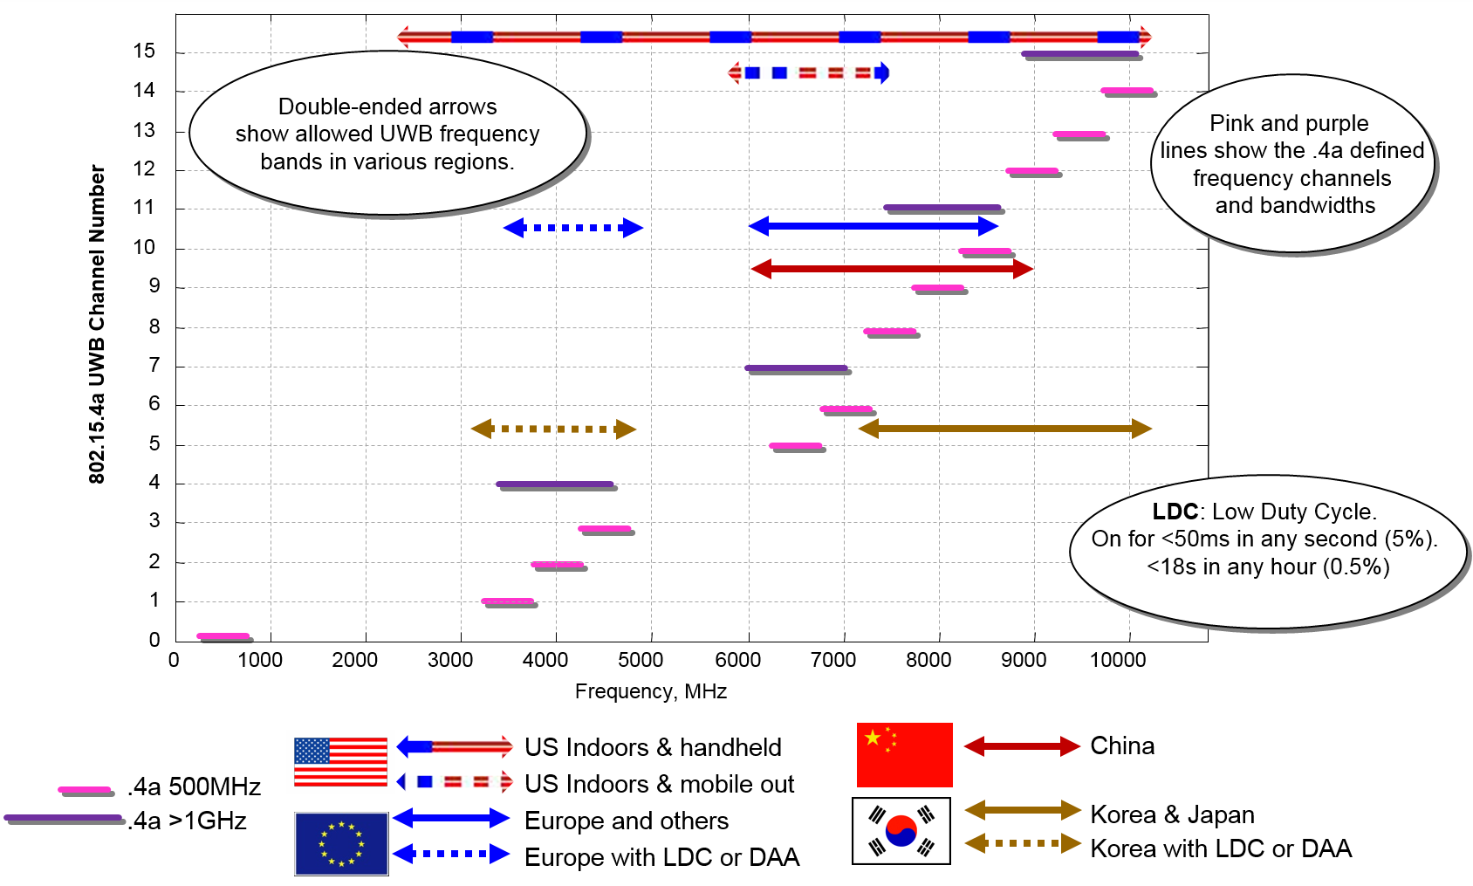
UWB regulations
TX power limits typically -41.3 dBm/MHz

Slide 7
UWB regulations
TX power limits typically -41.3 dBm/MHz
Channel Band at 6.5 GHz is especially useful for its coverage of EU, USA and China, and its USA mobile outdoor use as per FCC PART 15 .250

Slide 8
Applicable FCC regulations
FCC PART 15 - RADIO FREQUENCY DEVICES
Subpart C - Intentional Radiators
  Section 15.250 Operation of wideband systems within the band 5925-7250 MHz
Subpart F – Ultra-Wideband Operation
  Section 15.517 Technical requirements for indoor UWB systems.
  Section 15.519 Technical requirements for hand held UWB systems.
  Section 15.521 Technical requirements applicable to all UWB devices.

Slide 9
CONCERNS
If the bands used by UWB above 6 GHz are opened for additional unlicensed use, with modulations like 802.11, then these have the potential to be significant interferers to current UWB applications
Current applications are predominately real-time location including
  robot guidance, factory automation, hospitals,
  position based secure access control for automotive keyless entry, buildings and residential
  safety of personnel around vehicles, machines and robots
The market is seeded with numerous design-ins, and manufacturing underway in over a hundred different application areas
Deployments are to grow sharply in the next couple of years.

Slide 10
Conclusion
802.18 should not treat the FCC’s NOI as a positive move, but rather in its response bear testament to 802’s concerns about the negative effect on UWB applications should the bands 5.925-6.425 GHz and/or 6.425-7.125 GHz be opened

Slide 11
Thank you

