Slide 1
IEEE 802.18 RR-TAG
ISUS Ad-hoc Agenda
Date: 28 November 2022
Authors:
Name | Affiliation | E-mail
Amelia Andersdotter | Sky Group/Comcast | amelia.ieee@andersdotter.cc
Amelia Andersdotter (Sky group/ Comcast)

Slide 2
Meeting called to order
Ad-hoc Leader:
Chair: Amelia Andersdotter (Sky Group/Comcast)
Attendance:
  Stuart Kerry (OK-Brit, Self)
Secretary
Amelia Andersdotter (Sky group/ Comcast)
Notes:
<number>

Slide 3
IEEE 802 required notices
Affiliation: https://standards.ieee.org/faqs/affiliation/
Be sure to announce your name, affiliation, employer, and clients the first time you speak.
Anti-Trust: https://standards.ieee.org/wp-content/uploads/2022/02/antitrust.pdf
IEEE 802 WG Policies and Procedures: http://www.ieee802.org/devdocs.shtml
Patent & administration: https://standards.ieee.org/about/sasb/patcom/materials.html
Copyright notice: https://standards.ieee.org/faqs/copyrights/#1
Call for essential patents & copyright notice: the RR-TAG does not do standards, though all should be aware.
IEEE SA Standards Board Operations Manual: https://standards.ieee.org/about/policies/opman/
Amelia Andersdotter (Sky group/ Comcast)
Notes:
<number>

Slide 4
Other Guidelines for IEEE WG Meetings
All IEEE SA standards meetings shall be conducted in compliance with all applicable laws, including antitrust and competition laws.
  Don’t discuss the interpretation, validity, or essentiality of patents/patent claims.
  Don’t discuss specific license rates, terms, or conditions.
    Relative costs of different technical approaches that include relative costs of patent licensing terms may be discussed in standards development meetings.
      Technical considerations remain the primary focus
  Don’t discuss or engage in the fixing of product prices, allocation of customers, or division of sales markets.
  Don’t discuss the status or substance of ongoing or threatened litigation.
  Don't be silent if inappropriate topics are discussed. Formally object to the discussion immediately.
---------------------------------------------------------------
For more details, see IEEE SA Standards Board Operations Manual, clause 5.3.10 and Antitrust and Competition Policy: What You Need to Know at https://standards.ieee.org/wp-content/uploads/2022/02/antitrust.pdf
If you have questions, contact the IEEE SA Standards Board Patent Committee Administrator
at patcom@ieee.org
Amelia Andersdotter (Sky group/ Comcast)
Notes:
<number>

Slide 5
Participant behavior in IEEE SA activities is guided by the IEEE Codes of Ethics & Conduct
All participants in IEEE SA activities are expected to adhere to the core principles underlying the:
  IEEE Code of Ethics
  IEEE Code of Conduct
The core principles of the IEEE Codes of Ethics & Conduct are to:
  Uphold the highest standards of integrity, responsible behavior, and ethical and professional conduct
  Treat people fairly and with respect, to not engage in harassment, discrimination, or retaliation, and to protect people's privacy.
  Avoid injuring others, their property, reputation, or employment by false or malicious action
The most recent versions of these Codes are available at http://www.ieee.org/about/corporate/governance
Amelia Andersdotter (Sky group/ Comcast)

Slide 6
Participants in the IEEE SA “individual process” shall act independently of others, including employers
The IEEE SA Standards Board Bylaws require that “participants in the IEEE standards development individual process shall act based on their qualifications and experience”
This means participants:
  Shall act & vote based on their personal & independent opinions derived from their expertise, knowledge, and qualifications
  Shall not act or vote based on any obligation to or any direction from any other person or organization, including an employer or client, regardless of any external commitments, agreements, contracts, or orders
  Shall not direct the actions or votes of other participants or retaliate against other participants for fulfilling their responsibility to act & vote based on their personal & independently developed opinions
By participating in standards activities using the “individual process”, you are deemed to accept these requirements; if you are unable to satisfy these requirements then you shall immediately cease any participation (and would ask you to please leave the call or meeting.)
Amelia Andersdotter (Sky group/ Comcast)

Slide 7
IEEE-SA standards activities shall allow the fair & equitable consideration of all viewpoints
The IEEE SA Standards Board Bylaws (clause 5.2.1.3) specifies that “the standards development process shall not be dominated by any single interest category, individual, or organization”
– This means no participant may exercise “authority, leadership, or influence by reason of superior leverage, strength, or representation to the exclusion of fair and equitable consideration of other viewpoints” or “to hinder the progress of the standards development activity”
This rule applies equally to those participating in a standards development project and to that project’s leadership group
Any person who reasonably suspects that dominance is occurring in a standards development project is encouraged to bring the issue to the attention of the Standards Committee or the project’s IEEE SA Program Manager
Amelia Andersdotter (Sky group/ Comcast)

Slide 8
Housekeeping reminder
Weekly meeting reminders:
  IMAT is NOT being used for this session
  Please ensure that the following information is listed correctly when joining the call: “FIRST NAME LAST NAME, Affiliation” (e.g., Stuart Kerry, OK-Brit; Self)
  Remember to state your name and affiliation the FIRST TIME you speak
  When you want to be on the queue, please type “Q” or “q” in the chat window
  Remember to mute when not speaking, thank you
Amelia Andersdotter (Sky group/ Comcast)

Slide 9
Agenda
Meeting called to order
Administrative items (IEEE 802 and IEEE SA required notices)
Housekeeping reminder
Review and approve agenda
Review minutes from 15 August 2022 call (doc nr. 18-22-0099r0)
Discussion items
  New meeting time, strawpoll results
  Scope statement reminder
  Skeletal draft: 18-22-0087r0
Any other business
Adjourn
Amelia Andersdotter (Sky group/ Comcast)

Slide 10
Administrative motions
Motion #1 (Internal): To approve the meeting minutes of the 15 August 2022 ISUS call as shown in the document 18-22-0099r0, with editorial privilege for the ISUS Chair.
Moved:
Seconded:
Discussion: None.
Vote: Approved with unanimous consent.
Amelia Andersdotter (Sky group/ Comcast)

Slide 11
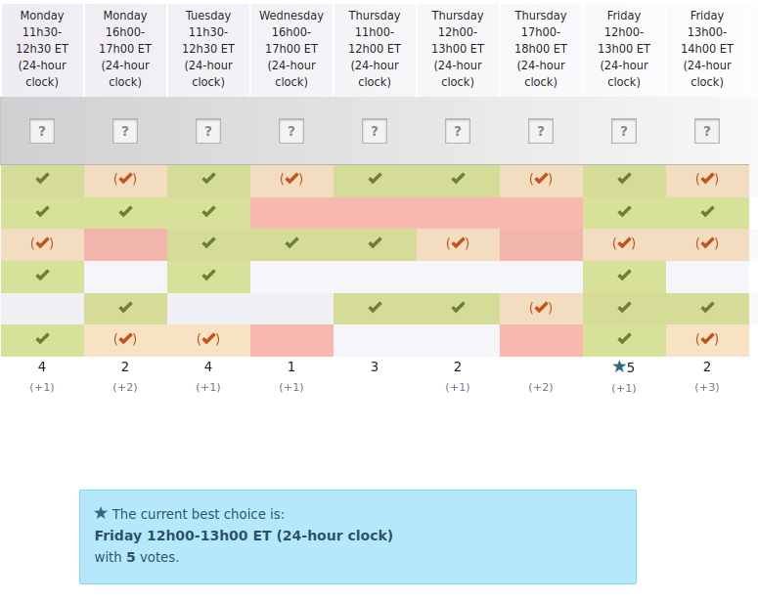
New meeting time, strawpoll results
Proposal: ISUS Ad-hoc Chair will put request to IEEE 802.18 Chair to change meeting time for ISUS Ad-hoc to Friday 12-13 ET.
Amelia Andersdotter (Sky group/ Comcast)

Slide 12
Scope statement for rewriting (for completion)
Scope statement
    We're expecting IEEE-SA/IEEE Public Policy team to be doing high-level engagement (e.g. with non-technical experts in various governance institutions, governments, ministers, political appointees, etc.). Our document should support these activities with respect to representing the work of IEEE 802 technologies that use unlicensed spectrum.
    We expect that subject matter experts from IEEE 802.18 RR-TAG (or similar) will, also in future, be the ones engaging with technical sub-groups at e.g. regulators on specific substance matter issues that require more in-depth knowledge about specific technical developments, requirements or market needs.
    This would suggest the document that we produce in ISUS should be a "high level overview" of the IEEE 802 family of standards:
      We will need references to some particularly strong brand-names, like Wi-Fi (footnote? Paragraph? Make the connection)
      Other 802 technologies may not be as strongly connected with particular consumer brands. They are more often embedded in consumer products but not identified with a particular consumer brand
      Link applications with technologies from 802 --> they use spectrum, share spectrum, co-existence, highlight 802.19 etc
      Unlicensed spectrum technologies is something that we contribute to and use and we provide technologies in this space, everyone is using them
Amelia Andersdotter (Sky group/ Comcast)

Slide 13
Any other business
Anything?
Amelia Andersdotter (Sky group/ Comcast)

Slide 14
Adjourn
Attendance today:
  On-line:
  Voters:
Next teleconference
  Scheduled for XXXXX. Call-in info available in slide-deck 18-16-0038r28 or in the Google Calendar.
Adjourn:
  Any objection to adjourn?
  Adjourned at
Amelia Andersdotter (Sky group/ Comcast)

