Slide 1
Spectrum Sensibilities: 2030 and Beyond
Date: 2023-07-11
Authors:
Notes:
September 2012

Slide 2
Abstract
The global RF Spectrum maps represent decades of adding licensees and unlicensed/license-exempt spectrum based on available spaces, not optimization of the applications being supported. This has led to a very complicated, and in some cases unworkable situations for new technologies.
The only real solution for the next 100 years is a full study of how best to remap spectrum based on today’s understanding of spectrum needs, application optimization and continued technology advances.
This is a first look – please provide your feedback and get involved!
Notes:
September 2012
doc.: IEEE 802.11-09/0301r1
March 2009
Stephen McCann, RIM
Page 2

Slide 3
Introduction
Where we are and how we got here
Technology limitations, not sensibility misconfigured the RF spectrum
Change is hard (and time-consuming and expensive)
Cost of reconfiguration vs cost of not doing it
Positive trends
Things to consider for remapping
Spectrum inventory is the first step
Notes:
September 2012
doc.: IEEE 802.11-09/0301r1
March 2009
Stephen McCann, RIM
Page 3

Slide 4
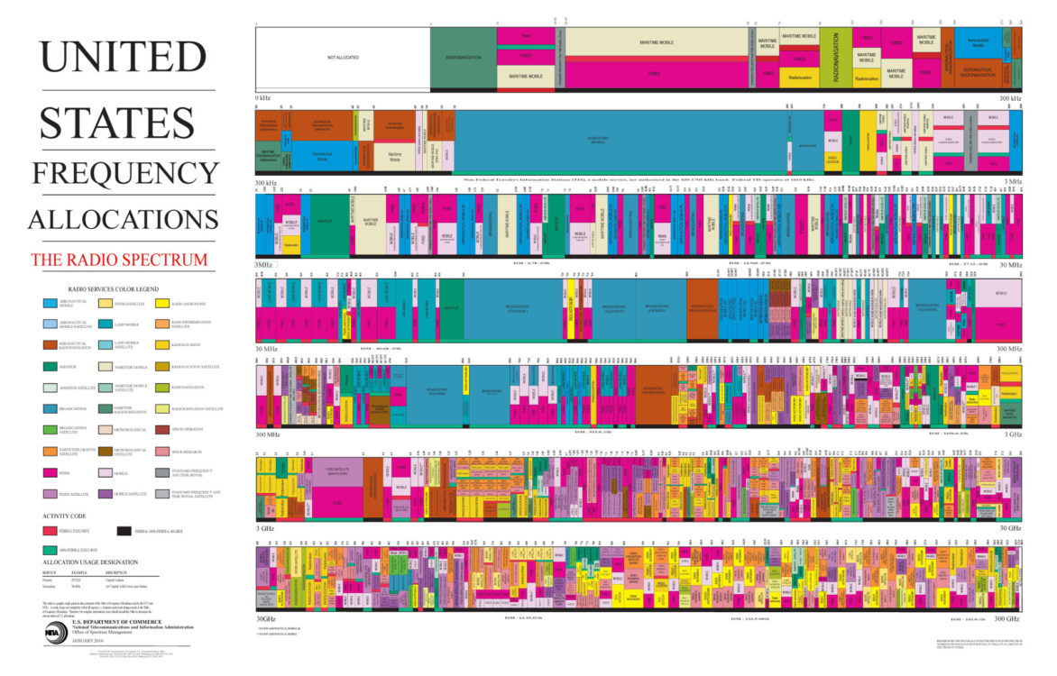
Where We Are and How We Got Here
This is the US map, but it is typical for global spectrum maps
Is there any way this leads to effective spectrum utilization for the next 100 years?
When will technology advancements be “ground stopped” (air stopped) by zero available spectrum?
Spectrum sharing must be accompanied by application considerations and remapping for proper placement of radio technologies

Slide 5
Where We Are and How We Got Here [2]
Technology limitations misconfigured the RF spectrum of today
  Early mapping was based on what was possible, not the long-term, application-dependencies
    Legacy allocations are not all optimized based on application requirements
    Regulators are forced to work around this status quo
  This will continue to cripple technologies looking for appropriate frequency bands unless we consider remapping
As technology makes terahertz an option, there is room to set this right

Slide 6
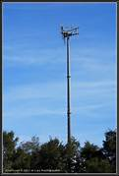
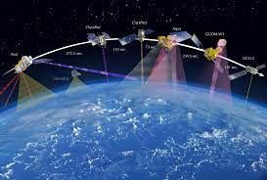



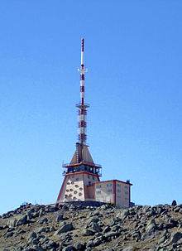

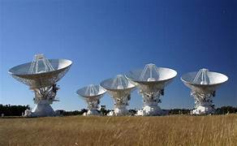
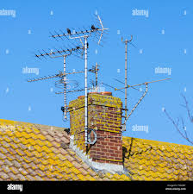
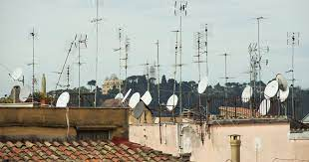
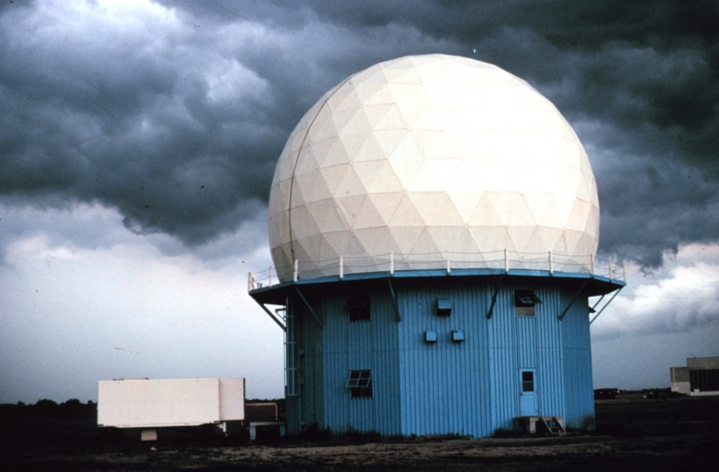

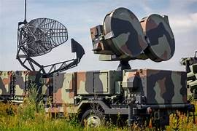


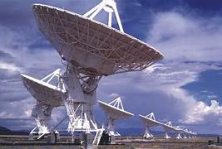
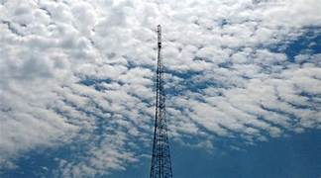
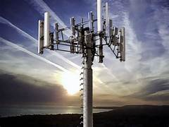
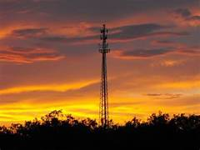



Just a Few of the Residents

Slide 7
Climate Change and Spectrum Congestion
In the 1970s automotive exhaust was seen as a hazard for long-term climate stability
  Instead of moving away from fossil fuels, the internal combustion engine was kludged almost to death
  It took 40 years for the automotive industry to start making the needed big change to EVs, etc.
RF Spectrum stability is on a parallel course
  In the 20 years since I began this campaign, various kludges have substituted for a long-term solution and created problems for spectrum users
    e.g., Recent 5G C-band startup created hazard for radio altimeters onboard commercial aircraft
  Regulators must start sooner than 2030 to address the coming spectrum “ground stop”

Slide 8
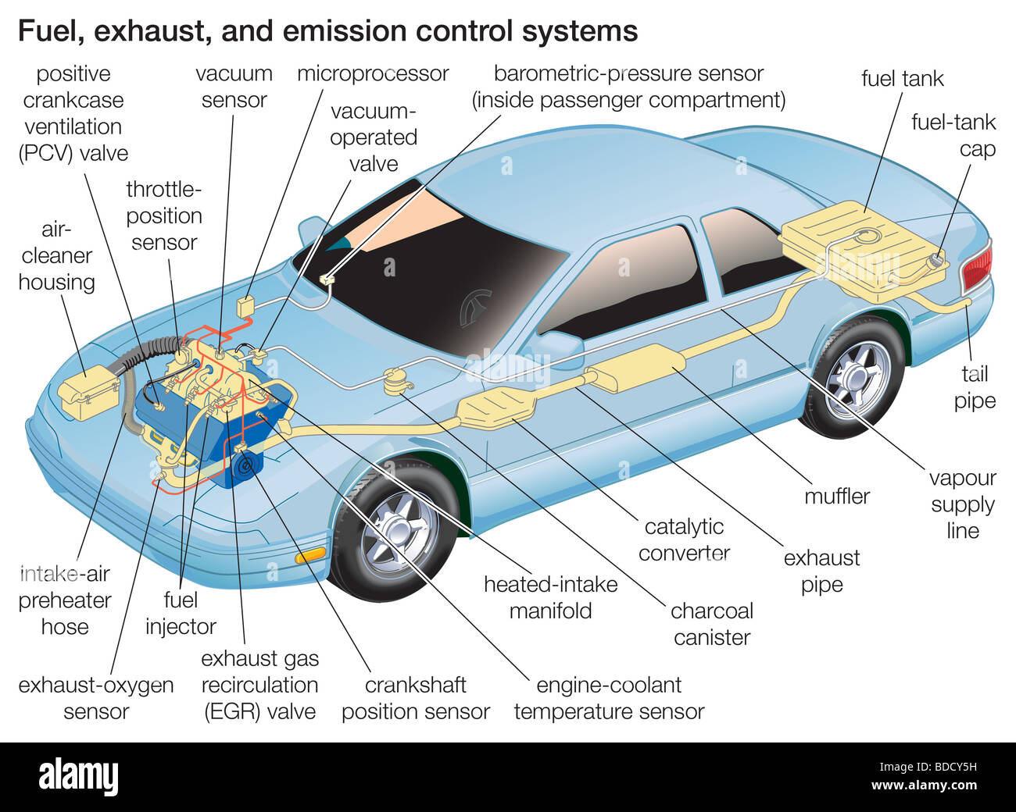
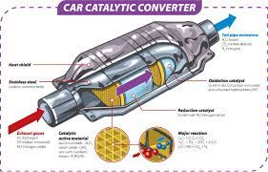
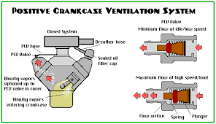
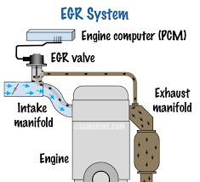
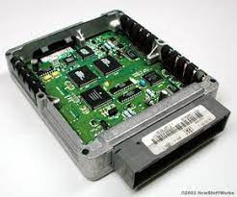
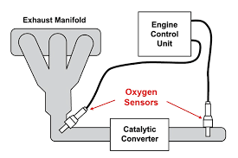
The Evolution of Automotive Pollution Control
Pollution control “enhancements”…
…and many more.

Slide 9
Positive Spectrum Trends
Dynamic Spectrum Access
  Geolocation databases define transmission contours for more effective spatial sharing
    Temporal sharing can also be accommodated
  Active sensing networks provide non-interference certainty
Understanding what comprises “harmful” interference
  Avoids blind keep-out zones
Beamforming/beam-steering (802.11/5G/Starlink/…) will become a multiplier for spatial sharing
  Regulators can look to this gain as the technology advances

Slide 10
Things To Consider for Remapping
Link range requirements
Link capacity requirements
Link resilience requirements
Need for 24/7/365 operation
Transmitter power source
  Mains vs batteries vs solar vs ambient, etc.
Is fiber a better alternative?
Broadcast vs Internet
Point-to-Point vs Internet
Ideas?

Slide 11
Spectrum Inventory is the First Step
Regulators must first know what actually is on the map
  Transmitters still in useful operation or gone
    e.g. Transmitters wiped off the geographical map by Katrina remained on the spectrum map
  Expired experimental licenses
Review legacy protection criteria
  No interference or no harmful interference
When will the system’s useful life end?

Slide 12
Proposed Way Forward
The time is NOW for long-term thinking and planning (a 40-year plan?)
  This will be hard, expensive and very time consuming, but is the only real solution for future efficient spectrum utilization

Slide 13
Motion
IEEE 802.18 Radio Regulatory TAG agrees that a study of the remapping of the RF spectrum is needed to support better, more efficient utilization and enabling greater capacity for the future.
Moved by: Rich Kennedy
Seconded by:
Vote: Y N A

Slide 14
References
United States FCC Frequency Allocation Chart
  https://www.ntia.doc.gov/files/ntia/publications/2003-allochrt.pdf
United States FCC Table of Frequency Allocations
  https://transition.fcc.gov/oet/spectrum/table/fcctable.pdf
European Union Table of Frequency Allocations
  https://www.itu.int/ITU-D/study_groups/SGP_2002-2006/JGRES09/CEPT2.pdf
ITU-R Radio Regulations
  https://www.itu.int/dms_pub/itu-r/opb/reg/R-REG-RR-2020-ZPF-E.zip
ITU-R Guidelines for the preparation of a NATIONAL TABLE OF REQUENCY ALLOCATIONS (NTFA)
  https://www.itu.int/en/ITU-D/Spectrum-Broadcasting/Documents/Publications/Guidelines-NTFA-E.pdf

