Slide 1
FCC KDB Basics
29 July 2025
Authors:
Name | Affiliation | Phone | email
Pelin Salem | Cisco Systems |  | pmohamed@cisco.com

Slide 2
What is ‘FCC KDB’?
  The ’FCC KDB’ stands for the Federal Communications Commission Knowledge Database.
  Purpose:
    Guidance on Equipment Authorization: KDBs provide guidance on the procedures and measurement methods for equipment authorization, which ensures that devices comply with FCC rules to prevent interference.
    Assist the Public: The information in the KDBs help individuals and companies understand and follow the FCC's requirements related to obtaining equipment authorization.
    Measurement Procedures: KDBs offer details on measurement procedures for devices subject to FCC rules, such as specific absorption rate (SAR) testing for RF exposure.
  Inquiry Responses and Publications: FCC staff publications and replies to inquiries from the KDB are based on one or more of the following criteria:
    Responses that the FCC staff have given to prior inquiries.
    Staff guidance of the Commission's rules and policies.
    Prior staff practices

Slide 3
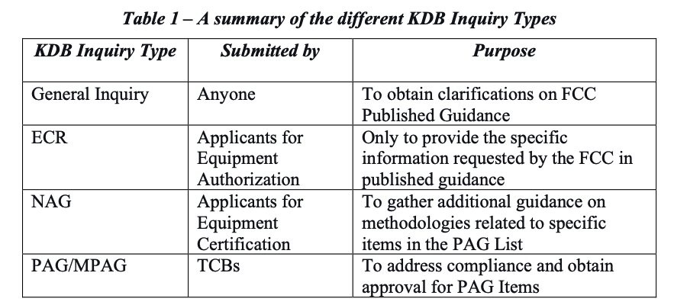
KDB Inquiry Types
(e.g., 987594 D01 U-NII 6GHz General Requirements v03r01)
(e.g., Persistent Inquiry Approval for 6GHz SP w/AFC)
(New Application Guidance and submitted pre-PAG)
Sources: 951290 D01 Equipment Compliance Review v01
  1.2 Publication Update & Administrative Notes (FCC, April 2023)
Why KDBs Exist?
  To provide rapid, flexible guidance as technologies evolve faster than normal rulemaking.
  To ensure uniform interpretation across TCBs and test labs.
  To fill gaps and clarify ambiguities in FCC rules.
  To provide test methodologies for compliance.

Slide 4
PAG and ECR
  Certain complex or unique situations may require a PAG or an ECR inquiry before submitting an equipment authorization application.
  ECR inquiries are required when published FCC guidance specifies submitting a KDB inquiry for certain types of equipment or scenarios (951290 D01 Equipment Compliance Review v01).
  ECR inquiries require a top-down approach, clearly describing the device, the reason for the ECR, how the device is compliant, and a summary/concluding remarks, all organized with clear pointers to attachments.
  For example, ECR inquiries with a Persistent Inquiry Acceptance (PIA) sub-category allow referencing previously accepted inquiries for cases where compliance demonstrations apply to various devices sharing the same technology or method, provided the initial PIA inquiry received FCC acceptance.
  ECR inquiries under the Wireless Power Transfer (WPT) sub-category are required for certain devices before proceeding with equipment authorization, based on KDB 680106 guidance.
  ECR inquiries with a Minimum RF Exposure Compliance Distance (RFXd) sub-category are needed when the device's use case doesn't always guarantee the minimum RF exposure separation distance considered during testing. The applicant describes the use conditions and measures taken to minimize non-compliance.
  An ECR under the Data Referencing (D-R) sub-category is used for related devices to obtain FCC acceptance for classifying them as "variants" of a "reference" device and for the spot-check test plan.

Slide 5
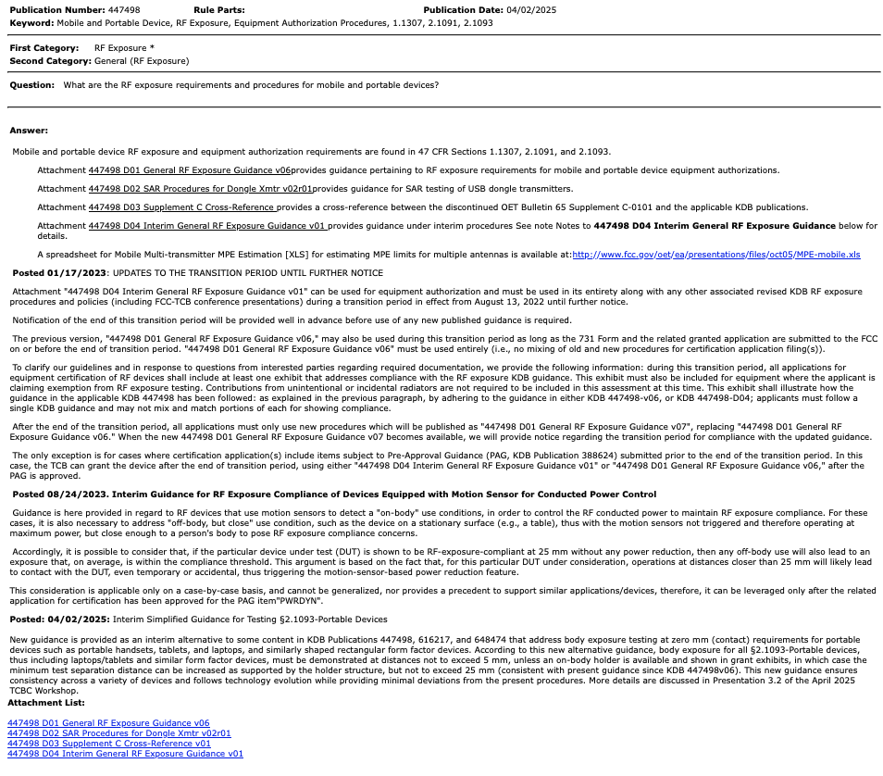
KDB Numbering and Structure
  Format: [Number] [Document Name] [Version]
    Example: 447498 D01 General RF Exposure Guidance v06
  Documents may have multiple attachments.
  Revisions tracked by version number and revision date

Slide 6
What Are KDBs Used For?
  Determine test procedures (e.g., for U-NII DFS, RF exposure, etc.)
  Understand compliance expectations.
  Reference FCC’s accepted interpretations.
  File inquiries when guidance is unclear or not available.
  Use by:
    TCBs, test labs, manufacturers, consultants
KDB System Overview
  Website: https://www.fcc.gov/kdb
  Features:
    Keyword & rule part search
    Browse public documents
    Submit & track inquiries (TCB login required)
    Access most-cited documents

Slide 7
KDB Inquiry Process
  Who can submit?: Everyone can submit, but typically TCBs, grantees, or authorized consultants do the submissions
  Process:
  Login to KDB Portal
  Draft detailed inquiry with rule reference and background
  Select private or public
  Submit and monitor for response
  Responses may:
    Be issued privately (confidential)
    Become part of public guidance
  Tip: Inquiries must be precise, justified, and scoped narrowly.

Slide 8
Examples of Common KDBs
KDB# | Topic | Usage
447498 | Mobile and Portable Device, RF Exposure, Equipment Authorization Procedures, 1.1307, 2.1091, 2.1093 | This KDB provides guidance on assessing RF exposure from mobile and portable devices.
248227 | RF Exposure (SAR) measurements for Wi-Fi, IEEE 802.11 | 248227 D01 802 11 Wi-Fi SAR v02r02 provides guidance on performing SAR measurements for devices incorporating IEEE 802.11 wireless transmitters.
996369 | Module Certification Guide, 15.212 | This KDB provides FCC guidance for equipment authorization of transmitter module devices, and equipment that incorporates transmitter modules
987594 | U-NII 6GHz General Requirements | This KDB specifies the requirements for obtaining a certification for U-NII 6 GHz devices operating in the 5.925-7.125 GHz band under Part 15, Subpart E.
616217 | SAR evaluation considerations for laptop, notebook, netbook and tablet computers | This KDB specifies the SAR evaluation procedures for laptop and tablet computers.
594280 | Software security requirements for SDR and non-SDR devices | This KDB specifies the requirements for software security implementation for U-NII devices operating under Part 15 rules and provides guidance on what much be submitted in a certification application filing.

Slide 9
KDBs and Certification
  TCBs rely on KDBs to ensure consistent decisions
  Certification test reports must reference applicable KDBs
  Deviations from KDBs:
    Must be explicitly justified
    May require waivers or direct FCC approval
  Important: Following KDBs is not optional in certification workflows.
When to use KDB inquiries?
  If the rule is ambiguous or not elaborative on your specific case
  Existing KDBs do not address new technologies
  You are seeking clarification before testing
  Seeking policy position for standardization
  Example: Inquiry on VLP P2P operation in the entire 6GHz band before the rules were finalized in Report and Order.

Slide 10
What happens if applicable KDB Publications are not listed?
From a TCB reviewer view:
    If a testing KDB is not listed in a test report, TCB raises a question to the filing entity (manufacturer or test lab) to address the gap.
    If going thru a PAG review, the FCC sends the application back to TCB with questions.
    If an operational KDB is not addressed in the manual, it will also be flagged during TCB review such as missing reference warnings.
    All other operational issues that are not addressed by the filing entity will be addressed by FCC.
Just because KDBs are not rules, it does not mean FCC cannot enforce them, especially if the guidance is based on discussions from the actual rulemaking procedures.
Additionally, as KDBs are formally published they have been vetted thru the FCC review process. Test procedures such as DFS may in fact have Public Notices stating adoption for use.
Not using a specific KDB for testing or certification must be further justified and reviewed by the FCC on a case-by-case basis. This usually requires approval upfront before testing has started.

Slide 11
KDBs and Test Standards
KDBs are in part incorporated in the rules. They are technical opinions, however majority of the testing KDBs are either referenced or incorporated verbatim in the IEEE ANSI C63 test standards such as:
      C63.4 (EMC),
      C63.10 (Licensed Exempt radios) and
      C63.26 (Licensed radios).
ANSI C63 standards are incorporated into the FCC rules by reference and are required to be used for testing. As such when using the C63 standards one is required to address the testing issues raised in any updated KDB that is referenced for use in C63.10.
As for the DFS procedure, it is mentioned in C63.10 (2020) but more importantly incorporated into the ITU-R test procedures for DFS evaluation under US requirements.
As far as CBP, the current test procedure is based on the technology evaluated and any changes would need to be evaluated & approved by both the 6Ghz industry workgroup and the FCC.
The current procedures are there to protect the primary incumbents of the band and any changes would require incumbent agreement, as well.

Slide 12
Best practices for using KDBs
  DOs:
    Use latest version of KDB publications
    Always ensure that the test lab is up to date on the applicable KDB publications and rules
    Cross-reference all relevant rule parts and list all applicable testing standards
    File an ECR inquiry early in development
  DON’Ts:
    Don’t copy/paste from expired or outdated KDBs
    Don’t guess on DFS, SAR, or UWB test plans – confirm with FCC
    Don’t ask FCC to approve full test plans – only ask targeted questions

Slide 13
Summary
  KDBs publications and inquiries are essential tools for compliance
  They bridge the gap between law and practice
  They enable faster response to innovation than rulemaking
  Every certified product likely involves at least one KDB inquiry
  If you work with TCBs or spectrum policy – know your KDBs
  Consequences of Ignoring KDBs:
    Certification may be rejected or delayed
    Post-market issues: Device recalls, enforcement, audits
    Inconsistent application = Regulatory risk for the manufacturer and TCB.
  In conclusion:
    FCC rules tell the industry, test labs, and TCBs what to do.
    KDB publications tell us how to do it and how the FCC expects to see it done for certification.

Slide 14
Resources
  FCC KDB Portal: https://apps.fcc.gov/oetcf/kdb/index.cfm
  FCC Part 2 rules: https://www.ecfr.gov/current/title-47/chapter-I/subchapter-A/part-2
  FCC Part 15 rules: https://www.ecfr.gov/current/title-47/chapter-I/subchapter-A/part-15?toc=1
  To Submit KDB Inquiries:
    - TCB KDB Inquiry https://apps.fcc.gov/tcb/ValidateLogin.do (Login Required)
    - Public Access KDB Inquiry: https://apps.fcc.gov/oetcf/kdb/forms/InquiryForm.cfm
  OET Laboratory Division Equipment Authorization System (EAS): https://apps.fcc.gov/oetcf/eas/index.cfm

Slide 15
APPENDIX

Slide 16
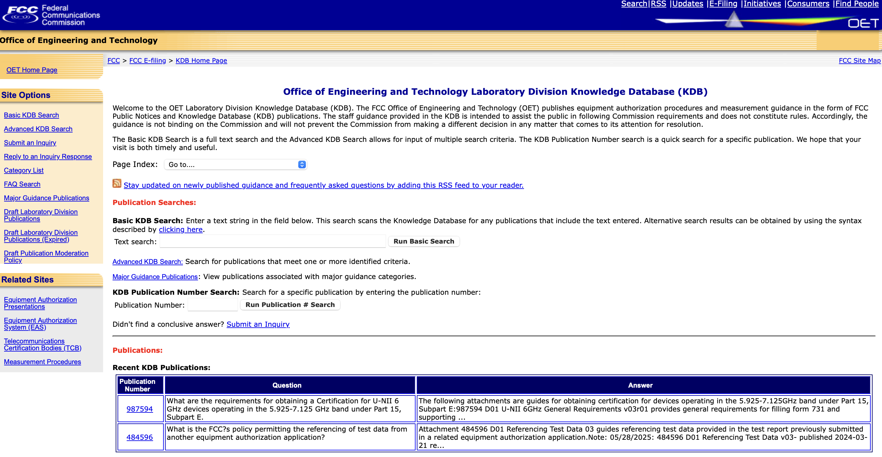
KDB System Access
https://apps.fcc.gov/oetcf/kdb/

Slide 17
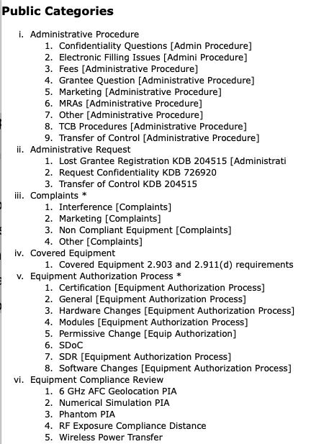
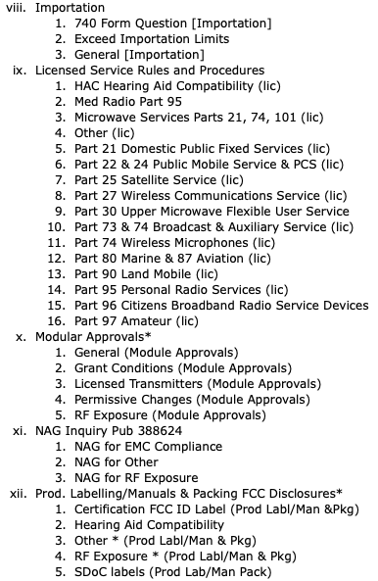
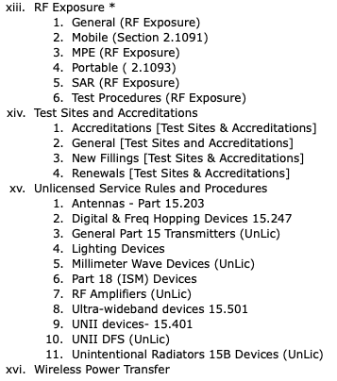
Public Access Categories
* vi is reserved for FCC use only.

Slide 18
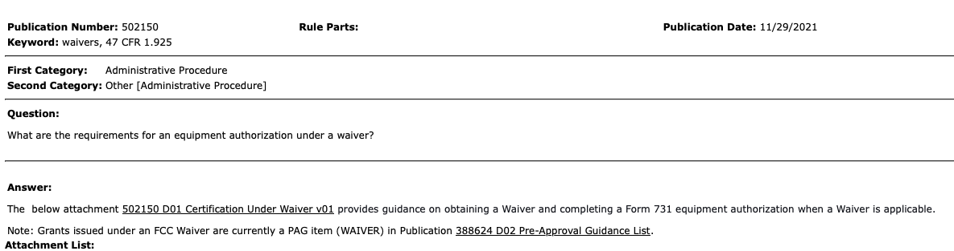
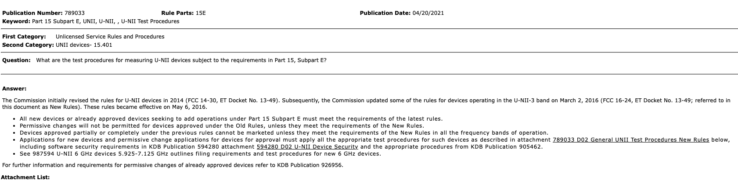
Major Guidance KDB Examples (1/2)
502150 D01 Certification Under Waiver v01
789033 D02 General UNII Test Procedures New Rules v02r01

Slide 19
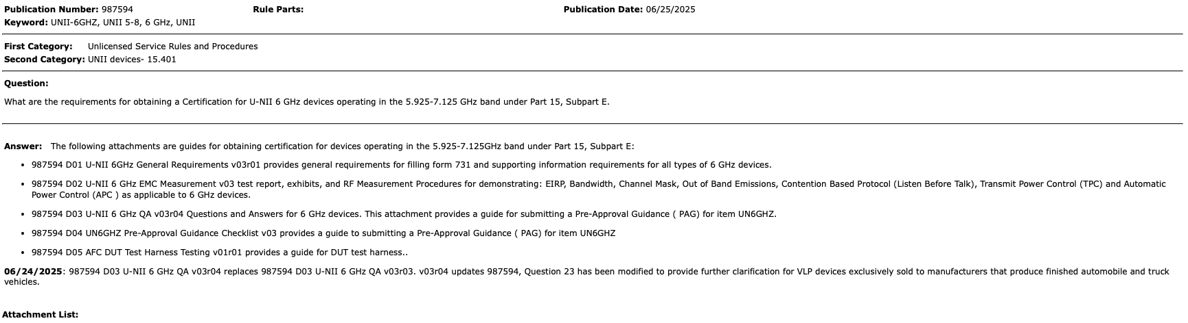
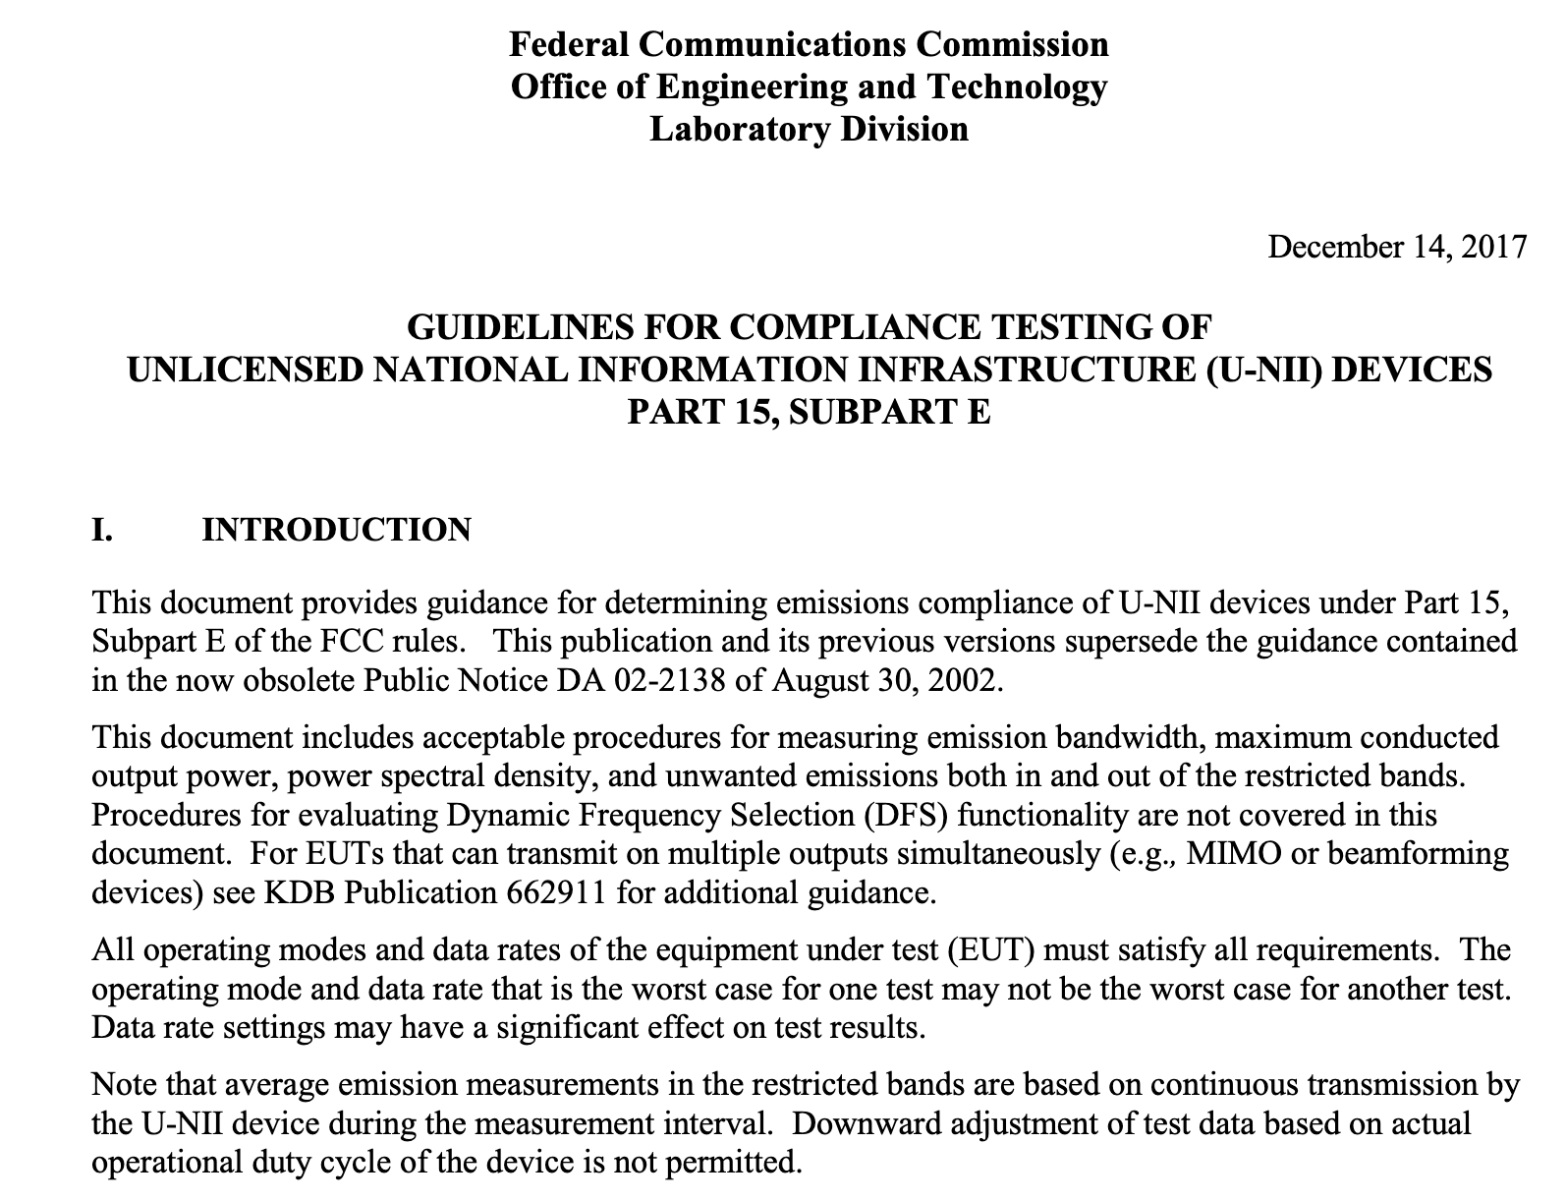
Major Guidance KDB Examples (2/2)
987594 D01 U-NII 6GHz General Requirements v03r01
987594 D02 U-NII 6 GHz EMC Measurement v03
987594 D03 U-NII 6 GHz QA v03r04
987594 D04 UN6GHZ Pre-Approval Guidance Checklist v03
987594 D05 AFC DUT Test Harness Testing v01r01
789033 D02 General UNII Test Procedures New Rules v02r01

Slide 20
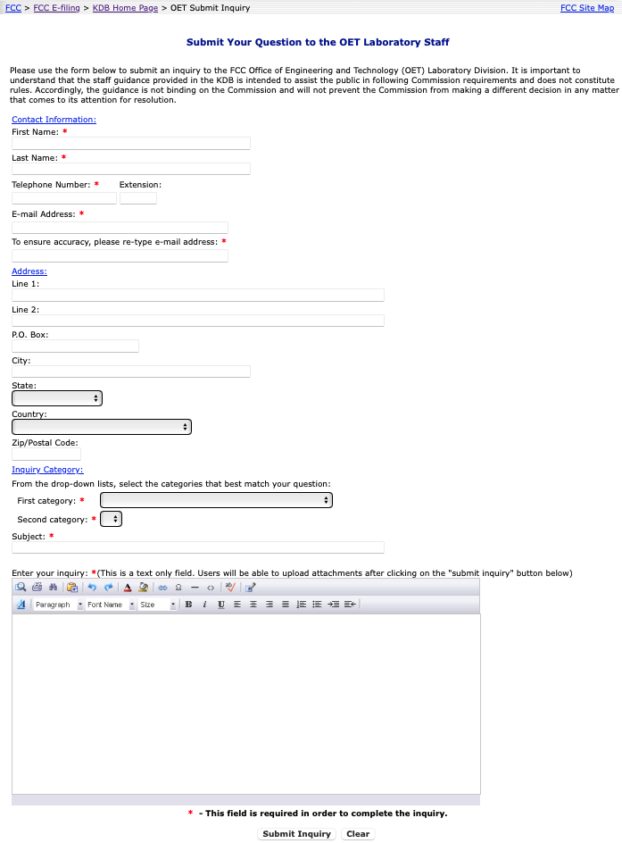
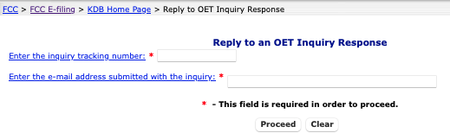
How to submit an inquiry and reply to an OET response?
  Reply to OET Inquiry Response
  Submit an inquiry

