Slide 1
Interferer discovery as one of the many coexistence system functionalities
Date: 2011-05-31
Authors:
Notice: This document has been prepared to assist IEEE 802.19. It is offered as a basis for discussion and is not binding on the contributing individual(s) or organization(s). The material in this document is subject to change in form and content after further study. The contributor(s) reserve(s) the right to add, amend or withdraw material contained herein.

Slide 2
Abstract
This presentation discusses interferer discovery, measurements and resource allocation/sharing and their relationships
Documents related to this presentation are
  19-11-0055-00-0001-discovery-of-interfering-TVBDs.docx
  19-11-0049-00-0001-full-proposal.pdf
  19-11-0005-01-0001-interference-analysis-for-channel-selection.ppt

Slide 3
  Analysis of the 19-11-0005-01-0001
The main idea:
  Phase 1 (interference analysis):
    Calculate maximum transmission power (PTx-max) of a new transmitter such that interference level at any existing receiver is below a certain level (Rxsensitivity)
    Calculate interference from any existing transmitter at a new receiver location and at each channel and accumulate the relevant interference powers to Pint-tot
  Phase 2 (channel selection):
    Select the channels which allow acceptable PTx-max => candidate channels (step one)
    Select from the candidate channels the one that has the lowest Pint-tot (step two)
    This channel is the one that is selected for the new transmitter

Slide 4
Analysis cont’d
Pairwise link analysis is used in a very similar manner as in the Nokia proposal to evaluate interfering TVBDs
  Location information also needed
  Path loss estimation with similar parameters as in our proposal
Analysis of mode I devices and multiple bandwidths open

Slide 5
Comments
  The 19-11-0005-01-0001 describes one possible way to make resource allocation
  It starts from the state in which one knows already the TVBDs that may interfere with the TVBD under study or that may be interfered by the TVBD under study
    A form of interferer discovery has been performed before the steps described in the proposal
      The task of the interferer discovery is to find those TVBDs that a TVBD under study may interfere or that may interfere the TVBD under study
    We can agree on the channel selection example described in the proposal
    The proposal doesn’t, however, cover interferer discovery that we believe should be treated separately from the resource allocations
      More on the reasons for this belief in the next slides

Slide 6
Rational behind the proposed interferer discovery in 19-11-0055-00-0001
Processes related to interference environment
  Interferer discovery
  Measurements
  Resource allocation
Each of these processes are discussed separately and shown why they are separate processes

Slide 7
Interferer discovery
Interferer discovery is done to a TVBD (mode II or fixed) e.g. when it joins the coexistence system
  Other reasons may exist as well, e.g. mode II device mobility
The purpose is to find those TVBDs that
  are in the coexistence system, and
  can interfere my TVBD or my TVBD can interfere them
    can potentially interfere each other based on capability to operate in the same frequencies
Discovery is based on estimation, not on measurements
No resource allocations yet, just a knowledge of potential interfering TVBD pairs
Note: Distribution of the interferer discovery results are beyond this presentation

Slide 8
Measurements
TVBD makes measurements to gain understanding of interference environment
  Supports later the result of interferer discovery
  Enables to find interfering sources other than the TVBDs that are found with the interferer discovery and that are not using the services of the coexistence system
  Measeurements are at least partly under control of the CM and possibly only required with some coexistence services
A CM has also other means to obtain information about environment related to the TVBDs it serves
  Communication with other CMs serving interfering TVBDs
  TVWD data base
  Etc.

Slide 9
Resource allocation
Resource allocation is the third coexistence system functionality discussed in this presentation
That’s the phase of the process or a process its own that results in resources (frequency, power, time, etc.) allocated to TVBDs and respective networks
The specification should not tie the resource allocation to other related functionalities like interferer discovery and measurements
  Reasons to initiate resource allocation may vary and differ
  The specification should not mandate certain order in the functionality but that should be left to implementers
  What matters is that the decisions are made in a unified manner (to ensure fair allocations) and the decision maker has up to date environment information

Slide 10
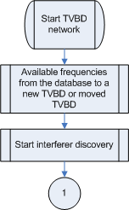
Examplary flows to 3 processes
Start of a new TVBD network or some other reason to trigger interferer discovery (e.g. mobility)

Slide 11
Flows cont’d
Event trigger

Slide 12
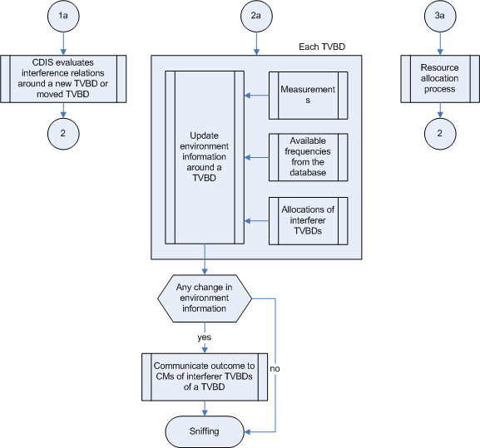
Flows cont’d
Actions in 3 processes

Slide 13
Summary
We propose an approach, where
  Interferer discovery, environment analysis and resource allocation processes are clearly separated
  Each process can be independently triggered
This approach enables several manufacturers to provide specific components to a coexistence system

