Slide 1
[Report on 802.18 Activities ]
Date: 2011-11-10
Authors:
Notice: This document has been prepared to assist IEEE 802.19. It is offered as a basis for discussion and is not binding on the contributing individual(s) or organization(s). The material in this document is subject to change in form and content after further study. The contributor(s) reserve(s) the right to add, amend or withdraw material contained herein.

Slide 2
Abstract
This document presents on-going activities in IEEE 802.18.

Slide 3
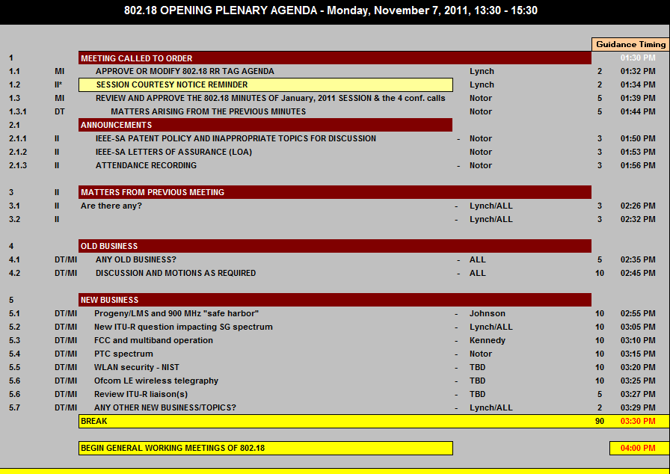
802.18 Agenda for the week

Slide 4
Recent Contributions
  “FCC_Actions_Related_to_Progeny_LMS”, by John Notor (Notor Research)
  “Comment_FCC_Progeny_M-LMS_Waiver”, by John Notor (Notor Research).
  “Comments_FCC_PTC”, by John Notor (Notor Research).
  “TVWS Regulatory Update”, by Peter Ecclesine (Cisco).
  “FCC Regulations and Multi-band Operation”, by Rich Kennedy (Research In Motion).

Slide 5
FCC Regulation and Multi-band Operation
Current situation in .11
  11ad: would like to do rapid band switching as the device get out of range.
  11af: would be beneficial from the multi-band operation
  11ai: proposed a fast initial link set up. What they want to do is to actively scan the 2.4 GHz band for available channel information in the 5 GHz band, thus saving at least 100 ms.
FCC Regulation
Outcome of the discussion: they would like to discuss with individual group about it on whether they need to feedback to FCC.

Slide 6
TVWS Regulatory Updates (1/3)
FCC TV White Spaces Spectral Mask
OFCOM TV White Space
  About 128 MHz of interleaved spectrum is available in nearly every household.
  Lower UHF 470-550 MHz, Upper UHF 614-790 MHz
    Analogue TV to be switched off October 24, 2012
  OFCOM TV white space Technical Working Group working on the rules, and OFCOM expect to issue a Statutory Instrument in 2012 – pushing back 4G spectrum auction to 4Q12 pushes back TVWS rules
  Database calculates white spaces depending on accuracy of location, device radio characteristics. To protect mobile uses, database must be checked every hour

Slide 7
TVWS Regulatory Updates (2/3)
Other countries TV White Space
  Canada allows Remote Rural Broadband Systems licensed use with up to 500W, has consultation SMSE-012-11 to align unlicensed use with FCC TVWS rules
  Finland, Singapore had TVWS trials in 2010, 2011
  Japan, Korea, South Africa expect to trial TVWS services in 2012
  ECC Report 159 sets technical and operational requirements for using TVWS by cognitive radios in EU
  CEPT SE43 Cognitive Radio Systems – White Space
  http://www.cept.org/ecc/groups/ecc/wg-se/se-43
Broadcast Band Technologies

Slide 8
TVWS Regulatory Updates (3/3)
Spectrum Politics
  Lawmakers tell regulators what to do
    The FCC reports to the US Congress, not to the Executive Branch
  Many European countries are under financial pressure
  Many 3rd world countries sell spectrum licenses to cover regulatory expenses
  US Joint Select Committee on Deficit Reduction has a $24B goal for auctioned spectrum
    Entirely likely will recommend consolidating DTV broadcasters on fewer TV channels and auction off unused spectrum
    Once Congressional Budget Office approves the auction, the projected proceeds can be spent (no waiting for the auction)
    Broadcast Broadband Plan $125B http://coalitionforfreetvandbroadband.org/?page_id=504

Slide 9
References
Document: 18-11/89r0
Document: 18-11/88r0

