Slide 1
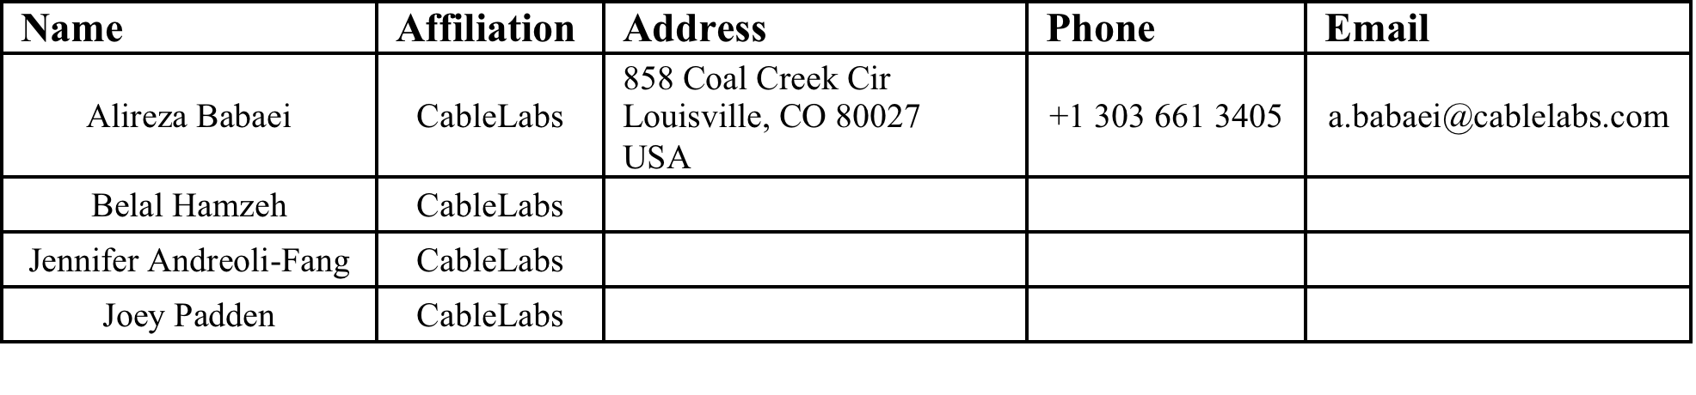
Impact of LTE in Unlicensed Spectrum on Wi-Fi
Date: 2014-07-15
Authors:

Slide 2
Abstract
This presentation provides a summary of analytical/numerical and lab test results on the impact of LTE in unlicensed spectrum on the performance of Wi-Fi networks

Slide 3
Background
3GPP is considering extending the use of LTE into the unlicensed spectrum as a seamless approach to enable traffic offload. This new approach is dubbed LTE Unlicensed (LTE-U).
LTE-U, being a centralized scheduling system, will change the ecosystem in unlicensed spectrum.
LTE-U introduces new coexistence challenges for other technologies operating in the same unlicensed bands, particularly for legacy Wi-Fi.

Slide 4
Probability of Wi-Fi Channel Access
802.11 devices follow the Listen-Before-Talk medium access mechanism and collision avoidance based on exponential backoff.
For a Wi-Fi device to have the opportunity to access the wireless medium, the quiet period between consecutive LTE transmissions (assuming that the received LTE interference level is above the CCA Energy Detect threshold) must be longer than the Wi-Fi backoff delay.
Backoff delay is random. Defining d as the random variable denoting backoff delay and L as the length of LTE-U quiet period:
  The probability of Wi-Fi grabbing the channel within an LTE-U quiet period is Pr{d<L}.

Slide 5
LTE Quiet Period
quiet period
LTE is an “almost” continuously transmitting protocol.
A Wi-Fi device needs to wait for a “quiet” period, when LTE is not transmitting, before attempting to transmit.
Even when LTE is not transmitting data, it periodically transmits a variety of Control and Reference Signals.
  LTE “quiet” period depends on the periodicity of these signals.
For FDD LTE mode, the maximum quiet period is only 215 μsec (depicted here).
In the absence of data, or when subframes are intentionally muted, maximum LTE quiet period is 3 msec in TD-LTE mode.
DL Control and Reference Signals
(LTE FDD)

Slide 6
Probability of Wi-Fi Channel Access vs. LTE Quiet Period
The cumulative distribution function (CDF) of backoff delay (d) is obtained in closed form.
  The analysis confirms that Wi-Fi will be mostly in LISTEN mode
Even with 2 Wi-Fi STAs (very light contention) and maximum LTE-U quiet period (3 msec), the chance of Wi-Fi grabbing the channel is very small (about 16%)
This probability is even smaller when the number of Wi-Fi STAs increases
Probability of channel access is the probability that a Wi-Fi device attempts to trasnmit
  Transmission attempt does not guarantee successful packet transmission

Slide 7
Lab Test Conditions
2.4 GHz Band
ISM Ch. 1 (2.412 GHz)
Conducted testing
LTE
20 MHz LTE FDD downlink frequency converted into the 2.4 GHz Band
LTE UE to setup the connection - no data passed
LTE had equal power at AP and client
Wi-Fi
1 AP and 1 Client
Wi-Fi Signal power -60 dBm (good average signal level)
DL/UL Loss was symmetrical
1 spatial stream, long guard interval (max MCS 4) or 39 Mbps
100 Mbps UDP traffic offered load
Reported throughput figures are average over 1 minute.

Slide 8

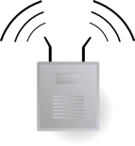

802.11n Wi-Fi vs. Rel. 8 Downlink LTE Co-Channel 20 MHz
Scenario Modeled in Lab Setup
eNodeB
Wi-Fi AP
Wi-Fi Client
LTE Interference Power vs. Wi-Fi Throughput*
Distance
Locations Fixed
Wi-Fi throughput diminishes as LTE transmission moves closer to Wi-Fi devices
With LTE power at Wi-Fi client energy detect threshold, throughput approaches zero
*Shape of curve dependent on device tested, trend is key take away

Slide 9
Coexistence with Duty Cycle LTE
Duty Cycle Period
LTE Off
LTE On
LTE On
time
Duty Cycle:
% of cycle LTE is active
Wi-Fi access gaps
when LTE is off
One popular concept for spectrum sharing is Duty Cycling
  Allow LTE to occupy the channel for fixed (or semi dynamic) percentage of time for each period
Selection of the period (in milliseconds) is critical to the performance on Wi-Fi network

Slide 10
Duty Cycle Approach- Wi-Fi Throughput
Wi-Fi throughput is consistent across LTE higher cycle periods
Wi-Fi gets <1Mbps for 10ms / 70% case
  Same as TD-LTE w/ 3 ms quiet period configuration

Slide 11
Duty Cycle Approach- Wi-Fi Delay
Light load Wi-Fi 95th percentile delay shows the real impact of duty cycle period
  Delay increases 20x, 40x, 60x or more
Mean delay follows same trend

Slide 12
Conclusions
The Listen-Before-Talk mechanism used by Wi-Fi devices coupled with continuous transmission of LTE traffic channels (hence small time gap even in the absence of data) lead to Wi-Fi users having little chance to sense a clear channel and deem it suitable for transmission.
  This is confirmed through analysis and lab testing
The Duty Cycle Approach for Coexistence of LTE and Wi-Fi provides one approach for airtime sharing between LTE and Wi-Fi
  The Wi-Fi delay increases significantly for larger duty cycle periods.

Slide 13
References
A. Babaei, J. Andreoli-Fang and B. Hamzeh, “On the Impact of LTE-U on Wi-Fi Performance,” To appear in Proceedings of IEEE PIMRC 2014.

