Slide 1
Coexistence Scenario and Use Cases
Date: 2015-01-13
Authors:
Notice: This document has been prepared to assist IEEE 802.19. It is offered as a basis for discussion and is not binding on the contributing individual(s) or organization(s). The material in this document is subject to change in form and content after further study. The contributor(s) reserve(s) the right to add, amend or withdraw material contained herein.

Slide 2
Abstract
Coexistence in Unlicensed frequency Band (CUB) Study Group (SG) was formed in the last November.
CUB SG should focus on the following coexistence use cases;
  Coexistence between managed and unmanaged Radio Access Technologies (RATs)
  Coexistence among same/different managed RATs within a single operator
  Coexistence between same managed RAT with multiple operators
  Coexistence between different managed RATs with multiple operators
CUB SG should focus on coexistence scenarios of unlicensed wireless devices operating in the specific frequency bands;
  5GHz U-NII Bands
  3.5GHz Band of United States (US).
CUB SG should provide the following solutions
  Solution for coexistence between different operators
  Unrestricted-RAT solution for any regulatory domains

Slide 3

Coexistence in TV band Whitespace (TVWS) provided by IEEE 802.19.1 system
Master Device
(AP)
IEEE 802.15.4m
Slave Device
(Terminal)
Registered Location Secure Server (RLSS)
IEEE 802.11af
Geolocation Database (GLDB)
Slave Device
(Terminal)
Master Device
(AP)
LTE-Unlicensed
Slave Device
(UE)
IEEE 802.19.1
system
Master Device
(eNB)
IEEE 802.19.1 system can manage spectrum usage of any RATs for TVWS.
weightless
Slave Device
(Terminal)
Master Device
(AP)

Slide 4
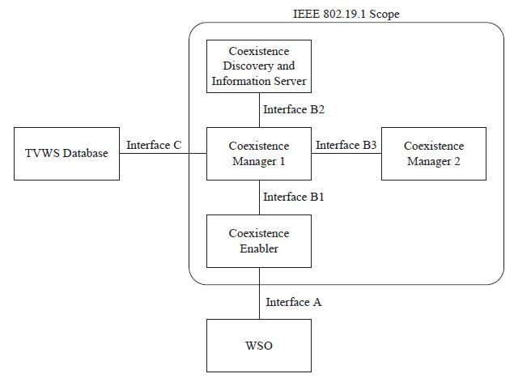
Service types defined in IEEE 802.19.1[1]
Information service
  Coexistence Manager (CM) provides the White Space Object (WSO) information about its potential neighbors including their operating frequencies, potential interference levels, etc.
Management service
  CM provides the WSO reconfiguration requests that create such configuration of this WSO that its operation is improved according to some criteria.
Interface C between a CM and a TVWS database is not defined in this standard and is implementation dependent

Slide 5
Coexistence Scenarios in the specific frequency bands
The target band of CUB SG was specified as sub 6GHz, but this is not clear.
IEEE 802.19.1 focused on coexistence among unlicensed wireless devices in TV band.
We suggest CUB SG focus on coexistence scenarios of unlicensed wireless devices in the specific bands;
  5GHz U-NII Bands
  US 3.5GHz Band

Slide 6
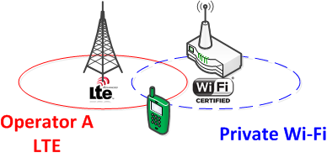
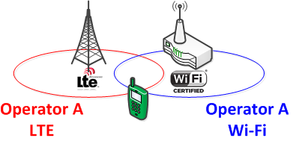
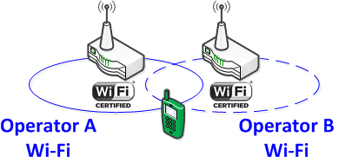
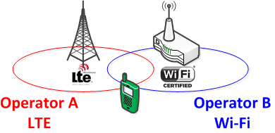
Coexistence Use Cases -System
Coexistence use cases to be studied;
  Coexistence between managed and unmanaged RATs
  Coexistence among same/different managed RATs within a single operator
  Coexistence between same managed RAT with multiple operators
  Coexistence between different managed RATs with multiple operators
1.
2.
3.
4.

Slide 7
Example 1: Coexistence between IEEE 802 system and non 802 system in 5GHz U-NII Bands
Example case
  IEEE 802 system: Wi-Fi
  Non 802 system: LTE-LAA[2]
Licensed spectrum
License-exempt spectrum
Unlicensed device (LTE small eNB)
LTE macro cell (e.g. 700MHz)
Necessary to coexist
Unlicensed device (802 system AP)
IEEE 802 system (5GHz)
LTE Small cell (5GHz)

Slide 8
Example 2: Coexistence in Generalized Authorized Access (GAA) tier in the 3.5GHz Band of US
FCC is now making new rule (i.e. Part 96) for a three-tiered authorization framework in the 3.5GHz Band to realize the Citizens Broadband Radio Service [3].
  Incumbent Access, Priority Access and GAA tiers.
In the GAA tier, wireless systems operate as unlicensed systems. IEEE 802 systems may be included in the GAA tier.
Then, IEEE 802 systems will have to coexist with various non 802 systems, not only among IEEE 802 systems.

Slide 9
Information exchange
Information sharing enables intelligent channel selection/allocation for same and/or different managed RATs
  Coexistence among different managed RATs within a single operator
    Expanding network planning to take LTE and managed Wi-Fi access points into account
  Coexistence between same managed RAT with multiple operators
    Intelligent information sharing of channel allocations of managed RATs in the 5GHz U-NII Bands (unlicensed)
    Providing an interrogation mechanism cross operator borders whilst keeping deployment information internal to all involved parties
  Coexistence between different managed RATs with multiple operators
    Expanding network planning to take LTE and managed Wi-Fi access points into account
    Intelligent information sharing of channel allocations of managed RATs in the 5GHz U-NII Bands (unlicensed)
    Providing an interrogation mechanism cross operator borders whilst keeping deployment information internal to all involved parties
    Each RAT measures spectrum environment requested by the intra-network (core network) and report its channel information, interference power level, geo-location information, etc. to database managed by operator

Slide 10
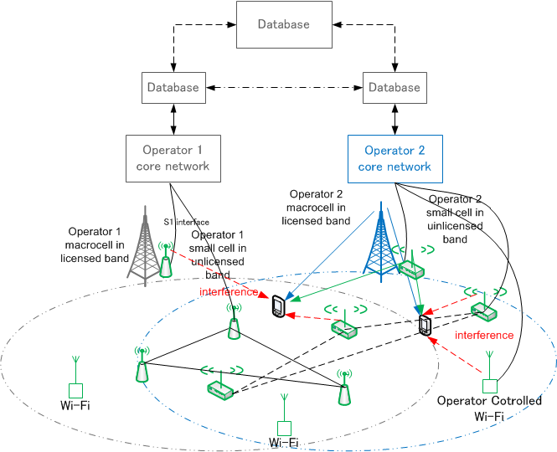
  Implementation example of coexistence between different managed RATs with multiple operators [4]

Slide 11
Regulations in 5GHz Bands
Dynamic Frequency Selection (DFS)
  Mandatory in UNII-2 bands
  No need in UNII-1 and UNII-3 bands
Transmission Power Control (TPC)
  Mandatory in U-NII 2 bands in EU and Japan
  No need in U-NII 2 bands in US
Listen Before Talk (LBT)
  Mandatory in EU and Japan
  No need in US, Korea and China

Slide 12
Solutions
Solution for Coexistence between Operators
  Information sharing enables intelligent channel selection/allocation for same and/or different managed RATs
Unrestricted-RAT solution for any regulatory domains
  IEEE 802 system will have to coexist with various RATs.
  Rules related to coexistence/sharing are different among regulatory domains.

Slide 13
Summary
Coexistence scenarios in the specific frequency bands
  5GHz U-NII Bands
  US 3.5GHz Band
Coexistence use cases
  Coexistence between managed and unmanaged RATs
  Coexistence among same/different managed RATs within a single operator
  Coexistence between same managed RAT with multiple operators
  Coexistence between different managed RATs with multiple operators
Necessary solutions
  Solution for coexistence among multiple operators
  Unrestricted-RAT solution for any regulatory domains

Slide 14
References
IEEE Standard Association, “IEEE Std 802.19.1-2014“, July 2014
3GPP TSG RAN, “RP-141664 Study on Licensed-Assisted Access using LTE”, September 2014
Federal Communications Commission, “GN Docket No. 12-354 FUTHER NOTICE OF PROPOSED RULEMAKING”, April 2014
3GPP LTE-U Workshop, “RWS-140010 Requirements and Coexistence Topics for LTE-U”, June 2014

