Slide 1
Expected Performance Improvement in the New Coexistence Scenario and Use Cases for IEEE 802.19.1
- Simulation Result -
Date: 2015-07-08
Authors:
Notice: This document has been prepared to assist IEEE 802.19. It is offered as a basis for discussion and is not binding on the contributing individual(s) or organization(s). The material in this document is subject to change in form and content after further study. The contributor(s) reserve(s) the right to add, amend or withdraw material contained herein.

Slide 2
Abstract
This document provides simulation result for performance improvement in the new coexistence scenario and use cases.
  Simulation assumption is based on the previous contribution [1].

Slide 3
Objective of simulation
To show the necessity of new work in IEEE 802.19
  Detail of “new work” is described in draft PAR [2].
  In the previous contribution[3], we showed new coexistence scenarios and use cases for IEEE 802.19.1-2014.
  IEEE 802.19.1-2014 system is a kind of frequency coordination system for coexistence.
  We have to compare the expected performance of frequency coordination by the future output of new work with the performance of IEEE 802.19.1-2014.
  In this document, we show that simulation result based on the assumptions in [1].

Slide 4
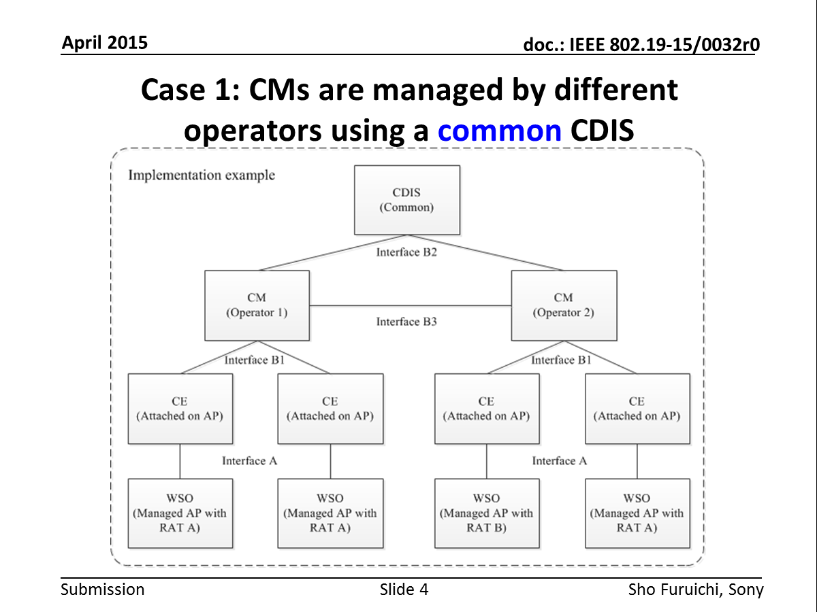
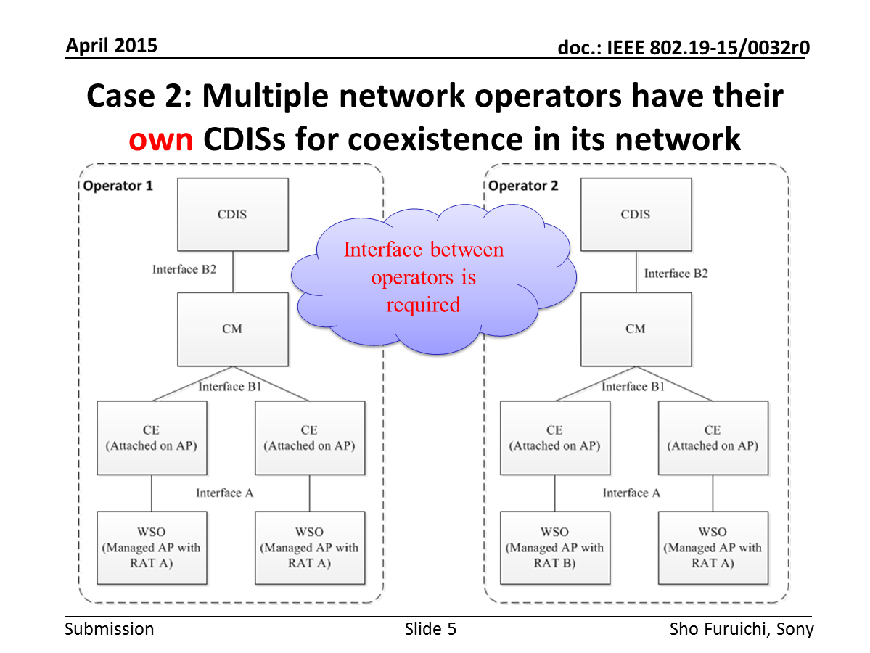
[Recap] The new coexistence use cases for IEEE 802.19.1-2014 [2]
IEEE802.19.1-2014 supports the case 1.
IEEE802.19.1-2014 does not support the case 2.

Slide 5
Summary of Assumptions [1]
1: Scenarios with or without frequency coordination between different networks (i.e. CMs) with different CDISs shall be compared.
2: Frequency coordination shall be treated as “node deployment coordination” in this simulation.
  Details are shown in backup slides.
3: Following scenarios shall be assumed;
4: Evaluation metric shall be “SINR at x-percentile CDF” as a function of “the number of node per operator”.
Scenario # | Available channel | Intra-operator coordination by IEEE 802.19.1-2014 | Inter-operator coordination by new work
1 | Single | No | No
2 | Multiple | Yes | No
3 | Multiple | Yes | Partially Yes
4 | Multiple | Yes | Yes

Slide 6
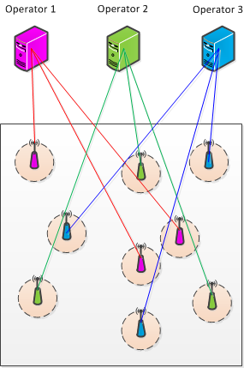
Simulation model
Operator’s management entity (w/ CM and CDIS)
300 [m]
Access point (w/ CE)
300 [m]

Slide 7
SINR at 5-percentile CDF
Scenario 4
SINR at 5-percentile CDF
Scenario 3
Scenario 2
Number of access points per network operator

Slide 8
SINR at 5-percentile CDF (Cont.)
Full inter-operator coordination can provide enough performance even in the congestion situation.
8dB gain
SINR at 5-percentile CDF
Intra and partial inter-operator coordination can provide better performance than intra coordination only.
2dB gain
IEEE802.19.1-2014 can provide this performance. SINR is very low in congestion situation.
Number of access points per network operator

Slide 9
Summary
In this contribution, simulation result for performance improvement in the new coexistence scenario and use cases of IEEE802.19.1 is shown.
It is shown that IEEE 802.19.1-2014 is not enough to support new scenario and use cases and that new work in IEEE 802.19 will be needed.

Slide 10
Reference
[1] IEEE 802.19-15/0043r0, “Expected Performance Improvement in the New Coexistence Scenario and Use Cases for IEEE 802.19.1”
[2] IEEE 802.19-15/0028r7, “Draft CUB PAR”
[3] IEEE 802.19-15/0032r0, “The new coexistence use cases for IEEE 802.19.1”

Slide 11
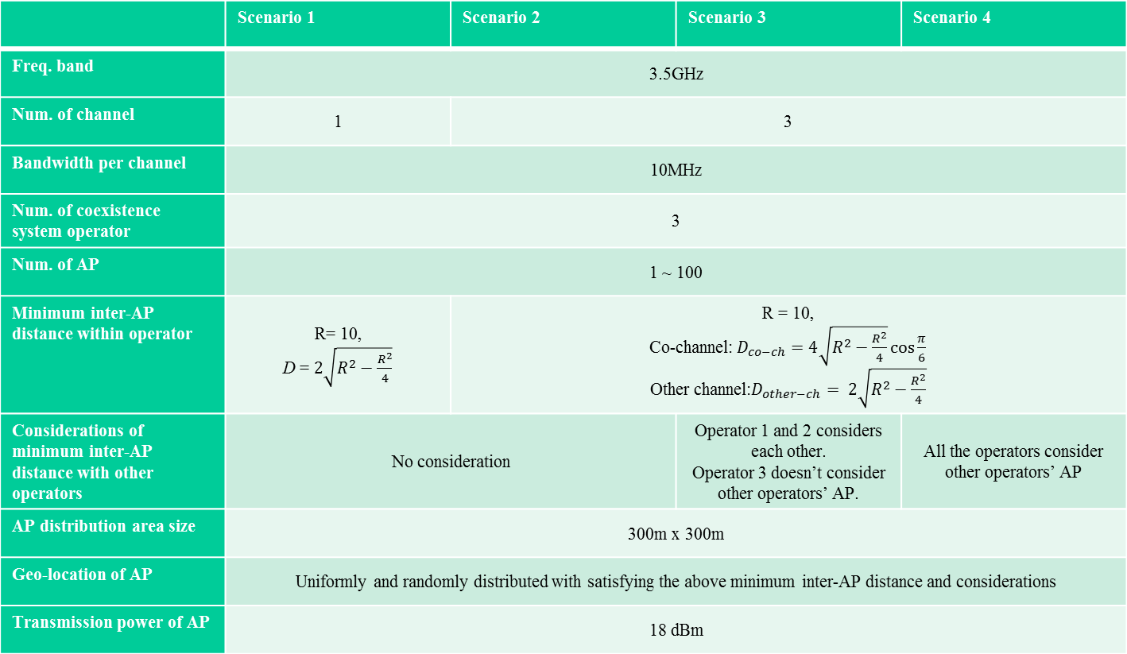
Appendix: Simulation parameter candidates
 | Scenario 1 | Scenario 2 | Scenario 3 | Scenario 4
Freq. band | 3.5GHz
Num. of channel | 1 | 3
Bandwidth per channel | 10MHz
Num. of coexistence system operator | 3
Num. of AP | 1 ~ 100
Minimum inter-AP distance within operator | R= 10, D = $2\sqrt{R^{2}−\frac{R^{2}}{4}}$ | R = 10, Co-channel:$D_{co−ch}=4\sqrt{R^{2}−\frac{R^{2}}{4}}cos\frac{π}{6}$ Other channel:$D_{other−ch}= 2\sqrt{R^{2}−\frac{R^{2}}{4}}$
Considerations of minimum inter-AP distance with other operators | No consideration |  | Operator 1 and 2 considers each other. Operator 3 doesn’t consider other operators’ AP. | All the operators consider other operators’ AP
AP distribution area size | 300m x 300m
Geo-location of AP | Uniformly and randomly distributed with satisfying the above minimum inter-AP distance and considerations
Transmission power of AP | 18 dBm

Slide 12
Appendix: Simulation parameter candidates (Cont.)
 | Scenario 1 | Scenario 2 | Scenario 3 | Scenario 4
Antenna Height | AP: 3.0 m, User terminal: 1.5m
Channel model | Pathloss model PL(d) = 40.05 + 20*log10(fc/2.4) + 20*log10(min(d,10)) + (d>10) * 35*log10(d/10) – d = max(3D-distance [m], 1) – fc = frequency [GHz] Shadowing Log-normal with 5 dB standard deviation, i.i.d across all links
Fading model | No small-scale fading is assumed.
AP selection criteria | Max reception power within the same operator-network
Adjacent channel interference | Assumes no interference

Slide 13
Backup

Slide 14
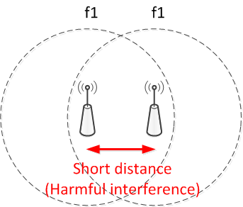
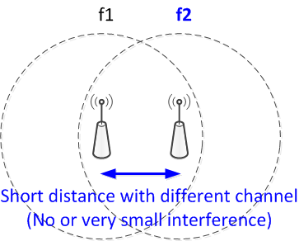
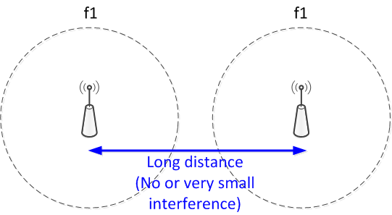
Assumption 2: Frequency coordination
Frequency coordination shall be treated as “node deployment coordination” in this simulation.
  The objective of simulation is NOT to evaluate “frequency coordination algorithms”.
  Any frequency coordination algorithm would result in the following situation.
No coordination
Two kind of coordination results

Slide 15
Assumption 2 (Cont.)
No frequency coordination in this simulation;
  Nodes are uniformly and randomly distributed without any considerations on the location of adjacent nodes and their channel.
Frequency coordination in this simulation;
  Nodes are uniformly and randomly distributed with considerations on the location of adjacent nodes and their channel.
No coordination
Two kind of coordination results

Slide 16
SINR at 5-percentile CDF
SINR at 5-percentile CDF
[Slide 8 – 9] Reasonable number range for 300 [m] x 300[m] area
Number of access points per network operator

