Slide 1
Information exchange between independent IEEE 802.19.1 systems
Date: 2015-11-xx
Authors:
Notice: This document has been prepared to assist IEEE 802.19. It is offered as a basis for discussion and is not binding on the contributing individual(s) or organization(s). The material in this document is subject to change in form and content after further study. The contributor(s) reserve(s) the right to add, amend or withdraw material contained herein.

Slide 2
Abstract
This document proposes amendment to architecture defined in IEEE 802.19.1-2014 to realize information exchange between independent IEEE 802.19.1 systems for new coexistence use cases.

Slide 3
Background
In CUB SG work, we have discussed about coexistence scenarios and use cases in sub-6GHz frequency bands as one of the study items.
Through discussion, CUB SG identified target frequency bands, where “general authorization” basis is adopted such as;
  TV band (TV White Space)
  2.4 GHz band
  3.55 – 3.70 GHz band in US
  5 GHz bands
  etc...
We raised the necessity of amendment to the architecture defined in IEEE 802.19.1-2014 in order to realize the new coexistence use cases in the above frequency bands.

Slide 4
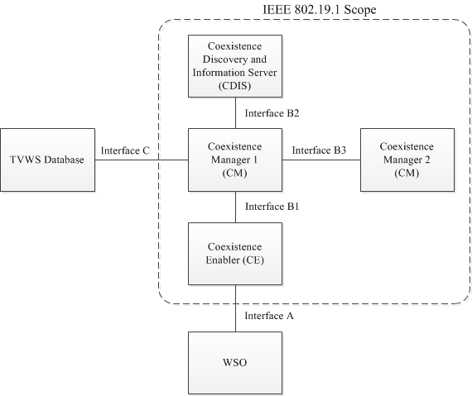
[Recap] System architecture defined in
IEEE 802.19.1-2014 [1]
coexistence discovery and information server (CDIS): An entity that is responsible for determining for coexistence managers (CMs) those white space objects (WSOs) that may affect performance of the WSOs that the CMs serve.
coexistence manager (CM): An entity that is responsible for making coexistence decisions related to reconfiguration of white space objects (WSOs) to solve coexistence problems among them.
coexistence enabler (CE): An entity that represents a white space object (WSO) in the coexistence system and serves one WSO at a time.

Slide 5
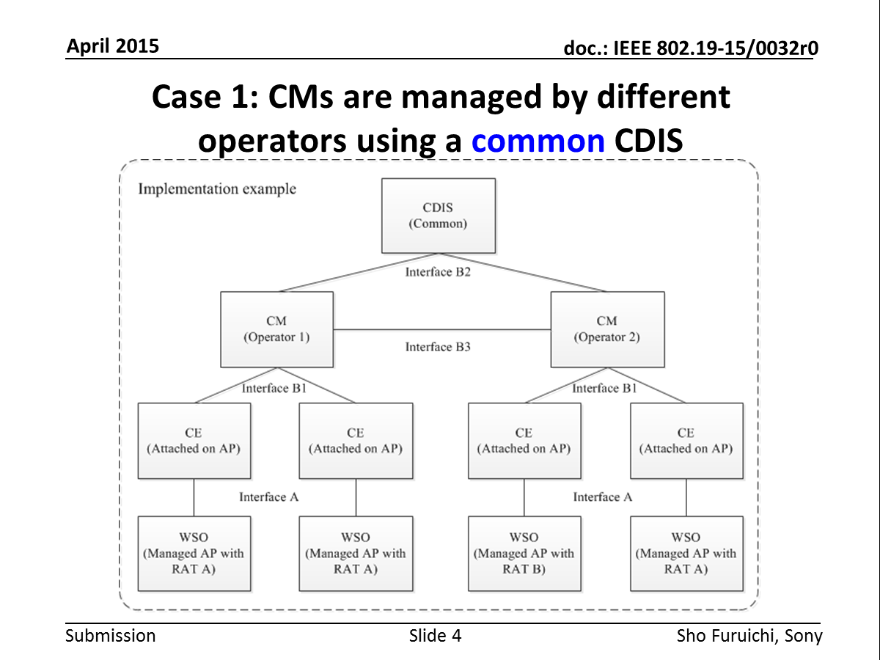
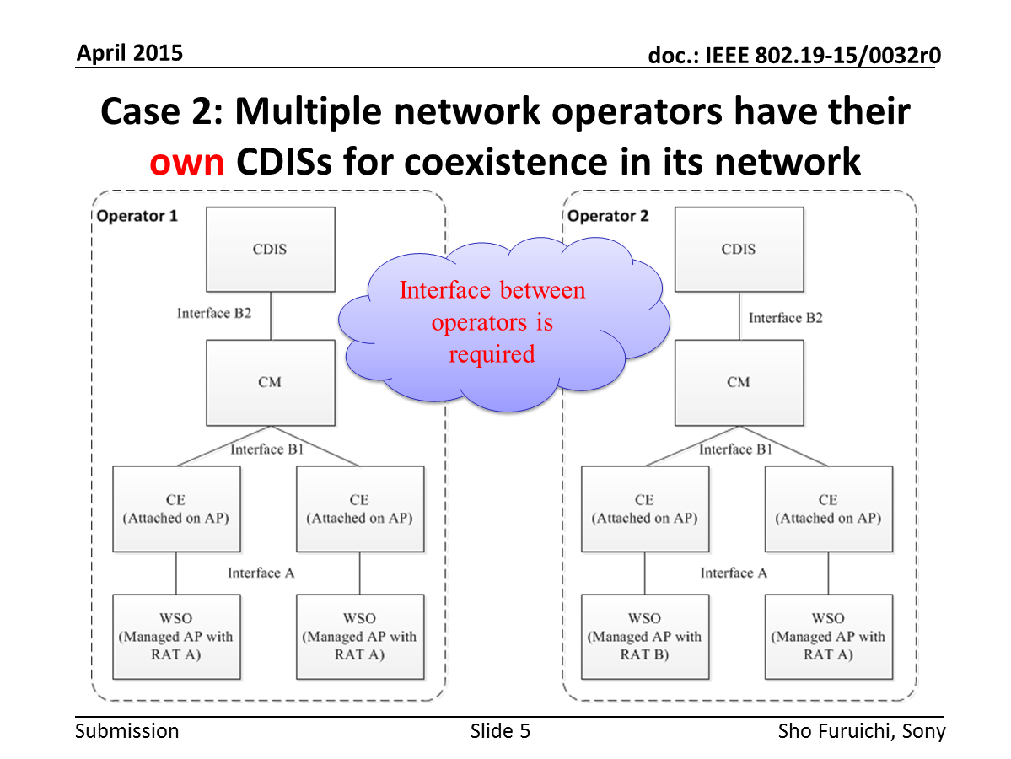
New coexistence use cases in the target frequency bands [2]
Multiple wireless internet providers share one CDIS for coexistence among different operator networks.
➔ IEEE 802.19.1-2014 can support this case.
Multiple wireless internet providers do not share the CDIS, but each provider has own CDIS for coexistence.
➔ IEEE 802.19.1-2014 cannot always support this case.

Slide 6
Challenges for information exchange between independent IEEE 802.19.1 systems managed by different wireless internet providers
Protection of information security, confidentiality, etc...
  Subscriber information, infrastructure installation information, etc...
  This might be the reason why wireless internet providers have own CDIS for coexistence in the future.
“Limited information exchange” for interference management between independent IEEE 802.19.1 systems
  What kind of information is needed at least?
  Should new information be defined?
How to exchange the information (architecture perspective)
  Which entity should be involved?
  Or new entity is needed?

Slide 7
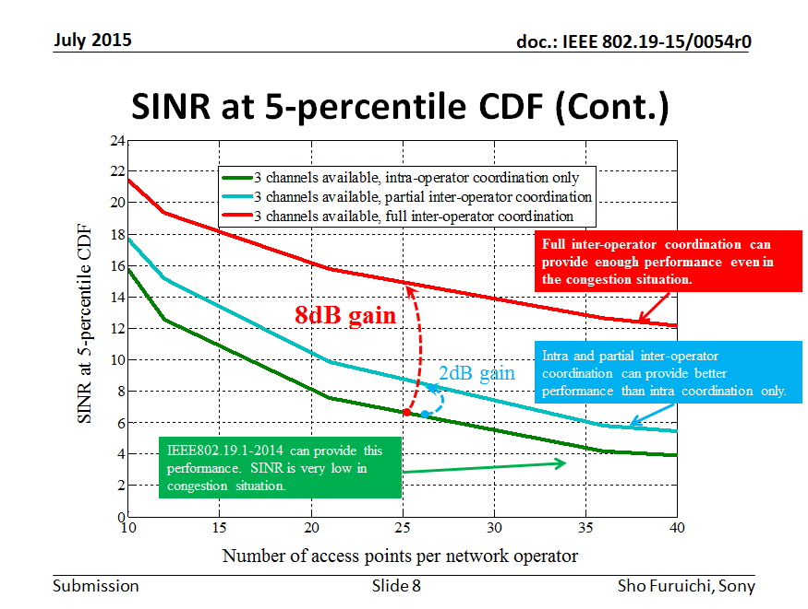
Proof of the necessity for information exchange by simulation[3]
Our simulation result showed that information exchange among different wireless internet providers would provide good coexistence if we overcome the abovementioned challenges.
Information exchange is done among all the providers.
Some providers do information exchange but the other one doesn’t do.
No information exchange

Slide 8
Conclusion
We suggest TG1a amend the architecture defined in IEEE 802.19.1-2014 in order to realize the new coexistence use cases in our target frequency bands.

Slide 9
Next step
Discussion about architecture

Slide 10
Reference
[1] IEEE Standard Association, “IEEE Std 802.19.1-2014“, July 2014
[2] Sho Furuichi, et al, “IEEE 802.19-15/0032r0 The new coexistence use cases for IEEE 802.19.1”, April 2015
[3] Sho Furuichi, et al, “IEEE 802.19-15/0054r0, Expected Performance Improvement in the New Coexistence Scenario and Use Cases for IEEE 802.19.1 – Simulation Result – ”, July 2015

