Slide 1
Discussion on possible architectures for information exchange between independent IEEE 802.19.1 systems
Date: 2015-12-22
Authors:
Notice: This document has been prepared to assist IEEE 802.19. It is offered as a basis for discussion and is not binding on the contributing individual(s) or organization(s). The material in this document is subject to change in form and content after further study. The contributor(s) reserve(s) the right to add, amend or withdraw material contained herein.

Slide 2
Abstract
This document shows possible architectures for information exchange between independent IEEE 802.19.1 systems.

Slide 3
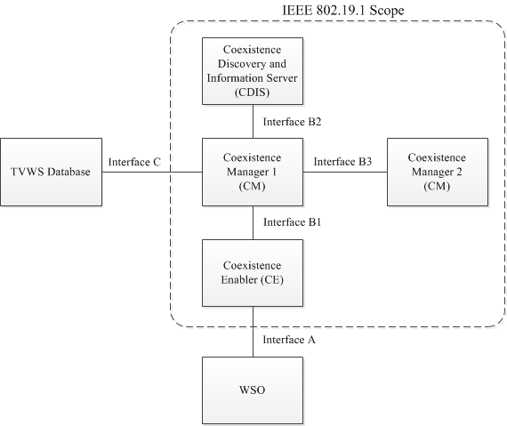
[Recap] System architecture defined in
IEEE 802.19.1-2014 [1]
coexistence discovery and information server (CDIS): An entity that is responsible for determining for coexistence managers (CMs) those white space objects (WSOs) that may affect performance of the WSOs that the CMs serve.
coexistence manager (CM): An entity that is responsible for making coexistence decisions related to reconfiguration of white space objects (WSOs) to solve coexistence problems among them.
coexistence enabler (CE): An entity that represents a white space object (WSO) in the coexistence system and serves one WSO at a time.

Slide 4
Option 1. Addition of interface between different CDISs
System 1
System 2
Pros
  No changes to the existing procedures and algorithms, just only new additions for information exchange between two CDISs.
Cons
  CDIS is server i.e. “passive” entity, and it cannot actively trigger the information exchange with the other CDIS and vice versa.

Slide 5
Option 2. Addition of new entity for realizing interface between different CDISs
System 1
System 2
New entity
  It can be defined as “active” entity.
  It can trigger the information exchange with the other CDIS via each new entity.
    In other words, it has decision making functionality for the information exchange with the other CDIS.

Slide 6
Option 2. Addition of new entity for realizing interface between different CDISs (Cont’d)
System 1
System 2
Pros
  CDIS can have this new entity and realize the interface with the other CDIS.
Cons
  It cannot make decision itself with considering the decision made by CM within the same system. It might additionally need the interface with CM within the same system. (Need red dashed-line in the figure !)

Slide 7
Option 3. Use the interface B2
System 1
System 2
Pros
  Existing interface can be reused.
Cons
  All the parameters defined in this interface are exchanged.
  There needs a lot of changes for interface B2. In that case, there will be large impact on the existing IEEE 802.19.1 standard. At least, we should protect the existing procedures and algorithms in order to compensate the inter-operability with the amendment.

Slide 8
Option 4. Addition of new entity for realizing interface between different CMs in the different systems.
System 1
System 2
New entity
  It can be defined as “enabler for inter-system coordination ”, not “decision maker”, because CM is already acting as “decision maker”.
  In the interface between different CMs in the different systems via new entities, we can use similar procedures and algorithms as defined in interface B2.

Slide 9
Option 4. Addition of new entity for realizing interface between different CMs in the different systems. (Cont’d)
System 1
System 2
Pros
  No changes to the existing procedures and algorithms
Cons
  We have to define the interface between CM and new entity and between new entities.
  Some decision making functionality should be added in the CM.

Slide 10
Option X.
Any more options ?

Slide 11
Next step
We have to identify appropriate architecture.

Slide 12
Reference
[1] IEEE Standard Association, “IEEE Std 802.19.1-2014“, July 2014
[2] Sho Furuichi, et al, “IEEE 802.19-15/0032r0 The new coexistence use cases for IEEE 802.19.1”, April 2015
[3] Sho Furuichi, et al, “IEEE 802.19-15/0054r0, Expected Performance Improvement in the New Coexistence Scenario and Use Cases for IEEE 802.19.1 – Simulation Result – ”, July 2015

