Slide 1
Wireless Coexistence in the Automotive Domain – Testing Scenarios
Date: 2016-03-01
Authors:
Notice: This document has been prepared to assist IEEE 802.19. It is offered as a basis for discussion and is not binding on the contributing individual(s) or organization(s). The material in this document is subject to change in form and content after further study. The contributor(s) reserve(s) the right to add, amend or withdraw material contained herein.

Slide 2
Abstract
The target of this document is to discuss the testing scenarios for the study group.

Slide 3
Background
Igal Kotzer (GM) presented the document (19-16/0034r0) on the automotive WLAN interference evaluation criteria
In this submission, I want to extend the testing scenarios which were presented by Igal, in order to provide different evaluation aspects

Slide 4
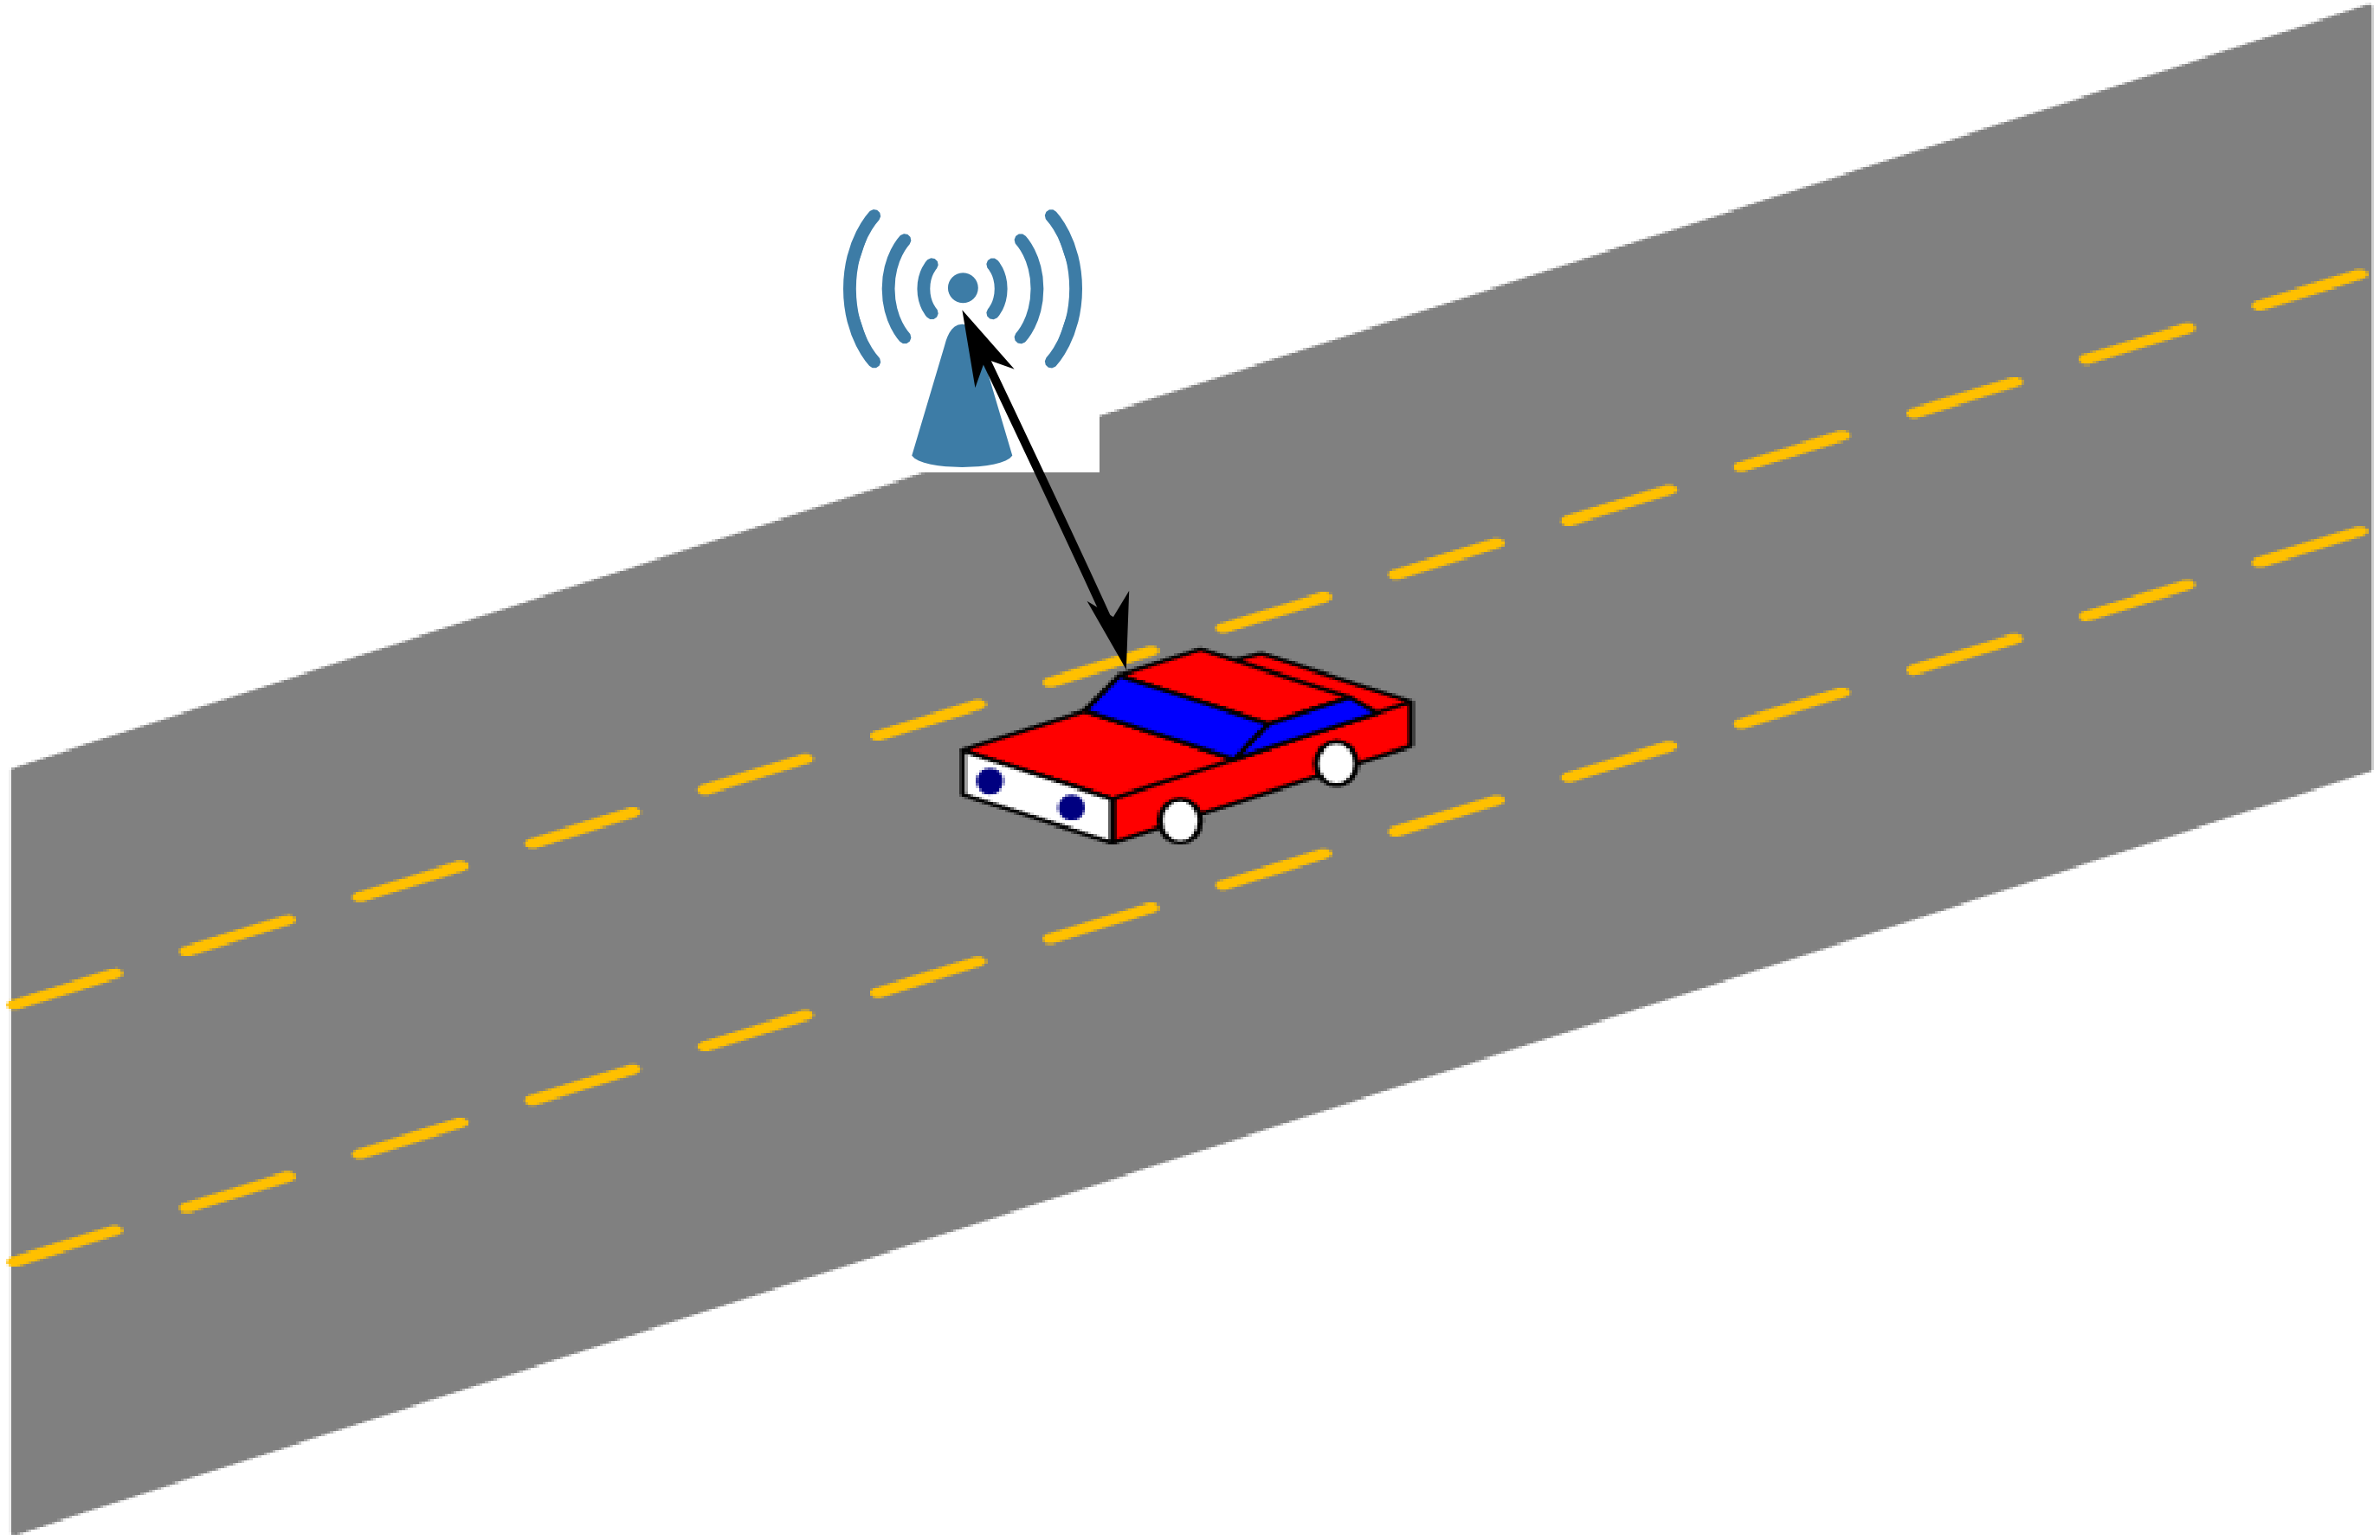
Testing scenarios (1)
The following scenarios should be considered:
Intra-Car case: Single car isolated form the surrounding
Inter-Car case: the car is affected by multiple surrounding cars
Car-other stationery 802.11 stations: how the car is affected by the stationery WLAN hotspot (mainly in the city), should we consider how the car will affect the stationery hotspot?!

Slide 5
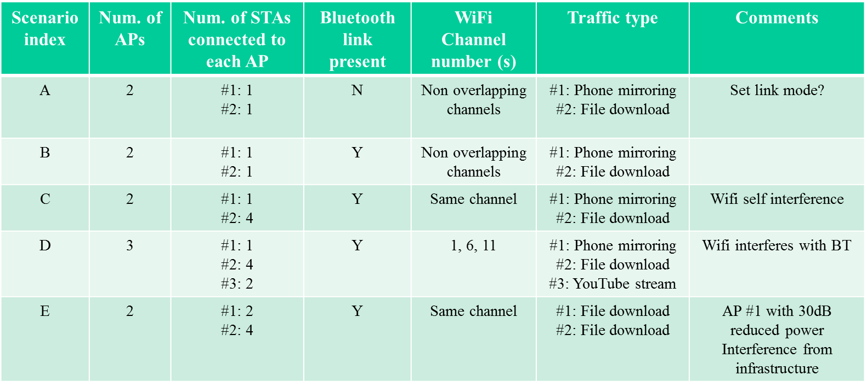
Testing scenarios (2)
The following test scenarios were presented by Igal, document (19-16/0034r0)

Slide 6
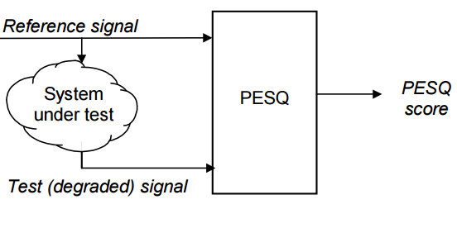
Testing scenarios (3)
We could focus on specific applications for WLAN as presented before, subjective quality check could be used.
However, with using IPERF for WLAN we could have more freedom with WLAN signal and we could easier measure the achieved throughput, latency,…
For Bluetooth, we could measure the throughput for ACL link, and PESQ (Perceptual Evaluation of Speech Quality) value for SCO link. The PESQ is standardized as ITU-T recommendations P.862, it is used for objective voice quality testing for a telephony system

Slide 7
Testing scenarios (4)
Scenario index | Bluetooth Link | WLAN Link | Num. of WLAN APs | Bluetooth Link type | WLAN channel | descriptions | Comments
A | N | Y | 2 | N/A | overlapping | Run IPERF on both Aps (TCP and UDP) | WLAN mutual interference
B | N | Y | 2 | N/A | Overlapping | Run IPERF on both Aps (TCP and UDP) | One AP with 30dB less power (infrastructure case)
C | Y | Y | 2 | ACL | Non overlapping | Run IPERF on both Aps File download | Throughput for Bluetooth link
D | Y | Y | 2 | SCO | Non overlapping | Run IPERF on both Aps Hands free call | Measure PESQ value for Bluetooth
E | Y | Y | 3 | ACL | 1,6,11 | Run IPERF on all APs File download | Throughput for Bluetooth link
F | Y | Y | 2 | SCO | 1,6,11 | Run IPERF on all APs Hands free call | Measure PESQ value for Bluetooth

Slide 8
Performance Indicators
We could use both high level and low level performance indicators (as in document 19-16/0034r0), I suggest to add PESQ value for Bluetooth performance indicator
For WLAN, we could measure the duty cycle, because assuming 100% activity leads to huge overestimations

Slide 9
Channel model
Channel mode is needed for simulations, any idea about possible channel models?

