Slide 1

5 GHz Band – Vehicle Wi-Fi Usage
Regulation Status
Bernd Napholz RD/UKA Infotainment Netzwerke
22.04.2016

Slide 2
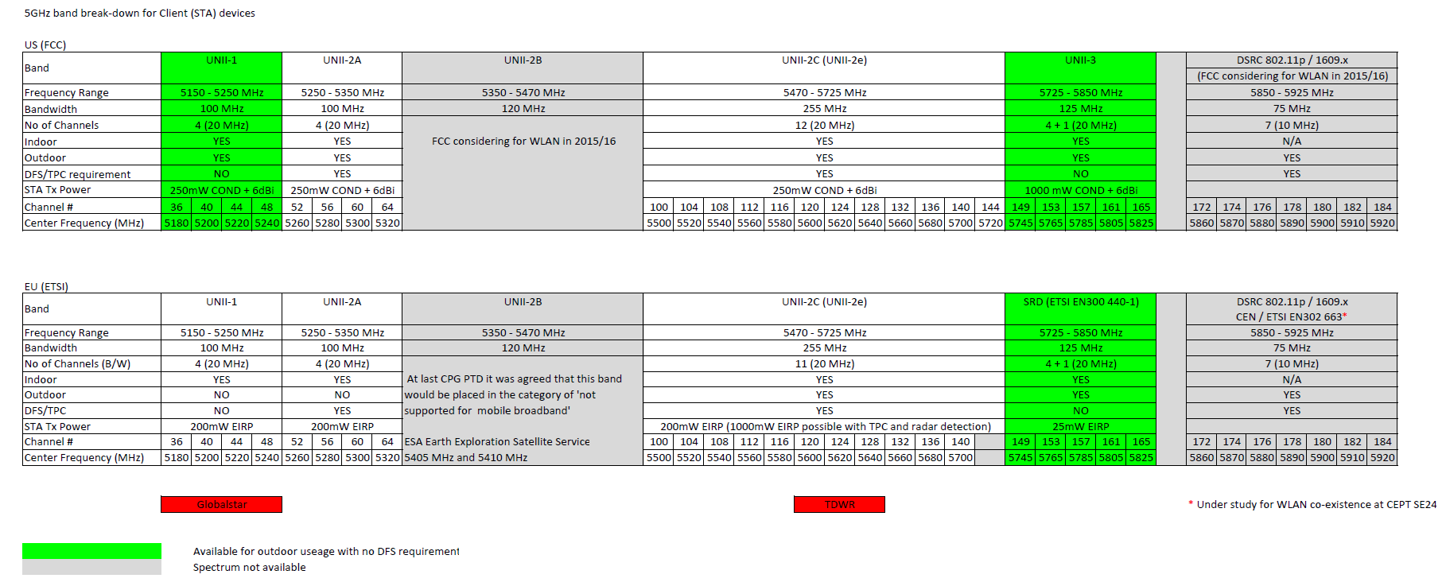
5 GHz Band for Wi-Fi
The band is broadly divided into four zones
    - UNII-1: 5.15 – 5.25 GHz
    - UNII-2: 5.25 – 5.35 GHz
    - UNII-2e: 5.47 – 5.725 GHz
    - UNII-3: 5.725 – 5.825 GHz = SRD (ETSI EN300 440‐1)
    (UNII = Unlicensed National Information Infrastructure)
  Legislation varies between
  countries and channels
  Automotive Wi-Fi is generally
  restricted
UNII-1
UNII-2
UNII-2e
UNII-3
802.11p
(car2x)
5.15
5.25
5.35
5.47
5.725
5.825
5.85
5.925
Frequency in GHz
US
EU

Slide 3
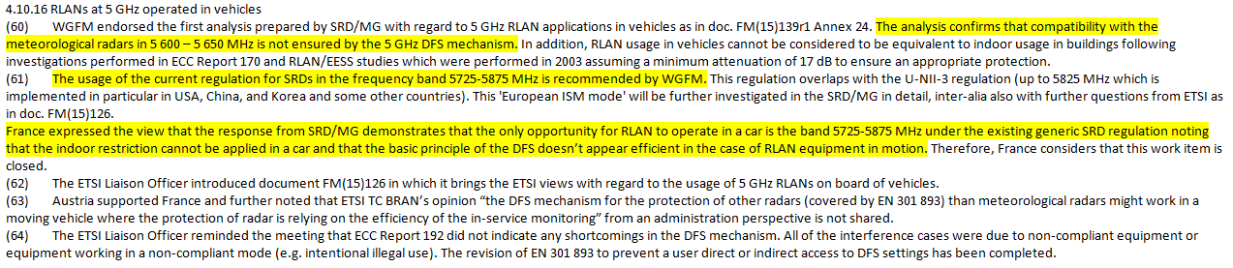
Regulation Status in Europe
Regulation status for 5 GHz Band Wi-Fi usage in vehicle according ‚CEPT ECC Working Group FM‘
Meeting minutes: „Final minutes WGFM#83 – approved“
For APs in vehicles in EU the Band ‚UNII-3 (SRD - ETSI EN300 440‐1)‘ has to be used

Slide 4
Regulation Status vs available channels in customer devices
  Devices of several suppliers do not support the only allowed channels
  For Android Devices the channels 149-165 are not supported with Regional Code DE.
  Changing the Regional Code to US the channels 149-165 are supported -> no HW restriction
Devices of several suppliers do not consider country specific regulation status correct
As soon as AP sends CountryInformation DE in Beacons a re-connection of a previous connection on channels 149-165 is not possible
anymore.
The RegulatoryDomain Information of iPad do not consider regulation.
If AP sends e.g. CountryInformation US these channels are supported by iPad.
Request to Customer Devices supplier: support country specific regulation,
especially for EU channels 149 - 165

Slide 5
Wireless Automotive Coexistence Study Group
  Request to Study Group:
  Push on a further unification of legislative regulation in 5 GHz Band Wi-Fi usage for Automotive
Push on customer devices suppliers to consider country specific regulation status correct

