Slide 1
Wi-Fi Measurements in Vehicle
Date: 2016-07-22
Authors:
Notice: This document has been prepared to assist IEEE 802.19. It is offered as a basis for discussion and is not binding on the contributing individual(s) or organization(s). The material in this document is subject to change in form and content after further study. The contributor(s) reserve(s) the right to add, amend or withdraw material contained herein.

Slide 2
Abstract
This document presents Wi-Fi measurements in the automotive domain
Many test drives were performed in order to have a first impression on the performance of Wi-Fi in vehicles
All the measurements were done as a cooperation between BMW and Qualcomm in Germany
All the test drives were performed in Ingolstad, Germany
Just initial measurements, more extensive measurements should be performed

Slide 3
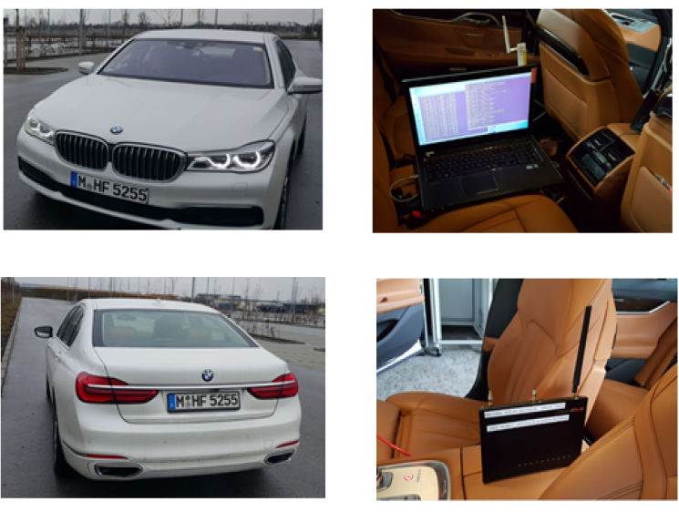
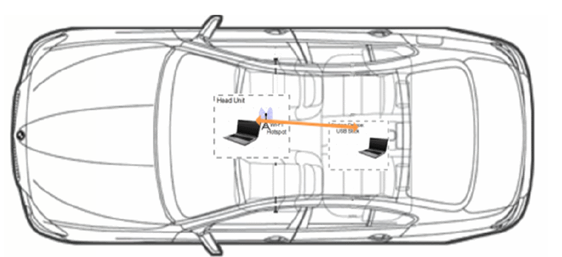
Measurement setup (1)
Wi-Fi network (AP and station) is established in a BMW 7 series
Different commercial router and Wi-Fi stick are used
The positions of the devices are as shown below
802.11n with 20 MHz channel
Test setup

Slide 4
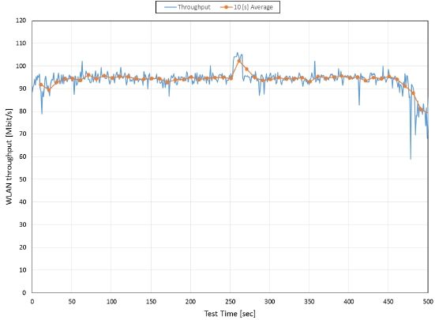
Measurement setup (2)
IPERF tool (network testing tool) is used to measure the TCP throughput of the Wi-Fi network
The ground truth throughput is measured in anechoic chamber
The throughput is quite stable at 94 Mbps
Measured throughput in chamber

Slide 5
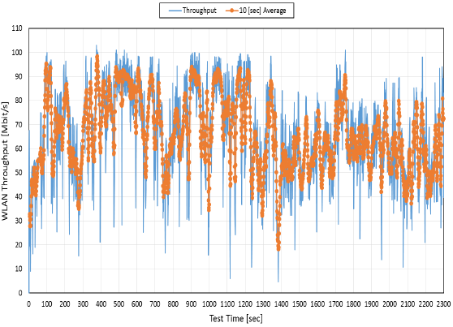
Measurement Results (1)
Many test drives in different places, 38 minutes example can be seen below.
The throughput achieves the maximum in a parking place, where no other Wi-Fi signals in the surrounding
The throughput fluctuates heavily
Clear trends can be seen in the figure: high way and city center
The throughput for
38 minutes test drive in and around Ingolstadt on channel 6

Slide 6
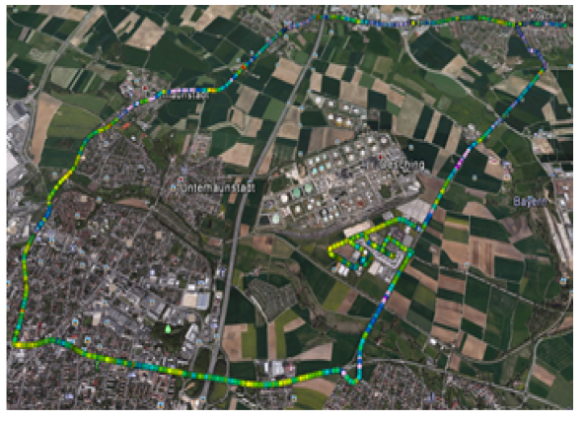
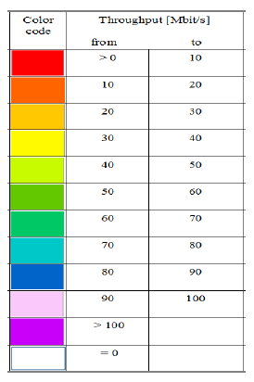
Measurement Results (2)
As expected, the throughput in the city center is much lower compared to the highway
Near the main train station, drops to below 10 mbps were observed

Slide 7
Observations and Conclusions
The measurements shows that the performance of Wi-Fi in vehicles is greatly affected by the surrounding
The problem will be more pronounced when most of the cars will have Wi-Fi in the near future
The Wi-Fi in vehicles will also affect the surrounding networks, millions of new OBSSs
The probability of having fully occupied 2.4 Ghz ISM band is very high, which makes the coexistences with Bluetooth severe

