Slide 1
IEEE 802.11ax Overview
Date: 2016-07-20
Authors:

Slide 2
Abstract
This submission provides a short overview of the progress in IEEE 802.11ax. IEEE 802.11ax is still a work in progress and decisions are yet to be made in some of the technical areas.

Slide 3
Introduction
The IEEE 802.11ax approved draft D0.1 in March 2016 and went through a comment collection (CC) process ended on April 11 2016.
  Draft 0.1 wasn’t totally complete and included its share of “TBD”.
Over 2900 comments are received.
The TG is now focusing on resolving these comments and is planning to produce draft D1.0 and go to official WG letter ballot by the end of September meeting.

Slide 4
The Big Picture
The use of Orthogonal Frequency Division Multiple Access (OFDMA)
  Allows the multiplexing of multiple users in the frequency domain.
    A departure from the use of the OFDM where all resources are assigned to a single user as in previous IEEE 802.11 amendments.
  Support of OFDMA is both for the Uplink (UL) and the Downlink (DL)
Supporting UL MU MIMO
  DL MU MIMO support is already in IEEE 802.11ac.
  Allows multiplexing of multiple users in the spatial domain
The use of 256 FFT for the data portion of the 802.11ax PPDU.
  A departure from the 64 FFT used in previous IEEE 802.11 amendments.
Additional guard interval durations for outdoor channels (0.8, 1.6, and 3.2 μsec.
Many additional MAC features to support the new PHY features.

Slide 5
General Frame Structure
RU
RL-SIG
HE-SIG-A
HE-SIG-B
…
HE-Data
L-Preamble
HE-STF
HE-LTF
HE-LTF
As in IEEE 802.11n/ac, HEW PPDU starts with a legacy preamble for backward compatibility. Legacy preamble is duplicated on every 20 MHz channel.
  L-Preamble consists of L-STF, L-LTF, and L-SIG.
Repeated L-SIG (RL-SIG) is included for auto-detection.
HE-SIG-A is two-symbol long and is duplicated on every 20 MHz channel. HE-SIG-A is available in every PPDU.
HE-SIG-B is of variable length. It includes resource allocation information. HE-SIG-B is only present in the DL MU PPDU.
HE-Data uses DFT period of 12.8 μsec and subcarrier spacing of 78.125 KHz.
Tone plan allowing 26-tone, 52-tone, 106-tone, 242-tone for OFDMA. 484-tone and 996-tone for non-OFDMA cases.
Mandatory support for LDPC coding in HE PPDU Data field for allocation sizes of 484 tones, 996 tones and 996*2 tones.
1024-QAM is an optional feature for SU and MU using resource units equal to or larger than 242 tones in 11ax.
Dual sub-carrier modulation (DCM) is an optional modulation scheme for the HE-SIG-B and Data fields. DCM is only applied to BPSK, QPSK and 16-QAM modulations

Slide 6
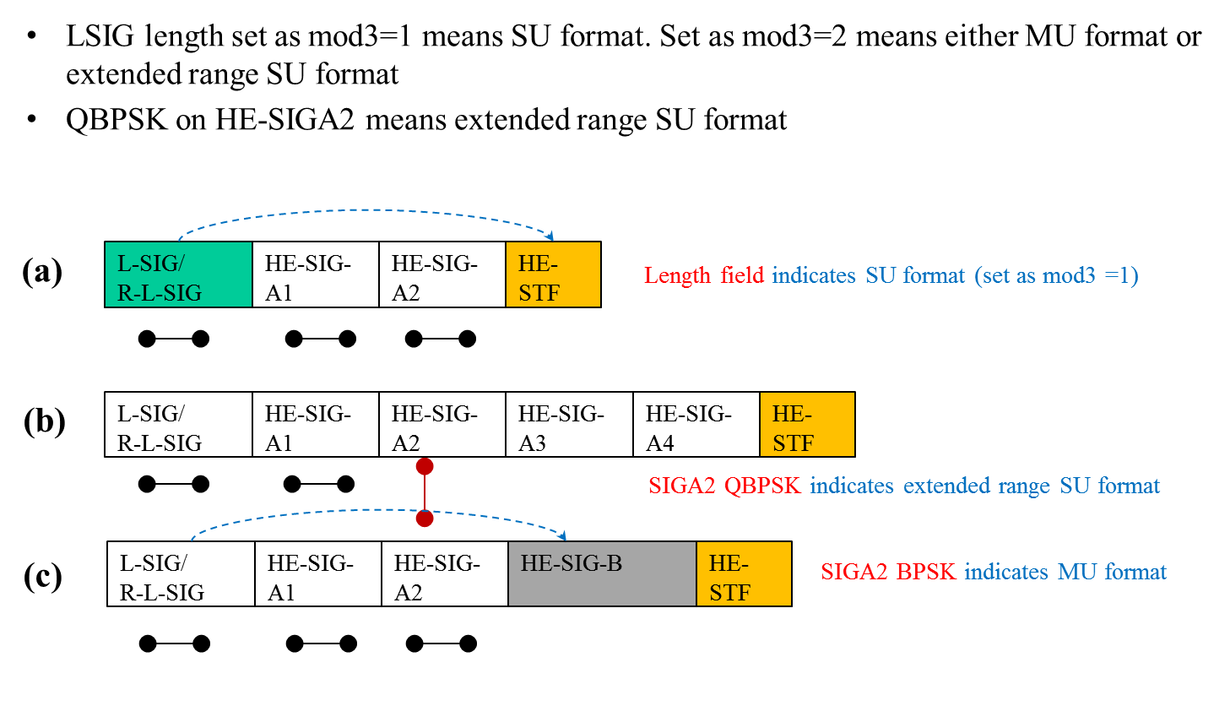
Three Preamble Formats
L-SIG length set at mod3=1 indicates SU format. Set as mod3=2 indicates MU Format
QBPSK on HE-SIGA2 indicates extended range SU format

Slide 7
SIG-A Contents (SU PPDU)
Field | Size | Description
DL/UL | 1 | UL or DL indication
Format | 1 | SU or Trigger-based PPDU
BSS Color | 6 | Base Station Identifier
Spatial Reuse | 4 | Indication of CCA level, interference level accepted, or TX Power
TXOP Duration | 7 | Remaining time of the current TXOP
Bandwidth | 2
CP+LTF Size | 2
Coding | 2
Field | Size | Description
Nsts | 3
STBC | 1
TxBF | 1
DCM | 1 | Dual Carrier Modulation indication
Packet Extension | 3 | “a”-factor field
Beam Change | 2 | Precoder change/no change
Doppler | 1
CRC | 4
Tail | 6

Slide 8
SIG-A Contents (MU PPDU)
Field | Size | Description
DL/UL | 1 | UL or DL indication
BSS Color | 6 | Base Station Identifier
Spatial Reuse | 4 | Indication of CCA level, interference level accepted, or TX Power
TXOP Duration | 7 | Remaining time of the current TXOP
Bandwidth | 3
SIG-B MCS | 3
SIG-B DCM | 1
SIG-B Compression Mode | >= 1 | Differentiate full BW MU MIMO from OFDMA MU PPDU
Field | Size | Description
Number of HE-LTF Symbols | 3
LPDC extra Symbol | 1
Packet Extension | 3
Doppler | 1
STBC | 1
CRC | 4
Tail | 6

Slide 9
SIG-A Contents (Trigger-based UL PPDU)
Field | Size | Description
DL/UL | 1 | UL or DL indication
BSS Color | 6 | Base Station Identifier
Spatial Reuse | 4 | Indication of CCA level, interference level accepted, or TX Power
TXOP Duration | 7 | Remaining time of the current TXOP
Bandwidth | TBD
CRC | 4
Tail | 6

Slide 10
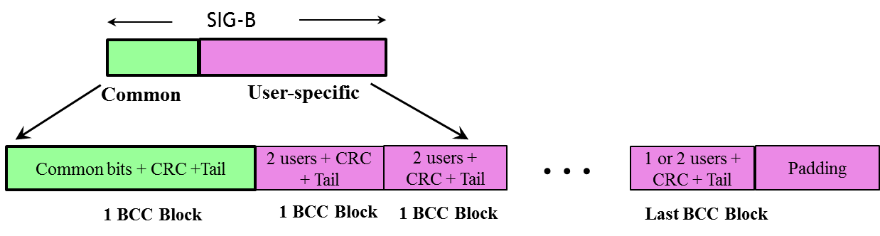
SIG-B Structure
SIG-B consists of two parts:
  Common part describes the RU configuration.
  Per-User part that includes STAID, Nsts, etc.

Slide 11
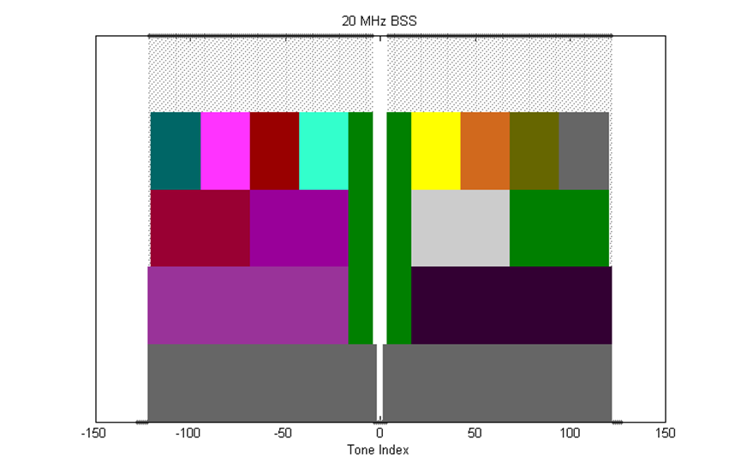
Tone Allocation- 20 MHz
26-tone with 2 pilots, 52-tone with 4 pilot and 106-tone with 4 pilots and with 7 DC Nulls and
(6,5) guard tones, and at locations shown in the Figure
An OFDMA PPDU can carry a mix of different tone unit sizes within each 242 tone unit boundary

Slide 12
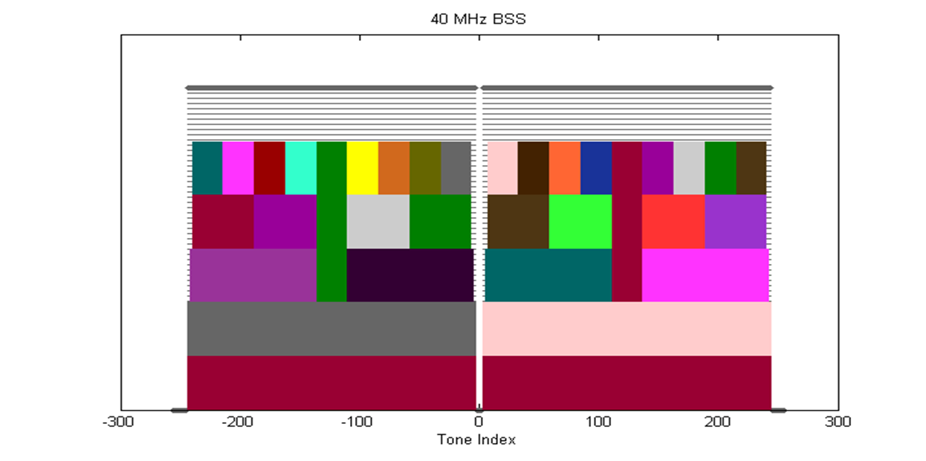
Tone Allocation – 40 MHz
26-tone with 2 pilots, 52-tone with 4 pilots, 106-tone with 4 pilots and 242-tone with 8 pilots and with 5 DC Nulls and (12,11) guard tones.

Slide 13
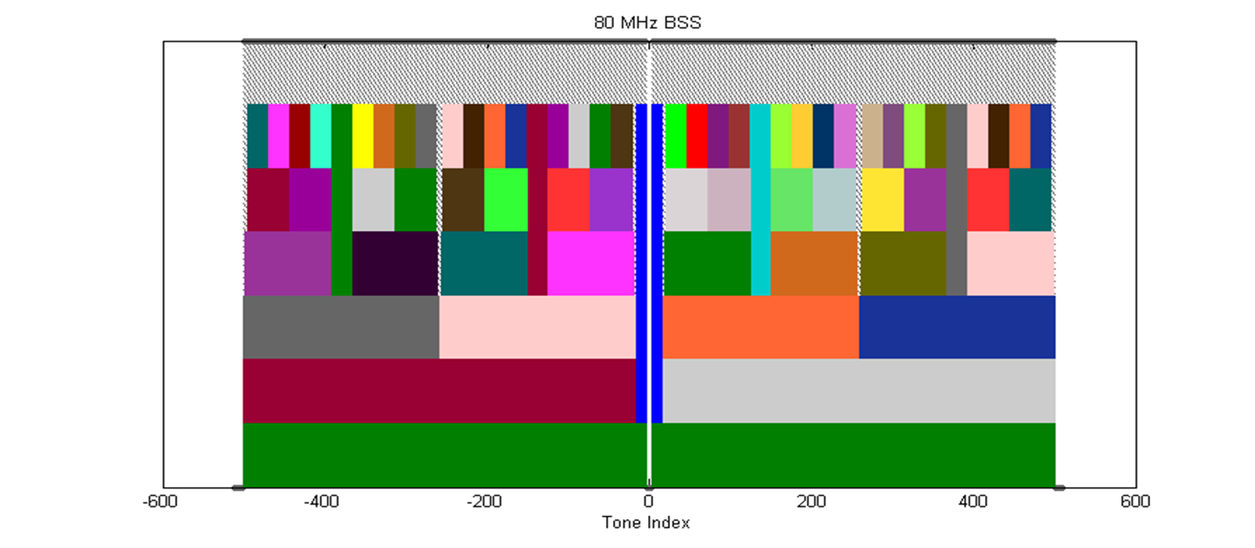
Tone Allocation – 80 MHz
Define 80 MHz OFDMA building blocks as follows:
  26-tone with 2 pilots, 52-tone with 4 pilots, 106-tone with 4 pilots, 242-tone with 8 pilots and 484-tone with 16 pilots and with 7 DC Nulls and (12,11) guard tones

Slide 14
UL MU Operation
Trigger Frame
AP
M-STA ACK
STA
STA
STA
UL
Transmissions
The specification defines a new Trigger frame sent by the AP to trigger UL transmissions by selected STAs.
  A trigger frame schedule can be set by using a variant of target wake up time (TWT) introduced in 11ah.
The specification defines a new ACK type, multi-STA ACK enabling the AP to acknowledge transmissions from multiple STAs

Slide 15
DL MU Operation
A-MPDU
AP
STA
ACK
STA
STA
A trigger frame may be present in the DL MU PPDU enabling the recipient to send it ACK/BA.
Multi-TID A-MPDU is supported.

Slide 16
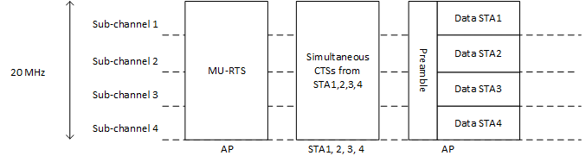
MU-RTS Operation
Define a frame, called MU-RTS, that solicits simultaneous CTS responses from multiple STAs to protect DL MU transmission
  Similar to trigger frame, MU-RTS provides
    Time synchronization among MU STAs based on the end of the MU-RTS
    Frequency offset correction based on the common AP reference
  MU-RTS will have signaling to identify the solicited STAs
  The CTS responses will be transmitted simultaneously from multiple STAs to reduce overhead and need to be exactly the same, i.e., the same scramble seed and data rate

Slide 17
MU-RTS (cntd)
To have the same scramble seed and data rate for simultaneous CTS responses, propose the following
  The scramble seed of simultaneous CTS is same as the scramble seed of the frame which triggers simultaneous CTS.
  The transmission rate of simultaneous CTS shall use the primary rate based on the rate or MCS of the frame that triggers simultaneous CTS

Slide 18
Spatial Reuse (Coexistence)
Ability to differentiate between Inter-BSS and Intra-BSS frames using BSS color or MAC address.
    If the detected frame is an inter-BSS frame, under TBD condition, the STA uses TBD OBSS PD level that is greater than the minimum receive sensitivity level
A STA differentiates between a NAVs set by intra-BSS and OBSS
    STA doesn’t update its NAV in response to inter-BSS frames with valid PHY header and a receive power/RSSI below OBSS PD used by the receiving STA. A CF-end frame that comes from intra-BSS should not reset NAV that was set by a frame from OBSS. To determine which BSS is the origin of a frame, the HE STA may use BSS color.

Slide 19
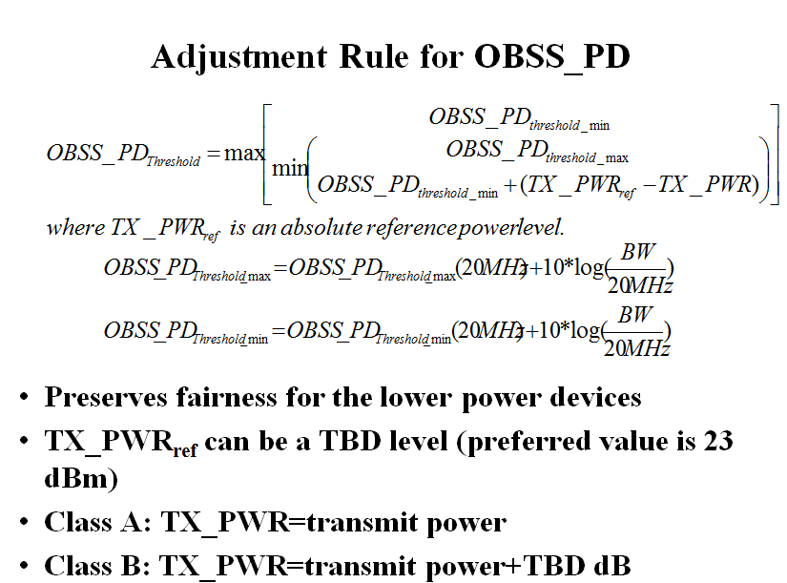

Slide 20
References
[1] https://mentor.ieee.org/802.11/dcn/15/11-15-0132-17-00ax-spec-framework.docx

