Slide 1
On The Inter Vehicle Channel Loss at 2.4GHz
Date: 16/1/2017
Authors:
Notice: This document has been prepared to assist IEEE 802.19. It is offered as a basis for discussion and is not binding on the contributing individual(s) or organization(s). The material in this document is subject to change in form and content after further study. The contributor(s) reserve(s) the right to add, amend or withdraw material contained herein.

Slide 2
Purpose
In this submission measurement results of the 2x2 RF channel links are presented.
The measurements are taken at 2.4GHz, two transmitting antennas and two receiving antennas, and at various locations inside the vehicles.

Slide 3
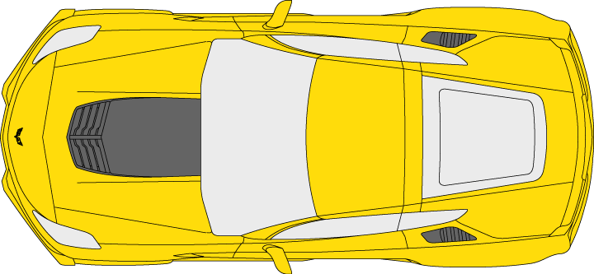
Measurement Setup – Vehicle Layout
A
B
C
1
2
4
3

Slide 4
Measurement Setup – Vehicle Layout (2)
3 vehicles parked side by side (vehicles A, B and C)
The distance between two adjacent vehicles is ~3m (~12ft)
Antennas – two monopole antennas spaced 7cm apart
Antenna locations:
  1: middle of the dash board
  2: middle of the vehicle, below hand break
  3: rear shelf
  4: center of the vehicle’s ceiling

Slide 5

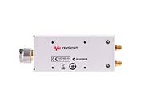
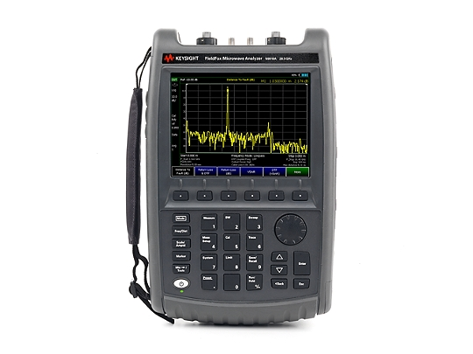
Measurement Methodology
A network analyzer measuring S12
Frequency range 2.4GHz – 2.5GHz
IF bandwidth 10KHz

Slide 6
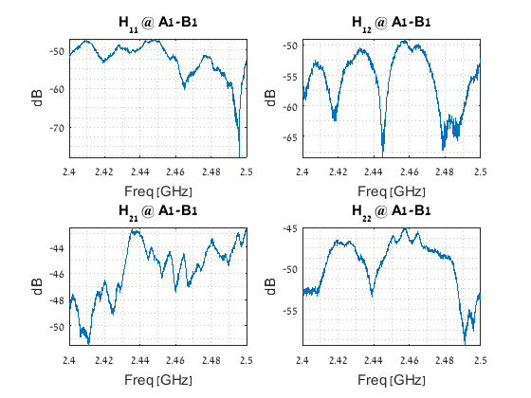
Measurement Results - Examples

Slide 7
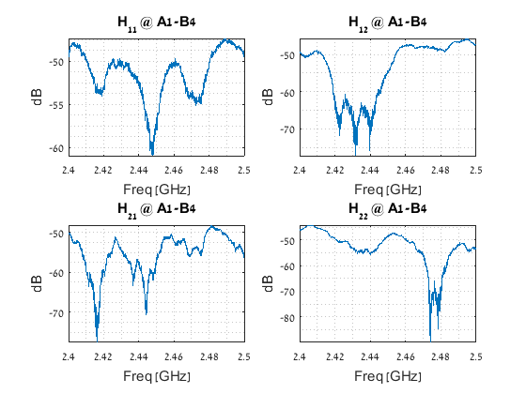
Measurement Results – Examples (2)

Slide 8
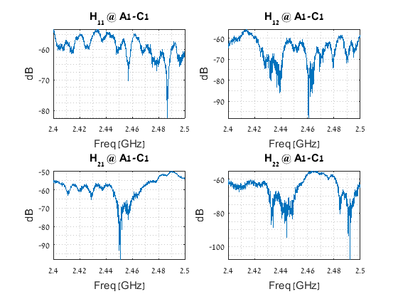
Measurement Results – Examples (3)

Slide 9
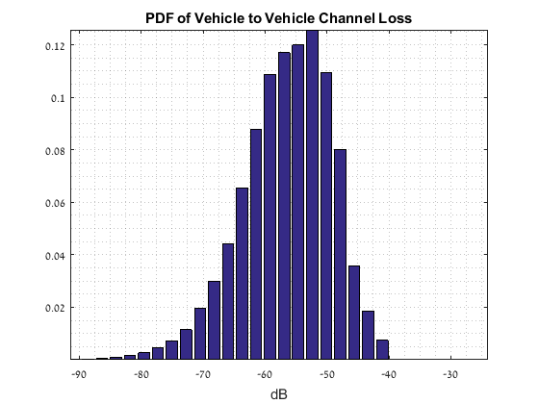
Measurement Results –
Analysis of Vehicles B and C Contribution

Slide 10
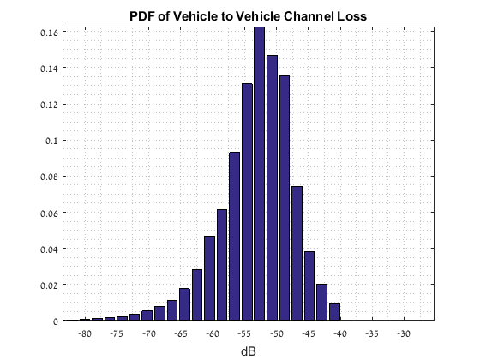
Measurement Results –
Analysis of Vehicle B Contribution

Slide 11
Discussion
The channel insertion loss between vehicles was measured
Generally, the loss between two adjacent vehicles is a little bit higher than the FSPL (~50dB @ 3m, 2.4GHz)
For some antenna locations the insertion loss is lower than the FSPL, due to the unique radiation pattern caused by the vehicle’s metal body
In this nomadic test we measured about 10% of the channels with insertion loss of close to only -40dB
Combined with [1] (Intra vehicle WiFi channel measurements), the receiving SNR would be <20dB in at least 10% of the channels, and a vacant vehicle

Slide 12
Suggestions for Future Work
Repeat the vehicle to vehicle measurement campaign while the vehicles are moving one relative to the other
Repeat [1] in the case of passengers in the vehicle

Slide 13
References
[1] On The Intra-Vehicle Channel Mode, IEEE 19-15/0084r0

