Slide 1
Title modification of standard
Date: 2017-03-13
Authors:
Notice: This document has been prepared to assist IEEE 802.19. It is offered as a basis for discussion and is not binding on the contributing individual(s) or organization(s). The material in this document is subject to change in form and content after further study. The contributor(s) reserve(s) the right to add, amend or withdraw material contained herein.

Slide 2
Abstract
This is the way to title modification of IEEE 802.19.1 Standard

Slide 3
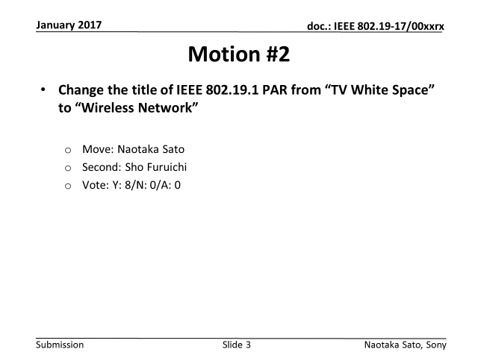
Motion result in January meeting

Slide 4
Title Modification Options
Jon Rosdahl and Steve Shellhammer discussed the way to title modification
Option A
  Complete the 802.19.1a amendment project
  Approve a PAR for a Revision Project for 802.19.1
  Incorporate 802.19.1a amendment into the 802.19.1 revision and change the title at the same time
Option B
  Withdraw the 802.19.1a PAR and approve a revision PAR for 802.19.1
  Cancel the 802.19.1 Sponsor Ballot Pool Formation
  Complete the work on the amendment and the title change as part of the revision
Option A is the only way

Slide 5
IEEE 802.19.1 revision project
Need to prepare PAR for a revision project for IEEE 802.19.1
Timeline proposal
  Submit PAR during Sponsor Ballot of IEEE P802.19.1a
    Approve in EC (earliest case): July meeting 2017
  The first meeting will take place after submitting the draft IEEE P802.19.1a to EC

