Slide 1
IEEE 802.11 systems Inter-Vehicle Measurements
Date: 2017-07-11
Authors:
Notice: This document has been prepared to assist IEEE 802.19. It is offered as a basis for discussion and is not binding on the contributing individual(s) or organization(s). The material in this document is subject to change in form and content after further study. The contributor(s) reserve(s) the right to add, amend or withdraw material contained herein.

Slide 2
Abstract
This document presents Wi-Fi measurements in the automotive domain.
Interference between two neighbouring cars is considered.
Both SISO and MIMO are considered.
The effect of power control is studied.

Slide 3
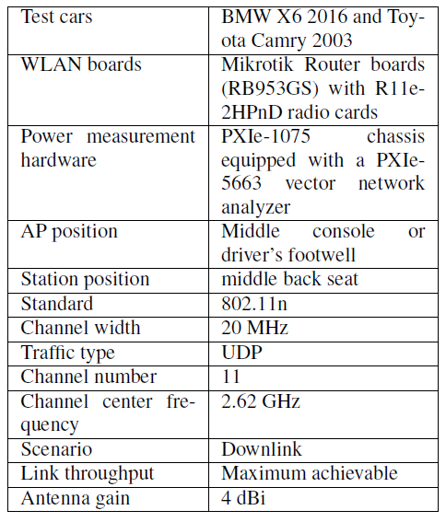
Measurement Setup and Baseline (1)
The performance is evaluated using network throughput test.
The WLAN board operating system supports throughput measurements.
The results are analyzed using collected power values.
Measurement parameters and equipment

Slide 4
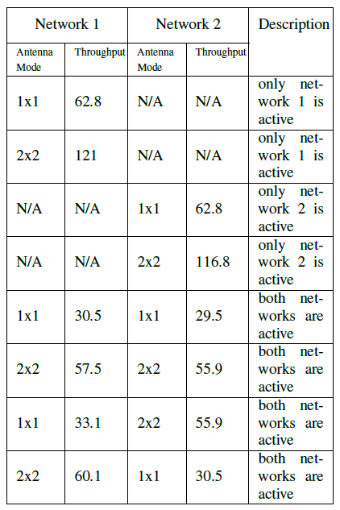
Measurement Setup and Baseline (2)
In order to define ground-truth throughput, baseline measurements were done in an anechoic chamber.
Two antenna configurations were considered: SISO and MIMO (2x2).
Baseline in anechoic chamber

Slide 5
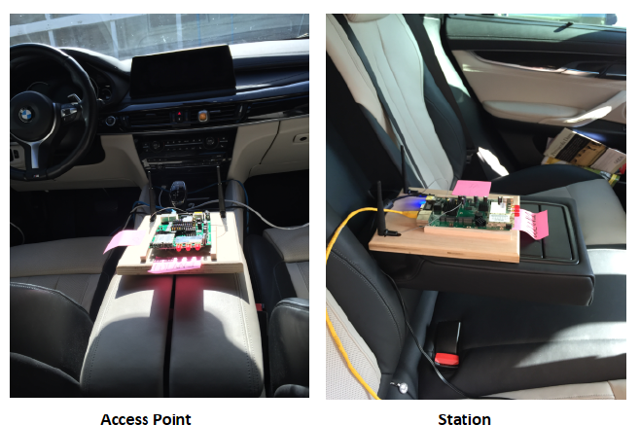
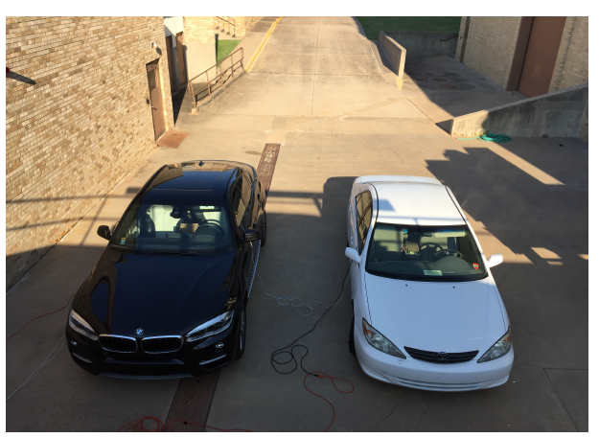
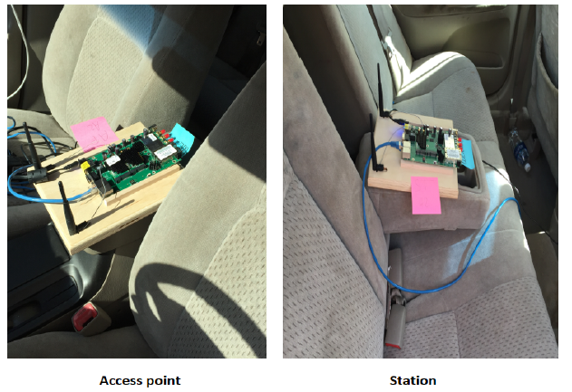
Measurement Setup and Baseline (3)
The two cars were parked parallel to each other with 1.5 m distance.
Two positions of access point were considered: middle console and driver’s footwell.
The test setup with the two cars
Access point and station positions

Slide 6
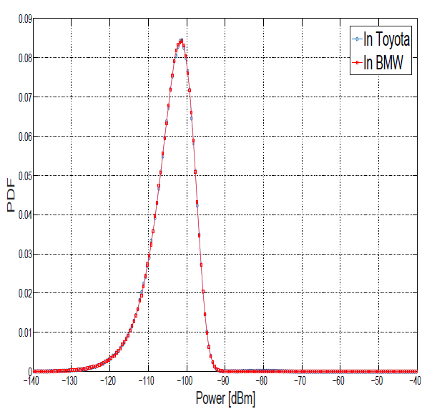
Measurement Results
A sixty-seconds average of throughput was used.
Measurements were repeated four times, which was enough to get low standard deviation around the mean (< 5Mbps).
Average values, in addition to the standard deviation around the means, are presented in the figures.
The probability density function (PDF) of power levels are used.
The noise mean is approximately -102 dBm in both cars
Background noise in both cars

Slide 7
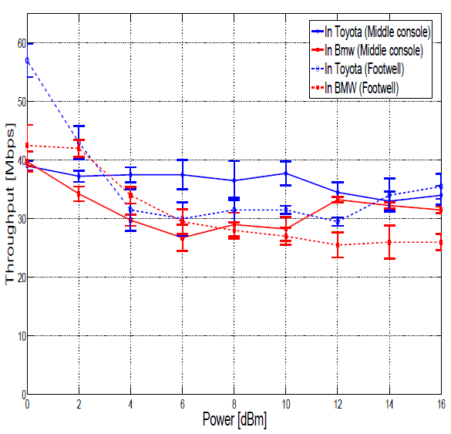
Measurement Results
SISO Case
  For high power levels, the sum of throughputs in both cars is slightly lower than the maximum achieved when only one network is active.
  The medium is shared evenly between the two networks.
  For low power levels, throughput in both cars rises.
The simultaneous increase in throughput occurs at higher power level for footwell position compared to middle console position
Throughput as a function of power for both AP positions

Slide 8
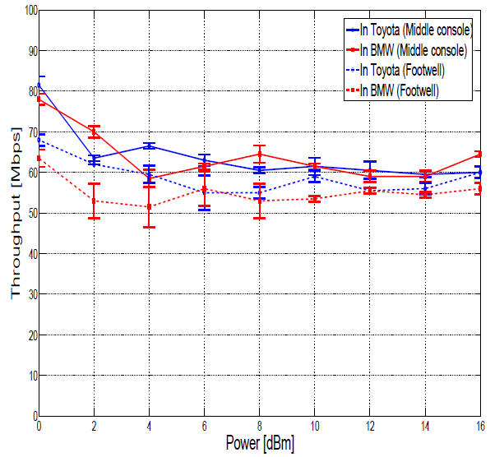
Measurement Results
MIMO Case
The throughput is approximately double SISO case.
Trends similar to those found in the SISO case are found in MIMO.
Throughput as a function of power for both AP positions

Slide 9
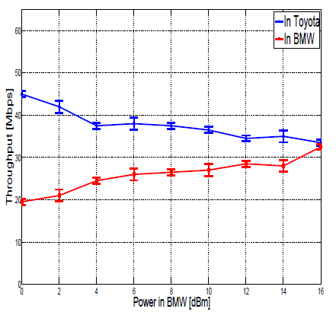
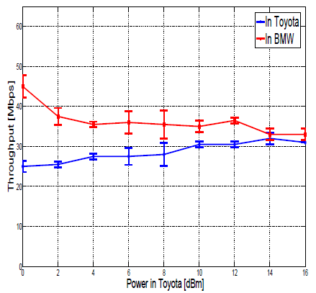
Measurement Results
Power Control
The AP is position on the middle console.
The power is fixed in one car to 16 dBm and changing in the second one.
Different power levels lead to unfairness in medium sharing.
Power in Toyota is fixed to 16 dBm
Power in BMW is fixed to 16 dBm

Slide 10
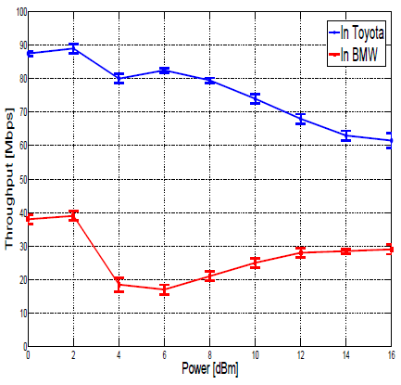
Measurement Results
SISO/MIMO
SISO in one car and MIMO (2x2) in the second one.
The medium is evenly shared between the two networks.
MIMO in Toyota and SISO in BMW

Slide 11
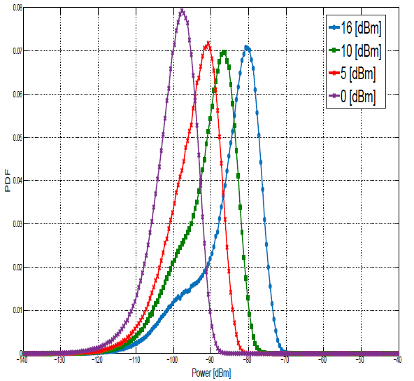
Measurement Results
Power levels
A vector signal analyzer is placed on the middle console in BMW.
The AP is positioned on the middle console in Toyota.
For a TX power level of 0 dBm, all the packets are received with power levels <-90 dBm.
PDF of received power in BMW for four transmission power levels in Toyota

Slide 12
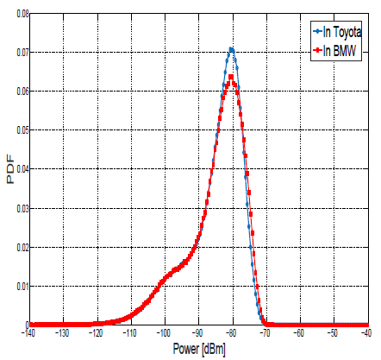
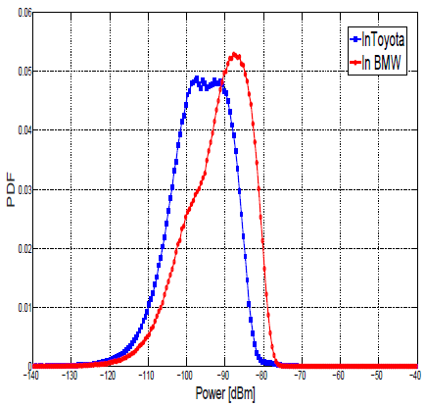
Measurement Results
Power levels
The transmission power is set to 16 dBm in both cars.
The PDF of received power in both AP positions are compared below.
middle console position
Footwell position

Slide 13
Observations and Conclusions
The automobile Wi-Fi domain is different than other domains, thus previous research performed in building environments cannot be easily extended.
Performed measurements show that interference between networks in cars is very high compared to building environments.
The position of the antennas should be optimized in order to reduce the interference to the surrounding networks.
Optimal tuning of transmission power is essential to guarantee good coverage inside the car and to reduce the interference with surrounding networks.
MIMO techniques could be used in order to boost the achieved data rates.

