Slide 1
In-band interference effects on 802.15 UWB
Date: 2018-03-05
Authors:
Name | Affiliations | Address | Phone | Email
Billy Verso | Decawave | Adelaide Chambers, Peter Street, Dublin, Ireland. | - | billy.verso @decawave.com
Notice: This document has been prepared to assist IEEE 802.19. It is offered as a basis for discussion and is not binding on the contributing individual(s) or organization(s). The material in this document is subject to change in form and content after further study. The contributor(s) reserve(s) the right to add, amend or withdraw material contained herein.

Slide 2
Purpose of this submission
Present to IEEE 802.19 the results of testing carried out to examine how in-band interference affects the performance of 802.15 UWB
Inform IEEE 802.19 members about the coexistence issues that are likely to arise for 802.15 UWB should other modulations be allowed to proliferate in the bands favored for UWB deployments

Slide 3
Bands of interest
While not currently allowed by FCC regulation 802.11ax (and others?) are looking for a spectrum allocation in the 6 GHz to 7 GHz band that is particularly favored by UWB product suppliers because of its wide regional regulatory suitability and FCC’s more permissive rules in this band.
  Next few slides summarize UWB regulatory applicability

Slide 4
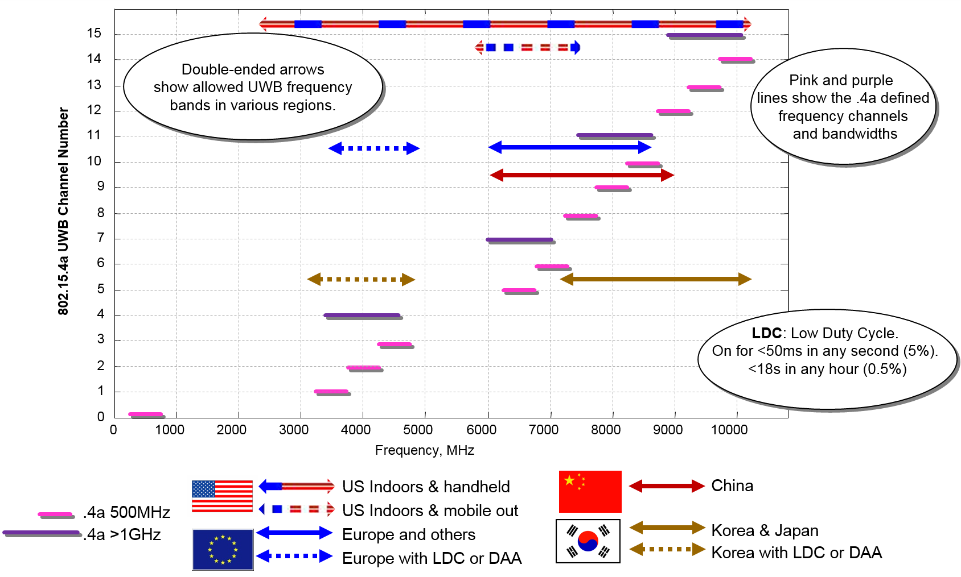
UWB regulations
FCC PART 15 - Subpart F
FCC PART 15
Subpart C

Slide 5
UWB regulations
Channel Band at 6.5 GHz is especially useful for its coverage of EU, USA and China, and its USA mobile outdoor use as per FCC PART 15 .250
Note: UWB channels were chosen to avoid 2.4 GHz and 5 to 6 GHz bands occupied by Wi-Fi

Slide 6
FCC regulation: 6 GHz to 7 GHz band
FCC PART 15 - RADIO FREQUENCY DEVICES
Subpart C - Intentional Radiators
Section 15.250 wideband systems within the band 5925-7250 MHz
The -10 dB bandwidth must be > 50 MHz, and lie between 5925 MHz and 7250 MHz
Maximum allowed TX power level is -41.3 dBm/MHz
Allows fixed and mobile indoors and mobile use outdoors

Slide 7
The testing
This testing was carried out in a wired setup using Decawave’s EVB1000 (an evaluation board for the DW1000 UWB transceiver IC).
  The DW1000 implements the UWB PHY specified by the 802.15 amendment 4a (2007), now called the HRP UWB PHY in the 2015 revision of 802.15.4
  The main application for this IC is real-time location including:
    robot guidance, factory automation, hospitals,
    position based access control for automotive keyless entry, buildings and residential
    safety of personnel around vehicles, machines and robots
  The EVB1000 has an SMA antenna connection

Slide 8
The test setup and procedure
The test setup is as shown. The Golden TX and DUT were configured to UWB Channel 5 (centred on 6.4896 GHz, with 499.2 MHz bandwidth) and to use the nominal 64 MHz PRF and the 6.81 Mb/s Data rate (the most popular configuration)
Levels at DUT were measured with a spectrum analyser
The power level from Golden TX was reduced until a 1% frame error rate was observed at the DUT
The power level was then increased by 3dB
The sig-gen was then used to generate a Wi-Fi like interference signal (at various bandwidths and centre frequencies for different tests) and its power level increased until a 1% frame error rate was again observed at the DUT
At this point the power level from the Golden TX was varied and frame error rates were recorded to generate the performance graph on the next sheet

Slide 9
Results
Interferer power levels required to cause a 3dB drop in DW1000 RX sensitivity

Slide 10
Results

Slide 11
How far away would an in-band Wi-Fi device need to be to avoid degrading an 802.15.4 UWB receiver?
We see (from results) the signal needs to be < -78 dBm (about x10 thermal noise)
The proponents of Wi-Fi would like to use the same power levels in the 6 GHz band that they currently use in the U-NII bands, typically +20 dBm
Let’s use Friis transmission equation* to find out the distance, in deciBel form:
Assuming 0 dB_{i} antennas and rearranging we get:
*https://en.wikipedia.org/wiki/Friis_transmission_equation

Slide 12
What power level would avoid excessive interference?
Obviously Wi-Fi devices like mobile phones cannot be guaranteed to be further away than 291m from 802.15.4a UWB devices such as key-fobs.
If the power allowed for such devices in the 6 GHz band was limited to the same level as current UWB devices, i.e. -41.3 dBm/MHz then a typical device with 40 MHz bandwidth would transmit at -25 dBm.
The distance now becomes:
This separation is certainly a lot more achievable
This power level may limit data rates and range, but perhaps not excessively since UWB can achieve 27 MB/s data rate at 80 m

Slide 13
Conclusion
The testing shows that in band interference has a big impact on UWB receiver performance
Clearly there are major coexistence concerns for 802.15 UWB deployments operating in the 6 GHz to 7 GHz band should 802.11ax (or similar) be allowed transmit at typical existing Wi-Fi power levels
Hopefully as a result of this submission 802.19 will be more aware and mindful of this issue when considering any 802.11 (or other) modulations looking to use these bands

Slide 14
THE END
THANK YOU

Slide 15
Backup info: Equations background

