Slide 1
July 2018 Sub 1 GHz Interest Group
Date: 2018-07-09
Authors:
Notice: This document has been prepared to assist IEEE 802.19. It is offered as a basis for discussion and is not binding on the contributing individual(s) or organization(s). The material in this document is subject to change in form and content after further study. The contributor(s) reserve(s) the right to add, amend or withdraw material contained herein.

Slide 2
Sub-1GHz Coexistence Interest Group
At the March Plenary interest was shown in forming an Interest Group on Coexistence in the sub-1GHz frequency bands
Met in May as IG.
The Interest Group will hold its first meetings this week
  Tuesday PM1
  Thursday PM1
IG Chair: Benjamin Rolfe, BCA, MERL
Recording Secretary: TBD

Slide 3
Opening
Meeting Preamble
Review and Approve Agenda
Review Objectives
Hear technical presentations
Discussion
Conclusions/Recommendations

Slide 4
Meeting Preamble
Be aware of:
http://standards.ieee.org/board/pat/pat-slideset.ppt
Any questions or disclosures?

Slide 5
Objectives of the IG
Examine coexistence situation with respect to 802.15.4 and 802.11 based systems operating in Sub-1GHz frequency bands
Evaluate possible actions in 802 to improve coexistence characteristics
  Review and discuss coexistence results
  Review possible mitigation techniques and strategies
    Standard changes?
    Implementation Strategies?
    Operational/deployment guidance?
    Other options?
Make recommendation(s) to the Working Group(s)

Slide 6
Meeting Objectives
Review simulation results
Continue work on simulation parameters
Begin use on use cases

Slide 7

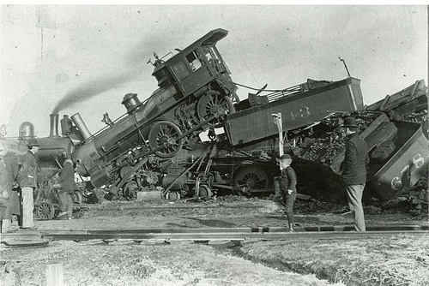
coexistence
noun
the state or fact of living or existing at the same time or in the same place.
Good Coexistence => rapidly growing opportunity
Poor Coexistence => missed opportunity

