Slide 1
Sub-1GHz Coexistence Simulation Models
Date: 2018-07-10
Authors:
Notice: This document has been prepared to assist IEEE 802.19. It is offered as a basis for discussion and is not binding on the contributing individual(s) or organization(s). The material in this document is subject to change in form and content after further study. The contributor(s) reserve(s) the right to add, amend or withdraw material contained herein.

Slide 2
Abstract
Share the Sub-1GHz Coexistence Simulation Models for simulation and use case scenario discussion
NS-3 can be reasonable for Coexistence Simulation by adding coexistence interface between 802.15.4g and 802.11ah modules

Slide 3
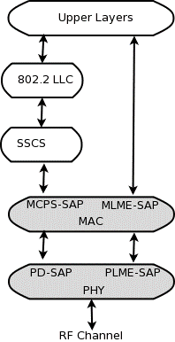
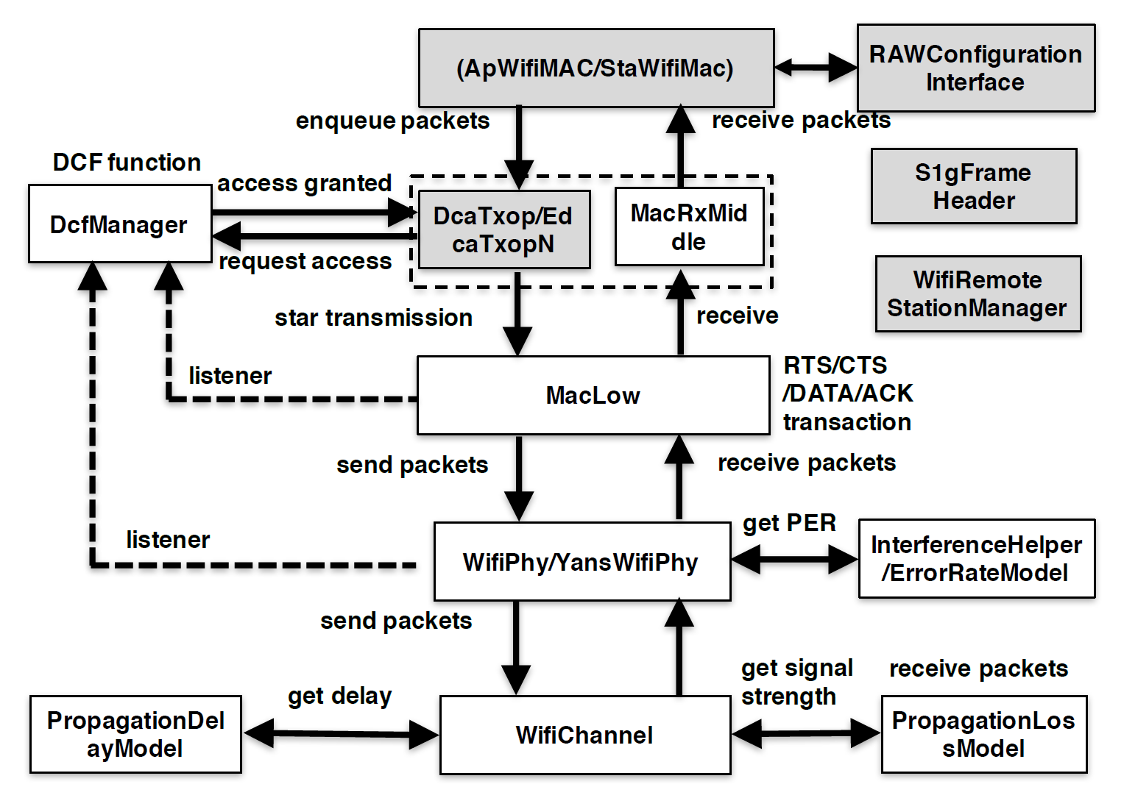
802.15.4g and 802.11ah Simulation Model
Current ns-3 does NOT include 802.11ah module, but 3rd party 802.11ah module can be implemented without coex function.
Additional coexistence interface between modules are needed.
802.15.4g module[1]
802.11ah module[2]

Slide 4
Sub-1GHz Coexistence Simulation Model
Additional Coexistence interfaces and functions on PHY/ channel modules are able to notify “Tx Info” each other to calculate mutual interference.
Notify 802.11ah Tx Info.
Notify 802.15.4g Tx Info.
802.15.4g module[1]
802.11ah module[2]

Slide 5
Simulation Functions and Requirements (1/2)
[Application Layer]
Each Application layer generates packets by Poisson distribution.
Packet interval can be calculated by application-level throughput and packet payload size from simulation scenario
[MAC Layer]
Each MAC layer senses transmitting frame by its own CSMA-CA algorithm (802.15.4g or 802.11ah), and senses channel activity via power detection, respectively.

Slide 6
Simulation Functions and Requirements (2/2)
[PHY Layer]
Each PHY layer calculates Frame Error Rate (FER) using SINR versus Bit Error Rate (BER) table in consideration of Tx frames from another system, and notifies “Tx Info” to another channel module.
[RF Channel]
Receive power can be calculated with propagation model.
ITU-R P.1411-8 model for propagation between terminals from below roof-top height to near street level[3]

Slide 7
Conclusion
Shared the Sub-1GHz Coexistence Simulation Models for simulation and use case scenario discussion
NS-3 can be reasonable for Coexistence Simulation by adding coexistence interface between 802.15.4g and 802.11ah PHY/channel modules

Slide 8
References
[1] Low-Rate Wireless Personal Area Network (LR-WPAN)
https://www.nsnam.org/docs/models/html/lr-wpan.html
[2] L. Tian, L. Latré, J. Famaey, “Implementation and validation of an IEEE 802.11ah module for NS-3,” Workshop on ns3 (WNS3), 2016.
[3] ITU-R P.1411

