Slide 1
S1G Coexistence Simulation Update
Date: 2019-03-12
Authors:
Notice: This document has been prepared to assist IEEE 802.19. It is offered as a basis for discussion and is not binding on the contributing individual(s) or organization(s). The material in this document is subject to change in form and content after further study. The contributor(s) reserve(s) the right to add, amend or withdraw material contained herein.

Slide 2
Summary
Presentation to TG3 of Simulation Update for Coexistence of IEEE 802.15.4g and IEEE 802.11ah Using New Simulation Parameters, and Japan Regulatory info on Transmission Time Control for Low Power Radio Station (ARIB STD-T108) towards Recommended Practice
Improved the accuracy of mutual interference in consideration of collision conditions
This document gathers relevant material from 19-18/0056r3

Slide 3
802.11ah and 802.15.4g Backoff Overview
802.11ah Backoff
Random Backoff Period
Busy: Re-backoff
Busy
DIFS
CCA
Backoff
counter = 0
Clear: Transmit
Busy: hold backoff counter
Clear: decrease backoff counter
802.15.4g Backoff
Random Backoff Period
Busy: Re-backoff
CCA
Backoff
counter = 0
Clear: Transmit
Observation
  802.11ah backoff time can be very long
  802.15.4g Backoff time is bounded

Slide 4
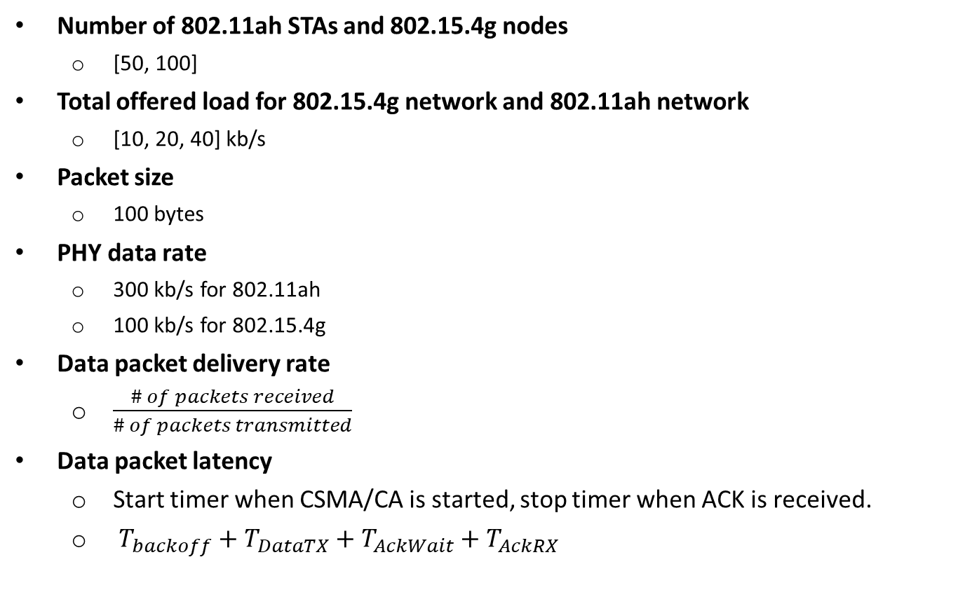
Simulation Parameters and Performance Metrics
Number of 802.11ah STAs and 802.15.4g nodes
  [50, 100]
Total offered load for 802.15.4g network and 802.11ah network
  [10, 20, 40] kb/s
Packet size
  100 bytes
PHY data rate
  300 kb/s for 802.11ah
  100 kb/s for 802.15.4g
Data packet delivery rate
  $\frac{\# of packets received}{\# of packets transmitted}$
Data packet latency
  Start timer when CSMA/CA is started, stop timer when ACK is received.
  $T_{backoff}+T_{DataTX}+T_{AckWait}+T_{AckRX}$

Slide 5
Node Deployment : 50 nodes
802.11ah (AP/STA) #1
802.11ah (AP/STA) #2
802.11ah (AP/STA) #3
802.15.4g (PANC)
*
802.15.4g (NODE)

Slide 6
Node Deployment : 100 nodes
802.11ah (AP/STA) #1
802.11ah (AP/STA) #2
802.11ah (AP/STA) #3
802.15.4g (PANC)
*
802.15.4g (NODE)

Slide 7
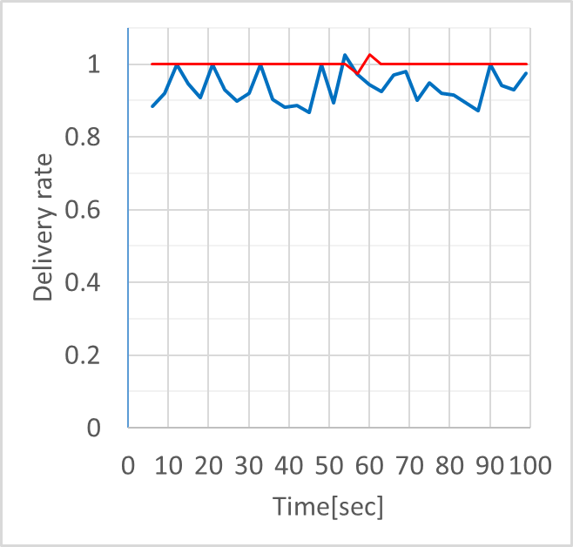
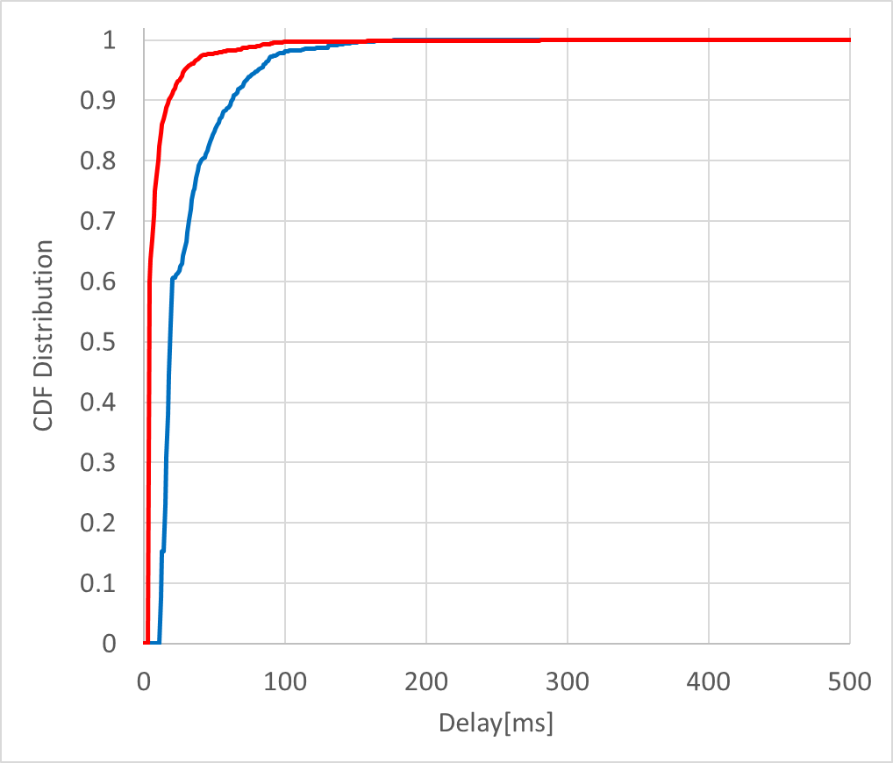
Case 1: 50 Nodes, 10 kbps for 802.11ah and 10 kbps for 802.15.4g
Packet delivery rate
  802.11ah delivers 100% of packets
  802.15.4g delivers 96.1% of packet
Packet latency
  In general, 802.11ah achieves shorter packet latency than 802.15.4g
  802.11ah delay in [4.9ms, 281.9ms], 802.1.5.4g delay in [12.8ms, 177.5ms]
15.4g CSMA → ACK Rx
11ah CSMA → ACK Rx

Slide 8
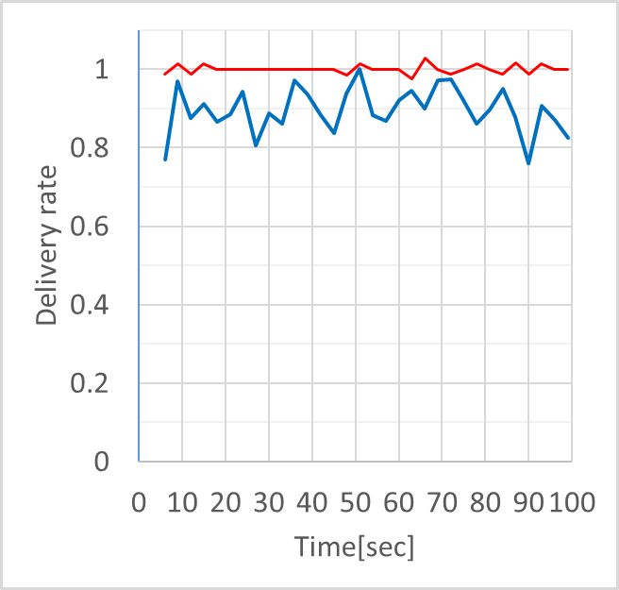
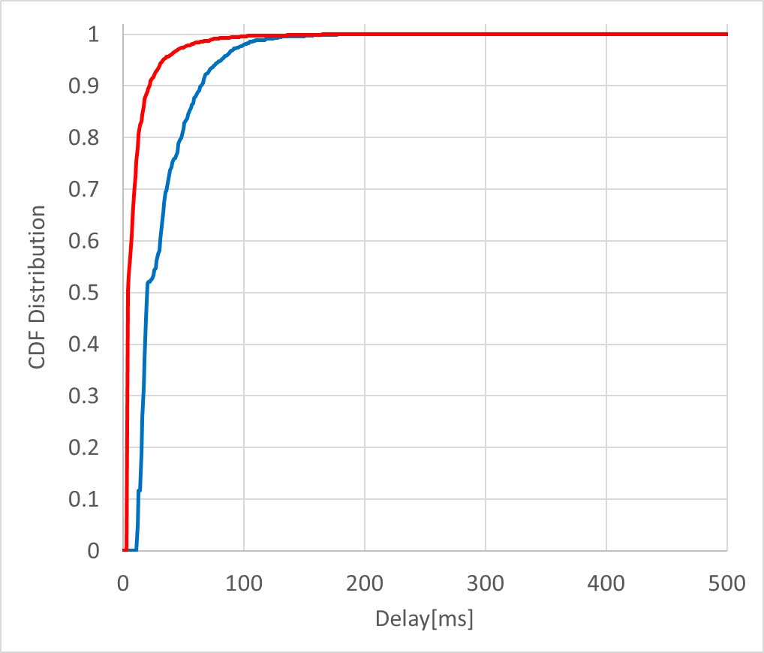
Case 2: 50 Nodes, 20 kbps for 802.11ah and 10 kbps for 802.15.4g
Packet delivery rate
  802.11ah delivers 100% of packets
  802.15.4g delivers 92.3% of packet
Packet latency
  In general, 802.11ah achieves shorter packet latency than 802.15.4g
  802.11ah delay in [4.9ms, 276.6ms], 802.1.5.4g delay in [12.8ms, 178.9ms]
15.4g CSMA → ACK Rx
11ah CSMA → ACK Rx

Slide 9
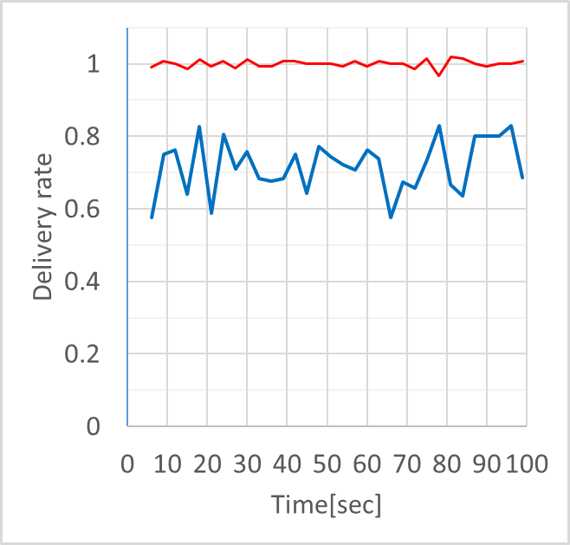
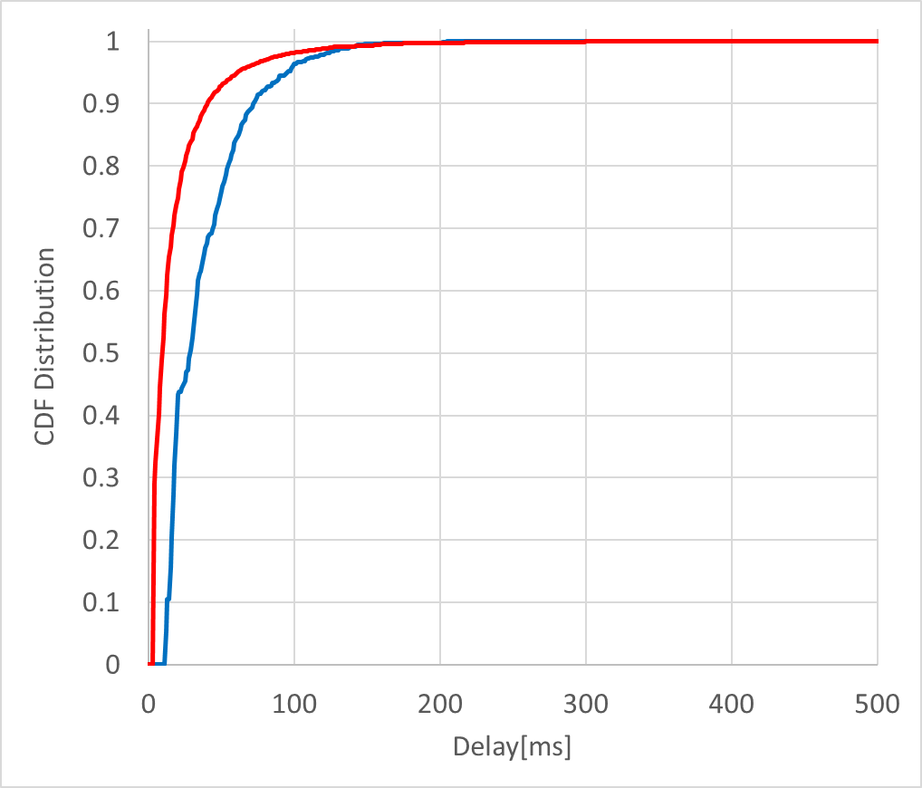
Case 3: 50 Nodes, 40 kbps for 802.11ah and 10 kbps for 802.15.4g
Packet delivery rate
  802.11ah delivers 100% of packets
  802.15.4g delivers 76.6% of packet
Packet latency
  In general, 802.11ah achieves shorter packet latency than 802.15.4g
  802.11ah delay in [4.9ms, 428.3ms], 802.1.5.4g delay in [12.8ms, 205.2ms]
15.4g CSMA → ACK Rx
11ah CSMA → ACK Rx

Slide 10
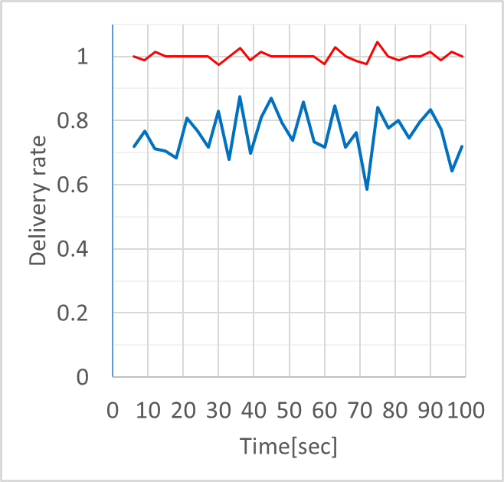
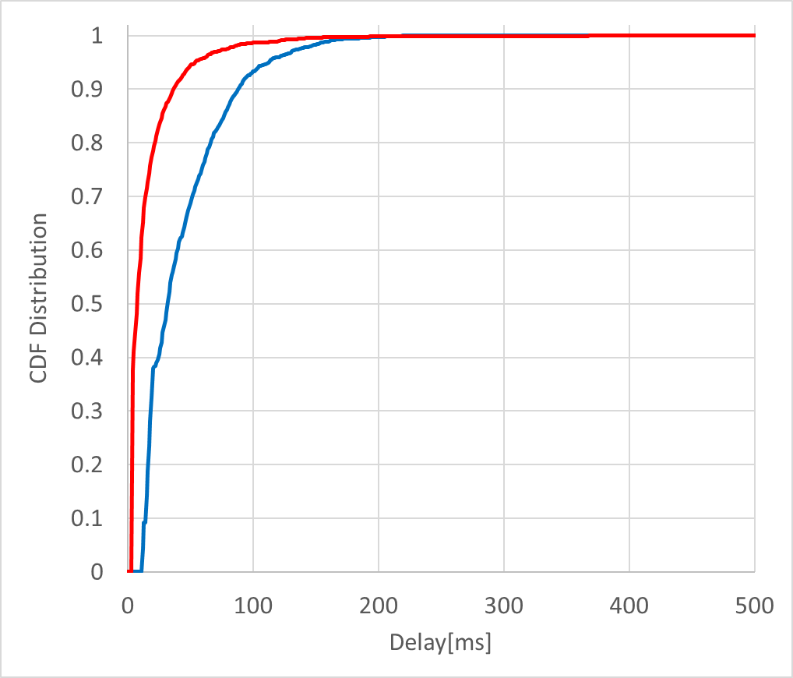
Case 4: 50 Nodes, 20 kbps for 802.11ah and 20 kbps for 802.15.4g
Packet delivery rate
  802.11ah delivers 100% of packets
  802.15.4g delivers 81.4% of packet
Packet latency
  In general, 802.11ah achieves shorter packet latency than 802.15.4g
  802.11ah delay in [4.9ms, 448.8ms], 802.1.5.4g delay in [12.8ms, 224.2ms]
15.4g CSMA → ACK Rx
11ah CSMA → ACK Rx

Slide 11
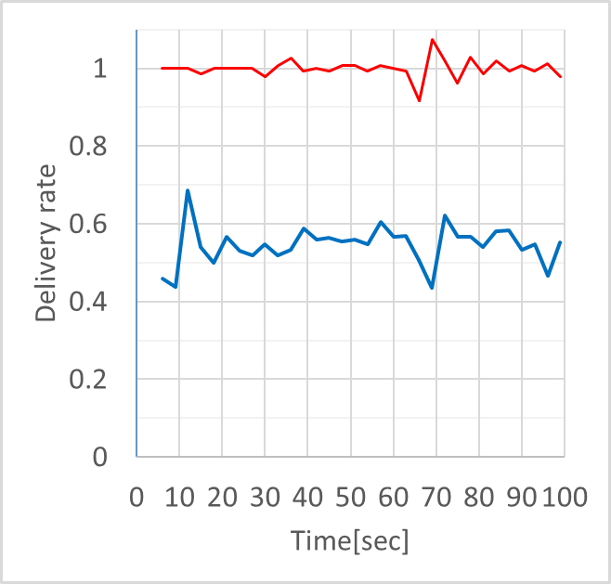
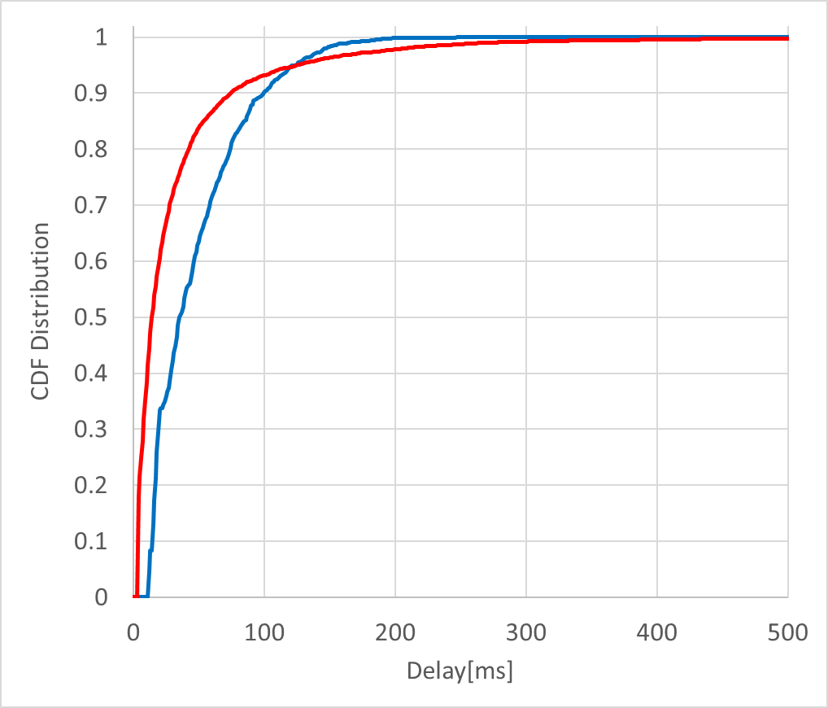
Case 5: 50 Nodes, 40 kbps for 802.11ah and 20 kbps for 802.15.4g
Packet delivery rate
  802.11ah delivers 99.9% of packets
  802.15.4g delivers 59.7% of packet
Packet latency
  In general, 802.11ah achieves similar packet latency as 802.15.4g
  802.11ah delay in [4.9ms, 982.4ms], 802.1.5.4g delay in [12.8ms, 247.3ms]
15.4g CSMA → ACK Rx
11ah CSMA → ACK Rx

Slide 12
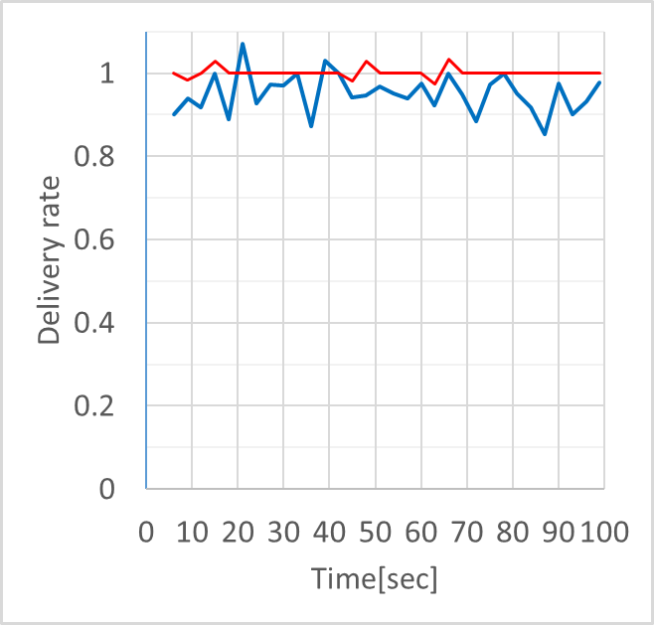
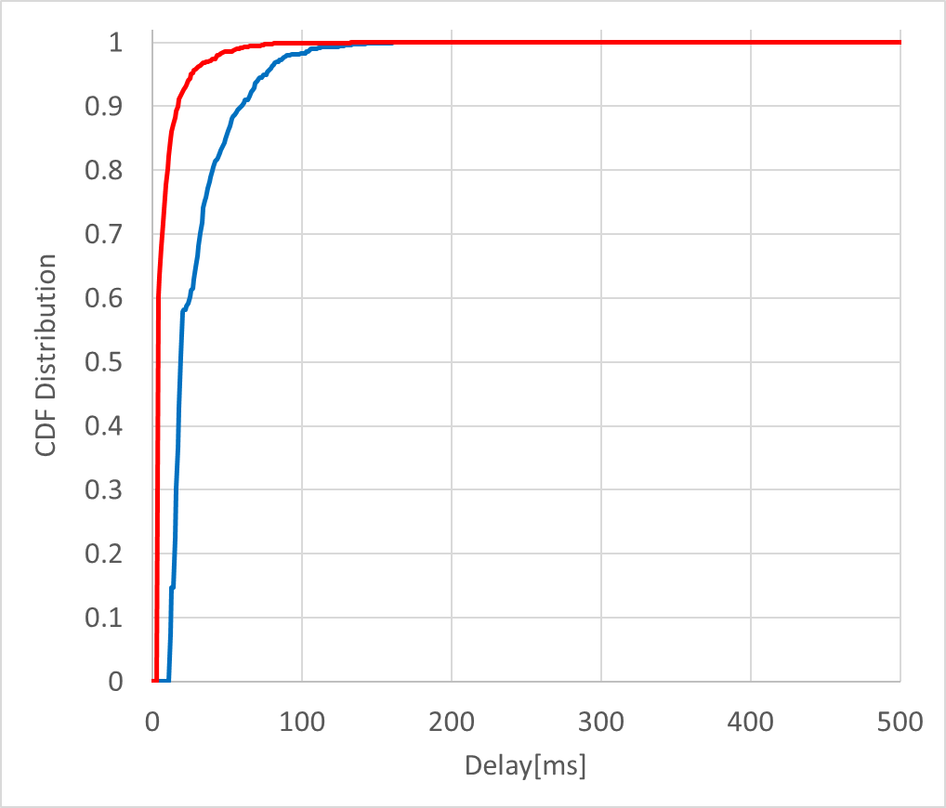
Case 6: 100 Nodes, 10 kbps for 802.11ah and 10 kbps for 802.15.4g
Packet delivery rate
  802.11ah delivers 100% of packets
  802.15.4g delivers 96.4% of packet
Packet latency
  In general, 802.11ah achieves shorter packet latency than 802.15.4g
  802.11ah delay in [4.9ms, 133.7ms], 802.1.5.4g delay in [12.8ms, 161.7ms]
15.4g CSMA → ACK Rx
11ah CSMA → ACK Rx

Slide 13
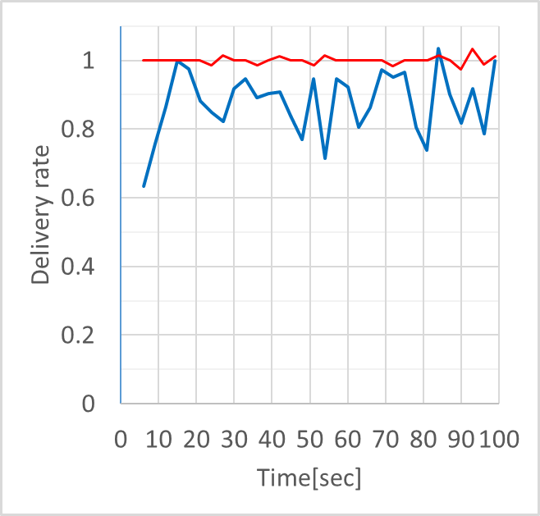

Case 7: 100 Nodes, 20 kbps for 802.11ah and 10 kbps for 802.15.4g
Packet delivery rate
  802.11ah delivers 99.9% of packets
  802.15.4g delivers 91.3% of packet
Packet latency
  In general, 802.11ah achieves shorter packet latency than 802.15.4g
  802.11ah delay in [4.9ms, 209.5ms], 802.1.5.4g delay in [12.8ms, 183.1ms]
15.4g CSMA → ACK Rx
11ah CSMA → ACK Rx

Slide 14
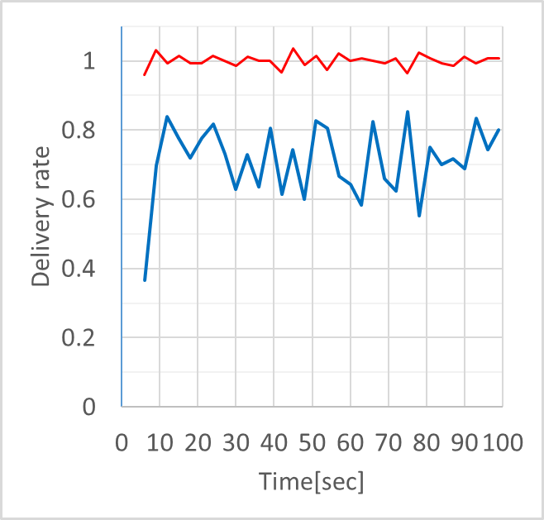
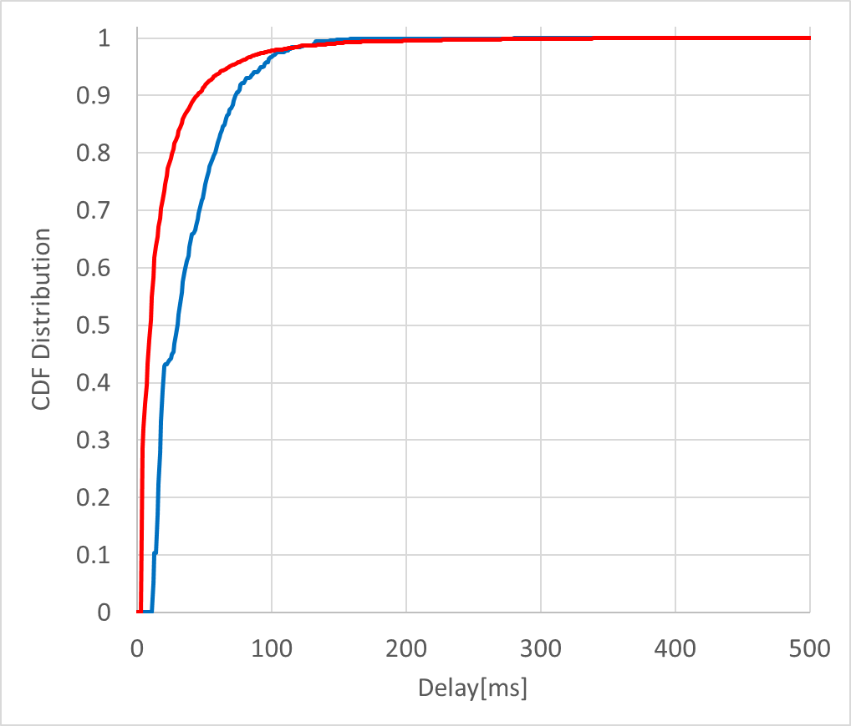
Case 8: 100 Nodes, 40 kbps for 802.11ah and 10 kbps for 802.15.4g
Packet delivery rate
  802.11ah delivers 100% of packets
  802.15.4g delivers 76.5% of packet
Packet latency
  In general, 802.11ah achieves longer packet latency than 802.15.4g
  802.11ah delay in [4.9ms, 824.4ms], 802.1.5.4g delay in [12.8ms, 280.3ms]
15.4g CSMA → ACK Rx
11ah CSMA → ACK Rx

Slide 15
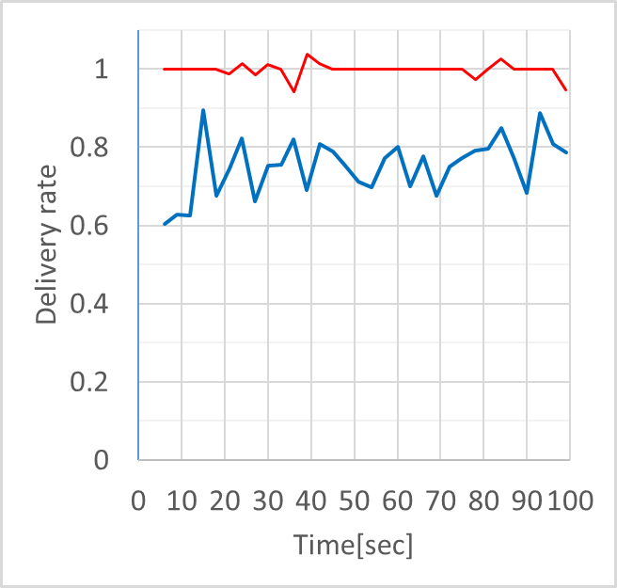
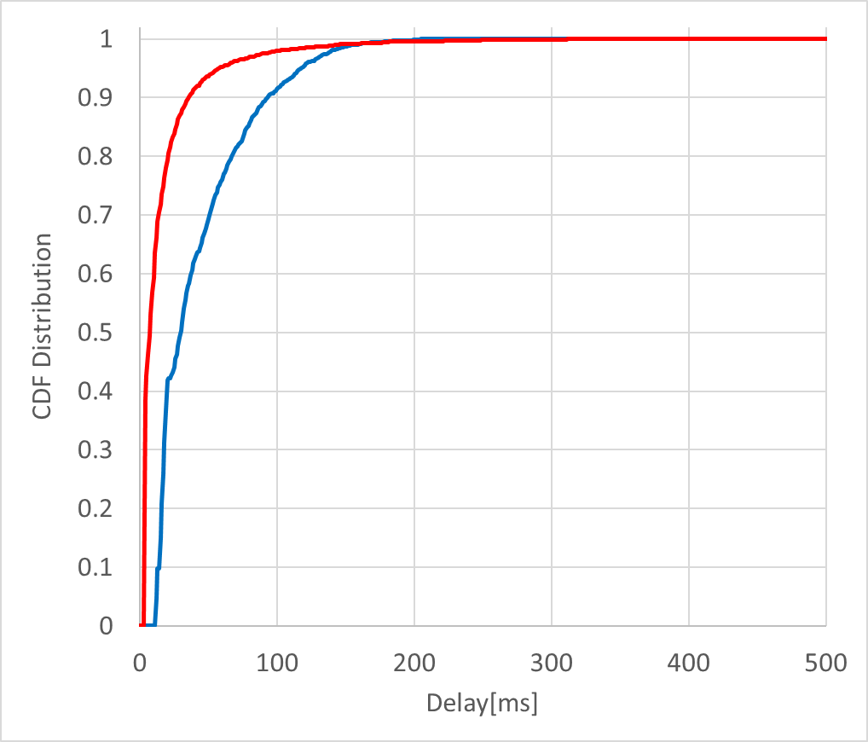
Case 9: 100 Nodes, 20 kbps for 802.11ah and 20 kbps for 802.15.4g
Packet delivery rate
  802.11ah delivers 100% of packets
  802.15.4g delivers 80.3% of packet
Packet latency
  In general, 802.11ah achieves longer packet latency than 802.15.4g
  802.11ah delay in [4.9ms, 343.9ms], 802.1.5.4g delay in [12.8ms, 209.6ms]
15.4g CSMA → ACK Rx
11ah CSMA → ACK Rx

Slide 16
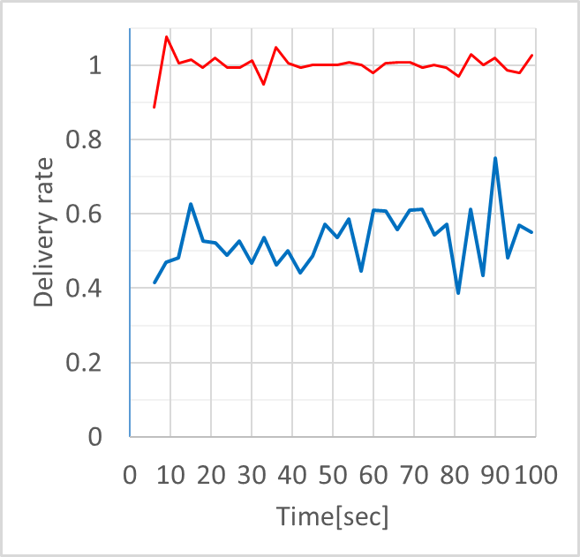
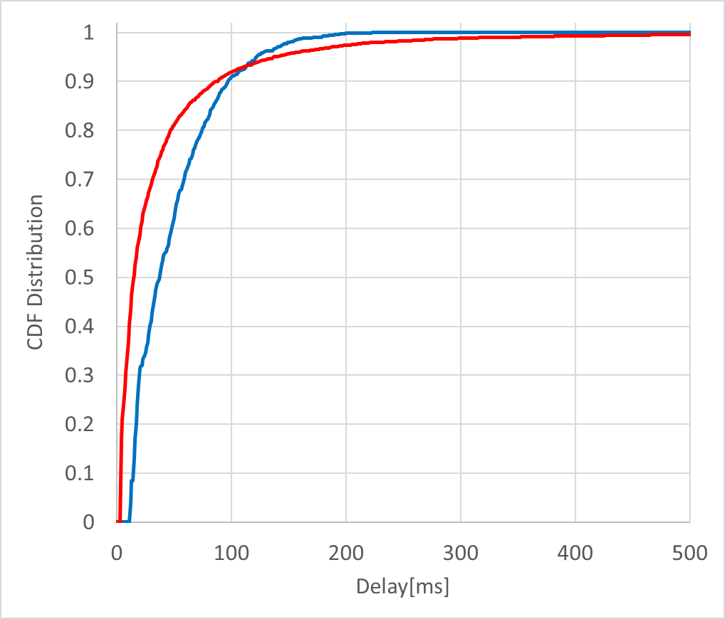
Case 10: 100 Nodes, 40 kbps for 802.11ah and 20 kbps for 802.15.4g
Packet delivery rate
  802.11ah delivers 99.9% of packets
  802.15.4g delivers 58.9% of packet
Packet latency
  In general, 802.11ah achieves much longer packet latency than 802.15.4g
  802.11ah delay in [4.9ms, 1168.2ms], 802.1.5.4g delay in [12.8ms, 223.5ms]
15.4g CSMA → ACK Rx
11ah CSMA → ACK Rx

Slide 17
Simulation Results Summary
Case | Node | Total Offered Load [kbps] |  | Packet Delivery Rate [%] |  | Packet Latency [Avg, min, max] [ms]
 |  | 11ah | 15.4g | 11ah | 15.4g | 11ah | 15.4g
1 | 50 | 10 | 10 | 100 | 96.1 | [10.1, 4.9, 281.9] | [30.7, 12.8, 177.5]
2 | 50 | 20 | 10 | 100 | 92.3 | [11.4, 4.9, 276.6] | [33.1, 12.8. 178.9]
3 | 50 | 40 | 10 | 100 | 76.6 | [18.8, 4.9, 428.3] | [37.7, 12.8, 205.2]
4 | 50 | 20 | 20 | 100 | 81.4 | [16.8, 4.9, 448.8] | [43.9, 12.8, 224.2]
5 | 50 | 40 | 20 | 99.9 | 59.7 | [33.9, 4.9, 982.4] | [48.4, 12.8, 247.3]
6 | 100 | 10 | 10 | 100 | 96.4 | [9.3, 4.9, 133.7] | [30.0, 12.8, 161.7]
7 | 100 | 20 | 10 | 99.9 | 91.3 | [11.9, 4.9, 209.5] | [33.2, 12.8, 183.1]
8 | 100 | 40 | 10 | 100 | 76.5 | [20.4, 4.9, 824.4] | [38.5, 12.8, 280.3]
9 | 100 | 20 | 20 | 100 | 80.3 | [17.4, 4.9, 343.9] | [43.6, 12.8, 209.6]
10 | 100 | 40 | 20 | 99.9 | 58.9 | [38.2, 4.9, 1168.2] | [48.9, 12.8, 223.5]

Slide 18
Summary
Simulation results were slightly different from 19-18/0056r3, because of NS3 bugs on mutual interference and collision.
802.11ah impacts 802.15.4g packet delivery
802.15.4g impacts 802.11ah packet latency
802.11ah packet latency is unbounded
  CCA is required in each backoff slot
  Backoff counter decreases only if the channel is idle
802.15.4g packet latency is bounded
  CCA is not required during random backoff period
  CCA is performed after random backoff period
We would like the IEEE 802.19.3 to continue the discussion of simulation towards Recommended Practice.

Slide 19
Straw Poll
Are you interested in Coexistence Simulation Results to be discussed on Recommended Practice?
Yes:
No:
Abstain:

