Slide 1
802.11ah and 802.15.4g coexistence Simulation and Coexistence issues
Date: 2019-08-15
Authors:
Notice: This document has been prepared to assist IEEE 802.19. It is offered as a basis for discussion and is not binding on the contributing individual(s) or organization(s). The material in this document is subject to change in form and content after further study. The contributor(s) reserve(s) the right to add, amend or withdraw material contained herein.

Slide 2
Introduction
This document summarizes 802.11ah and 802.15.4g coexistence performance and identifies coexistence issues to be addressed
This document is intended for Section 7 in the Table of Content #19-19/0035r3

Slide 3
802.11ah and 802.15.4g Functions Related to Coexistence
Coexistence Mechanism
802.11ah
  802.11ah specifies ED based CCA for inter-system coexistence
  ED threshold
    -75 dBm for primary 1 MHz channel
    -72 dBm for primary 2 MHz channel and secondary 2 MHz channels
    -69 dBm for secondary 4 MHz channel
    -66 dBm for secondary 8 MHz channel
802.15.4g
  802.15.4g does not specifically define inter-system coexistence
  However, ED based CCA is implicitly used for inter-system coexistence if ED based CCA is applied. Otherwise, no ED based inter-system coexistence is provided.
    For FSK PHY with FEC, threshold is in [-100 dBm, -78 dBm]
  CSM based intra-system coexistence

Slide 4
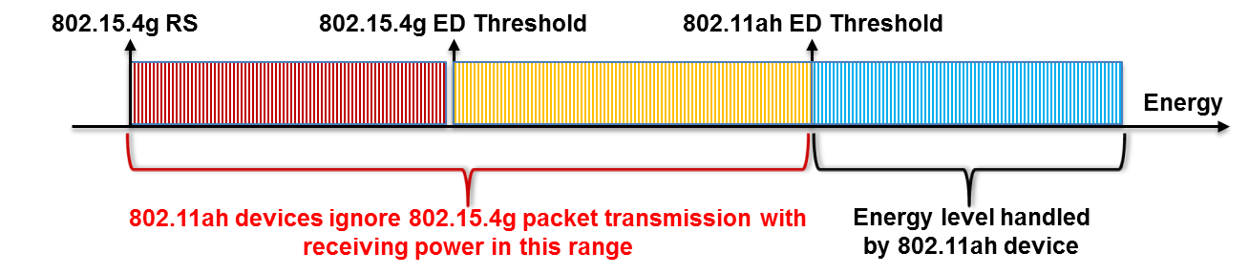
802.11ah and 802.15.4g Functions Related to Coexistence
ED Threshold
Higher ED threshold of 802.11ah can cause coexistence Issue
For FSK PHY with FEC, threshold is in [-100 dBm, -78 dBm], 802.15.4g receiver sensitivity (RS) is in [-110 dBm, -88 dBm]
Consequence
  Readable 802.15.4g packets with receiving power level within the range [802.15.4g RS, 802.11ah ED Threshold] are ignored by 802.11ah ED CCA mechanism, which result in
    802.15.4g packet collision
  802.11ah devices access channel more, which result in
    802.15.4g packet drop due to channel access failure

Slide 5
802.11ah and 802.15.4g Functions Related to Coexistence
PHY, Channel Width and Data Rate
802.11ah
  OFDM PHY
  1MHz/2MHz/4MHz/8MHz/16MHz channels
  150kbps – 78Mbps data rate (for 1 spatial stream)
802.15.4g
  MR-FSK/MR-OFDM/MR-O-QPSK PHYs
  200kHz/400kHz/600kHz/800kHz/1200kHz channels
  6.25kbps – 2.4Mbps data rate

Slide 6
802.11ah and 802.15.4g Functions Related to Coexistence
CSMA/CA Mechanism
802.11ah allows immediate channel access
However, 802.15.4g requires backoff no matter how long channel has been idle.
802.11ah backoff is much faster than 802.15.4g backoff due to much smaller parameters
802.11ah requires backoff suspension, i.e., 802.11ah device must perform CCA in each backoff slot and can decrease backoff counter only if the channel is idle.
On the other hand, 802.15.4g has no backoff suspension. 802.15.4g device performs CCA after the backoff procedure completes.802.11ah

Slide 7
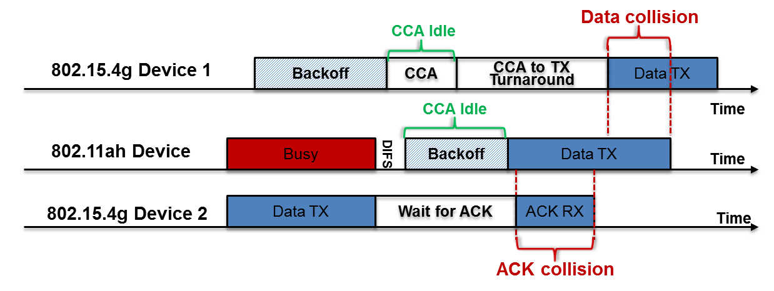
802.11ah and 802.15.4g Functions Related to Coexistence
CSMA/CA Mechanism
Consequence of 802.11ah Faster CSMA/CA
  802.11ah device may start packet transmission when 802.15.4g device performs CCA-to-TX turnaround, which causes data packet collision
  802.11ah device may start packet transmission when 802.15.4g device is waiting for ACK packet, which causes ACK packet collision and retransmission

Slide 8
802.11ah and 802.15.4g Functions Related to Coexistence
Summary
Functions in favor of 802.11ah
  ED threshold
  Channel width
  Data rate
  Immediate channel
  Smaller backoff parameters
Function in favor of 802.15.4g
  802.11ah backoff suspension
    802.15.4g packet transmission takes longer time
    Theoretically, an 802.11ah packet can be infinitely delayed, but an 802.15.4g packet has bounded delay.

Slide 9
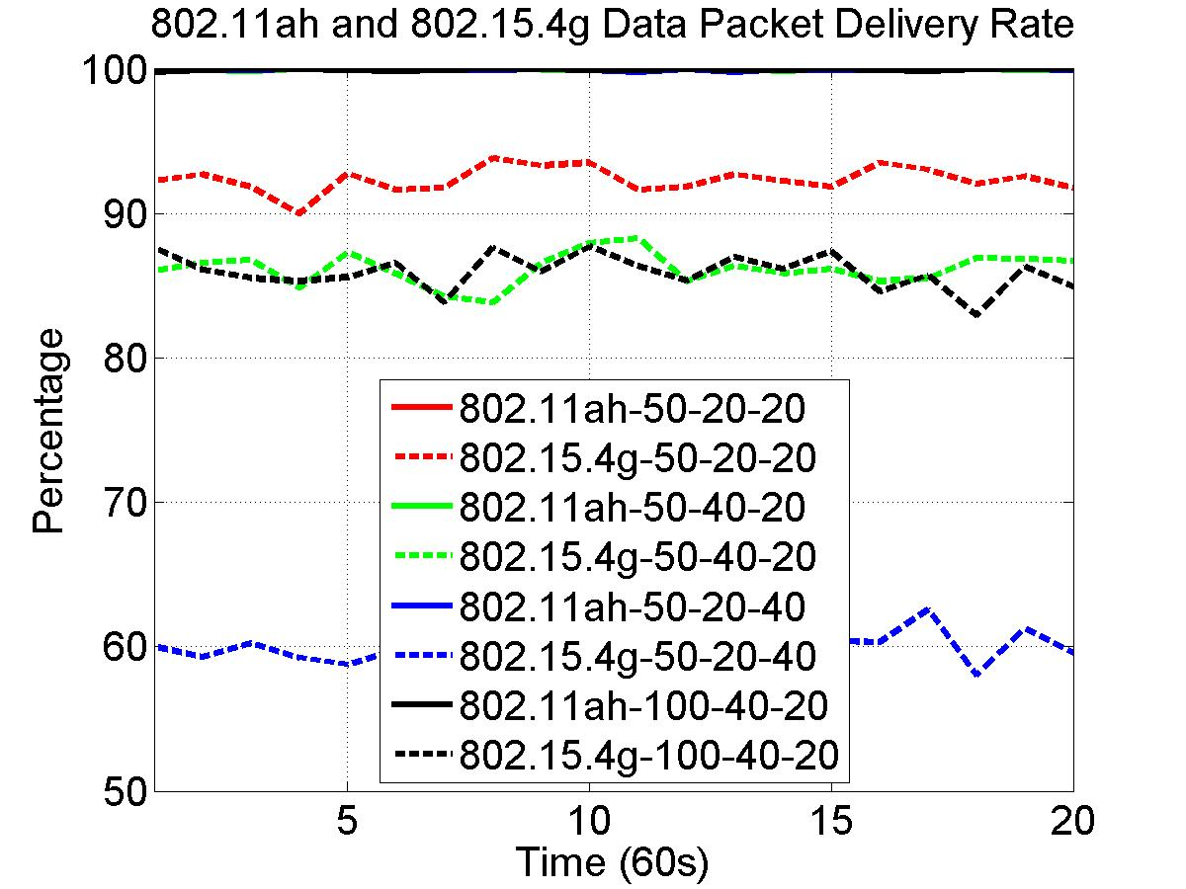
802.11ah and 802.15.4g Coexistence Simulation - Packet Delivery Rate
Solid lines for 802.11ah, and dash lines for 802.15.4g
50-20-20 indicates that 50 nodes for each network, 20 kbps offered load for 802.11ah network, 20kbps offered load for 802.15.4g network
The highest duty cycle is 0.8%, which is less than 1%

Slide 10
Observations from 802.11ah and 802.15.4g Data Packet Delivery Rate
For all scenarios, 802.11ah network delivers near 100% of the packet
  Indicate that network traffic and network size have less impact on 802.11ah packet delivery rate
802.11ah network traffic has impact on 802.15.4g packet delivery rate
  802.15.4g network packet delivery rate decreases as 802.11ah network traffic increases
802.15.4g network traffic affects more on its packet delivery rate
  802.15.4g network packet delivery rate decreases significantly as its network traffic doubles
The network size has little effect on 802.15.4g network packet delivery rate

Slide 11
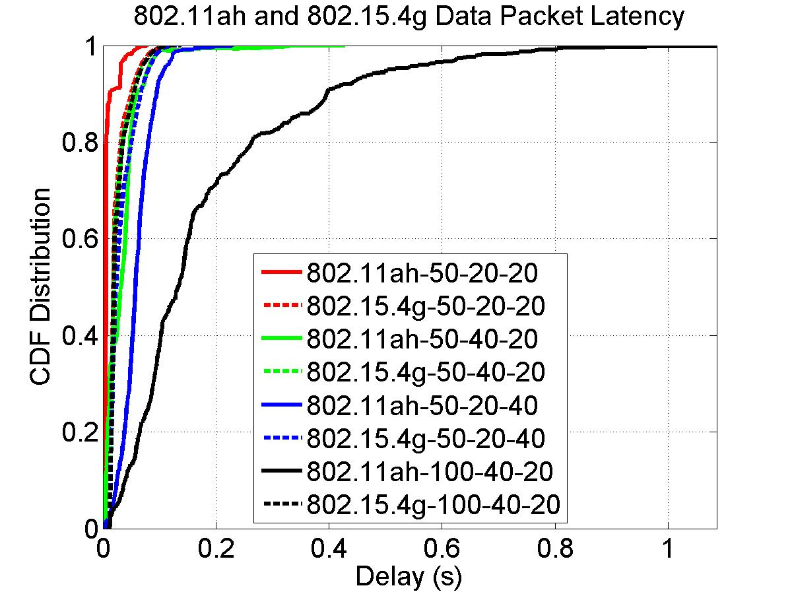
802.11ah and 802.15.4g Coexistence Simulation - Packet Latency
Solid lines for 802.11ah, and dash lines for 802.15.4g
50-20-20 indicates that 50 nodes for each network, 20 kbps offered load for 802.11ah network, 20kbps offered load for 802.15.4g network

Slide 12
Observations from 802.11ah and 802.15.4g Packet Latency
For all scenarios, 802.15.4g network achieves similar packet latency
  Indicate that 802.15.4g packet is either delivered with the bounded delay or dropped
  Therefore, network traffic and network size have little impact on 802.15.4g packet latency
802.11ah network traffic has impact on its packet latency
  802.11ah packet latency increases as its network traffic increases
802.15.4g network traffic has more impact on 802.11ah packet latency
  802.11ah network packet latency increases more as 802.15.4g network traffic doubles
Network size has major influence on 802.11ah packet latency
  802.11ah packet latency increases significantly as the number of nodes doubles, which verifies that 802.11ah packet can be infinitely delayed

Slide 13
802.11ah and 802.15.4g Coexistence Issues to Be Addressed
802.15.4g data packet delivery reliability
  First priority
802.11ah data packet latency
  Second priority

Slide 14
802.11ah and 802.15.4g Use Cases

