Slide 1
802.15.4w Overview and Status
Date: 2019-11-12
Authors:
Notice: This document has been prepared to assist IEEE 802.19. It is offered as a basis for discussion and is not binding on the contributing individual(s) or organization(s). The material in this document is subject to change in form and content after further study. The contributor(s) reserve(s) the right to add, amend or withdraw material contained herein.

Slide 2
Abstract
Introduction to LPWAN
LPWAN challenges
802.15.4w technological approaches
802.15.4w current status

Slide 3
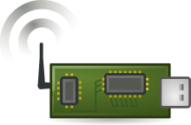
Introduction to Low Power Wide Area Networks
up to 100m
e.g. >10km
e.g. 10dBm (10mW)
Low Power Wide Area Networks (LPWAN) enable long-range transmission with very low transmit powers by using
  very low payload bit-rates (~1kBit/s) → high sensitivity (e.g. -140dBm)
  highly exposed base-station antennas → reduced path-loss
Focus is almost completely on uplink traffic

Slide 4
LPWAN Challenges
Large spectral footprint of LPWAN signals due to low payload bit-rates
  High probability of collision with interferer
Very low required reception levels
  Other systems may not be able to detect our LPWAN transmissions
Highly exposed base-stations
  Listen before talk (CCA) will not work due to hidden node problem
Significantly increased use of license-exempt bands expected in the future
  Introduction of new systems, e.g. sub-GHz WiFi (IEEE 802.11ah), and increased use of other sub-GHz systems

Slide 5
802.15.4w Approaches
Amends 802.15.4k FSK PHY as it operates already quite close to the theoretical bounds in the AWGN channel
Adds additional lower bit-rates and frequency hopping
Adds improved forward error correction using powerful LDPC and convolutional codes
All additional features on the transmitter side can be achieved purely by software using existing FSK transmitter chips

Slide 6
Typical Parameter Configurations
System | PHY | PHY Mode | Coding | SNR for FER < 1% | Sensitivity | Eff. Bit-rate*)
802.15.4.w | MSK, SF1 | 19.04kS/s | Conv. 1/2 | 0.3 dB | -131 dBm | 9.5kb/s
 |  | 9.52kS/s | Conv. 1/3 | -1.7 dB | -136 dBm | 3.2kb/s
 |  | 2.38kS/s | Conv. 1/3 | -1.7 dB | -142 dBm | 0.8kb/s
 | MSK, SF2 | 2.38kS/s | LDPC 1/4 | -7.5dB | -148 dBm | 0.3kb/s
CCA will not be able to reliably detect 802.15.4w transmissions

Slide 7
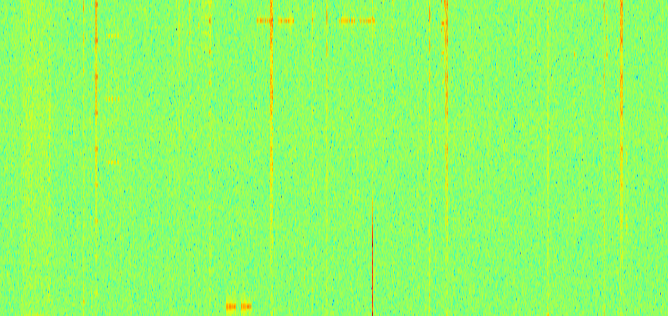
802.15.4w Frequency Hopping
Frequency
Collided Hop
Non-Collided Hop
Time
Number of lost hops gets predictable (law of large numbers)
Coexistence mechanism for highly occupied frequency bands

Slide 8
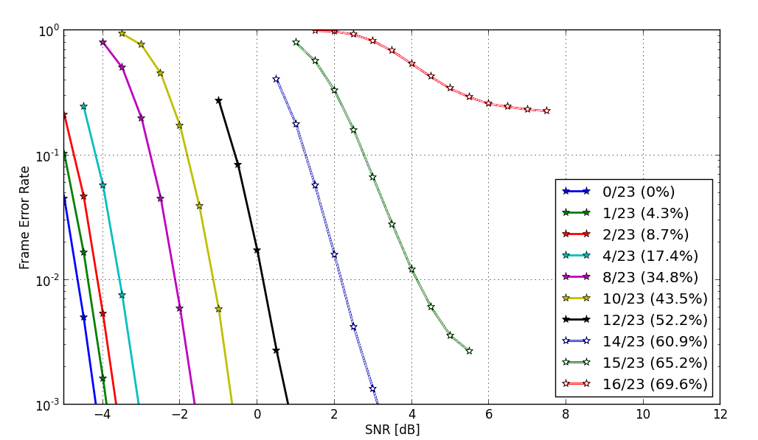
Simulation Results SNR vs. Number of Collided Hops
LDPC Code-Rate ¼, 23 Hops
Still works with 65% lost hops

Slide 9

Current Status of IEEE 802.15.4w
TASK | Completed
Start of TG work | Mar, 2018
Call for Proposals | Mar, 2018
Technical Guidelines Doc. | Mar, 2018
Initial discussion of proposals | July, 2018
Editing Draft | Jan, 2019
LB | Mar, 2019
LB Comment Resolution | May, 2019
LB Recirculation / SB | July, 2019
SB Comment Resolution | Nov, 2019
Submission to RevCom | ?, 2020
802.15.4w has to wait for current 802.15.4 revision to complete before publication

Slide 10
Summary
LPWAN will suffer strong interference from other systems due to their system design
802.15.4w uses diversity and strong forward error correction for reliable communication in densely used license-exempt frequency bands
802.15.4w offers passive co-existence by design
802.15.4w sponsor ballot has been completed
Currently waiting for latest 802.15.4 revision before final publication

