Slide 1
Consideration of Fairness Index for
Sub-1GHz Coexistence
Date: 2019-11-12
Authors:
Notice: This document has been prepared to assist IEEE 802.19. It is offered as a basis for discussion and is not binding on the contributing individual(s) or organization(s). The material in this document is subject to change in form and content after further study. The contributor(s) reserve(s) the right to add, amend or withdraw material contained herein.

Slide 2
Abstract
Consider Fairness Index when 802.11ah and 802.15.4g coexist on the same frequency band.
Jain’s Fairness Index was applied for coexistence fairness index to evaluate fair degradation at coexistence situation.
Fairness index between 802.11ah and 802.15.4g is calculated by throughput degradation ratio from offered load.
Results shows that Fairness Index worked correctly, and the coexistence mechanisms improved fairness between 802.11ah and 802.15.4g.

Slide 3
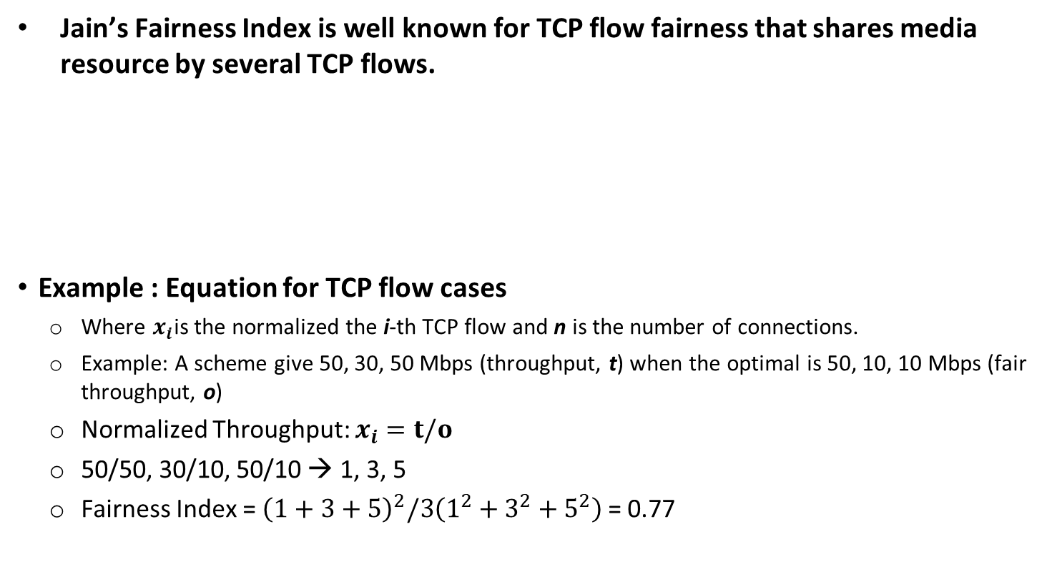

Fairness Index
Jain’s Fairness Index is well known for TCP flow fairness that shares media resource by several TCP flows.
Example : Equation for TCP flow cases
  Where $x_{i}$is the normalized the i-th TCP flow and n is the number of connections.
  Example: A scheme give 50, 30, 50 Mbps (throughput, t) when the optimal is 50, 10, 10 Mbps (fair throughput, o)
  Normalized Throughput: $x_{i}=t/o$
  50/50, 30/10, 50/10 → 1, 3, 5
  Fairness Index = ${\left(1+3+5\right)}^{2}/3\left(1^{2}+3^{2}+5^{2}\right)$ = 0.77
$$\frac{{(\sum_{i=1}^{n}{x_{i}})}^{2}}{n\sum_{i=1}^{n}{x_{i}^{2}}}$$
D.-M. Chiu and R. Jain, “Analysis of the increase and decrease algorithms for congestion avoidance in computer networks,” Computer Networks and ISDN Systems, vol. 17, pp. 1–14, 1989

Slide 4
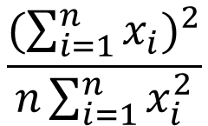
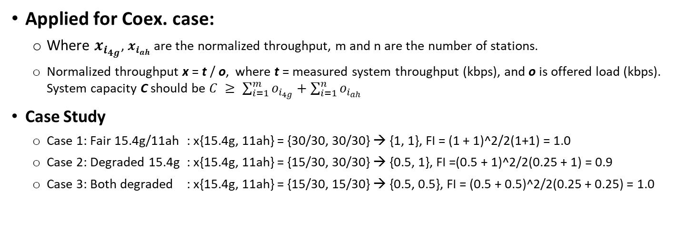
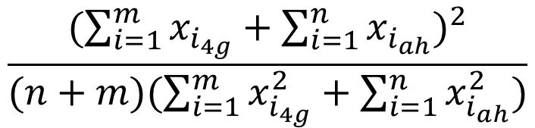
Fairness Index for Coex.
Apply Jain’s Fairness Index for IEEE 802.15.4g and IEEE 802.11ah coexistence situation to evaluate fair degradation at coexistence situation.
$$\frac{{(\sum_{i=1}^{n}{x_{i}})}^{2}}{n\sum_{i=1}^{n}{x_{i}^{2}}}$$
$$\frac{{(\sum_{i=1}^{m}{x_{i_{4g}}}+\sum_{i=1}^{n}{x_{i_{ah}}})}^{2}}{(n+m)(\sum_{i=1}^{m}{x_{i_{4g}}^{2}}+\sum_{i=1}^{n}{x_{i_{ah}}^{2}})}$$
→
Applied for Coex. case:
  Where $x_{i_{4g}}$, $x_{i_{ah}}$ are the normalized throughput, m and n are the number of stations.
  Normalized throughput x = t / o, where t = measured system throughput (kbps), and o is offered load (kbps). System capacity C should be $C ≥ \sum_{i=1}^{m}{o_{i_{4g}}+\sum_{i=1}^{n}{o_{i_{ah}} }}$
Case Study
  Case 1: Fair 15.4g/11ah : x{15.4g, 11ah} = {30/30, 30/30} → {1, 1}, FI = (1 + 1)^2/2(1+1) = 1.0
  Case 2: Degraded 15.4g : x{15.4g, 11ah} = {15/30, 30/30} → {0.5, 1}, FI =(0.5 + 1)^2/2(0.25 + 1) = 0.9
  Case 3: Both degraded : x{15.4g, 11ah} = {15/30, 15/30} → {0.5, 0.5}, FI = (0.5 + 0.5)^2/2(0.25 + 0.25) = 1.0

Slide 5
Fairness Index Evaluation
Evaluate Fairness Index for conventional method (Coex. Param #1) and the coexistence mechanisms (Coex. Param #2-4) introduced in TG3.
Simulation condition:
  Coex. Param #1:
    Non Coexistence Mechanism for both IEEE 802.15.4g and IEEE 802.11ah
  Coex. Param #2:
    alpha-Fairness Coexistence Mechanism for IEEE 802.11ah
    See details on IEEE 802.19-19/0059r3, 19-18-0027/r1 (Jianlin)
  Coex. Param #3:
    Q-Learning Coexistence Mechanism for IEEE 802.11ah
    See details on IEEE 802.19-19/0059r3, 19-18-0027/r1 (Jianlin)
  Coex. Param #4:
    alpha-Fairness/Q-Learning Coexistence Mechanism for IEEE 802.11ah
    See details on IEEE 802.19-19/0059r3, 19-18-0027/r1 (Jianlin)

Slide 6
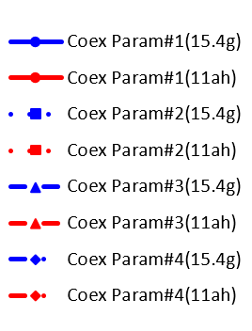
Summary of Fairness Index Evaluation
Coex. Param #1: Non Coexistence Mechanism
  IEEE 802.15.4g (●) is degraded by IEEE 802.11ah (●).
  IEEE 802.15.4g PDR is dropped by 0.537, IEEE 802.11ah PDR keeps 0.999. Fairness Index is 0.916
Coex. Param #2: alpha-Fairness Coexistence Mechanism
  IEEE 802.15.4g (■) is improved without degradation of IEEE 802.11ah (■) .
  IEEE 80215.4g PDR is improved to 0.681, IEEE 802.11ah PDR keeps 0.999, Fairness Index is 0.965.
Coex. Param #3: Q-Learning Coexistence Mechanism
  IEEE 802.15.4g (▲) is improved without degradation of IEEE 802.11ah (▲).
  IEEE 802.15.4g PDR is improved to 0.710, IEEE 802.11ah PDR keeps 0.999, Fairness Index is 0.972.
Coex. Param #4: alpha-Fairness/Q-Learning Coexistence Mechanism
  IEEE 802.15.4g (♦) is improved with negligible degradation of IEEE 802.11ah (♦).
  IEEE 802.15.4g PDR is improved to 0.770, IEEE 802.11ah PDR is 0.998, Fairness Index is 0.983.
Improve Fairness
Improve PDR
Non Coex.
Offered load (15.4g, 11ah) = (30kbps, 30kbps)
Fairness Index for Coexistence

Slide 7
Summary
Consider Fairness Index when 802.11ah and 802.15.4g coexist on the same frequency band.
Jain’s Fairness Index was applied for coexistence fairness index to evaluate fair degradation at coexistence situation.
Fairness index between 802.11ah and 802.15.4g is calculated by throughput degradation ratio from offered load.
Results shows that Fairness Index worked correctly, and the coexistence mechanisms (alpha-Fairness, Q-learning and their combination) improved fairness index.
Propose Fairness Index for Recommended Practice

Slide 8
References
D.-M. Chiu and R. Jain, “Analysis of the increase and decrease algorithms for congestion avoidance in computer networks,” Computer Networks and ISDN Systems, vol. 17, pp. 1–14, 1989
Jianlin, et al., “Interference Mitigation for Coexisting 802.15.4g and 802.11ah Networks,” 19-18-0027/r1
Jianlin, et al., “Distributed Coexistence Methods, ” 19-19/0059r3

