Slide 1
Sub 1 GHz Task Group Meeting Slides
Date: 2020-10-21
Authors:
Notice: This document has been prepared to assist IEEE 802.19. It is offered as a basis for discussion and is not binding on the contributing individual(s) or organization(s). The material in this document is subject to change in form and content after further study. The contributor(s) reserve(s) the right to add, amend or withdraw material contained herein.

Slide 2
Sub-1GHz Coexistence Task Group
Recommended Practice for Local and Metropolitan Area Networks - Part 19: Coexistence Methods for 802.11 and 802.15.4 based systems operating in the Sub-1 GHz Frequency Bands
Scope:
This recommended practice provides guidance on the implementation, configuration and commissioning of systems sharing spectrum between IEEE Std 802.11ah-2016 and IEEE Std 802.15.4 Smart Utility Networking (SUN) Frequency Shift Keying (FSK) Physical Layer (PHY) operating in Sub-1 GHz frequency bands.

Slide 3
Meeting Preamble
Meeting Slides can be found here:
https://grouper.ieee.org/groups/802/sapolicies.shtml

Slide 4
Instructions for the WG Chair
The IEEE-SA strongly recommends that at each WG meeting the chair or a designee:
  Show slides #1 through #4 of this presentation
  Advise the WG attendees that:
    IEEE’s patent policy is described in Clause 6 of the IEEE-SA Standards Board Bylaws;
    Early identification of patent claims which may be essential for the use of standards under development is strongly encouraged;
    There may be Essential Patent Claims of which IEEE is not aware. Additionally, neither IEEE, the WG, nor the WG Chair can ensure the accuracy or completeness of any assurance or whether any such assurance is, in fact, of a Patent Claim that is essential for the use of the standard under development.
  Instruct the WG Secretary to record in the minutes of the relevant WG meeting:
    That the foregoing information was provided and that slides 1 through 4 (and this slide 0, if applicable) were shown;
    That the chair or designee provided an opportunity for participants to identify patent claim(s)/patent application claim(s) and/or the holder of patent claim(s)/patent application claim(s) of which the participant is personally aware and that may be essential for the use of that standard
    Any responses that were given, specifically the patent claim(s)/patent application claim(s) and/or the holder of the patent claim(s)/patent application claim(s) that were identified (if any) and by whom.
  The WG Chair shall ensure that a request is made to any identified holders of potential essential patent claim(s) to complete and submit a Letter of Assurance.
  It is recommended that the WG Chair review the guidance in IEEE-SA Standards Board Operations Manual 6.3.5 and in FAQs 14 and 15 on inclusion of potential Essential Patent Claims by incorporation or by reference.
  Note: WG includes Working Groups, Task Groups, and other standards-developing committees with a PAR approved by the IEEE-SA Standards Board.
(Optional to be shown)

Slide 5
Participants have a duty to inform the IEEE
  Participants shall inform the IEEE (or cause the IEEE to be informed) of the identity of each holder of any potential Essential Patent Claims of which they are personally aware if the claims are owned or controlled by the participant or the entity the participant is from, employed by, or otherwise represents
  Participants should inform the IEEE (or cause the IEEE to be informed) of the identity of any other holders of potential Essential Patent Claims
  Early identification of holders of potential Essential Patent Claims is encouraged
Slide #1

Slide 6
Ways to inform IEEE
Cause an LOA to be submitted to the IEEE-SA (patcom@ieee.org); or
Provide the chair of this group with the identity of the holder(s) of any and all such claims as soon as possible; or
Speak up now and respond to this Call for Potentially Essential Patents
If anyone in this meeting is personally aware of the holder of any patent claims that are potentially essential to implementation of the proposed standard(s) under consideration by this group and that are not already the subject of an Accepted Letter of Assurance, please respond at this time by providing relevant information to the WG Chair
Slide #2

Slide 7
Other guidelines for IEEE WG meetings
All IEEE-SA standards meetings shall be conducted in compliance with all applicable laws, including antitrust and competition laws.
  Don’t discuss the interpretation, validity, or essentiality of patents/patent claims.
  Don’t discuss specific license rates, terms, or conditions.
    Relative costs of different technical approaches that include relative costs of patent licensing terms may be discussed in standards development meetings.
      Technical considerations remain the primary focus
  Don’t discuss or engage in the fixing of product prices, allocation of customers, or division of sales markets.
  Don’t discuss the status or substance of ongoing or threatened litigation.
  Don’t be silent if inappropriate topics are discussed … do formally object.
---------------------------------------------------------------
For more details, see IEEE-SA Standards Board Operations Manual, clause 5.3.10 and
Antitrust and Competition Policy: What You Need to Know at http://standards.ieee.org/develop/policies/antitrust.pdf
Slide #3

Slide 8
Patent-related information
  The patent policy and the procedures used to execute that policy are documented in the:
    IEEE-SA Standards Board Bylaws
    (http://standards.ieee.org/develop/policies/bylaws/sect6-7.html#6)
    IEEE-SA Standards Board Operations Manual (http://standards.ieee.org/develop/policies/opman/sect6.html#6.3
  Material about the patent policy is available at
  http://standards.ieee.org/about/sasb/patcom/materials.html
  If you have questions, contact the IEEE-SA Standards Board Patent Committee Administrator at patcom@ieee.org
Slide #4

Slide 9
Instructions for Chairs of standards development activities
At the beginning of each standards development meeting the chair or a designee is to:
    Show the following slides (or provide them beforehand)
    Advise the standards development group participants that:
    IEEE SA’s copyright policy is described in Clause 7 of the IEEE SA Standards Board Bylaws and Clause 6.1 of the IEEE SA Standards Board Operations Manual;
    Any material submitted during standards development, whether verbal, recorded, or in written form, is a Contribution and shall comply with the IEEE SA Copyright Policy;
    Instruct the Secretary to record in the minutes of the relevant meeting:
    That the foregoing information was provided and that the copyright slides were shown (or provided beforehand).

Slide 10
IEEE SA Copyright Policy
By participating in this activity, you agree to comply with the IEEE Code of Ethics, all applicable laws, and all IEEE policies and procedures including, but not limited to, the IEEE SA Copyright Policy.
  Previously Published material (copyright assertion indicated) shall not be presented/submitted to the Working Group nor incorporated into a Working Group draft unless permission is granted.
  Prior to presentation or submission, you shall notify the Working Group Chair of previously Published material and should assist the Chair in obtaining copyright permission acceptable to IEEE SA.
  For material that is not previously Published, IEEE is automatically granted a license to use any material that is presented or submitted.

Slide 11
IEEE SA Copyright Policy
    The IEEE SA Copyright Policy is described in the IEEE SA Standards Board Bylaws and IEEE SA Standards Board Operations Manual
      IEEE SA Copyright Policy, see
      Clause 7 of the IEEE SA Standards Board Bylaws
      https://standards.ieee.org/about/policies/bylaws/sect6-7.html#7
      Clause 6.1 of the IEEE SA Standards Board Operations Manual
      https://standards.ieee.org/about/policies/opman/sect6.html
    IEEE SA Copyright Permission
      https://standards.ieee.org/content/dam/ieee-standards/standards/web/documents/other/permissionltrs.zip
    IEEE SA Copyright FAQs
      http://standards.ieee.org/faqs/copyrights.html/
    IEEE SA Best Practices for IEEE Standards Development
      http://standards.ieee.org/develop/policies/best_practices_for_ieee_standards_development_051215.pdf
    Distribution of Draft Standards (see 6.1.3 of the SASB Operations Manual)
      https://standards.ieee.org/about/policies/opman/sect6.html

Slide 12
Participant behavior in IEEE-SA activities is guided by the IEEE Codes of Ethics & Conduct
All participants in IEEE-SA activities are expected to adhere to the core principles underlying the:
  IEEE Code of Ethics
  IEEE Code of Conduct
The core principles of the IEEE Codes of Ethics & Conduct are to:
  Uphold the highest standards of integrity, responsible behavior, and ethical and professional conduct
  Treat people fairly and with respect, to not engage in harassment, discrimination, or retaliation, and to protect people's privacy.
  Avoid injuring others, their property, reputation, or employment by false or malicious action
The most recent versions of these Codes are available at
  http://www.ieee.org/about/corporate/governance

Slide 13
Participants in the IEEE-SA “individual process” shall act independently of others, including employers
The IEEE-SA Standards Board Bylaws require that “participants in the IEEE standards development individual process shall act based on their qualifications and experience”
This means participants:
  Shall act & vote based on their personal & independent opinions derived from their expertise, knowledge, and qualifications
  Shall not act or vote based on any obligation to or any direction from any other person or organization, including an employer or client, regardless of any external commitments, agreements, contracts, or orders
  Shall not direct the actions or votes of other participants or retaliate against other participants for fulfilling their responsibility to act & vote based on their personal & independently developed opinions
By participating in standards activities using the “individual process”, you are deemed to accept these requirements; if you are unable to satisfy these requirements then you shall immediately cease any participation

Slide 14
IEEE-SA standards activities shall allow the fair & equitable consideration of all viewpoints
The IEEE-SA Standards Board Bylaws (clause 5.2.1.3) specifies that “the standards development process shall not be dominated by any single interest category, individual, or organization”
  This means no participant may exercise “authority, leadership, or influence by reason of superior leverage, strength, or representation to the exclusion of fair and equitable consideration of other viewpoints” or “to hinder the progress of the standards development activity”
This rule applies equally to those participating in a standards development project and to that project’s leadership group
Any person who reasonably suspects that dominance is occurring in a standards development project is encouraged to bring the issue to the attention of the Standards Committee or the project’s IEEE-SA Program Manager

Slide 15
IEEE SA Policy Documents
IEEE Code of Ethics
  http://www.ieee.org/about/corporate/governance/p7-8.html
IEEE Standards Association (IEEE-SA) Affiliation FAQ
  http://standards.ieee.org/faqs/affiliation.html
Antitrust and Competition Policy
  http://standards.ieee.org/resources/antitrust-guidelines.pdf
Letter of Assurance Form
  http://standards.ieee.org/develop/policies/bylaws/sect6-7.html#loa
  https://development.standards.ieee.org/myproject/Public//mytools/mob/loa.pdf
IEEE-SA Patent Committee FAQ & Patent slides
  http://standards.ieee.org/board/pat/faq.pdf and http://standards.ieee.org/board/pat/pat-slideset.ppt
Notes:
Agenda item 2.1.2.1

Slide 16
IEEE SA Rules Documents
The current version of the IEEE-SA Standards Board Bylaws is available at:
  http://standards.ieee.org/develop/policies/bylaws/index.html (HTML version)
  http://standards.ieee.org/develop/policies/bylaws/sb_bylaws.pdf (PDF version)
The current version of the IEEE-SA Standards Board Operations Manual is available at:
  http://standards.ieee.org/develop/policies/opman/index.html (HTML version)
  http://standards.ieee.org/develop/policies/opman/sb_om.pdf (PDF version)

Slide 17
IEEE 802 Ground Rules
Respect … give it, get it
NO product pitches
NO corporate pitches
NO prices
NO restrictive notices – (no confidentially notices in email)
Presentations must be openly available

Slide 18
IEEE 802 Rules Documents
IEEE 802 Policies & Procedures (Approved June 2014)
  http://standards.ieee.org/board/aud/LMSC.pdf
IEEE 802 Operations Manual (Approved 13 July 2018)
  https://mentor.ieee.org/802-ec/dcn/17/ec-17-0090-22-0PNP-ieee-802-lmsc-operations-manual.pdf
IEEE 802 Working Group Policies & Procedures (29 July 2016)
  http://www.ieee802.org/PNP/approved/IEEE_802_WG_PandP_v19.pdf
IEEE 802 LMSC Chair's Guidelines (Approved 13 July 2018)
  https://mentor.ieee.org/802-ec/dcn/17/ec-17-0120-27-0PNP-ieee-802-lmsc-chairs-guidelines.pdf
Participation in IEEE 802 Meetings
  https://mentor.ieee.org/802-ec/dcn/16/ec-16-0180-05-00EC-ieee-802-participation-slide.pptx
Policies and Procedures hierarchy: http://www.ieee802.org/11/Rules/rules.shtml
  IEEE 802 Procedural document website: http://www.ieee802.org/devdocs.shtml

Slide 19
IEEE 802.19 Operations Manual
http://ieee802.org/19/pub/IEEE%20802.19%20Operations%20Manual.pdf

Slide 20
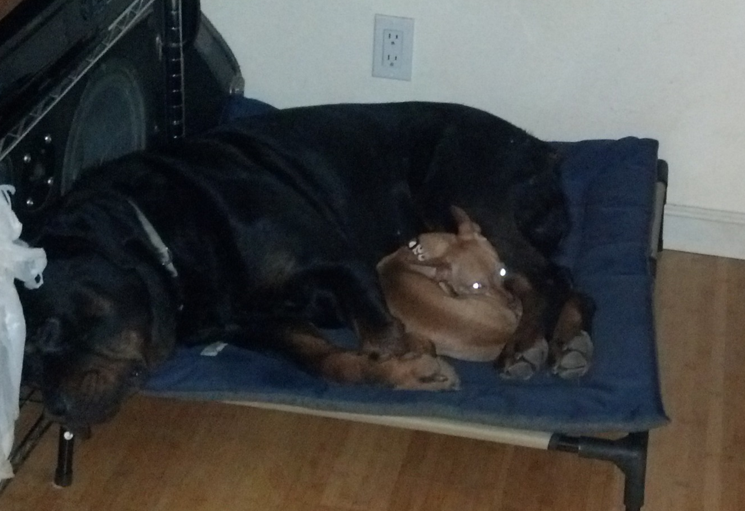
Coexistence Example
Cooperative Coexistence combined with Low Activity Factor

Slide 21
Agenda – October 21, 2020
Meeting preamble (the usual slides)
Comment Review and Resolution
Any other business.

Slide 22
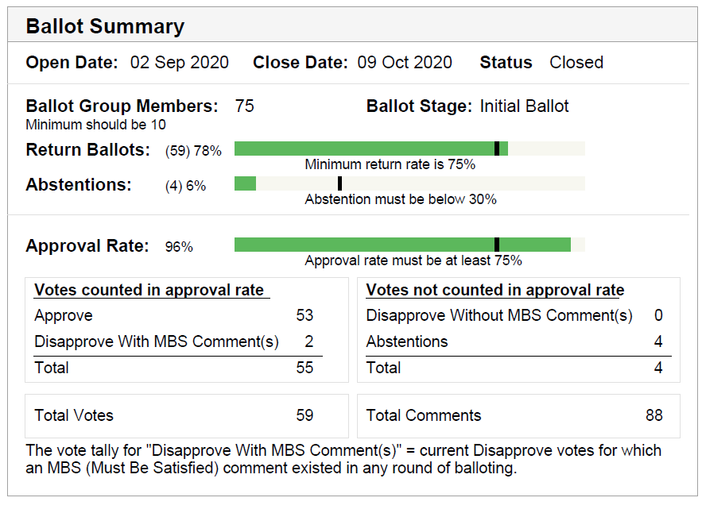
Ballot Results

Slide 23
Comment Summary
Total comments | 88
General | 21
Technical | 20
Editorial | 47
Technical MBS | 11

Slide 24
Comment Resolution Contributions
https://mentor.ieee.org/802.19/dcn/20/19-20-0040-00-0003-contribution-for-comment-resolution-cid-271714-271718-271719.pptx
  Comment IDs 271598 and 271599
https://mentor.ieee.org/802.19/dcn/20/19-20-0041-00-0003-sa-initial-ballot-comment-resolution-proposal.docx
  Comment IDs 271721 271712 271706 271681 271680 271675 271643 271638 271624 271622 271606 271601 271593 271592 271589 271586 271482 271481 271453 271452

Slide 25
Virtual Plenary
30 October 2020 to 13 November 2020
Calendar: https://grouper.ieee.org/groups/802/802tele_calendar.html
Current TG Plan: 2 Meetings, usual time slots
Can add time slots during plenary as needed
  Just like a normal plenary
CRC membership

Slide 26
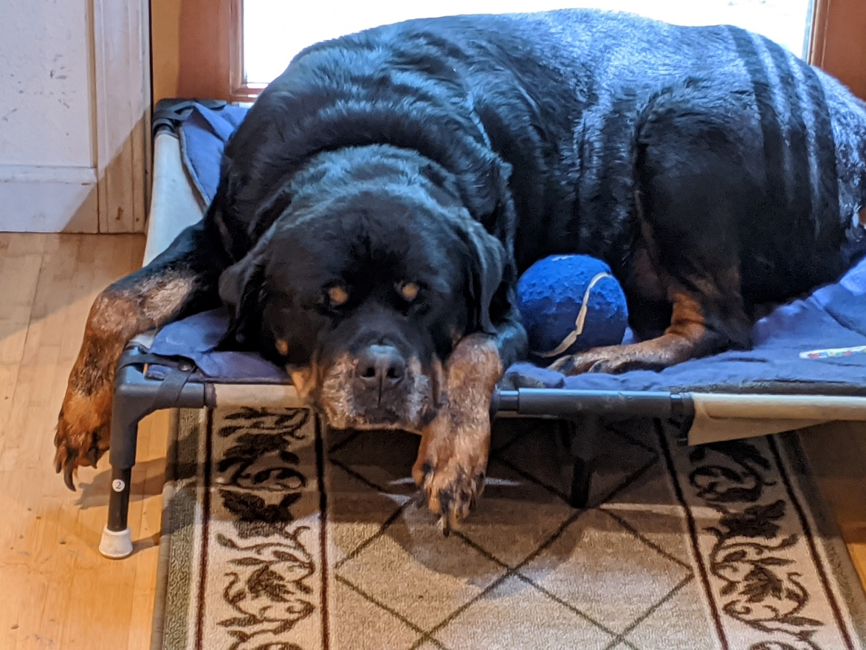
Any Other Business

